Slide 1

Basics of Neural Network Programming
Derivatives
deeplearning.ai

Slide 2
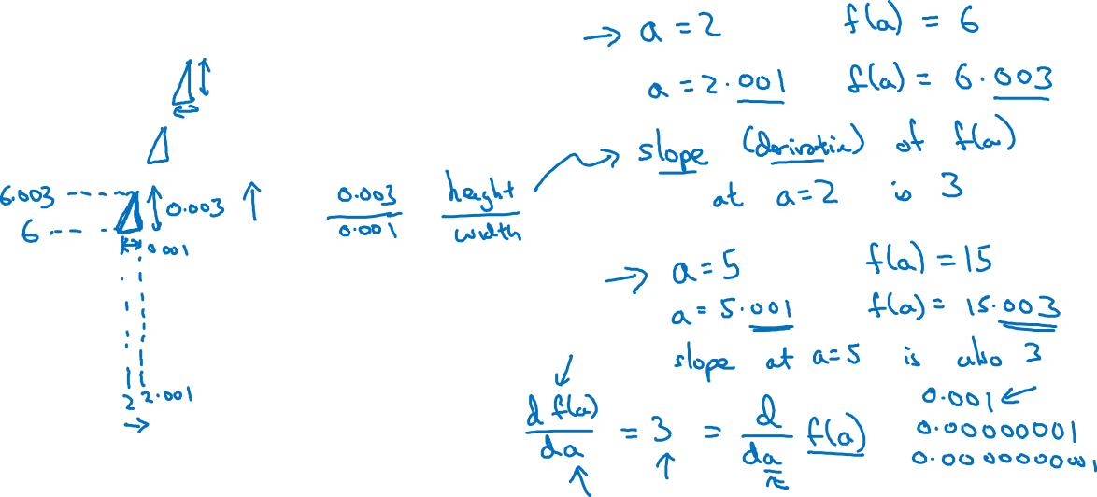


Intuition about derivatives

Slide 3
Basics of Neural Network Programming
More derivatives examples
deeplearning.ai

Slide 4
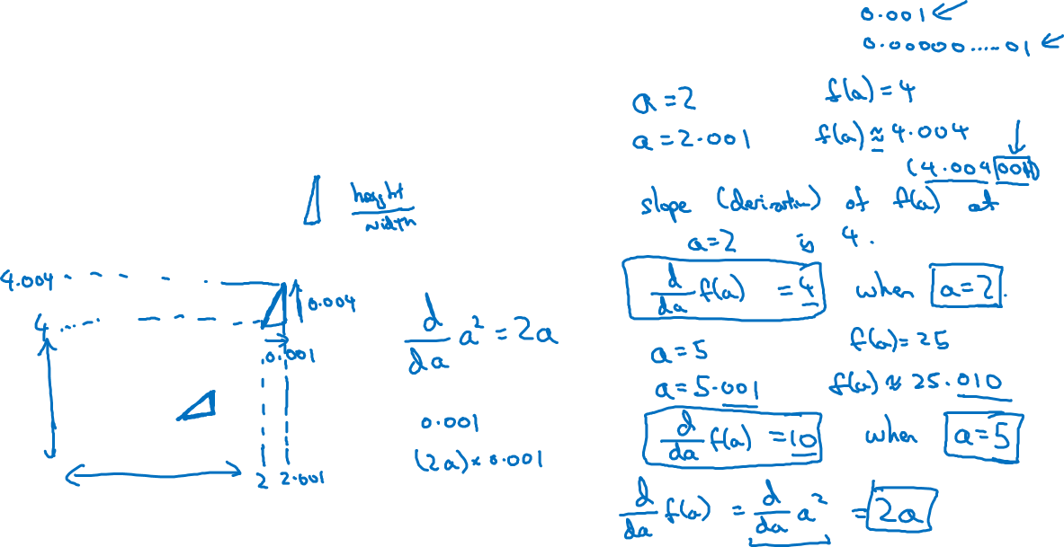


Intuition about derivatives

Slide 5
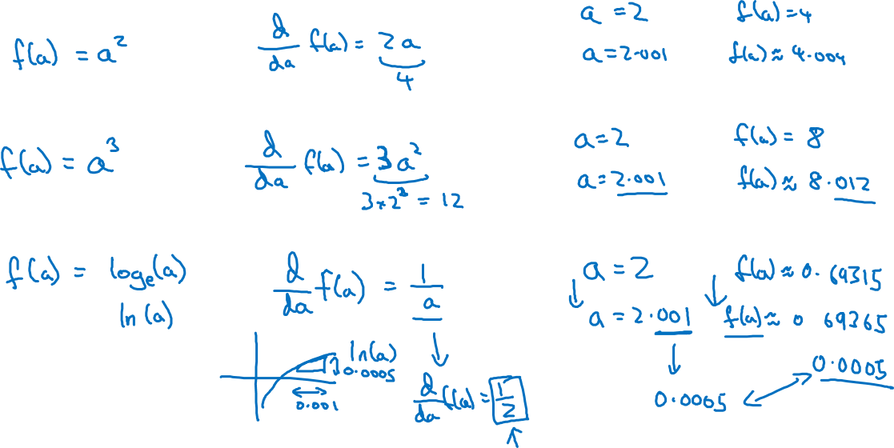
More derivative examples

