Slide 1

Basics of Neural Network Programming
Computation Graph
deeplearning.ai

Slide 2
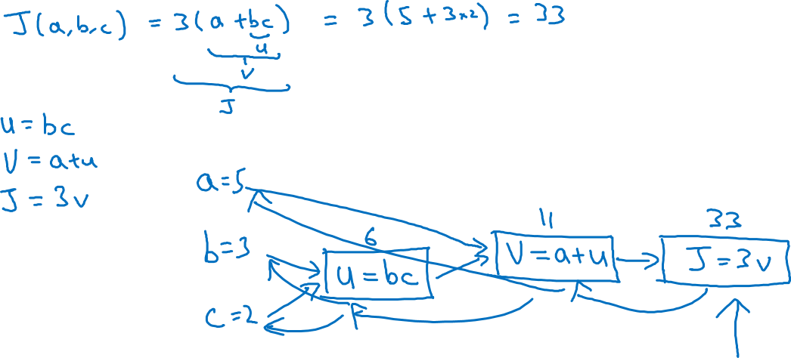
Computation Graph

Slide 3
Basics of Neural Network Programming
Derivatives with a Computation Graph
deeplearning.ai

Slide 4
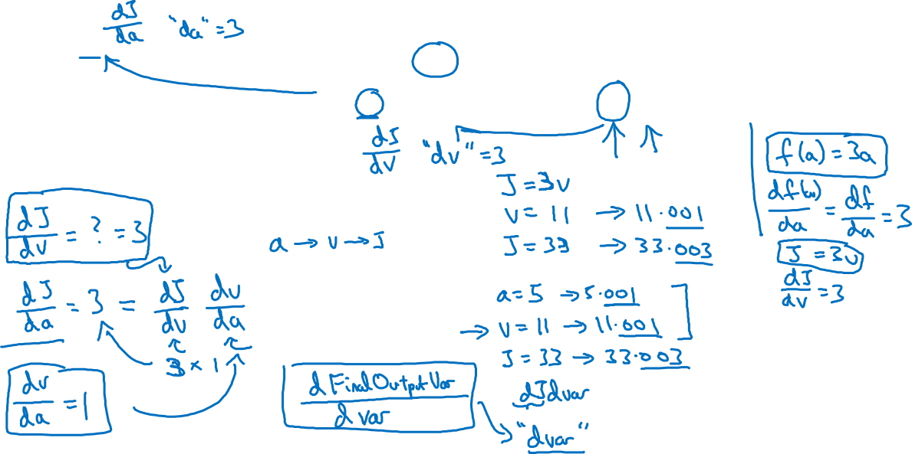



Computing derivatives
11
33
6
=

Slide 5
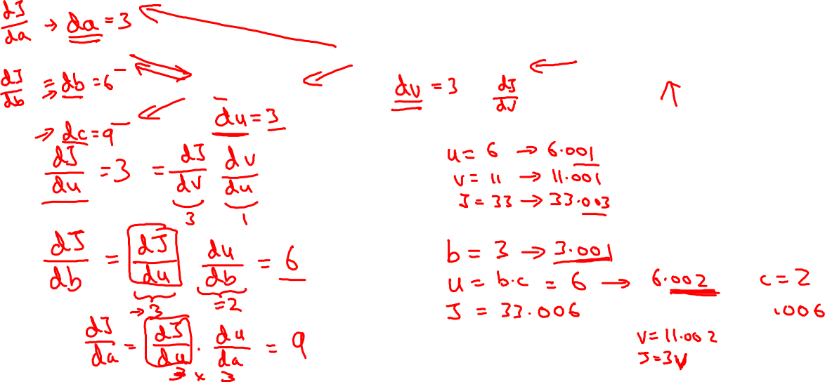
Computing derivatives
11
33
6
=

