Slide 1
One hidden layer
Neural Network
Neural Networks
Overview

Slide 2



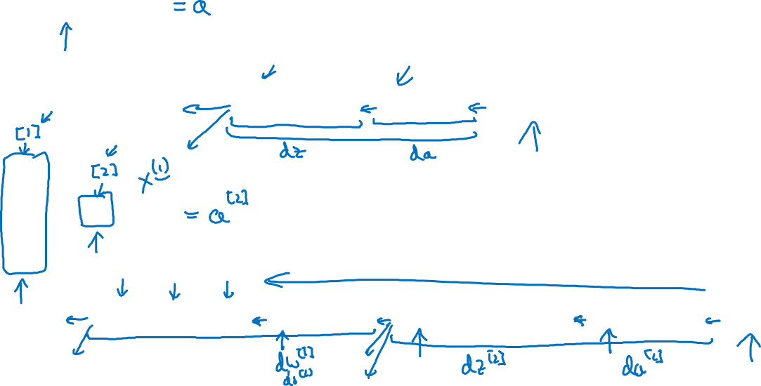













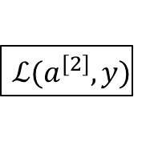



What is a Neural Network?
x
w
b
x

