Slide 1
One hidden layer
Neural Network
Neural Network
Representation

Slide 2
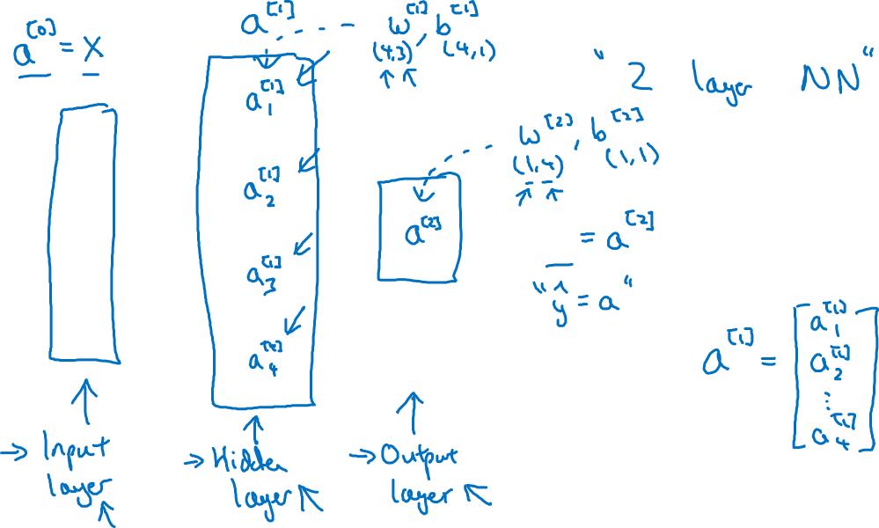




Neural Network Representation

Slide 3
One hidden layer
Neural Network
Computing a
Neural Network’s
Output

Slide 4











Neural Network Representation

Slide 5
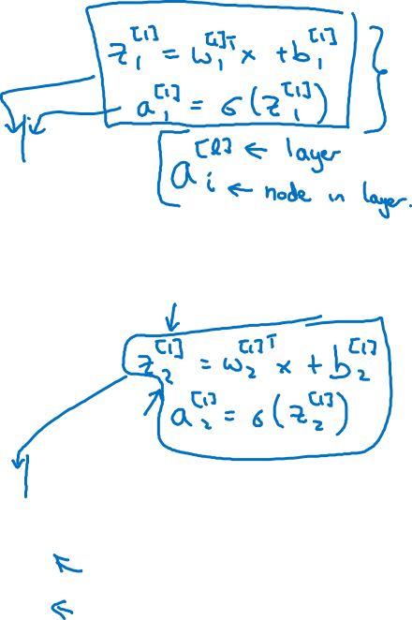






Neural Network Representation

Slide 6
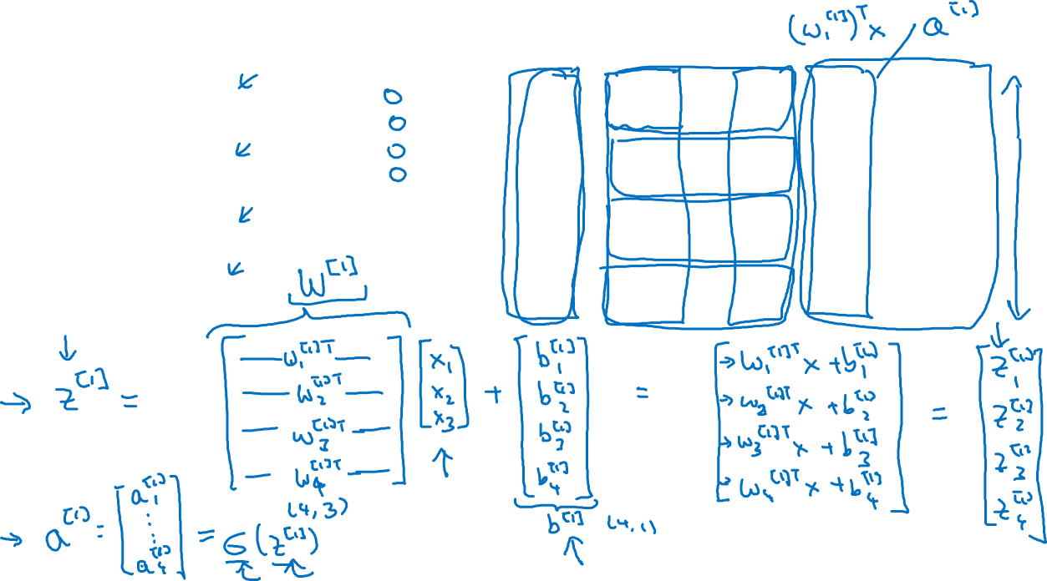

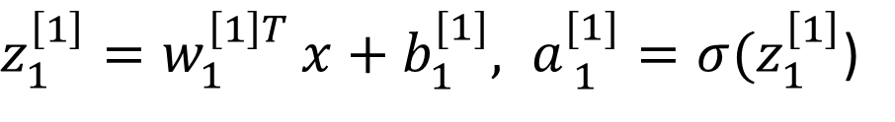


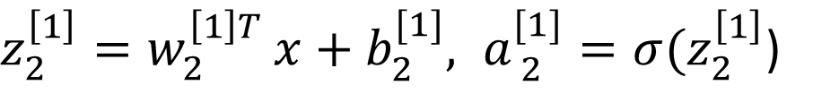



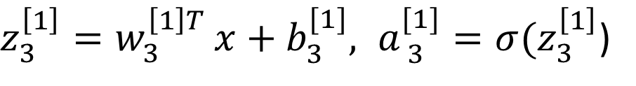


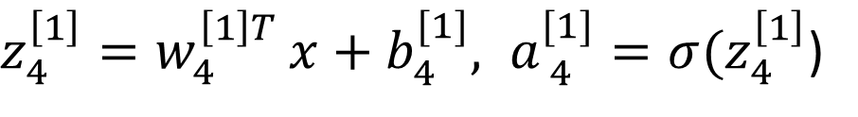
Neural Network Representation
)
)
)
)

Slide 7
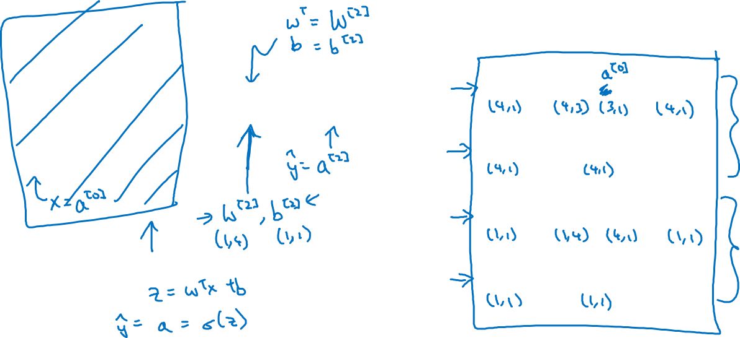




Neural Network Representation learning
Given input x:

