Slide 1
One hidden layer
Neural Network
Vectorizing across
multiple examples

Slide 2
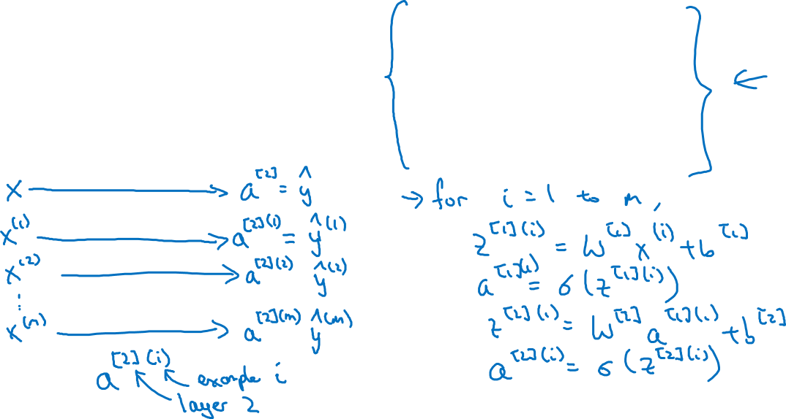





Vectorizing across multiple examples

Slide 3
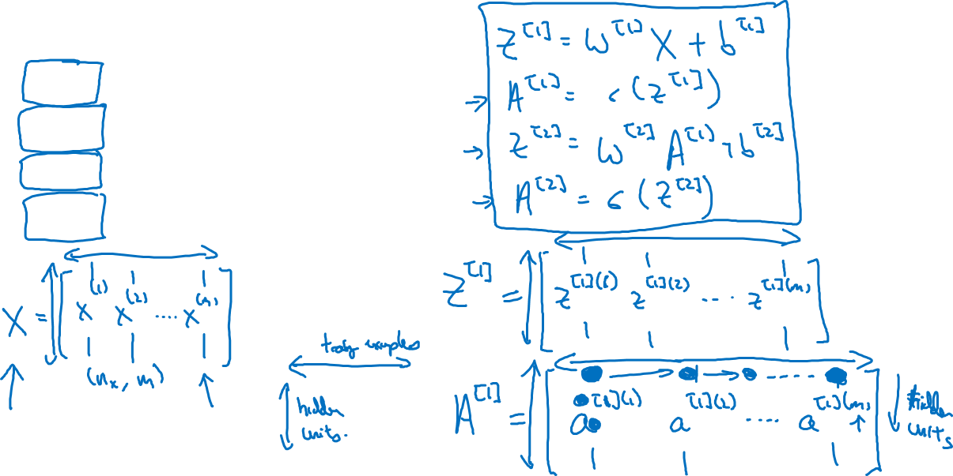




Vectorizing across multiple examples
for i = 1 to m:

Slide 4
One hidden layer
Neural Network
Explanation
for vectorized
implementation

Slide 5
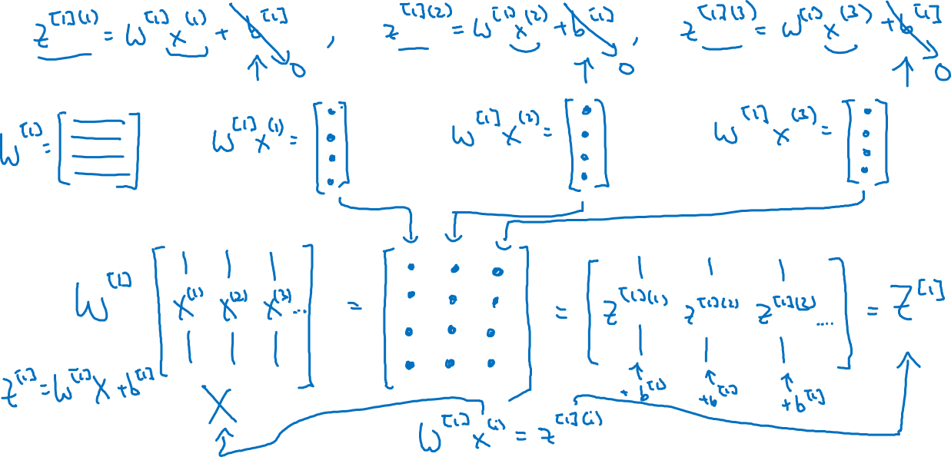
Justification for vectorized implementation

Slide 6
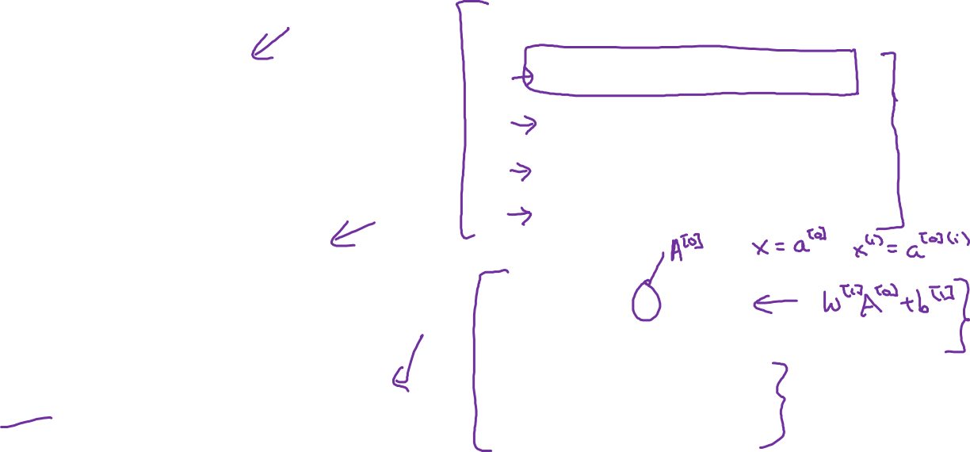
















Recap of vectorizing across multiple examples
for i = 1 to m
…
…

