Slide 1
One hidden layer
Neural Network
Activation functions

Slide 2
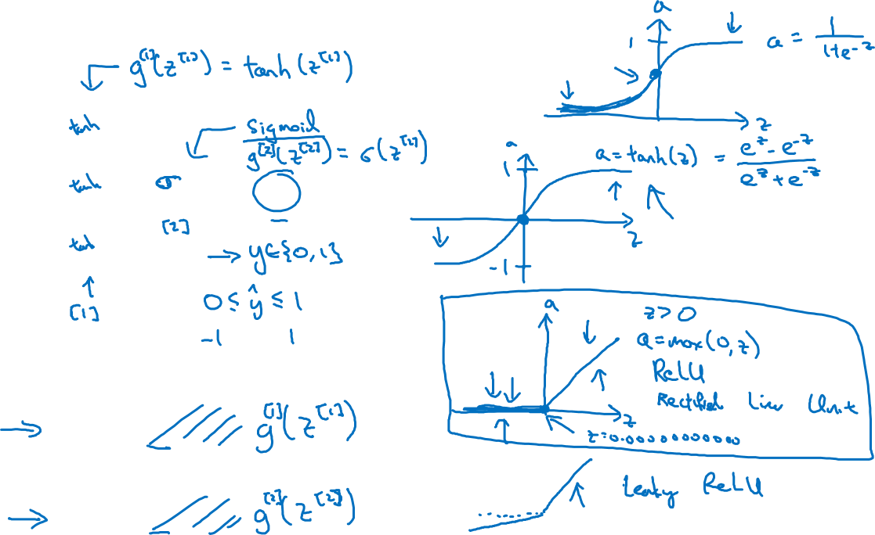






Activation functions
Given x:

Slide 3
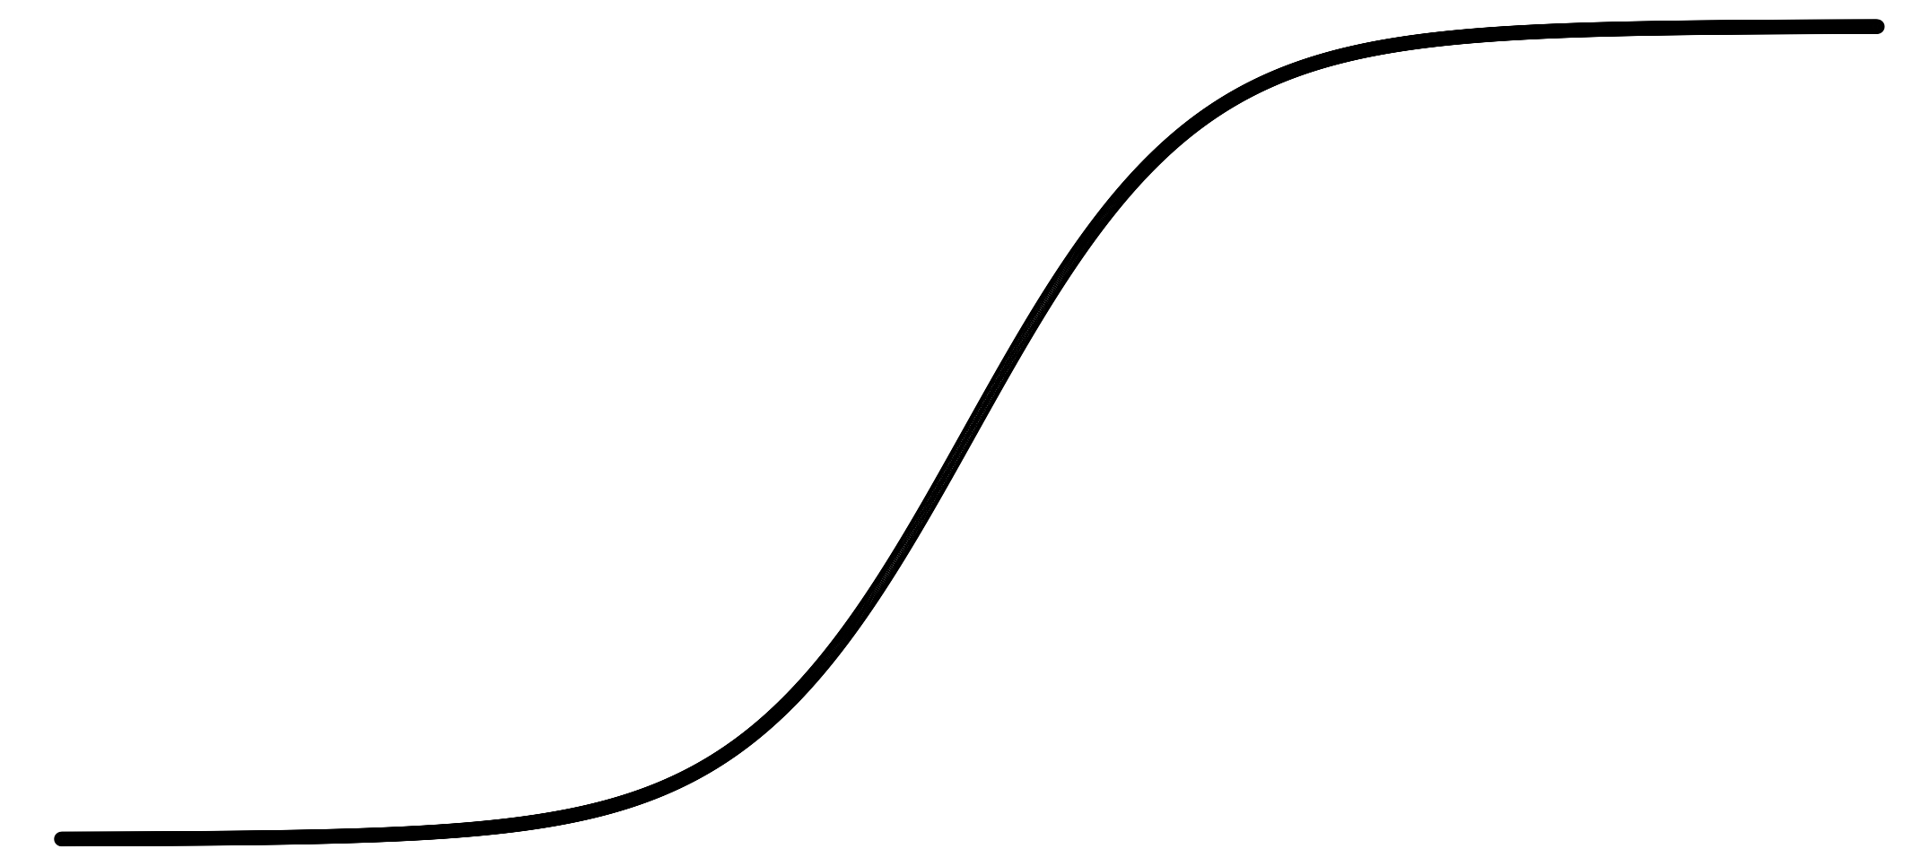
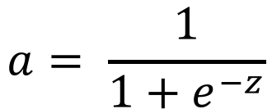
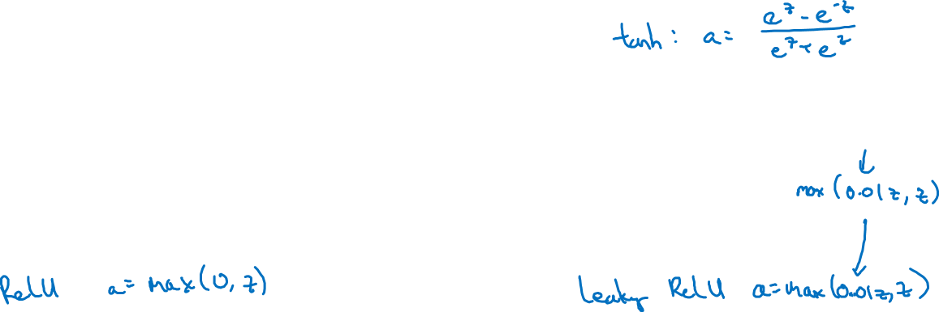
Pros and cons of activation functions
a
a
x
z
sigmoid:
a
a
z
z

