Slide 1
One hidden layer
Neural Network
Why do you
need non-linear
activation functions?

Slide 2
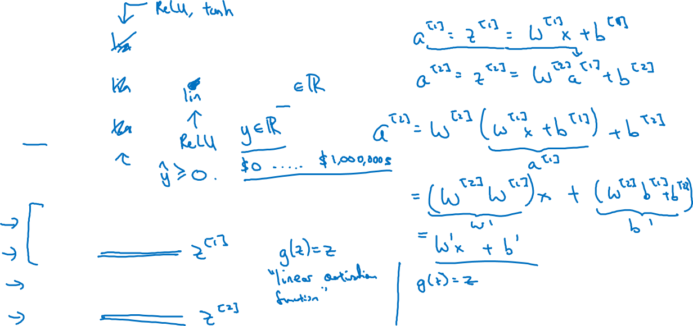








Activation function
Given x:

