Slide 1
One hidden layer
Neural Network
Derivatives of
activation functions

Slide 2
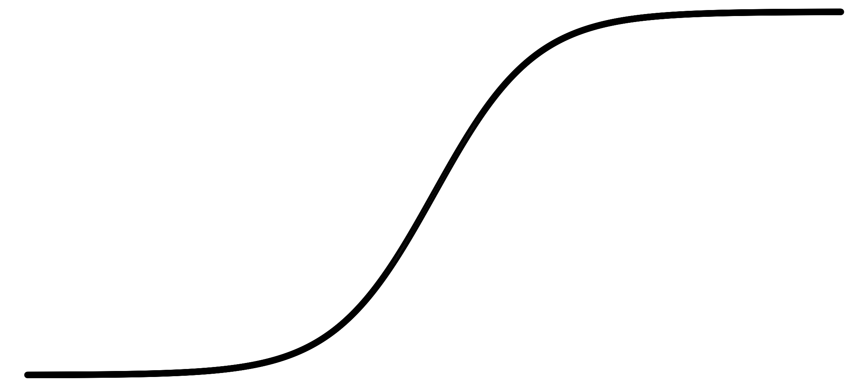
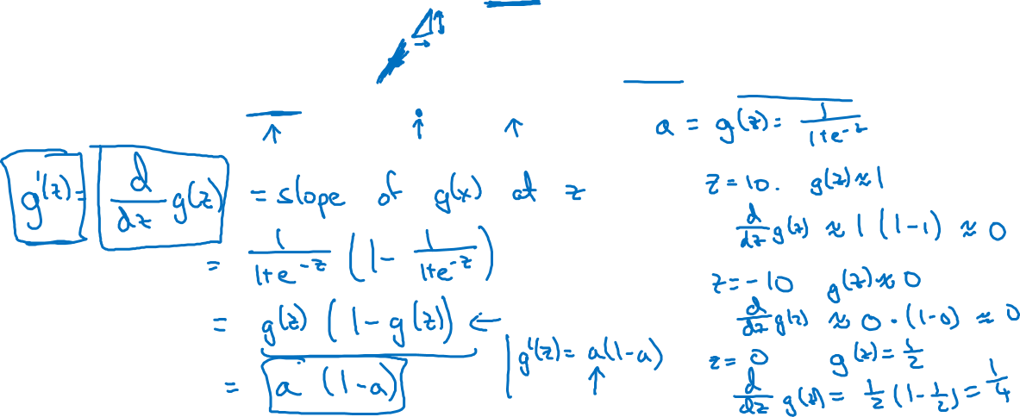
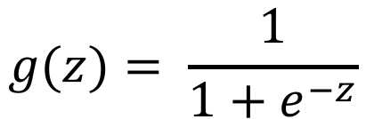
Sigmoid activation function
a
z

Slide 3
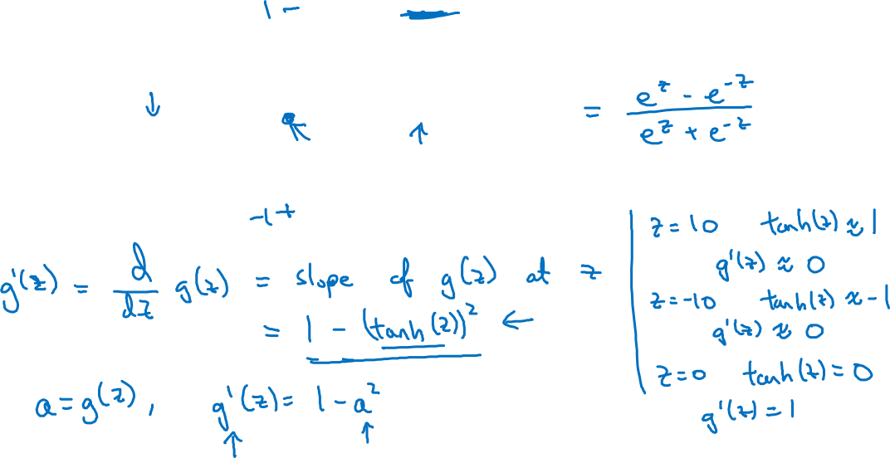

Tanh activation function
a
z

Slide 4
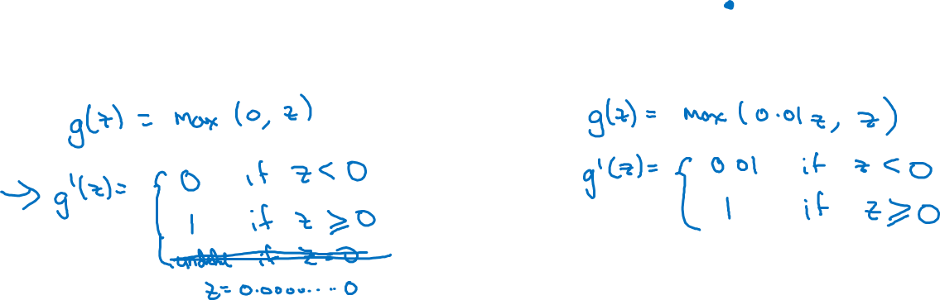
ReLU and Leaky ReLU
a
a
z
z
ReLU
Leaky ReLU

