Slide 1
One hidden layer
Neural Network
Backpropagation
intuition (Optional)

Slide 2
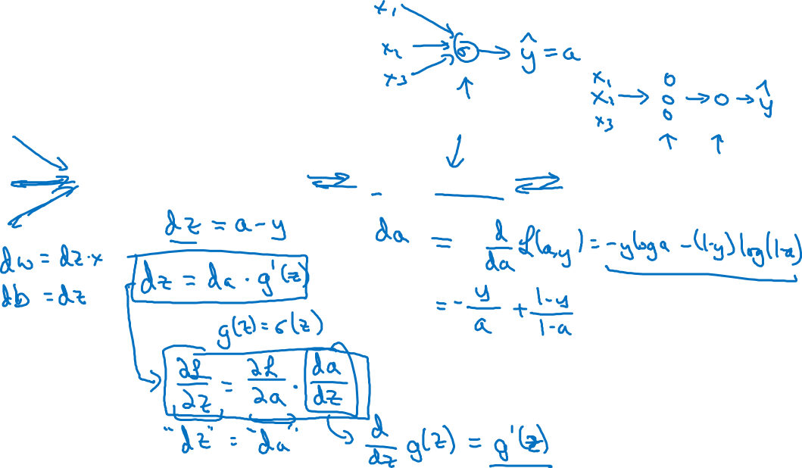



Computing gradients
Logistic regression

Slide 3
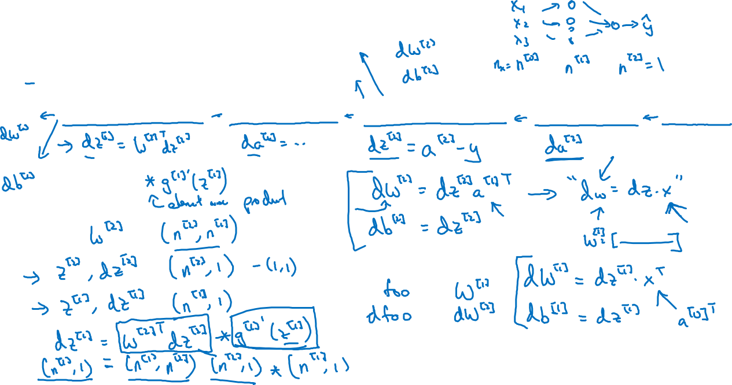





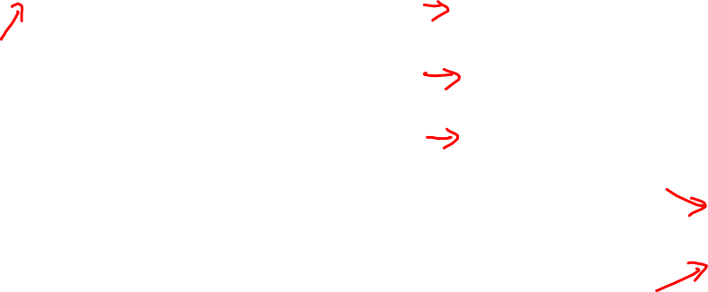
Neural network gradients

Slide 4

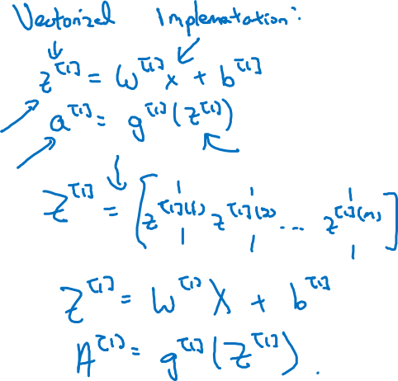




Summary of gradient descent

Slide 5





Summary of gradient descent

