Slide 1
One hidden layer
Neural Network
Random Initialization

Slide 2
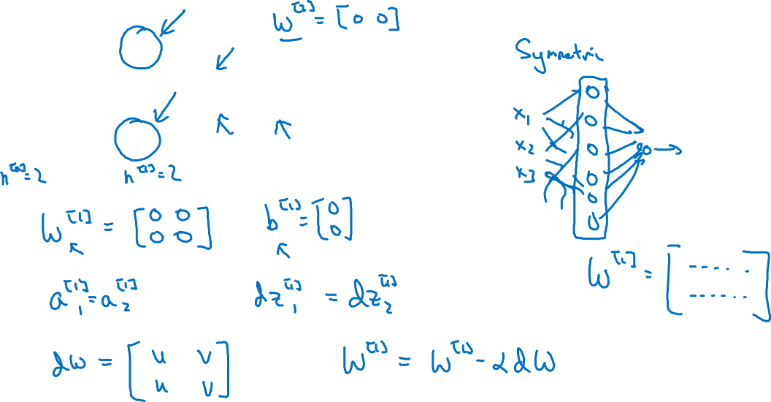






What happens if you initialize weights to zero?

Slide 3
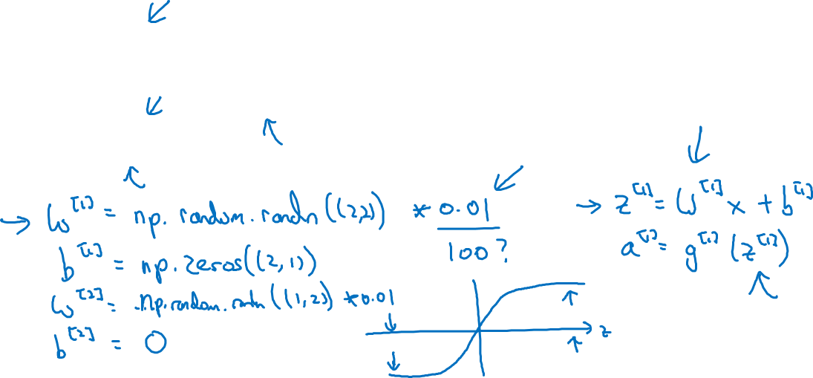
Random initialization

