Slide 1
Deep Neural Networks
Getting your matrix
dimensions right

Slide 2

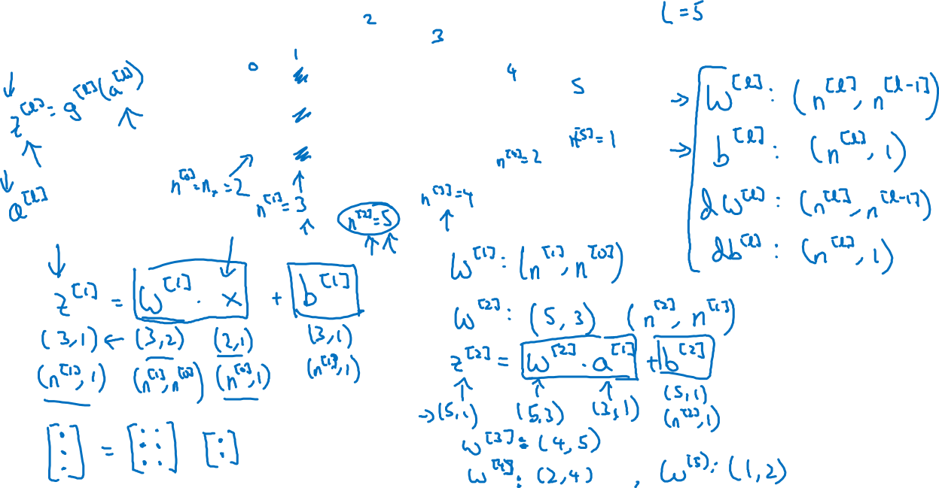



Parameters and

Slide 3
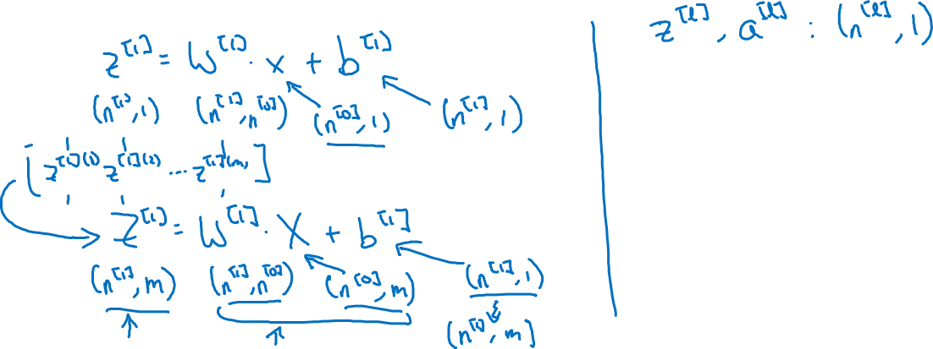
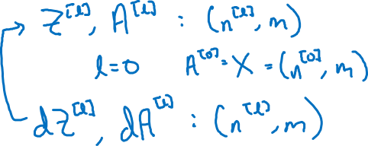
Vectorized implementation

