Slide 1

Setting up your
ML application
Train/dev/test
sets
deeplearning.ai

Slide 2
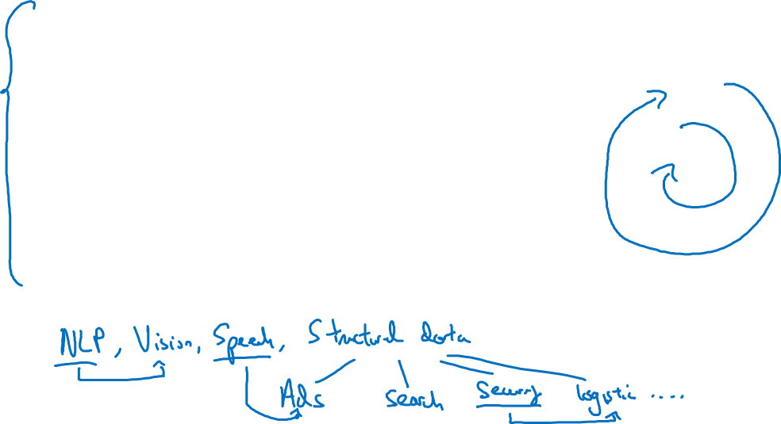

Applied ML is a highly iterative process
# layers
Idea
# hidden units
learning rates
activation functions
…
Experiment
Code

Slide 3
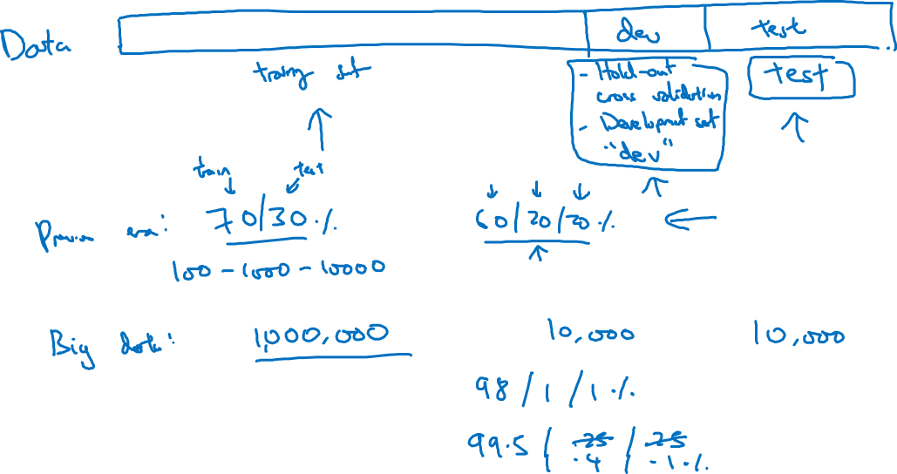
Train/dev/test sets

Slide 4
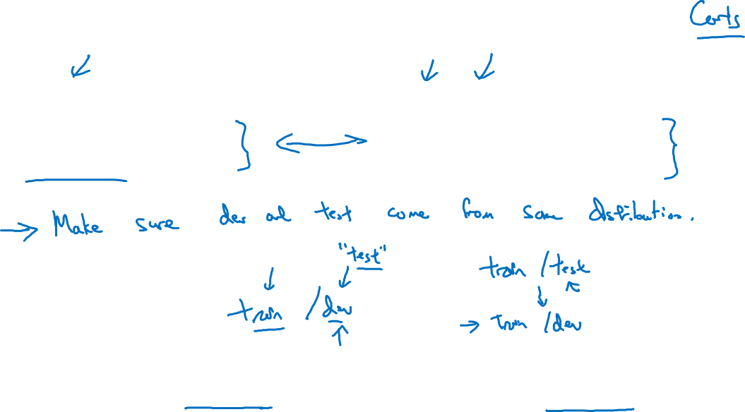
Mismatched train/test distribution
Training set:
Cat pictures from webpages
Dev/test sets:
Cat pictures from users using your app
Not having a test set might be okay. (Only dev set.)

