Slide 1

Regularizing your neural network
Regularization
deeplearning.ai

Slide 2
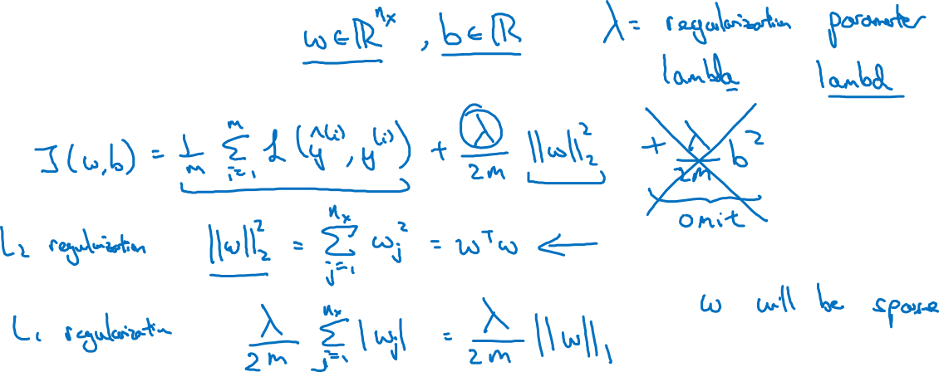
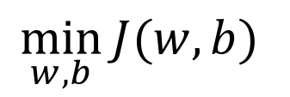
Logistic regression

Slide 3
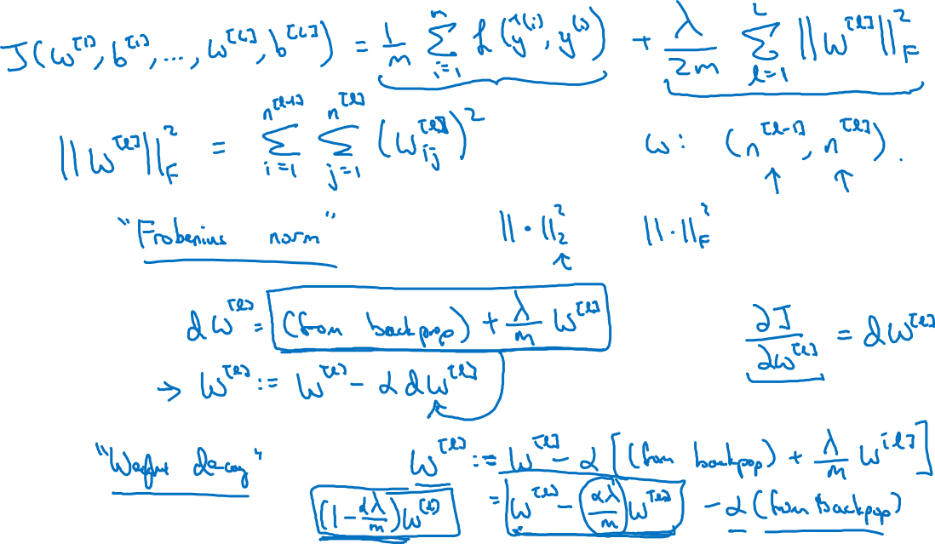
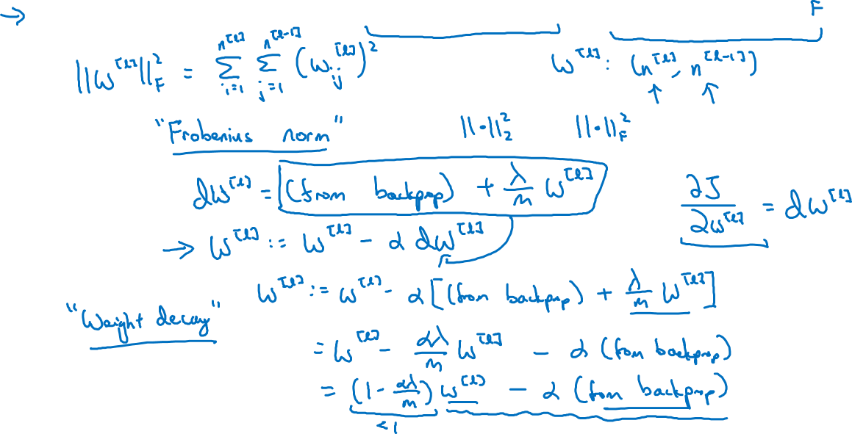
Neural network

Slide 4
Neural network

Slide 5




How does regularization prevent overfitting?

Slide 6
How does regularization prevent overfitting?

