Slide 1
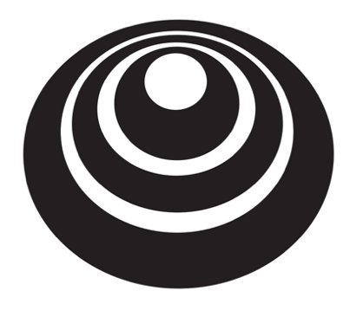
Regularizing your neural network
Why regularization reduces overfitting
deeplearning.ai

Slide 2
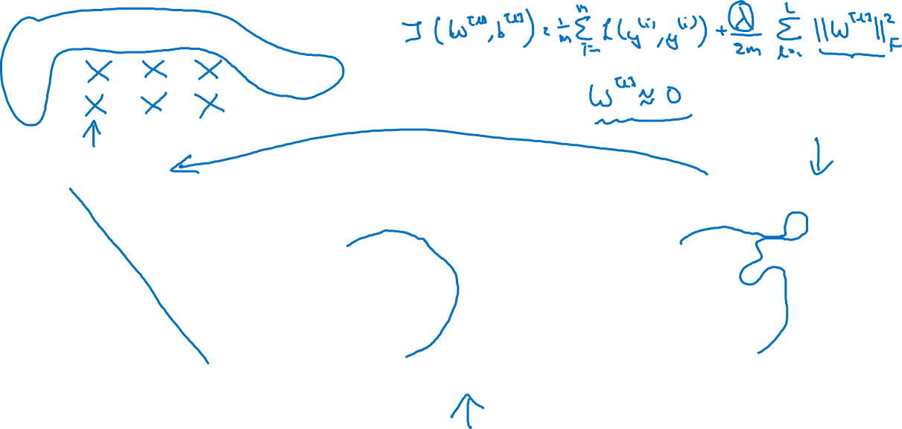




How does regularization prevent overfitting?
high bias
“just right”
high variance

Slide 3
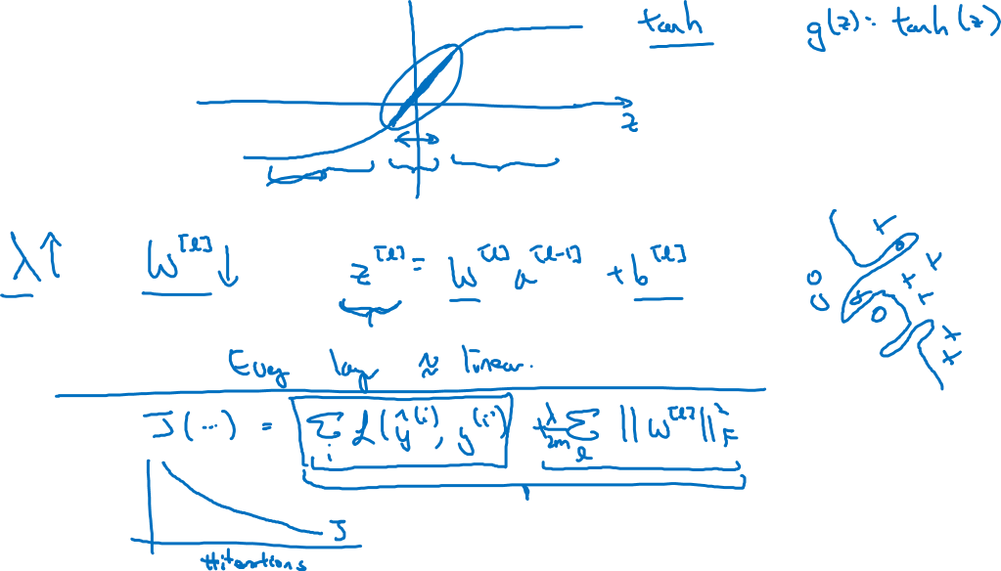
How does regularization prevent overfitting?

