Slide 1

Setting up your optimization problem
Normalizing inputs
deeplearning.ai

Slide 2
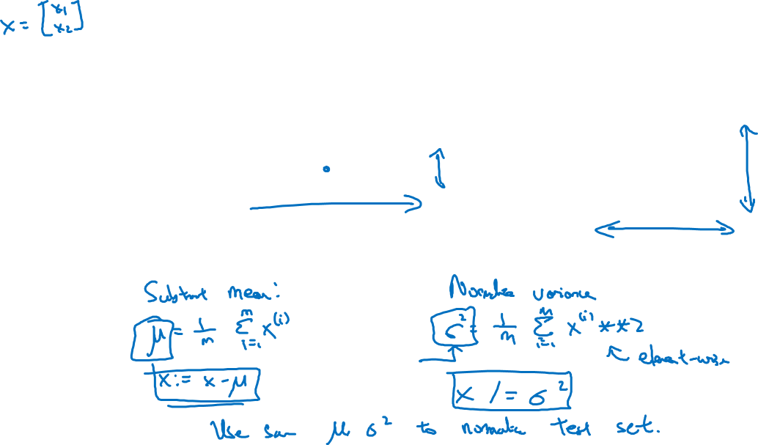








Normalizing training sets

Slide 3
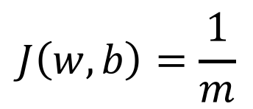
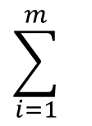

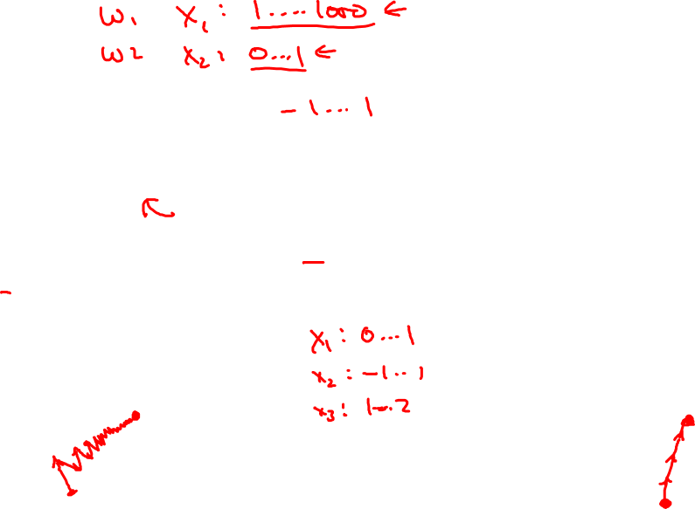


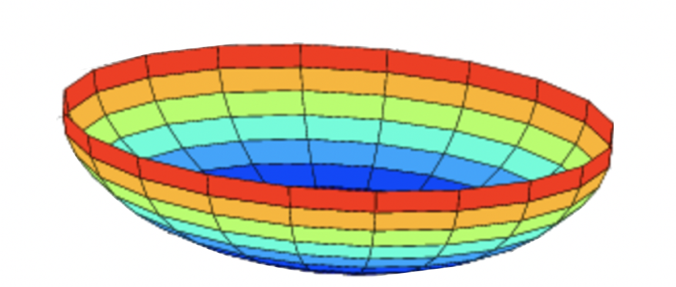









Why normalize inputs?
Unnormalized:
Normalized:

