Slide 1

Setting up your optimization problem
Vanishing/exploding
gradients
deeplearning.ai

Slide 2
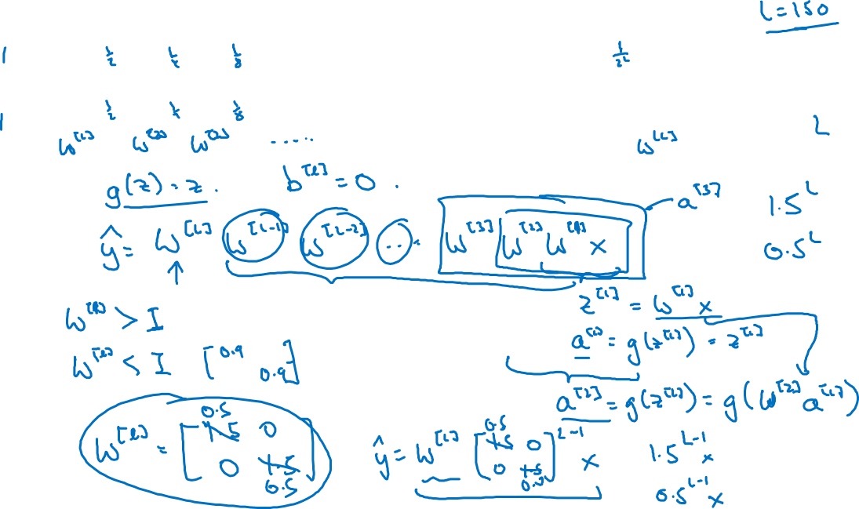



Vanishing/exploding gradients
=

Slide 3
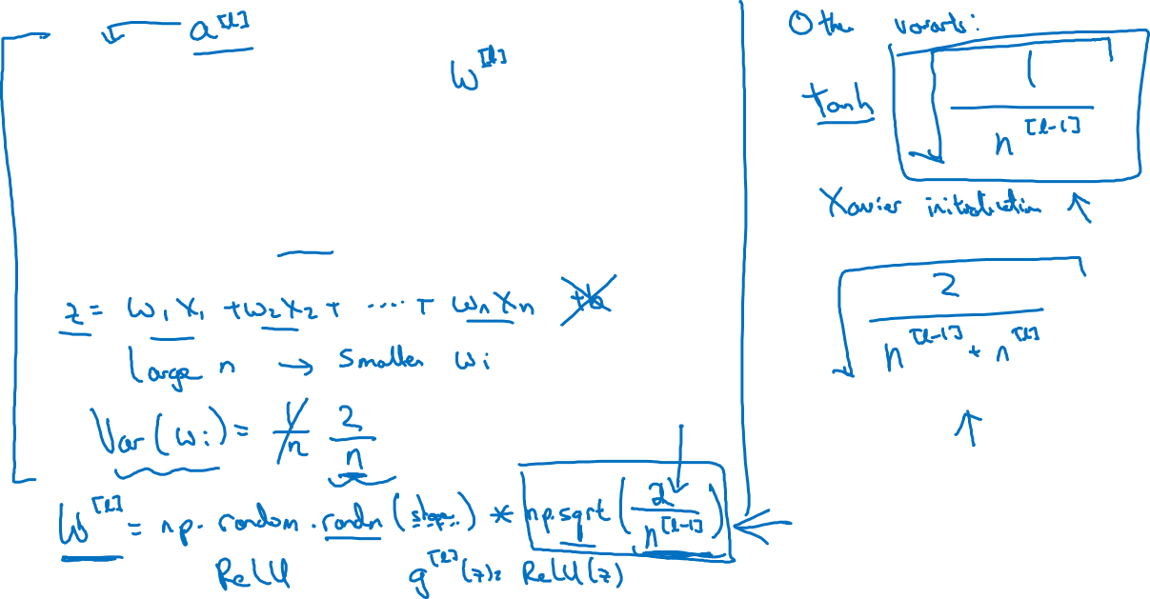






Single neuron example

