Slide 1

Optimization Algorithms
Understanding exponentially weighted averages
deeplearning.ai

Slide 2

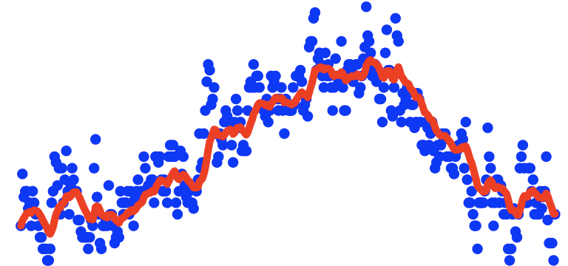
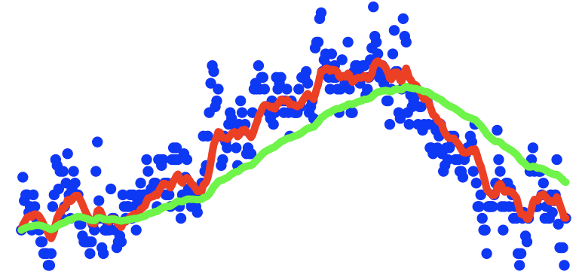
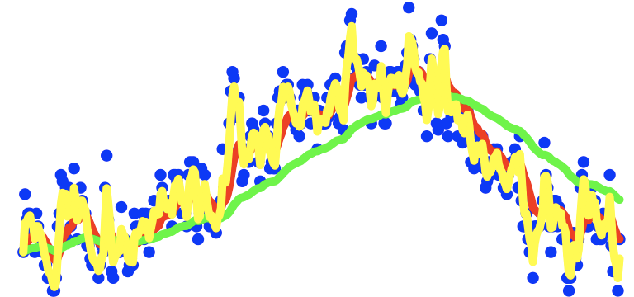
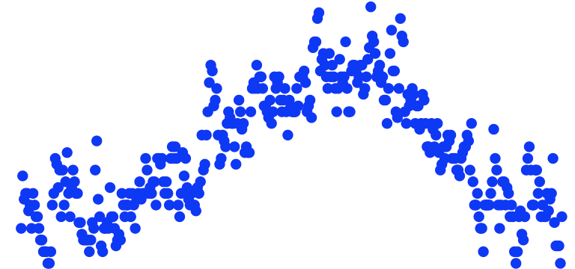
Exponentially weighted averages
temperature
days

Slide 3

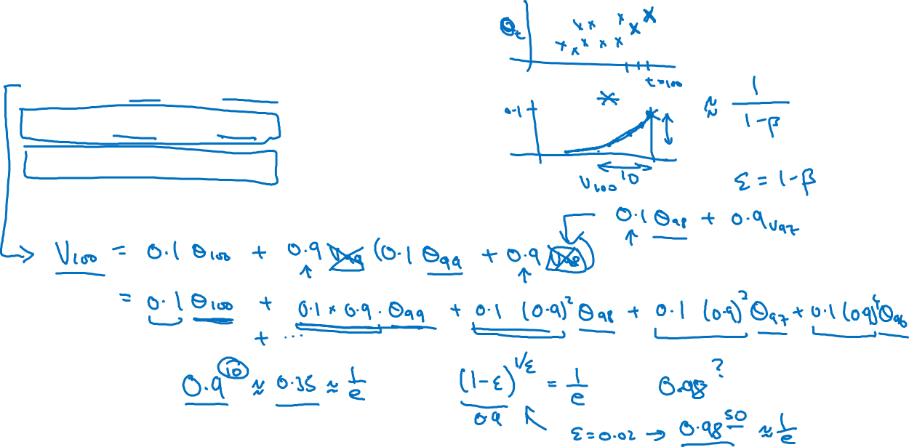




Exponentially weighted averages

Slide 4
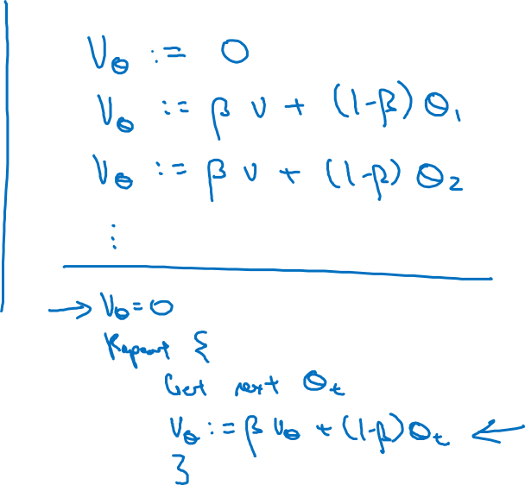





Implementing exponentially weighted averages

