Slide 1

Optimization Algorithms
Bias correction
in exponentially
weighted average
deeplearning.ai

Slide 2
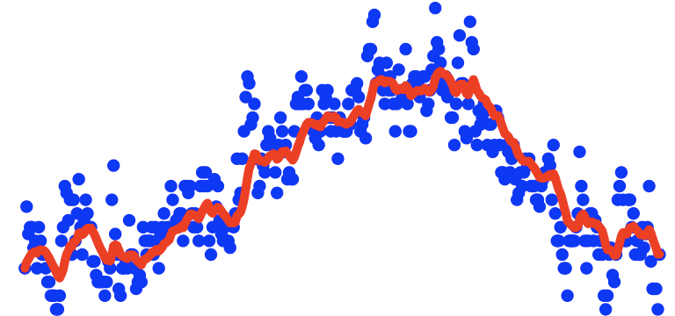
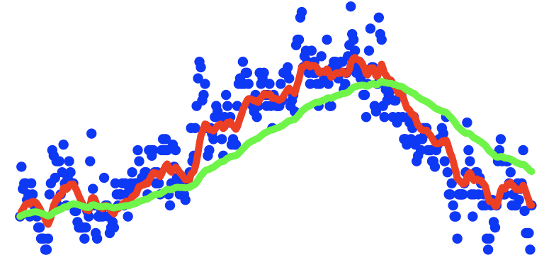
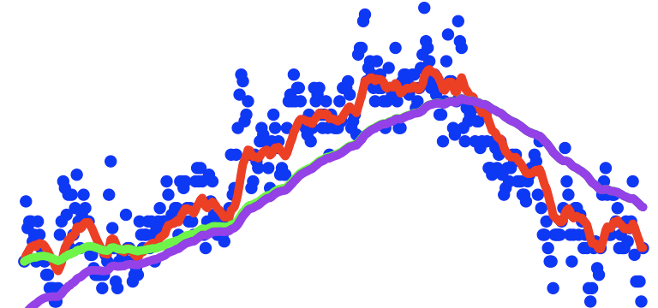
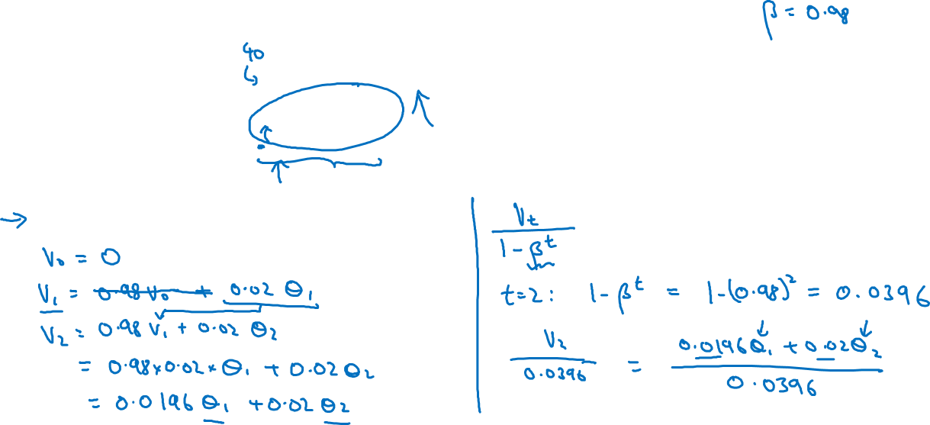

Bias correction
temperature
days

