Slide 1

Optimization Algorithms
Gradient descent with momentum
deeplearning.ai

Slide 2
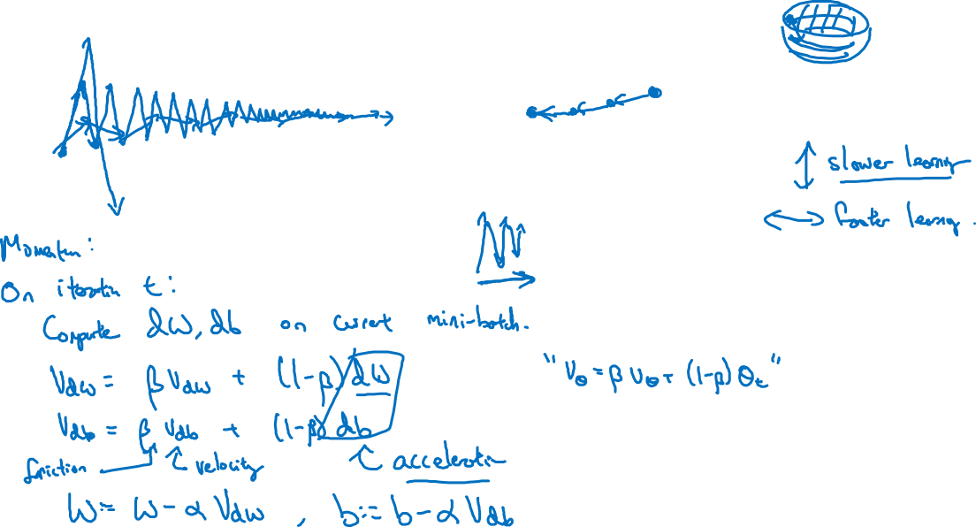
Gradient descent example
deeplearning.ai

Slide 3
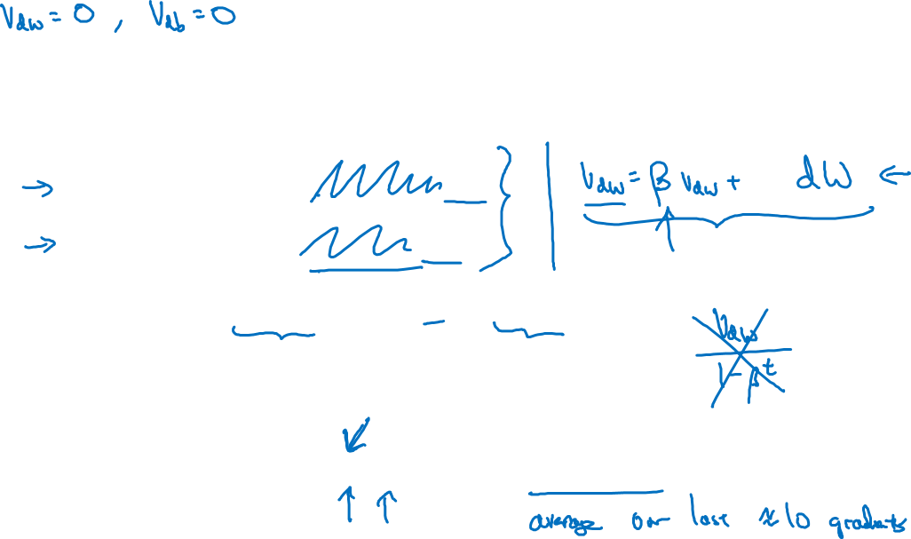





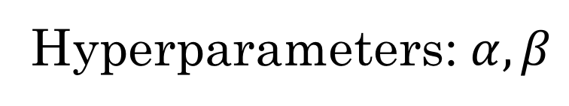

Implementation details
Compute on the current mini-batch
Hyperparameters:

