Slide 1


Slide 2
Table of Contents
Introduction to Postman
Why Developers use Postman
Key Features of Postman
Postman Installation
Sending Requests(GET,POST,PUT,DELETE)
Status Codes
Collections
Variables
Environment
Test Scripts
Postman Console
Conclusion

Slide 3

Introduction to Postman
Postman is a popular API development and testing tool.
It provides a user-friendly interface to send requests and view responses.
Widely used for automation, debugging, and API collaboration.
It is used by developers to design, test, and document APIs.

Slide 4
Why Developers use Postman?
Easy API Testing – Simple interface to send requests (GET, POST, PUT, DELETE) and check responses.
Time-Saving – No need to write extra code just to test APIs.
Supports Automation – Can run test scripts automatically with JavaScript.
Organized Collections – Store, group, and reuse API requests easily.
Monitoring & Debugging – Detect issues in APIs before production.

Slide 5
Key Features of Postman
Create and send HTTP requests:
1.GET
2.POST
3.PUT
4.DELETE
Save and organize requests into collections.
Automated testing using scripts
Collaboration with team workspaces.
Import/export collections.
Generate API documentation.

Slide 6
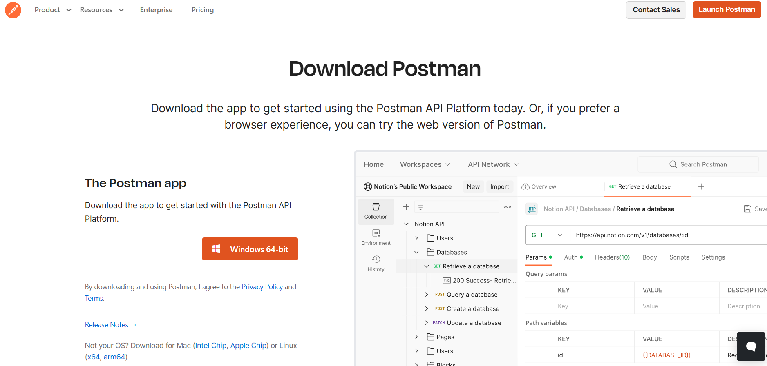
Postman Installation
1. Go to- https://www.postman.com/downloads/
2. Download Postman for Windows/Mac/Linux.
3. Launch Postman and sign in (optional).
4.Postman can also be directly used from web browser.

Slide 7
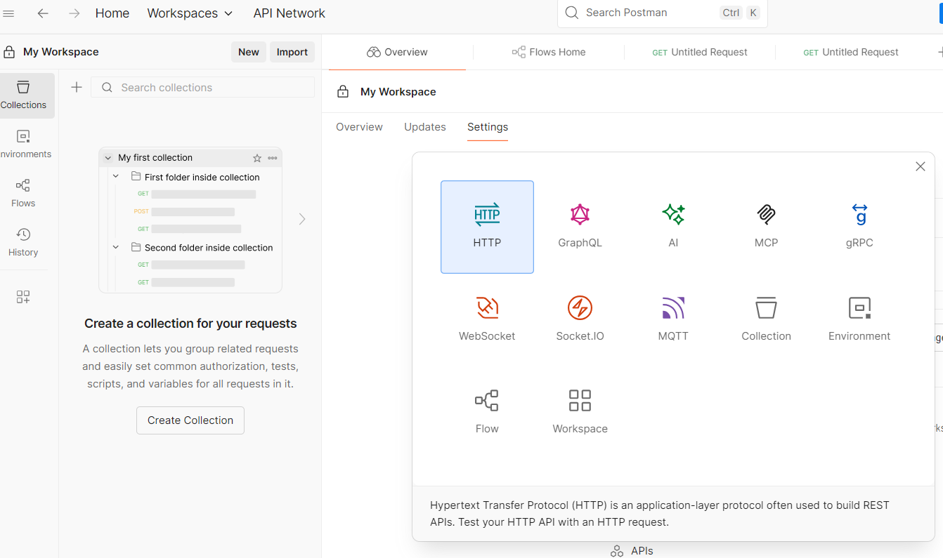
Sending Requests & Checking Responses
1. Select the HTTP method
2. Add the API endpoint
3. Add Headers,Authorizations as needed
4. For POST,PUT requests add Body
5. Save and Run and also Check Response

Slide 8
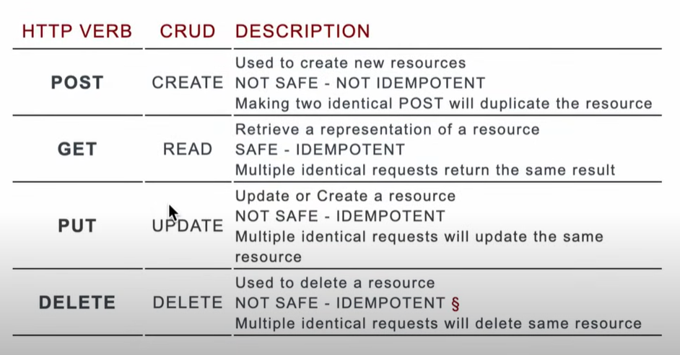

Slide 9
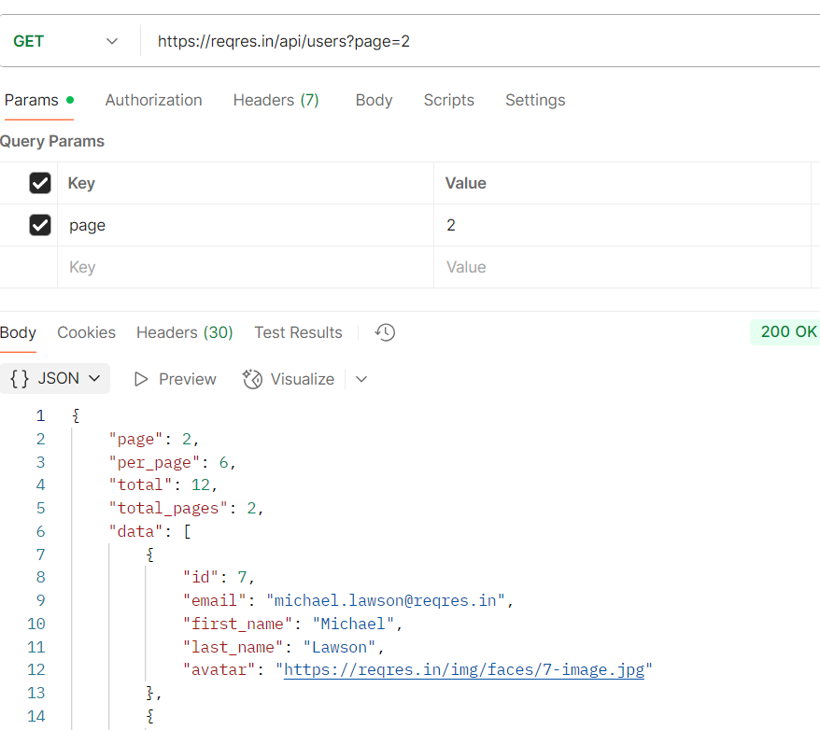
GET

Slide 10
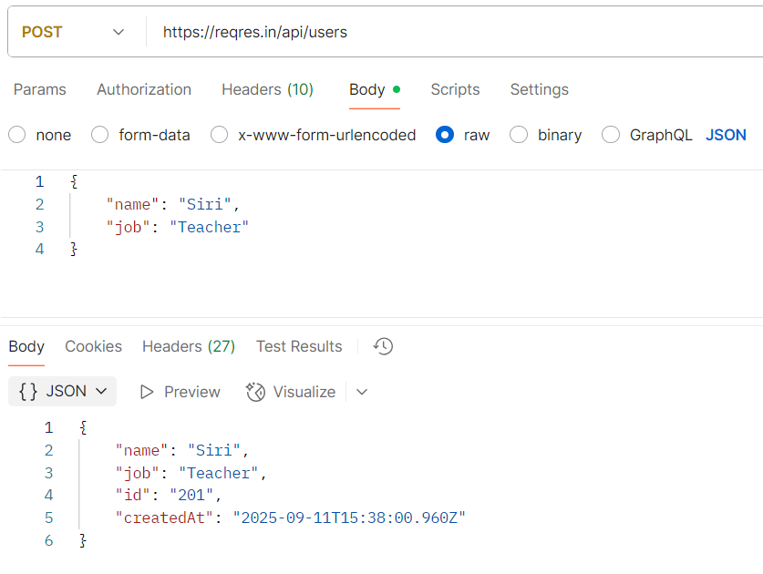
POST

Slide 11
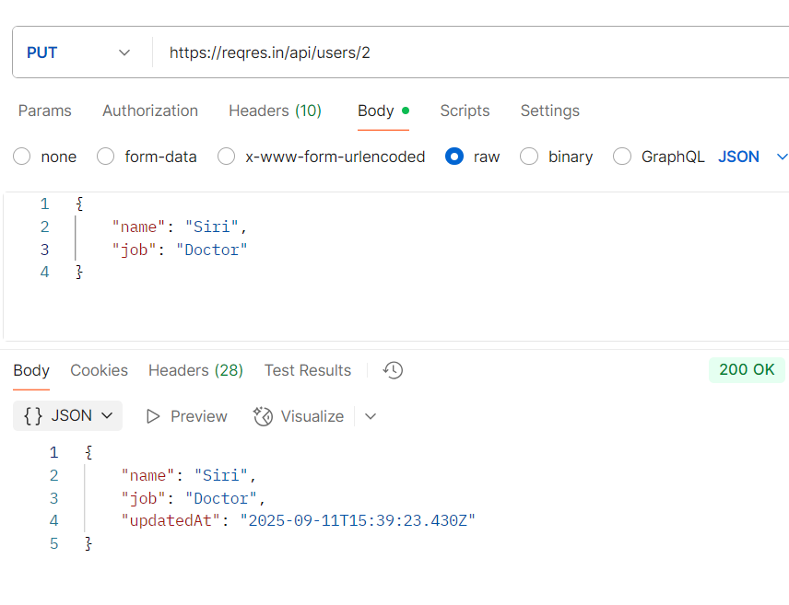
PUT

Slide 12
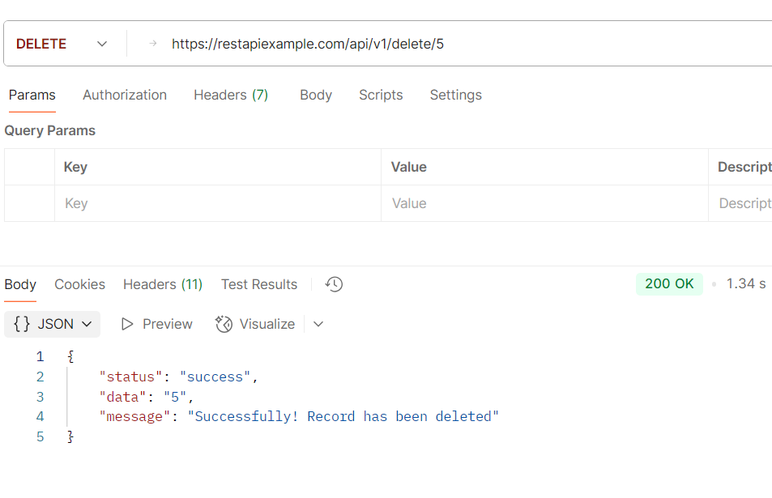
DELETE

Slide 13
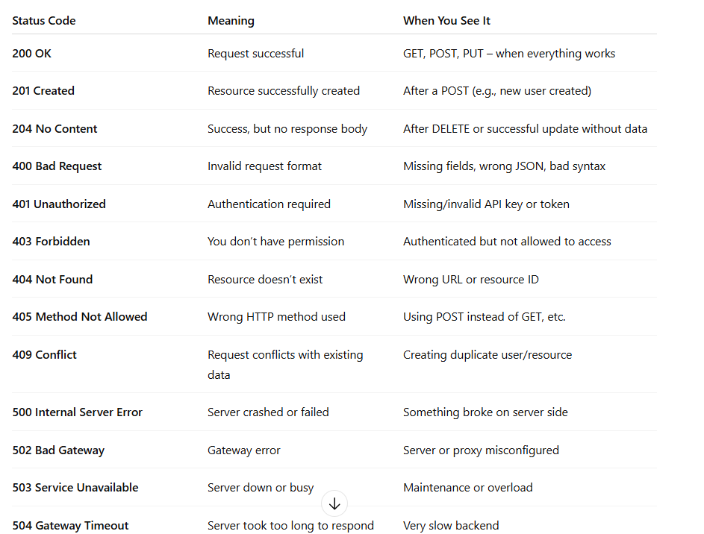
STATUS CODES

Slide 14
COLLECTION
1.Group of API Requests – Organize related APIs together (GET, POST, PUT, DELETE) in one place
2.Reusable – Save headers, body, auth settings for later use
3.Supports Variables – Use {{baseURL}}, {{token}} across requests
4.Automatable – Run all requests at once with Collection Runner
5.Collaborative – Easy to share/export collections with team members.

Slide 15
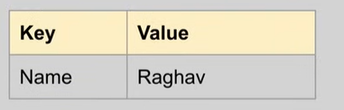
Variables
Variables are Key-Value pairs.
Reusable Values – Store common data (e.g., baseURL, authToken) in one place. Reuse the value at multiple locations and if needed change can be done at a single place.
Dynamic – Update value once, reflect everywhere in the collection
Use in Requests – Refer with {{variableName}}
Types of Variables Global – Available across all collections Collection – Limited to one collection Environment – Specific to selected environment Local – Exist only during request execution

Slide 16
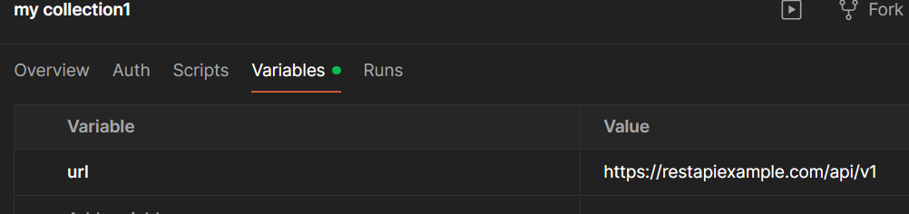
URL as Variable:
So, now we can replace :
https://restapiexample.com/api/v1/user/5 with {{url}}/user/5

Slide 17
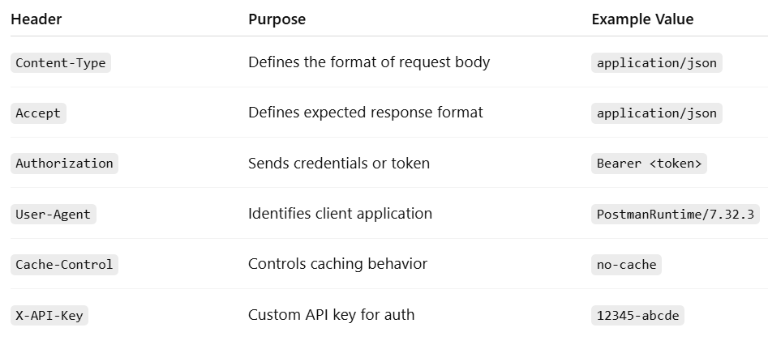
Headers
Key-value pairs sent with every request/response
Provide metadata about the request/response
Help the server & client understand how to process data

Slide 18
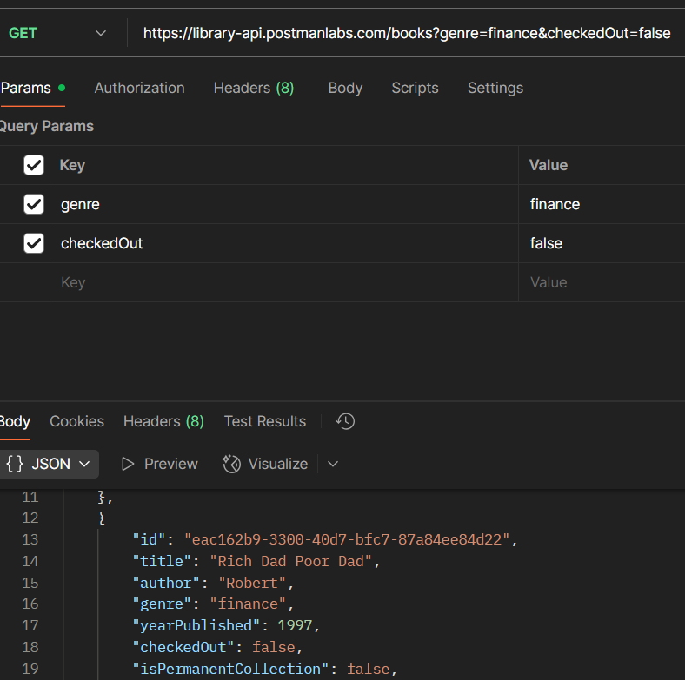
Query Parameter
Query Parameters are added at the end of the URL to send extra information to the server.
They always start with ? key=value format.
So, to add Query parameters in the postman, we need to add key-values pairs in the Params of Request API.

Slide 19
Scripts: Pre-request & Post-response
Pre-request and Post-response are the JavaScript codes that runs before or after an API request.
Request → Pre-request Script → Server → Response → Test Script
1. Pre-request:
Pre-request runs before the request is sent and it is used to set or update variables dynamically and also can generate timestamps, tokens, random data.
E.g.:
pm.environment.set("authToken", "12345");
2.Post-response:
Post-response runs after the response is received and it is used to validate response data and assert status codes and also helps in automation & test reporting.
E.g.:
pm.test("Status code is 200", function () {
pm.response.to.have.status(200);
});

Slide 20
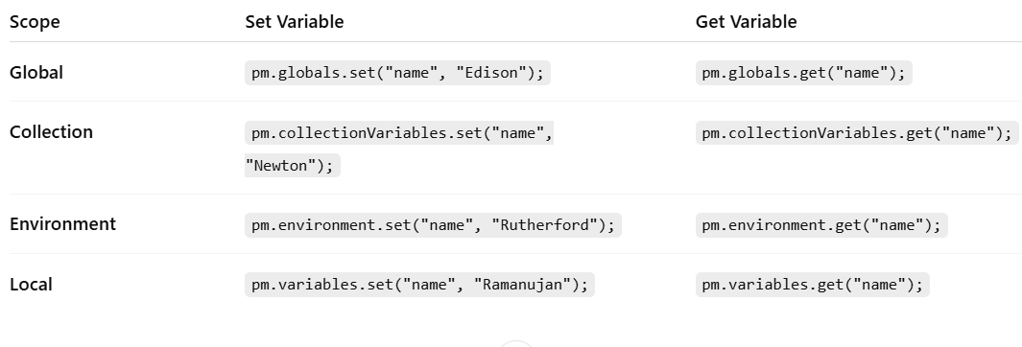
Get & Set variables through scripts
Variable Priority:
Local > Data > Environment > Collection > Global

Slide 21
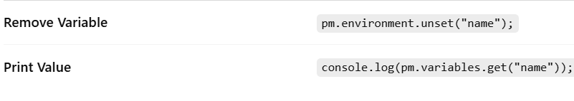
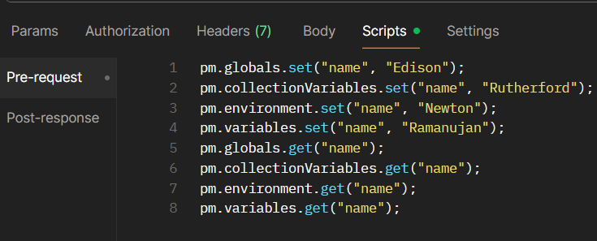

Slide 22
Environments
A set of variables that can be switched quickly to test APIs in different setups.
Avoid Hardcoding – Use variables like {{baseURL}} instead of typing full URLs
Easily Switch Between Setups – e.g., Dev, QA, Production
Centralized Control – Change value once, reflect everywhere
Better Collaboration – Team can share environment files

Slide 23
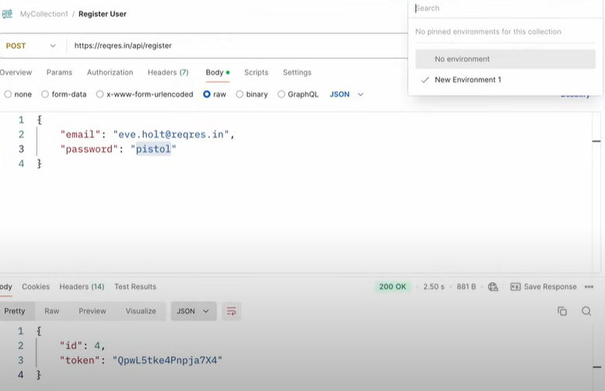
Creating Environment for Register User(Post Request)
1.Create API request.
2.Create environment with variables:
endpoint - api/register
email - eve.holt@reqres.in
password - pistol
3.Then make the necessary changes in the API request and body(refer the variables created).
4.Select the created environment and run the request.

Slide 24
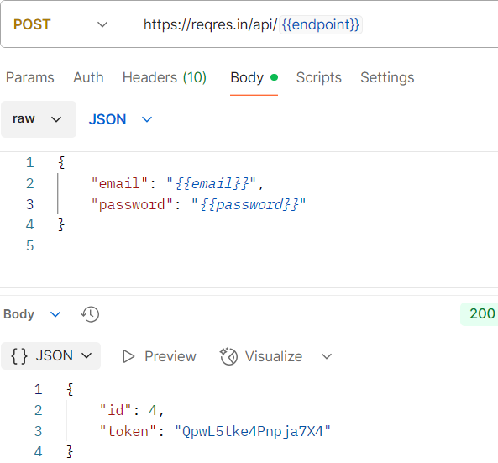
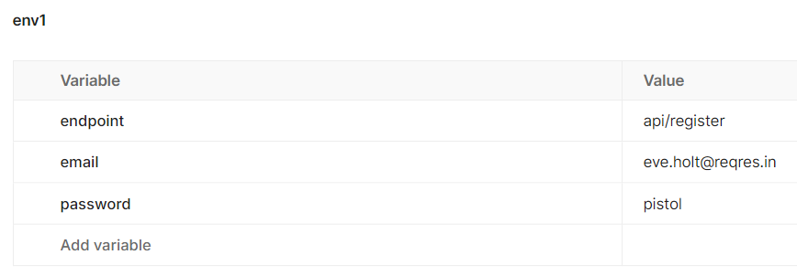
Changes in the API request after creating Environment :

Slide 25
Tests in Postman
Tests in Postman are JavaScript code that is executed after receiving response.
These tests are written in Post-response section.
Tests can be created at folder level,collection level,request level.
Steps to create Tests:
1.Create API request.
2.Check the Scripts section and select Post-Response(at folder level or collection level or request level as per requirement).
3.In Post-Response section ,write tests and run them.
4.Check tests outputs in Test Results sections.

Slide 26
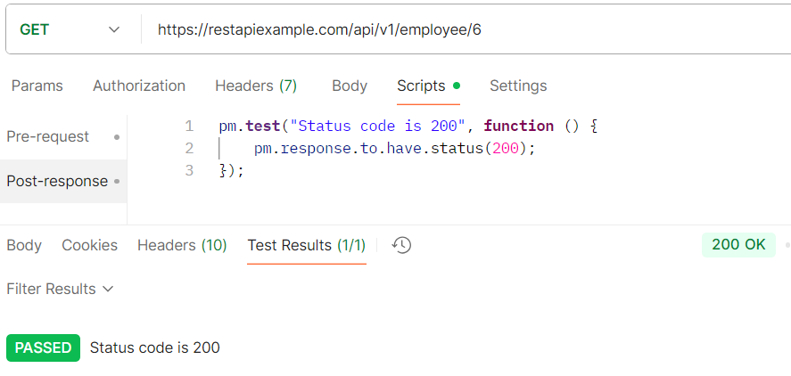
Verifying Status Codes
Scripts for Verifying Status Codes:
We knew that for successful GET request the status code should be 200(OK).
So,We can test it by:
pm.test("Status code is 200", function () {
pm.response.to.have.status(200);
});
We can check the test-outputs in the Test Results.
Passes if status code = 200,else fails

Slide 27
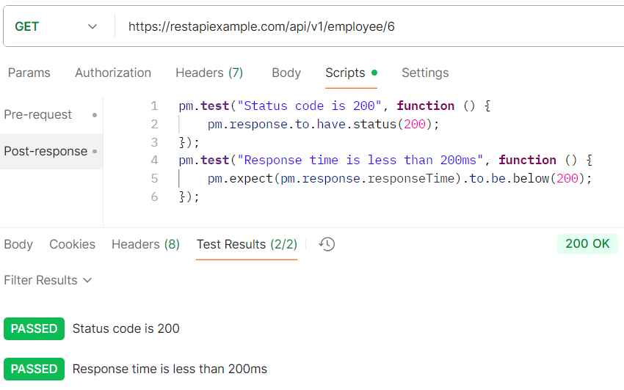
Check Response Time (Ping Delay)
We can test the Response Time by the following Script:
pm.test("Response time is under 200ms", function () {
pm.expect(pm.response.responseTime).to.be.below(200);
});
TEST RESULTS:
1.If the response is under 200ms, test passes.
2.If more than 200ms , test fails → helps catch performance issues early.

Slide 28
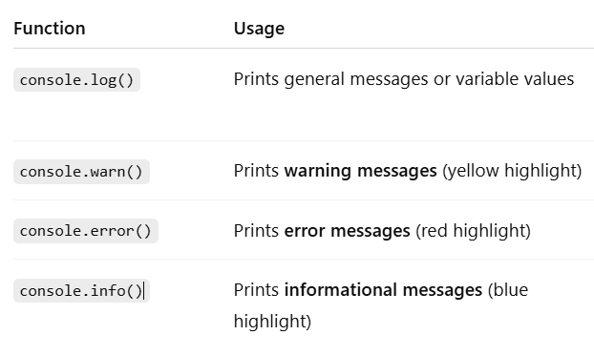
Postman Console
Postman Console is a built-in debugging tool.

Slide 29
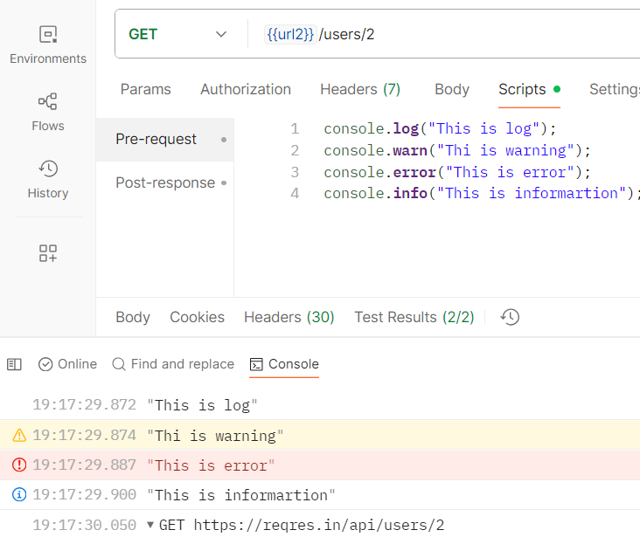
1.Better Debugging – Differentiate normal logs, warnings, and errors
2.Easier Troubleshooting – Helps quickly find issues in console output
3.Organized Output – Color-coded for readability

Slide 30
DATA DRIVEN TESTING
Runs the same request multiple times with different sets of data automatically.
Test multiple input combinations quickly
Reduce manual effort
Catch edge cases (valid, invalid, empty values)
Ensure API works for different users / payloads

Slide 31
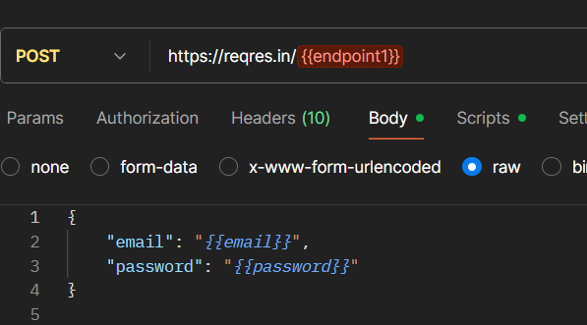
STEPS IN DATA DRIVEN TESTING BY CSV FILE
1.Create a API request.
2.Create variables and refer them in request and also write required test scripts.

Slide 32
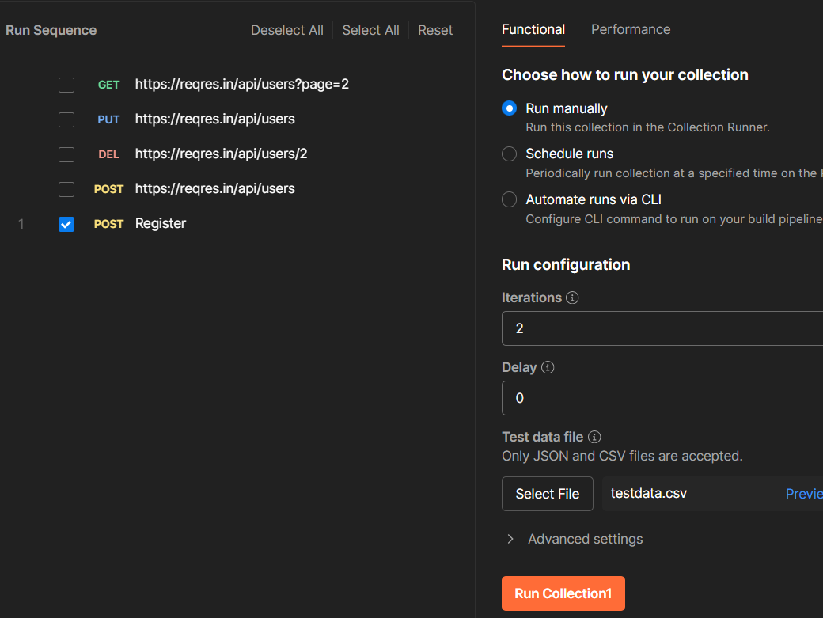

3.Goto RUN COLLECTION
4.Create CSV/JSON File and add data
5.Refer this created file in Run Collection
6.Refer data in Test Scripts
testdata.csv file
In the same way ,we can also create json file and refer it.
Testdata.csv -file

Slide 33
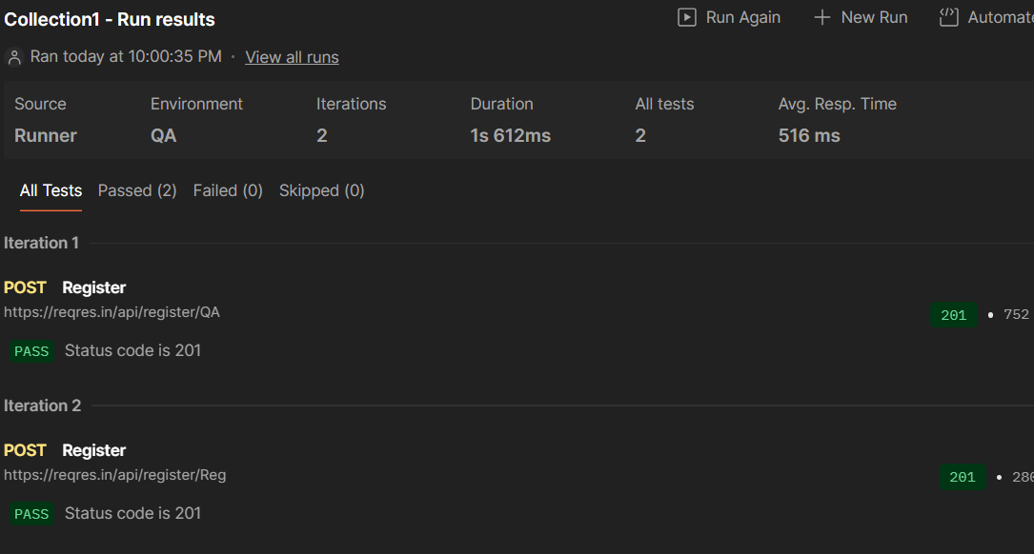
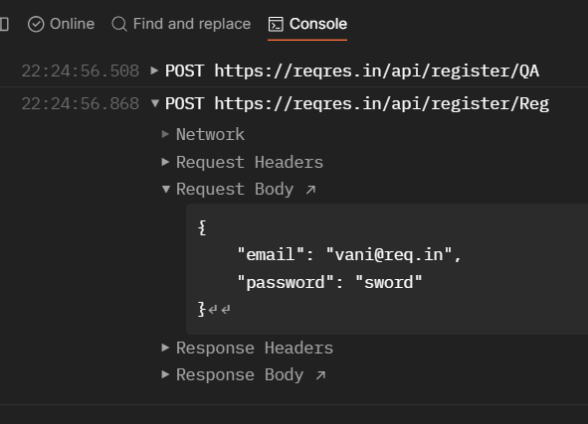
TEST RESULTS
Console output:

Slide 34
Script to verify email from datafile
Request Body:
{
"email" : "{{email}}",
"password": "{{password}}"
}
Test Script:
let jsonData = pm.response.json();
pm.test("Verify Email", function () {
pm.expect(jsonData.email).to.eql(pm.iterationData.get("email"));
});
pm.response.json() → parses response body into JSON object
pm.test("Verify email", function(){...}) → defines a test case
pm.expect(...).to.eql(...) → asserts equality (email in response = email in data file)

Slide 35
Authorization
Process of authenticating & granting access to APIs
Ensures only authorized users can access protected resources
Types of Authorization (Supported in Postman):
No Auth – Open APIs, no credentials needed
API Key – Key passed as header, query param, or body
Bearer Token – Token passed in Authorization header (Bearer <token>)
Basic Auth – Sends username:password in Base64 encoded format
OAuth 1.0 / OAuth 2.0 – Industry-standard token-based authentication
Digest Auth – More secure than Basic (hashed credentials)
Hawk, AWS Signature, NTLM – Advanced / special cases for enterprise APIs

Slide 36
Steps to set Authorization
1.Select the Request 2.Go to Authorization Tab 3.Choose Type (API Key, Bearer Token, Basic Auth, etc.) 4.Enter credentials / token 5.Postman automatically adds headers to your request

Slide 37
Conclusion
Postman is an essential tool for API testing and development.
It is easy to install, beginner-friendly, and powerful for advanced users.
Supports both manual and automated testing and it saves a lot of time in API testing.
Supports multiple API types (REST, SOAP, GraphQL).
Enhances productivity in API development lifecycle.

Slide 38
THANK YOU

