Slide 1


Love, we share
Share, we love

Slide 2
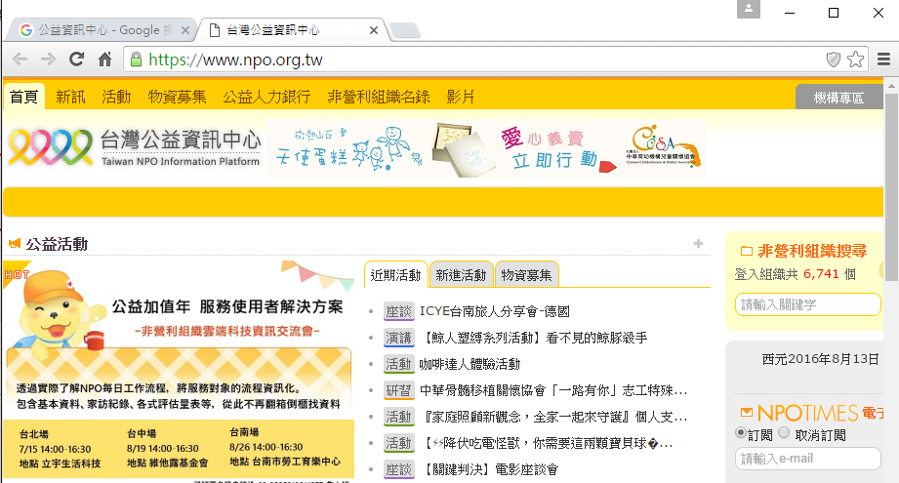
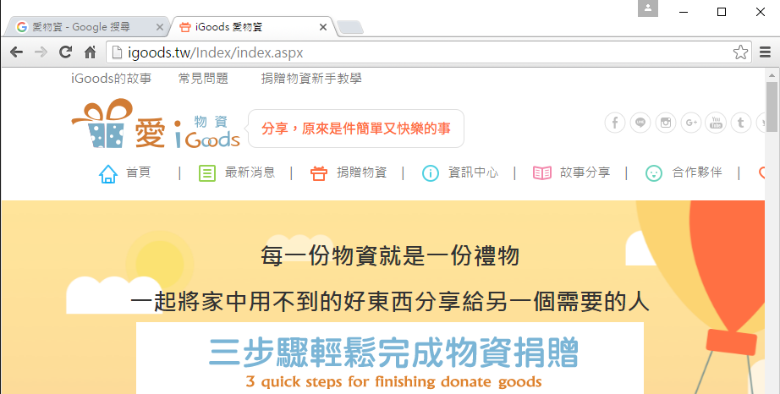
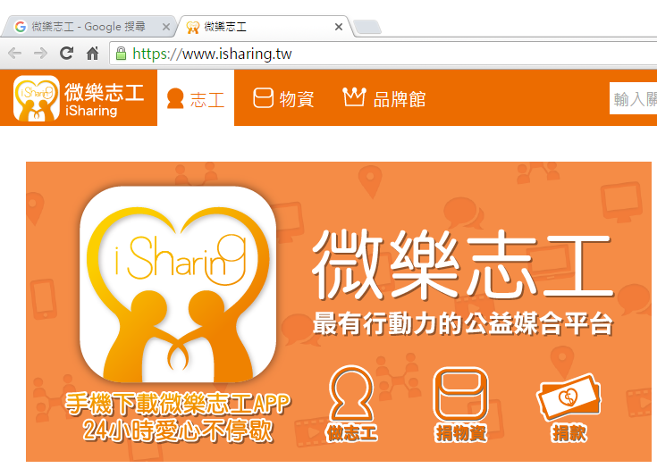
Charity Platform
At this moment
Passive Donation Pattern
Notes:
所以一開始我們簡介一下現行的物資分享系統與平台，其中規模比較大的大概是這三個，我就不逐一介紹各網站的特點，我們要強調的是這些平台所共有的困難與限制，我們把它命名為被動供給的困境，公益團體就是物資的需求者，那他們遇到了什麼困境？

Slide 3






Passive Donation Model
At this moment
We want to donate
We Need
Still need
But … TOO LATE …
We have no time to wait anymore

Slide 4

Aggressive Donation Model
AirHappot
goods requesters
donators

Slide 5
Invisible Barriers
At this moment

Slide 6










AirHappot
Make Every Little Highly Helpful

Slide 7
Why it can work?

Slide 8
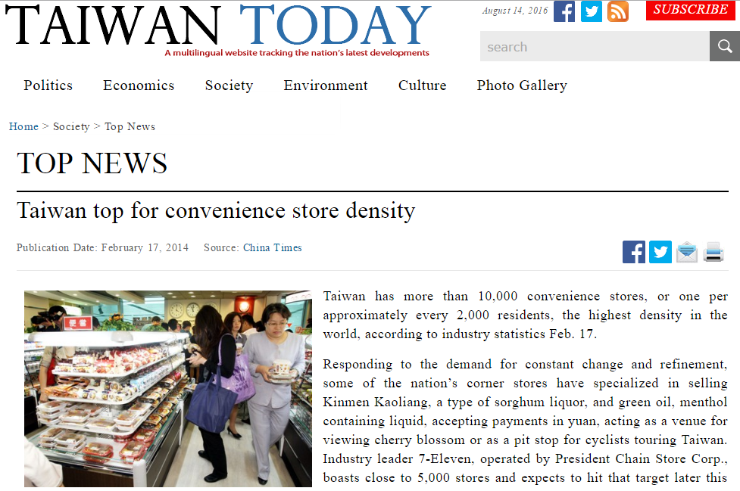
store sites of goods
- convenient store
Taiwan top for
convenience store density
Low shipment cost
between stores
The shipment cost is
available on the web

Slide 9
How to support it?

Slide 10












convenience store
collector store
demander
1
3
2
The cost of minimum shipment
The cost of minimum shipment
350
400
100
100
450
500
The cost of minimum shipment
400
200
200
The lowest
400

Slide 11

Workflow for assessing possibility of donation
check if quantity reach the standard
e.g. 100% + 50%(buffer)
check donator’s willing by deadline
re-check how many qty reach the standard
e.g. 100% + 20%(buffer)
start our model to Make Every Little Highly Helpful
inform donator to deliver

Slide 12
Open Data
Via Current Reachable Open Data:
災害救助物資庫存
(disaster relief goods inventory data set )
Via Innovative Open Data We Create and Share:
The statistics of volunteer’s resources and contents in our virtual space.
The donation history via this innovative model.
The Innovative Value for Deep Analysis !!!

Slide 13
Conclusions
So, what we are going to do is to make -
Supply comes in advance before demand
Lower shipment cost, higher possibility of donation

Slide 14
問題2 解決方法
積沙成塔的藝術
物資據點的運用
小華 ( 捐贈者 ) 礙於手邊只有兩瓶防蚊液，造成與其捐出去，倒不如把交通費拿去直購十瓶給需求者，我相信小華並不孤單，有愛心卻礙於個體力量過於渺小，所以我們集結這些有愛心個體的力量，嘗試發揮長尾效應，利用台灣極高的的人口密度與極佳的物流系統，讓在一特定地區中目標物資累計到一定量時，通知捐贈者將指定物資在時限內放置在指定物資據點，將這些鄰近據點的物資集合起來運送至需要的社福團體，取代個別運送的高成本，讓每個人的少量物資一次集結運送……

Slide 15
added value
收集大量資料後，後續分析出貨狀況比例、特定區域資源分配，預測物資需求週期並列舉需求物資的需求預測排名，提供供給者參考用
誘發一些替代 ( 拼圖以樂高來替代 ) 或額外 ( 把眾多曬衣架蒐集來布置環境 ) 的需求

Slide 16
