Slide 1
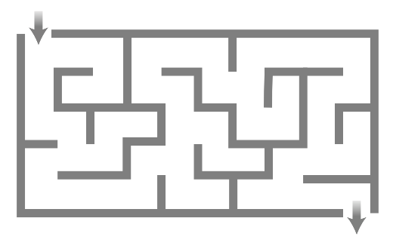
Push
50
Data
Pop
Data
30
60
3
7
2
6
1
Data
Insert
Delete
Data
10
40
80
Data
4
20
70
90
Subtree
T
2
5
8
10
-1
4
Enqueue
7
-5
6
9
S
Dequeue
-3
3
0

