Slide 1


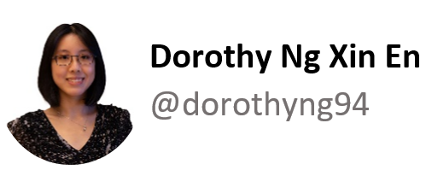
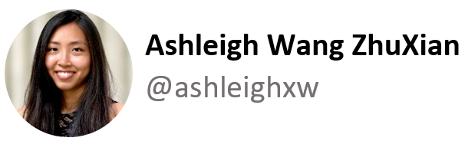



Interim Project
Twitter Data Crawler
Notes:
Intro, objective, github, source libraries (Din: slide 1-8)
Schema + Jupyter notebook - Twitter API (elaborate on source libraries imported), profile info and social network tables (Ash: slide 9-11)
Jupyter notebook - Tweet table + explain cursor (KY: slide 12-14)
Jupyter notebook - loading info into database (SY: slide 15-17)
Jupyter notebook - python analysis (Dory: slide 18-22)
Jupyter notebook - SQL analysis/aggregation and conclusion (Pierre: slide 23-end)

Slide 2

Agenda
Objective
Open-source libraries used in Jupyter Notebook
GitHub - Collaboration Tool
Database Design & Schema
Twitter Data Crawler Source Code
Analysis - Python
Analysis - SQL
References
Start crawling!

Slide 3

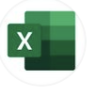
Objective
XX
Goal: To build a crawler to search through 1000 no. of tweets containing selected keywords from a Twitter user
Baseline:
Collect user's profile information, social network information from the Twitter user- Joe Biden (@JoeBiden).
Filter tweets containing two keywords: [Covid, Vaccine].
Analysis: How does keywords from @Joe Biden’s current Build Back Better campaign fare [Jobs and Economy] as compared to [Covid and Vaccine]?

Slide 4
Open-source libraries used in Jupyter Notebook
Open Source Library
API and Data
Database driver and SQL
Analytics and Graphs
Tweepy
Pandas
Psycopg2
IPython - SQL
SQLAlchemy
Matplotlib
Spacy
Natural Language Toolkit (NLTK)
Regular expression (Re)
Seaborn
Notes:
Open Source Libraries are like pieces of software with a open source license. A programmer can use them to add certain functionality to the program he is coding by linking them to his program.
A database driver is a computer program that implements a protocol (ODBC or JDBC) for a database connection.

Slide 5

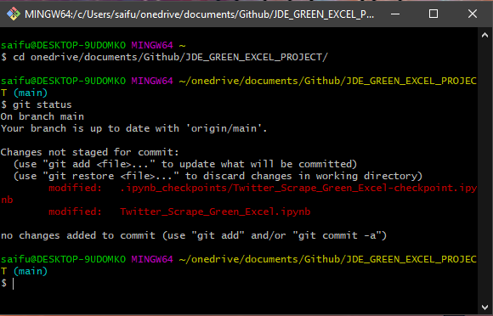
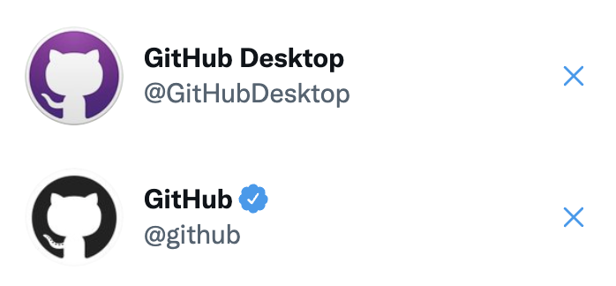
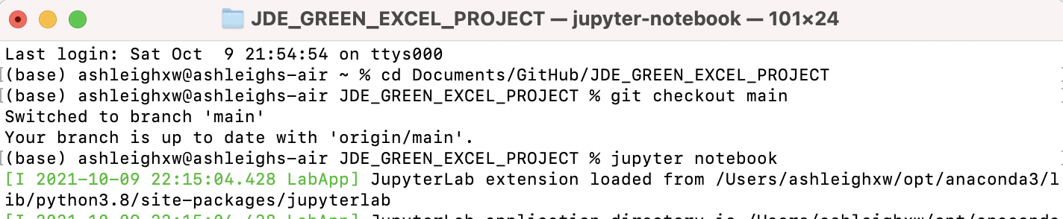
GitHub as a Collaboration Tool
Our experience using GitHub Desktop vs Git Bash (Windows) /Terminal (Mac)
GitHub

Slide 6

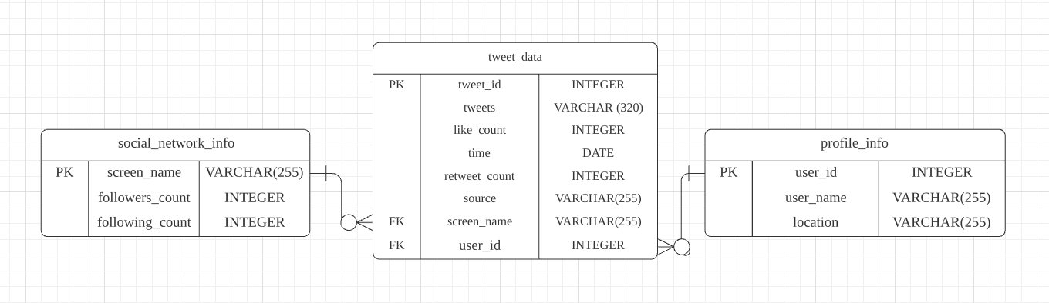
Database Design & Schema
From tweet data dictionary, we derive the relevant attributes useful for our crawler.
Notes:
ERD: There can only be one screen_name (per account) and tweet can come from either zero, one, or many screen_name. There is only one user_id for each profile, and tweets can come from either zero, one, or many user_id.
Note: one screen_name/ user_id can create an account and not tweet (hence can be zero) and can tweet many many (hence many)

Slide 7
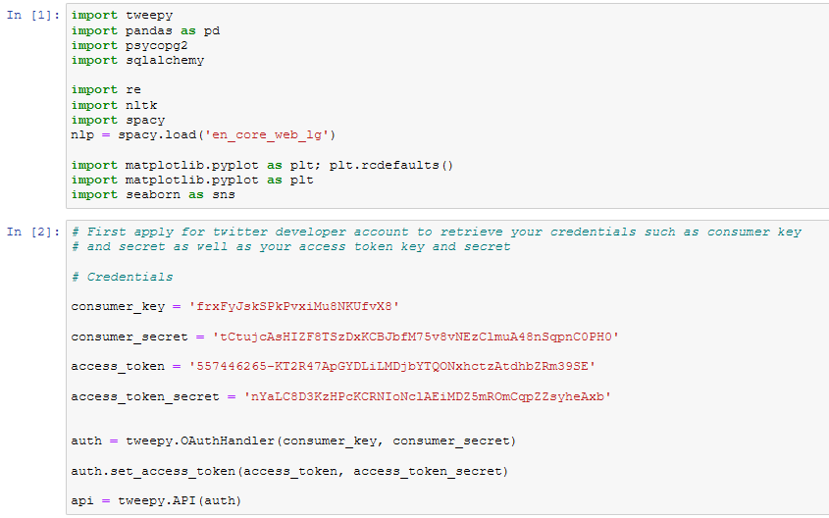
Twitter Data Crawler Source Code
Notes:
Import library and API

Slide 8
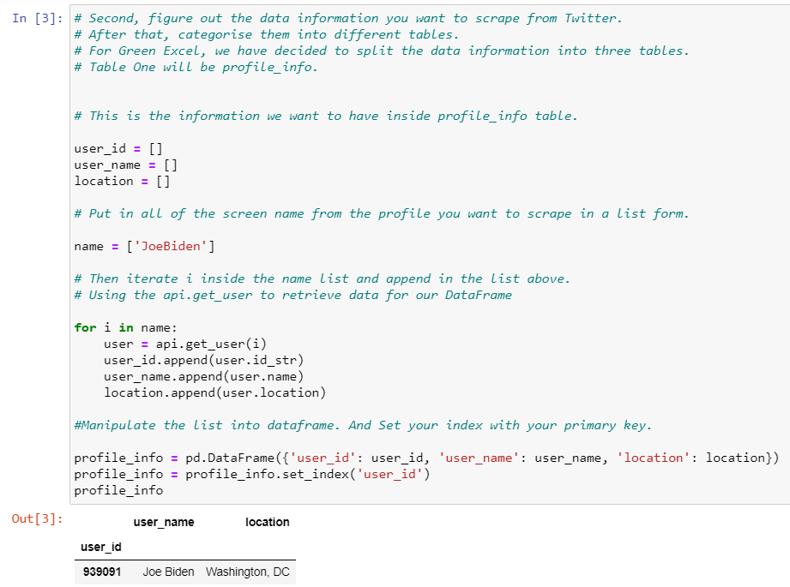
Notes:
Extract data

Slide 9
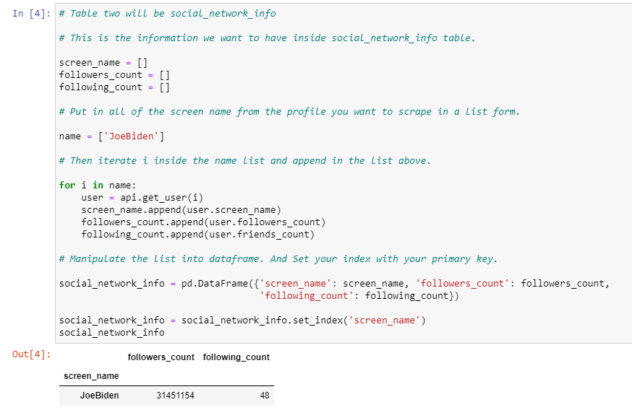
Notes:
Extract data

Slide 10
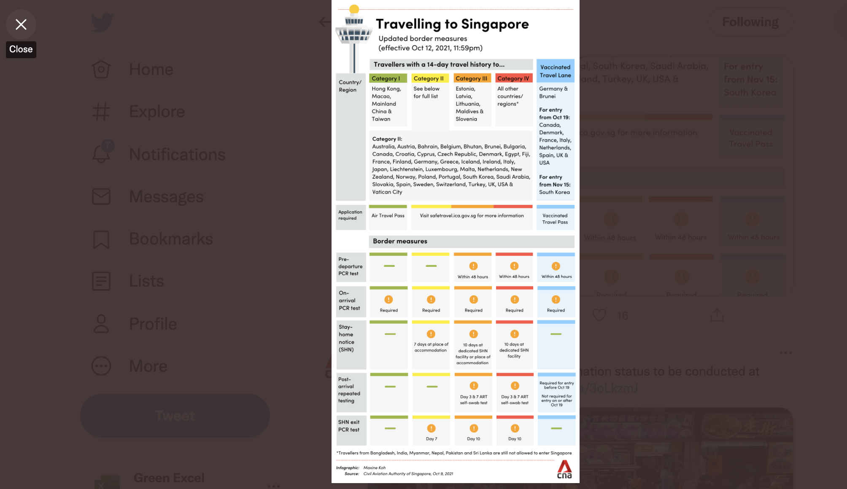
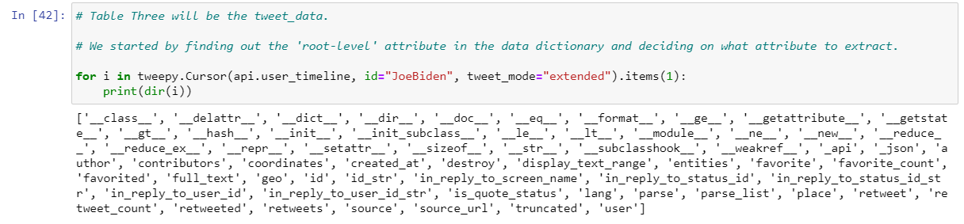
Notes:
The third table will be the Tweet_data table. First we would like to determine what kind of ‘root-level’ attribute is available to extract for the tweet_data table.​​ This can be done with dir() method to return list of valid attribute. And this is enabled by using a Tweepy class called cursor where we pass user_timeline API. (Like the other groups, we use cursor and) to expand on cursor briefly, it is an object that uses pagination with the item/page function. In this case, we only want to find out attribute, so we return just one item so we can see all the available attributes in a single tweet. Just to provide a little context on pagination that was used in cursor: in brief, it means breaking results into pages. An example(we can relate) is Google search result page where we only see first 10 results out of millions and we click next button to view the next 10 results.
Extra note:
-Pagination is a method of presenting content in a limited and digestible manner / subset of items. Cursor help us manage/simplify pagination with less codes. By passing item 1, we only get one search result back. Alternatively, can also pass page function.
-API user_timeline - retrieve the recent tweets.

Slide 11
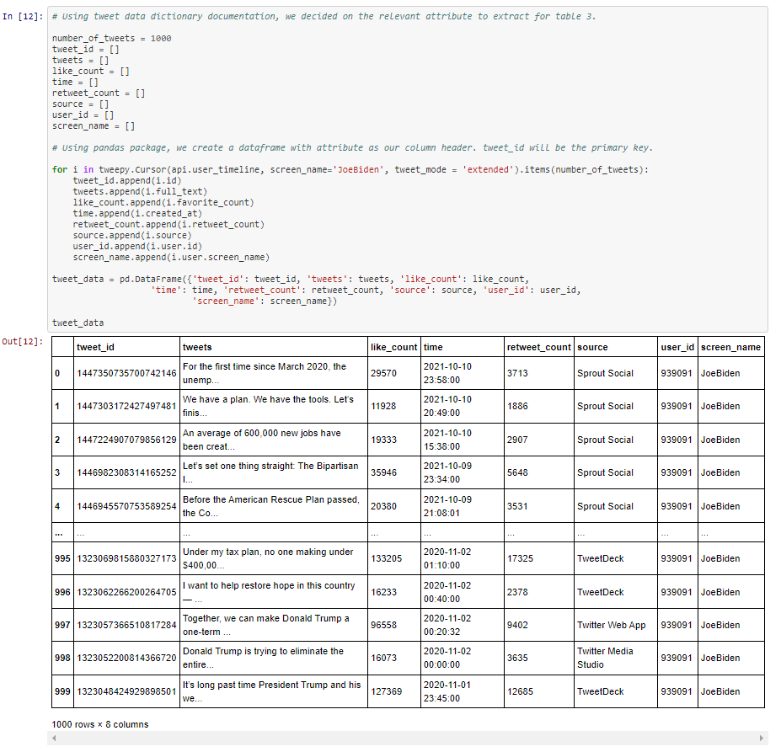
Notes:
Looking at the available attribute, our team went through the tweet data dictionary documentation. In the end, we decide to extract (1) tweet_id, (2) tweet content, (3) number of likes, (4) date and time tweet is created at, (5) number of retweet, (6) source (such as from twitter app, or what other medium they use to post the tweet), (7) user_id number (from table 1: profile_info), (8) user screen name (from table 2: social_network_info), for our tweet_data table.
Same as what we did for the previous tables table, we pass parameter to cursor and using for loop, append the results back to the empty list. The user_timeline API will return a collection of the most recent tweets posted by Joe Biden as indicated in the user_id parameter.
In our case, we use 1000 recent tweets on our item function and used pandas to create the dataframe (so we can see our data in a nice structured way).
Extra note: In the code here, we pass parameter of id (Joe Biden) and tweet_modes (extended allows us to view full_text instead of truncated 140 characters) to Cursor and Cursor will pass the parameter into user_timeline API.

Slide 12
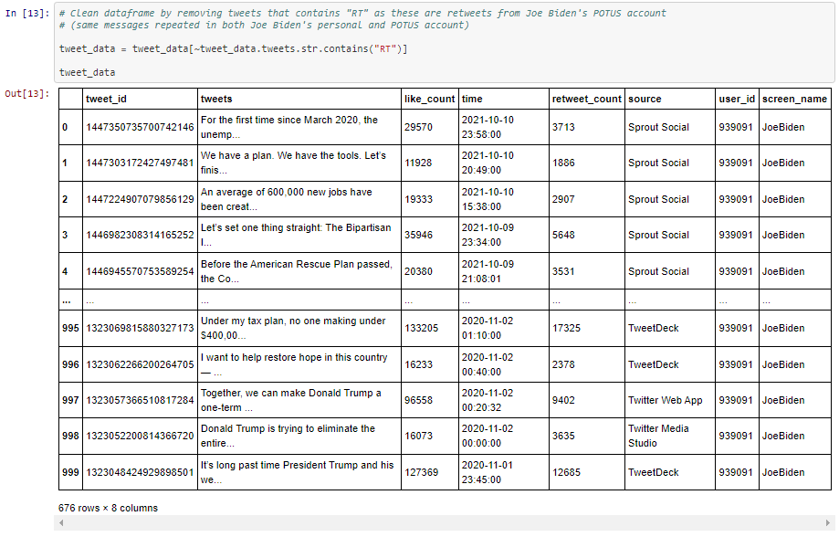
Notes:
As the dataframe returns tweets from Joe Biden’s personal account and REtweets from his POTUS (President Of The United States) account, we want to remove tweets containing string “RT” as this will skew our data.
We clean the dataframe by having tilda ~ which acts as not operator to remove tweets with string “RT”.
After cleaning, we set index on tweet_id in this dataframe.
Next I will be passing on to Sook Yin to continue with the next part of the presentation.

Slide 13
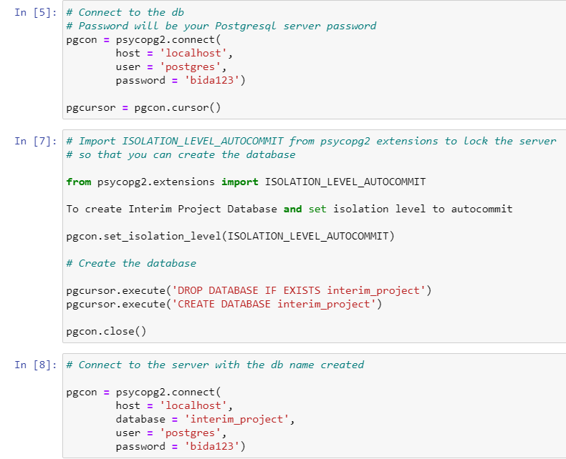
Notes:
We are going to create the database and connect in posgre. Firstly we use the psycopg2 establish a connection to postgre server, but we are not going to give it a database cause we will use the python code to create a database later. We create a cursor.
Another new library bringing in here which is psycopg2.extension, we will import isolation level autocommit > >
Isolation levels can be set when creating database. Purpose is to set the type of lock on the database if multiple users are making changes on the same data at the same time and
Autocommit isolation level means: each query will be committed on the database after it is executed
Since we’re just creating a database, there are no changes to the table/database. So we use autocommit.
Then we will use pgcursor.execute to drop database in case it’s out there and recreate it
Close it and it’s connect to the postgre instance, ideally it will create a database for us
Now we connect again to the server with the database we created just now
No transaction is started when command are issued and no commit() or rollback() is required.
Can choose from different type of locks
Other type of locks - read uncommitted, read committed etc.

Slide 14
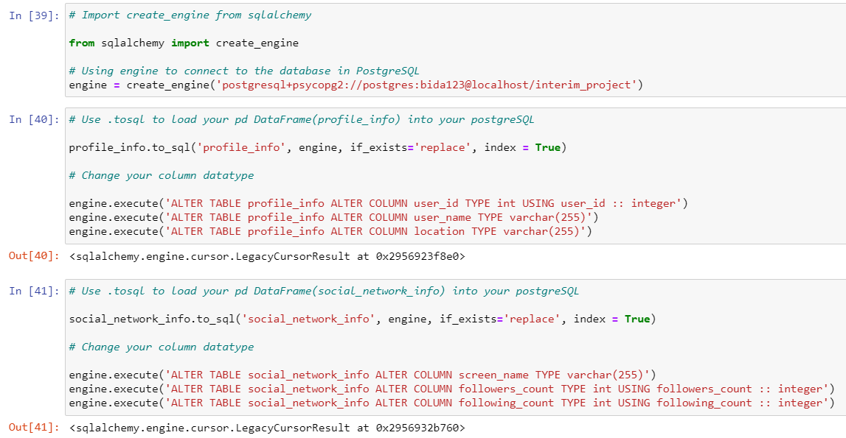
Notes:
Next step To use pandas in sql() method, we are using sqlalchemy to import create_engine
To connect the engine to the database in postgreq, passing in the driver “postgredsql + psycopg” follow by userid, pw, server & database, return the result that point to the variable object called engine
2. Use the pandas to SQL method to load the 3 dataframe we created earlier to a Postgresql table, the first table name is profile_info, with the engine which is our database connection object, if it’s found the database exist it will replace it, and we will have index for the particular table. Then we will execute this command to indicate the datatype for each column
A same method are used for the dataframe social_network_info
And also the tweet data. We found that Tweet id is too big to fit in into others integer so we use big integer for tweet_id. This is how we create and connect the database in server

Slide 15
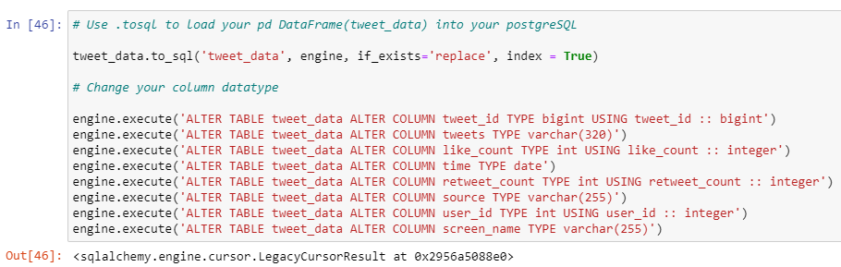
Notes:
Load tweet_data dataframe into postgreSQL - specifying column name and data type.

Slide 16
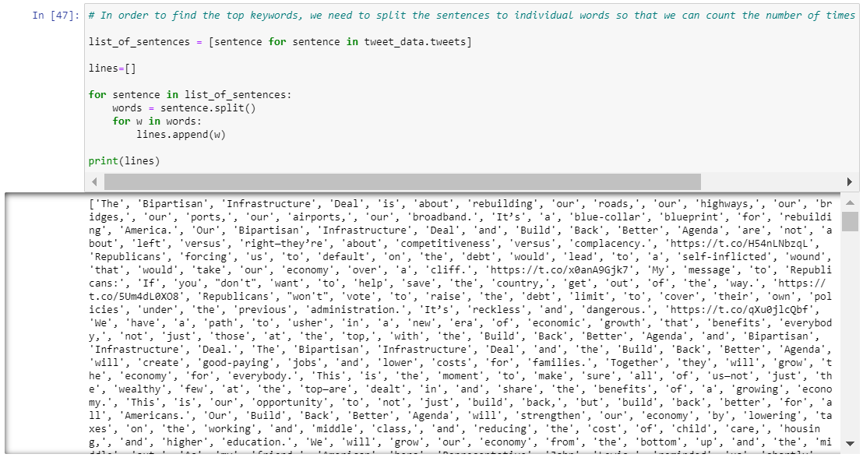
Python Analysis
Notes:
For our analysis using python, we aim to find out the top keywords that appear in Biden’s tweets, to check if the keywords covid and vaccine or economy and jobs are among the most frequently used keywords.
We selected the 2 keywords based on recent news that Biden has been focusing on the build back better agenda which focuses on improving the economy and creating jobs.
First, the sentences in the tweets are split into individual words, since it’s difficult to analyse for keywords using whole sentences. This will allow us to count the number of times the word appears later.
We use a for loop to iterate through all the tweets and append each word individually to the list (called lines).

Slide 17
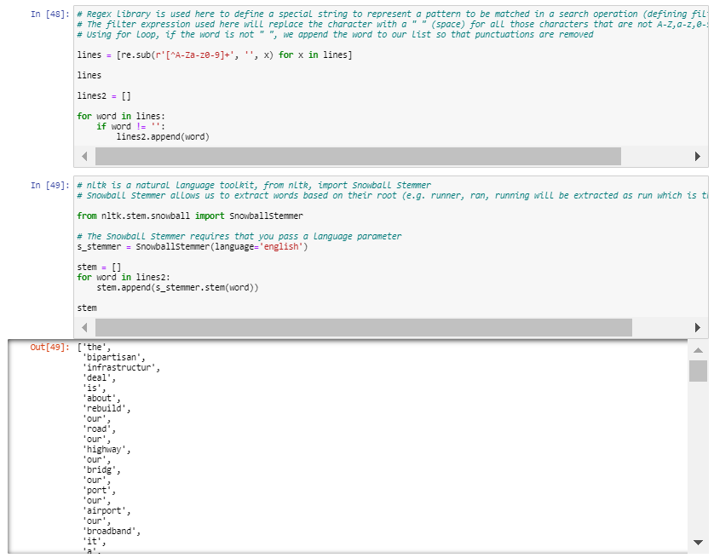
Notes:
Next, we want to remove any punctuation from the words, since they are not relevant keywords. Regular expression (regex) library is used here to find and replace certain characters.
In this expression, we will replace characters that are not A-Z, a-z, and 0-9 will be with a space (“ “) in the list we generated just now of the individual words. Using for loop to iterate through the entire list of words again, we append the word to our list if the word is not a space (“ “), so that punctuations are removed.
After words are filtered, we use snowball stemmer from NLTK (natural language toolkit), This allows us to extract words based on their root word. For example, runner, ran, running will be extracted as run which is the root word). We also specify the language to be English when using the snowball stemmer. WE do this because we want to sum up the frequency of words that appear in the tweets later. If we have variations of teh same words (eg. running, run, ran), each word will appear as a distinct count instead of being aggregated together. So we want to standardize the word used for our count later.

Slide 18
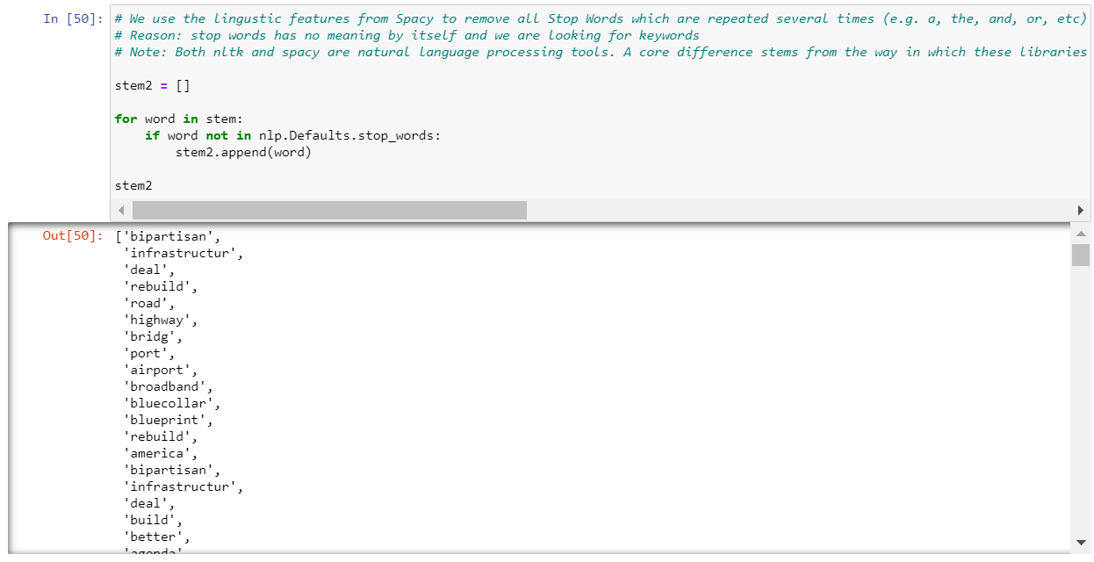
Notes:
Using linguistic features from Spacy, we remove all stop words such as a, the, and, or. We remove stops words because we are only interested in key words and stop word have no meaning by itself and it is repeated several times.
NLTK and Spacy are both natural language processing packages available for use in Python. Why do we need both?
NLTK - Snowball stemmer process the individual words to find out the root word. Spacy does not have stemming abilities, which is why we use NLTK.
NLP - part of spacy package. Spacy is the fastest and most accurate syntactic analysis of any NLP library available currently. Spacy library has more stop words compared to NLTK, thus we chose spacy for this job.

Slide 19
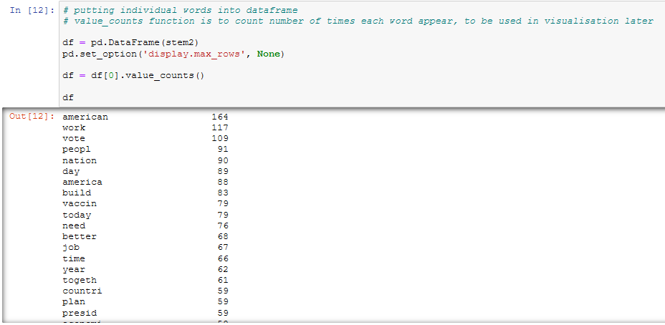
Notes:
New word frequency
Job + economy + econom= 67 + 58 + 34 = 129
Covid19 + vaccine = 56 + 79 = 135

Slide 20
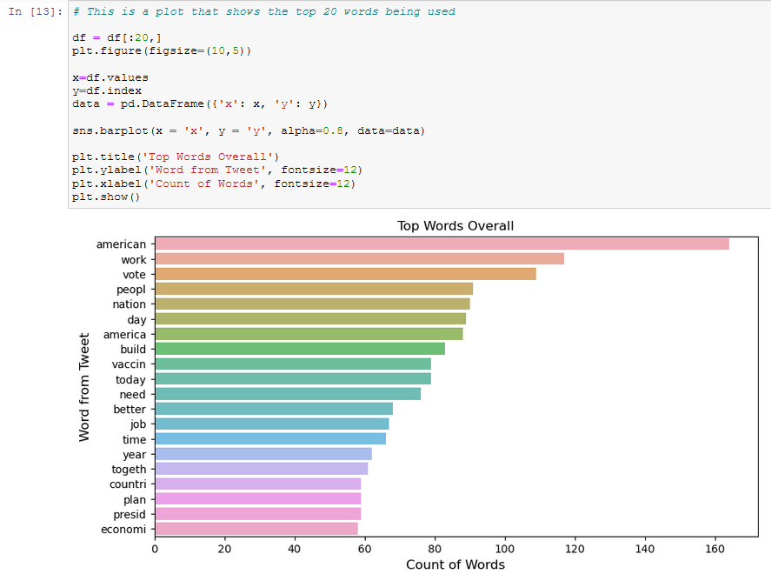
Notes:
New chart

Slide 21
Database Design & Schema
From tweet data dictionary, we derive the relevant attributes useful for our crawler.
Notes:
By using the schema we set we are going to set our pk and fk . but first we want to run sql code in the notebook

Slide 22
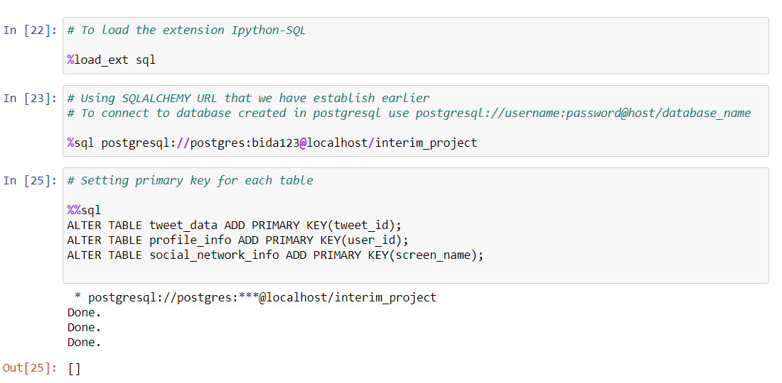
SQL - Primary Key
Notes:
The load extension sql is to load the ipython to let sql run in the notebook with the percentage sql
So for the %Sql postgresql code to tell the notebook to connect the postgresql into our database
Now using alter table we set the primary key for each table

Slide 23
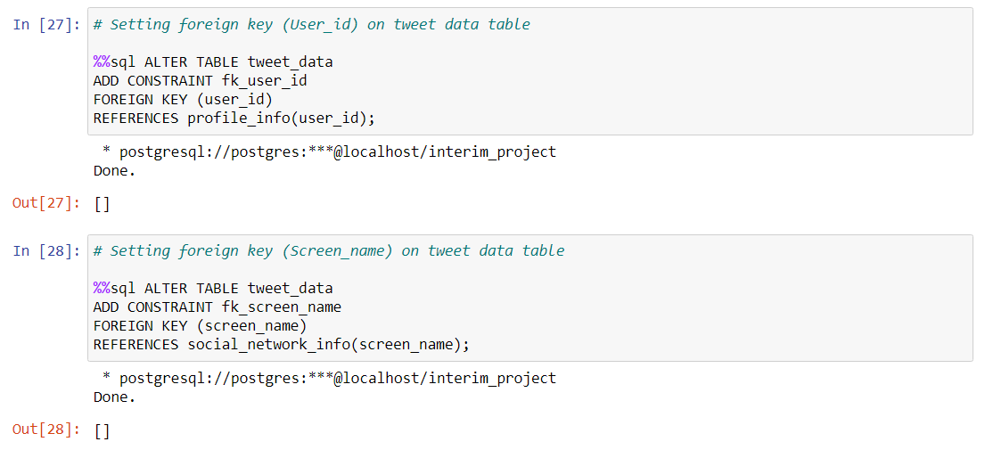
SQL - Foreign Keys
Notes:
Now we set the foreign key on the fact table using alter table as well

Slide 24
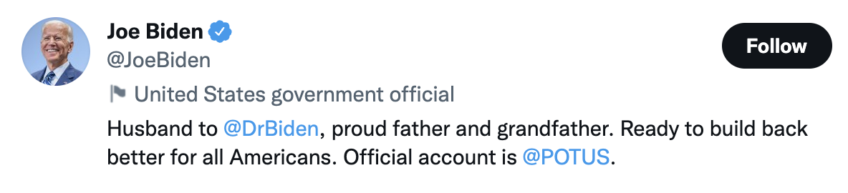


Keywords comparison
Notes:
The other key of key word compare with vaccin and covid will be economy and job like what din just say . we choice this 2 key word is cause of the baiden campaign which focus on improve the economy and create more job. The way we compare their engagement is by comparing their avg like and retweet

Slide 25
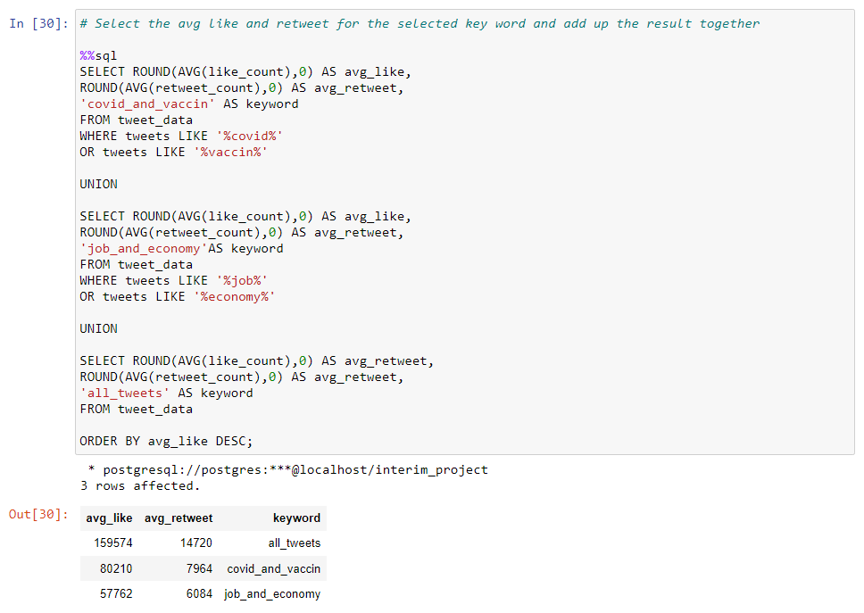
SQL - Finding keywords
Notes:
So now in order to find the avg like and retweet for each set of key word we write the sql code as shown and we join up the result of each query using union
So we can easily compare to result by looking at this one result

Slide 26
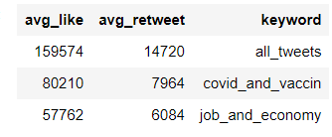
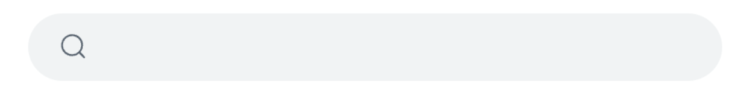

Keywords | Total word frequency
Covid19, vaccin | 135
Job, economy | 129
covid & vaccine
job & economy
Notes:
From the above result we can see that Biden’s followers are more engaged in tweets that are related to covid and vaccine compared to tweets related to job and economy (covid and vaccin > job and economy)and the frequency of keywords for job and economy appears more often in Biden’s tweets.
(IF ASK ABOUT ALL TWEET) This show there are keyword with higher avg like and retweet set of keyword, but the reason we can’t get the set of keyword is because there is too many combination. Example of solution can be machine learning.

Slide 27
Conclusion
Limitations of data crawler:
Data crawler only scrapes latest 1000 tweets everytime code is run
Python and SQL analysis only reflects the keyword frequency and tweet engagement at this current point in time
Top keywords and average likes/retweets will change as the data crawler is run in future
Solution: Factor in time period in which the crawler is running for a better comparison between keywords.
Notes:
As our Data Crawler will only scrape the latest 1000 tweets from Joe Biden everytime our code is run, our current Python and SQL analysis only reflects the keyword frequency and tweet engagement at this current point in time.
This means that the top keywords and average likes/retweets will change as the data crawler is run in future, since Biden would have added new tweets by that time.
One possible solution that can be explored in the future to factor in time period in which the crawler is running for a better comparison between keywords.

Slide 28









Reference
Loading Dataframe into postgreSQL from YouTube
https://www.youtube.com/watch?v=FQzzQnYERBc
Introduction to Tweepy from YouTube
https://www.youtube.com/watch?v=bNDRiaFyLrs
NLTK VS Spacy as natural language process tool
https://www.activestate.com/blog/natural-language-processing-nltk-vs-spacy/
Using Tweepy’s get_user
from geeksforgeeks (computer sc portal)
https://www.geeksforgeeks.org/python-user-object-in-tweepy/
Tweet data dictionary from twitter documentation
https://developer.twitter.com/en/docs/twitter-api/enterprise/data-dictionary/native-enriched-objects/tweet
Guide on using GitHub to collaborate from Medium(blog)
https://medium.com/@jonathanmines/the-ultimate-github-collaboration-guide-df816e98fb67
Code to generate top 20 keywords
from GitHub @AlexTheAnalyst
https://github.com/AlexTheAnalyst/PythonCode/blob/master/Twitter%20Scraper%20V8.ipynb
Connect to PostgresSQL Database Server from PostgresSQL documentation
https://www.postgresqltutorial.com/postgresql-python/connect/
Using Regex: what each character stands for in code
https://support.docparser.com/article/1290-how-does-the-regular-expression-regex-filter-work
Using PostgreSQL for Data Analysis
from YouTube
https://www.youtube.com/watch?v=FQzzQnYERBc
Notes:
If you need reference in order to understand our project , this will be the reference

Slide 29
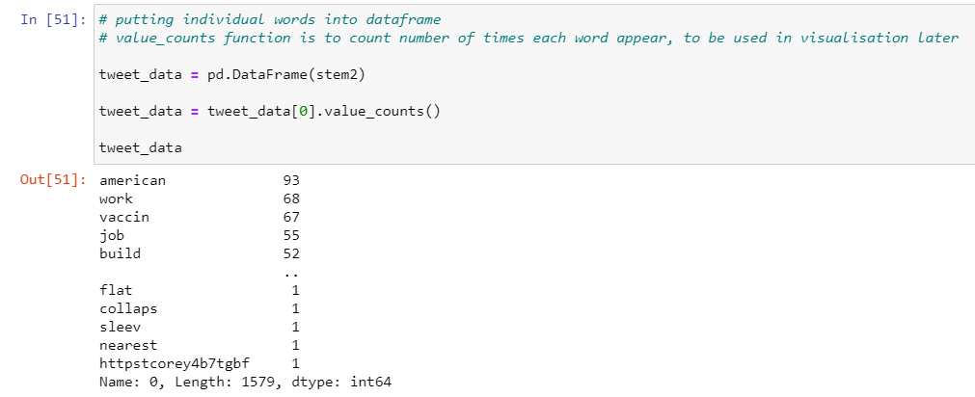
Notes:
After clearing punctuation, and removing stop words, we arrive at our keyword list. Here we put individual words into dataframe and count the number of times each word appear via value_counts function. This will be used in visualisation later.

Slide 30
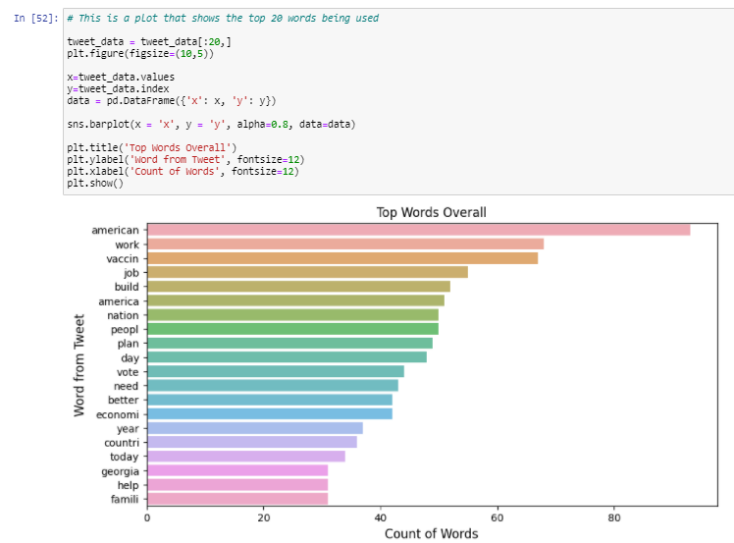
Notes:
Using matplotlib and seaborn, we show the top 20 keyword used in Joe Biden’s tweets.
We can see that the top keyword is Americans, which is used more than 80 times, and other top words are work, vaccine, job and build. Covid/coronavirus didn’t appear as a top keyword in the chart

