Slide 1
A Tutorial on Hidden Markov Models
하진영
강원대학교 컴퓨터공학과

Slide 2
Contents
Introduction
Markov Model
Hidden Markov model (HMM)
Three algorithms of HMM
  Model evaluation
  Most probable path decoding
  Model training
Pattern classification using HMMs
HMM Applications and Software
Summary
References
A Tutorial on HMMs

Slide 3
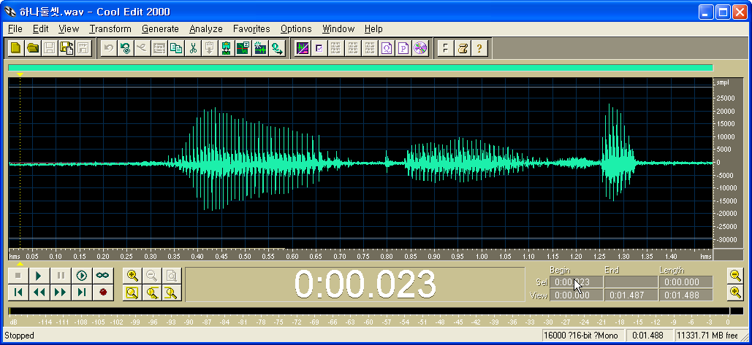
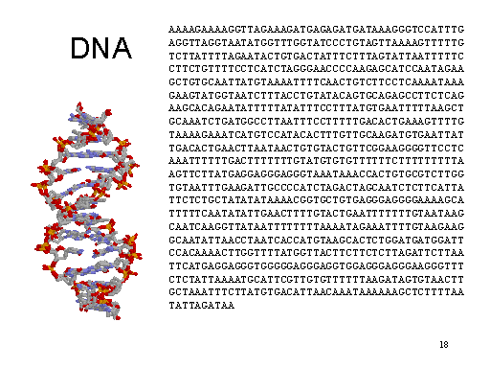

Sequential Data
Examples
Speech data
(“하나 둘 셋”)
Handwriting data
A Tutorial on HMMs

Slide 4
Characteristics of such data
Data are sequentially generated according to time or index
Spatial information along time or index
Often highly variable, but has an embedded structure
Information is contained in the structure
A Tutorial on HMMs

Slide 5
Advantage of HMM on Sequential Data
Natural model structure: doubly stochastic process
  transition parameters model temporal variability
  output distribution model spatial variability
Efficient and good modeling tool for
  sequences with temporal constraints
  spatial variability along the sequence
  real world complex processes
Efficient evaluation, decoding and training algorithms
  Mathematically strong
  Computationally efficient
Proven technology!
  Successful stories in many applications
Tools already exist
  HTK (Hidden Markov Model Toolkit)
  HMM toolbox for Matlab
A Tutorial on HMMs

Slide 6
Successful Application Areas of HMM
On-line handwriting recognition
Speech recognition and segmentation
Gesture recognition
Language modeling
Motion video analysis and tracking
Protein sequence/gene sequence alignment
Stock price prediction
…
A Tutorial on HMMs

Slide 7
What’s HMM?
Hidden Markov Model
Hidden
Markov Model
+
Markov Model
What is ‘hidden’?
What is ‘Markov model’?
A Tutorial on HMMs

Slide 8
Markov Model
Scenario
Graphical representation
Definition
Sequence probability
State probability
A Tutorial on HMMs

Slide 9



Markov Model: Scenario
Classify a weather into three states
  State 1: rain or snow
  State 2: cloudy
  State 3: sunny
By carefully examining the weather of some city for a long time, we found following weather change pattern
 |  | Tomorrow
 |  | Rain/snow | Cloudy | Sunny
Today | Rain/Snow | 0.4 | 0.3 | 0.3
 | Cloudy | 0.2 | 0.6 | 0.2
 | Sunny | 0.1 | 0.1 | 0.8
Assumption: tomorrow weather depends only on today’s weather!
A Tutorial on HMMs

Slide 10
Markov Model: Graphical Representation
Visual illustration with diagram
0.4
1:
rain
0.3
2:
cloudy
0.6
0.2
0.3
0.2
0.1
0.1
3:
sunny
0.8
Each state corresponds to one observation
Sum of outgoing edge weights is one
A Tutorial on HMMs

Slide 11
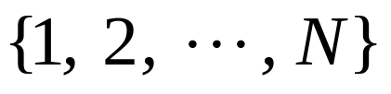
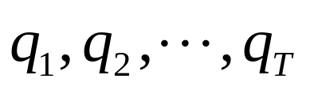



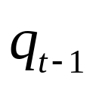

Markov Model: Definition
0.4
1:
rain
0.3
2:
cloudy
Observable states
Observed sequence
1st order Markov assumption
Stationary
0.6
0.2
0.3
0.2
0.1
0.1
3:
sunny
0.8
Bayesian network representation
A Tutorial on HMMs

Slide 12
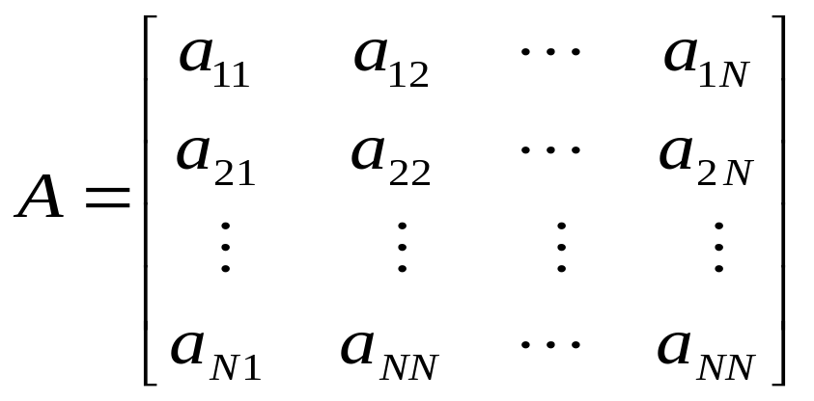
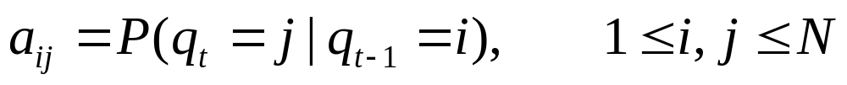
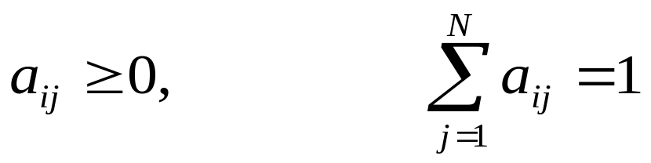
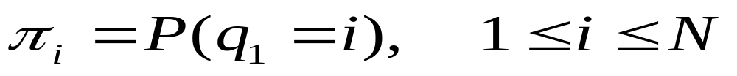
Markov Model: Definition (Cont.)
0.4
1:
rain
0.3
2:
cloudy
State transition matrix
  Where
  With constraints
Initial state probability
0.6
0.2
0.3
0.2
0.1
0.1
3:
sunny
0.8
A Tutorial on HMMs

Slide 13

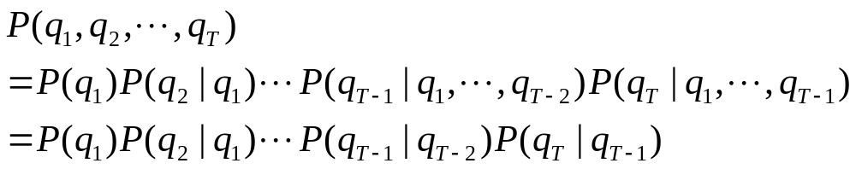
Markov Model: Sequence Prob.
Conditional probability
Sequence probability of Markov model
Chain rule
1st order Markov assumption
A Tutorial on HMMs

Slide 14
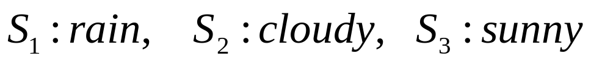
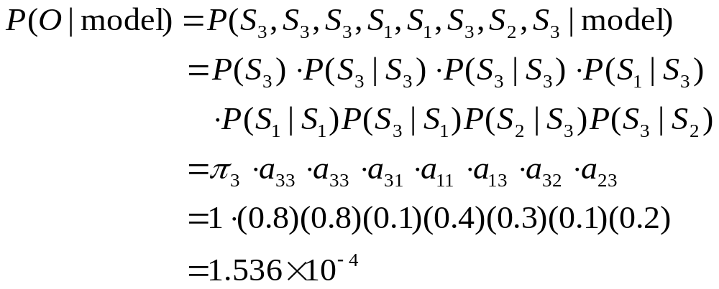
Markov Model: Sequence Prob. (Cont.)
Question: What is the probability that the weather for the next 7 days will be “sun-sun-rain-rain-sun-cloudy-sun” when today is sunny?
0.4
1:
rain
0.3
2:
cloudy
0.6
0.2
0.3
0.2
0.1
0.1
3:
sunny
A Tutorial on HMMs
0.8

Slide 15
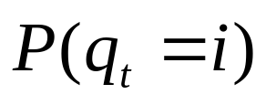
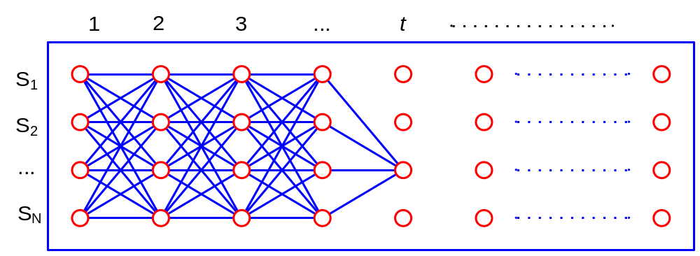
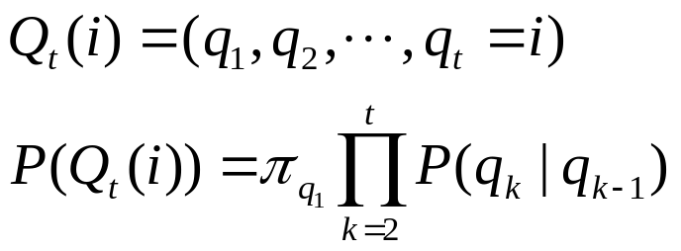

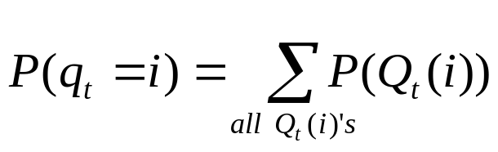
Markov Model: State Probability
State probability at time t :
Simple but slow algorithm:
  Probability of a path that ends to state i at time t:
  Summation of probabilities of all the paths that ends to i at t
Exponential time complexity:
A Tutorial on HMMs

Slide 16
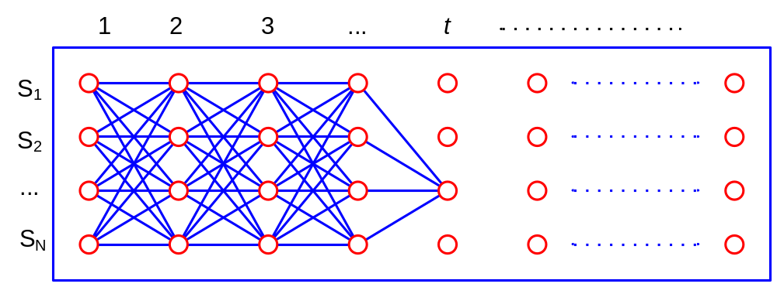
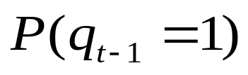
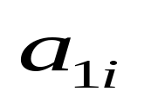
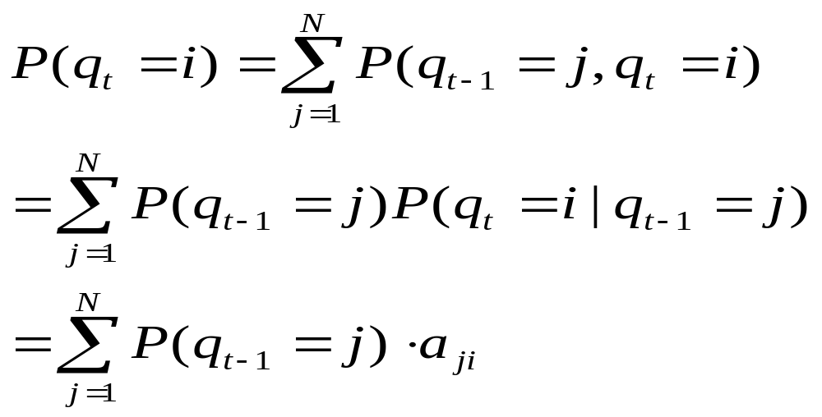

Markov Model: State Prob. (Cont.)
State probability at time t :
Efficient algorithm (Lattice algorithm)
  Recursive path probability calculation
Each node stores the sum
of probabilities of partial paths
Time complexity:
A Tutorial on HMMs

Slide 17
What’s HMM?
Hidden Markov Model
Hidden
+
Markov Model
What is ‘hidden’?
What is ‘Markov model’?
A Tutorial on HMMs

Slide 18
Hidden Markov Model
Example
Generation process
Definition
Model evaluation algorithm
Path decoding algorithm
Training algorithm
A Tutorial on HMMs

Slide 19
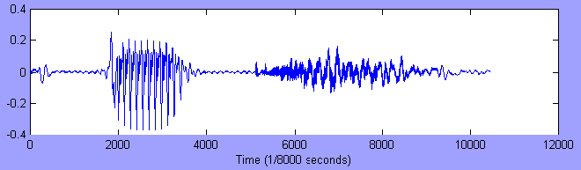
Time Series Example
Representation
  X = x₁ x₂ x₃ x₄ x₅ … x_{T-1} x_{T}
  = s φ p iy iy iy φ φ ch ch ch ch
A Tutorial on HMMs

Slide 20
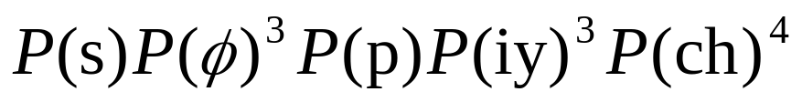
Analysis Methods
Probability-based analysis?
Method I
  Observations are independent; no time/order
  A poor model for temporal structure
    Model size = |V| = N
A Tutorial on HMMs

Slide 21
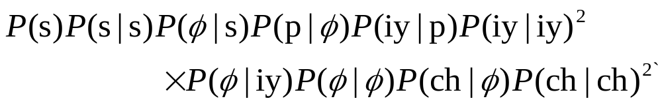
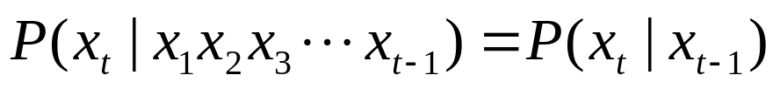
Analysis methods
Method II
  A simple model of ordered sequence
    A symbol is dependent only on the immediately preceding:
    |V|×|V| matrix model
    50×50 – not very bad …
    10⁵×10⁵ – doubly outrageous!!
A Tutorial on HMMs

Slide 22
The problem
“What you see is the truth”
  Not quite a valid assumption
  There are often errors or noise
    Noisy sound, sloppy handwriting, ungrammatical sentences
  There may be some truth process
    Underlying hidden sequence
    Obscured by the incomplete observation
A Tutorial on HMMs

Slide 23
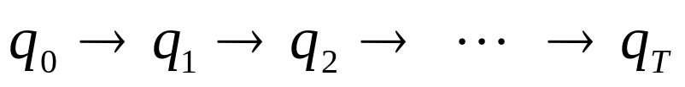
Another analysis method
Method III
  What you see is a clue to what lies behind and is not known a priori
    The source that generated the observation
    The source evolves and generates characteristic observation sequences
A Tutorial on HMMs

Slide 24
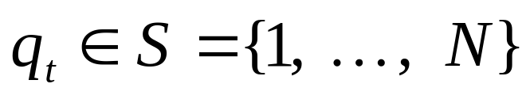
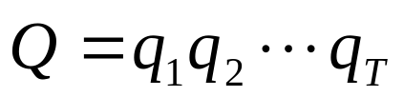
The Auxiliary Variable
N is also conjectured
{q_{t}:t≥0} is conjectured, not visible
  is
  is Markovian
  “Markov chain”
A Tutorial on HMMs

Slide 25
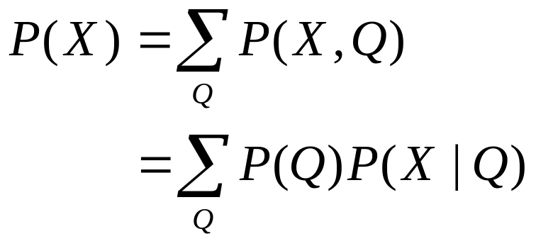
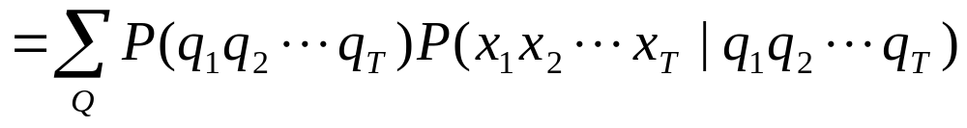
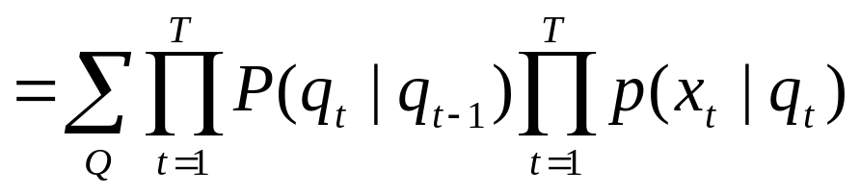
Summary of the Concept
Markov chain process
Output process
A Tutorial on HMMs

Slide 26
Hidden Markov Model
is a doubly stochastic process
  stochastic chain process : { q(t) }
  output process : { f(x|q) }
is also called as
  Hidden Markov chain
  Probabilistic function of Markov chain
A Tutorial on HMMs

Slide 27
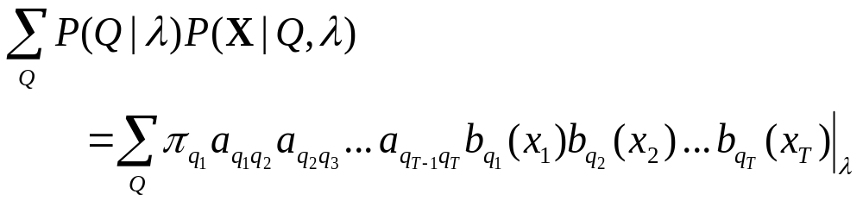
HMM Characterization
λ = (A, B, π)
  A : state transition probability
    { a_{ij} | a_{ij} = p(q_{t+1}=j|q_{t}=i) }
  B : symbol output/observation probability
    { b_{j}(v) | b_{j}(v) = p(x=v|q_{t}=j) }
  π : initial state distribution probability
    { π_{i} | π_{i} = p(q₁=i) }
A Tutorial on HMMs

Slide 28
Graphical Example
π = [ 1.0 0 0 0 ]
0.6
0.5
0.7
1.0
1 2 3 4
1
2
3
4
0.6 0.4 0.0 0.0
0.0 0.5 0.5 0.0
0.0 0.0 0.7 0.3
0.0 0.0 0.0 1.0
0.4
0.5
0.3
1
2
3
4
A =
iy
s
p
iy
ch
p
ch
ch iy p s
1
2
3
4
0.2 0.2 0.0 0.6 …
0.0 0.2 0.5 0.3 …
0.0 0.8 0.1 0.1 …
0.6 0.0 0.2 0.2 …
B =
A Tutorial on HMMs

Slide 29
Data interpretation
0.6 0.4 0.0 0.0
0.0 0.5 0.5 0.0
0.0 0.0 0.7 0.3
0.0 0.0 0.0 1.0
P(s s p p iy iy iy ch ch ch|λ)
= ∑_{Q} P(ssppiyiyiychchch,Q|λ)
= ∑_{Q} P(Q|λ) p(ssppiyiyiychchch|Q,λ)
0.2 0.2 0.0 0.6 …
0.0 0.2 0.5 0.3 …
0.0 0.8 0.1 0.1 …
0.6 0.0 0.2 0.2 …
Let Q = 1 1 2 2 3 3 3 4 4 4
P(Q|λ) p(ssppiyiyiychchch|Q, λ)
= P(1122333444|λ) p(ssppiyiyiychchch|1122333444, λ)
= (1×.6)×(.6×.6)×(.4×.5)×(.5×.5)×(.5×.8)×(.7×.8)²
×(.3×.6)×(1.×.6)²
≅ 0.0000878
#multiplications ~ 2TN^{T}
A Tutorial on HMMs

Slide 30
Issues in HMM
Intuitive decisions
  number of states (N)
  topology (state inter-connection)
  number of observation symbols (V)
Difficult problems
  efficient computation methods
  probability parameters (λ)
A Tutorial on HMMs

Slide 31
The Number of States
How many states?
  Model size
  Model topology/structure
Factors
  Pattern complexity/length and variability
  The number of samples
Ex:
r r g b b g b b b r
A Tutorial on HMMs

Slide 32
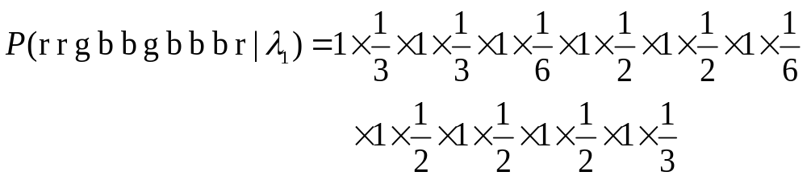
(1) The simplest model
Model I
  N = 1
  a₁₁=1.0
  B = [1/3, 1/6, 1/2]
1.0
≅ 0.0000322 (< 0.0000338)
A Tutorial on HMMs

Slide 33
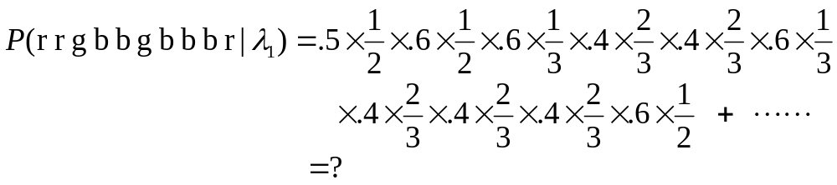
(2) Two state model
Model II:
  N = 2
0.6 0.4
0.6 0.4
0.6
1
0.4
2
0.4
A =
1/2 1/3 1/6
1/6 1/6 2/3
0.6
B =
A Tutorial on HMMs

Slide 34
(3) Three state models
N=3:
2
0.3
0.2
0.7
0.6
1
3
0.7
0.2
0.3
2
0.6
0.2
0.2
0.2
0.6
0.5
1
3
0.3
0.3
0.1
A Tutorial on HMMs

Slide 35
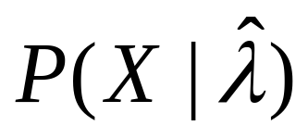
The Criterion is
Obtaining the best model(λ) that maximizes
The best topology comes from insight and experience
  ← the # classes/symbols/samples
A Tutorial on HMMs

Slide 36
A trained HMM
.5
.6
.2
.2
π =
1. 0. 0.
R
G
B
1
1 2 3
.4
1
2
3
.5 .4 .1
.0 .6 .4
.0 .0 .0
.6
.1
.2
.5
.3
A =
2
.4
R G B
.0
.3
.7
1
2
3
.6 .2 .2
.2 .5 .3
.0 .3 .7
3
B =
A Tutorial on HMMs

Slide 37
Hidden Markov Model: Example
2
0.3
0.2
0.6
0.1
0.1
1
3
0.6
0.6
0.2
0.3
N pots containing color balls
M distinct colors
Each pot contains different number of color balls
A Tutorial on HMMs

Slide 38
HMM: Generation Process
Sequence generating algorithm
  Step 1: Pick initial pot according to some random process
  Step 2: Randomly pick a ball from the pot and then replace it
  Step 3: Select another pot according to a random selection process
  Step 4: Repeat steps 2 and 3
2
0.3
0.2
0.6
0.1
0.1
0.6
0.6
1
0.2
3
1
1
3
0.3
  Markov process: {q(t)}
  Output process: {f(x|q)}
A Tutorial on HMMs

Slide 39
HMM: Hidden Information
Now, what is hidden?
  We can just see the chosen balls
  We can’t see which pot is selected at a time
  So, pot selection (state transition) information is hidden
A Tutorial on HMMs

Slide 40
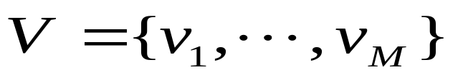
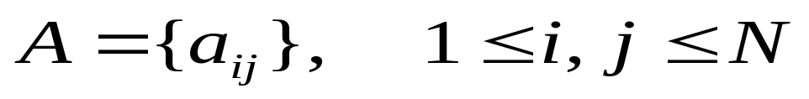
HMM: Formal Definition
Notation: λ = ( Α, Β, π )
  (1) N : Number of states
  (2) M : Number of symbols observable in states
  (3) A : State transition probability distribution
  (4) B : Observation symbol probability distribution
  (5) π : Initial state distribution
A Tutorial on HMMs

Slide 41
Three Problems
Model evaluation problem
  What is the probability of the observation?
  Forward algorithm
Path decoding problem
  What is the best state sequence for the observation?
  Viterbi algorithm
Model training problem
  How to estimate the model parameters?
  Baum-Welch reestimation algorithm
A Tutorial on HMMs

Slide 42
Solution to
Model Evaluation Problem
Forward algorithm
Backward algorithm

Slide 43
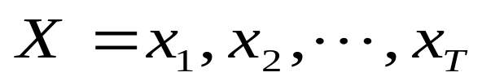

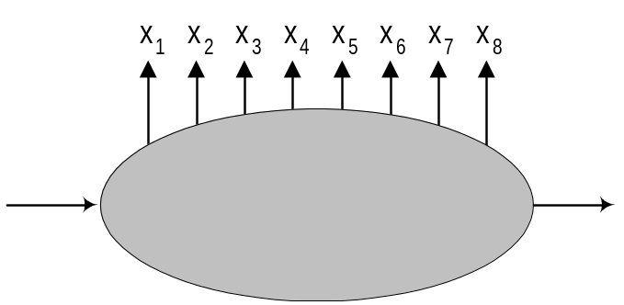
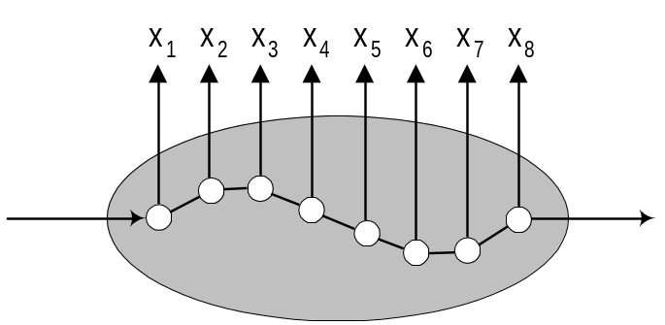
Definition
Given a model λ
Observation sequence:
P(X| λ) = ?
(A path or state sequence: )
A Tutorial on HMMs

Slide 44
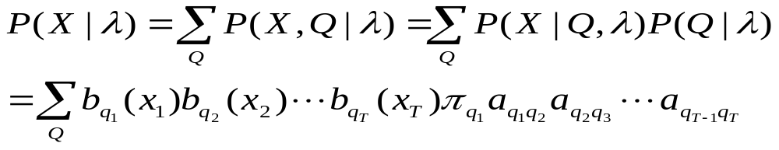

Solution
Easy but slow solution: exhaustive enumeration
  Exhaustive enumeration = combinational explosion!
Smart solution exists?
  Yes!
  Dynamic Programming technique
  Lattice structure based computation
  Highly efficient -- linear in frame length
A Tutorial on HMMs

Slide 45
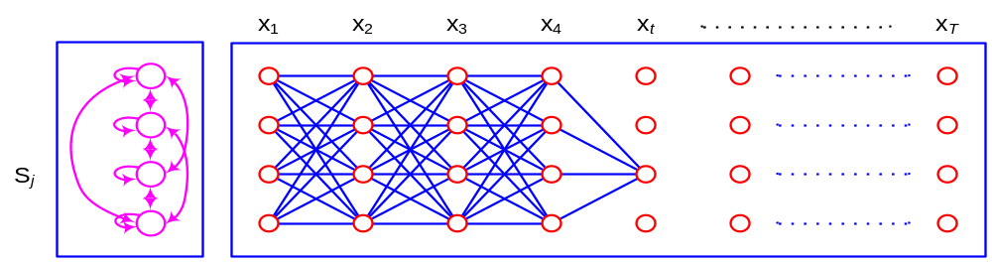
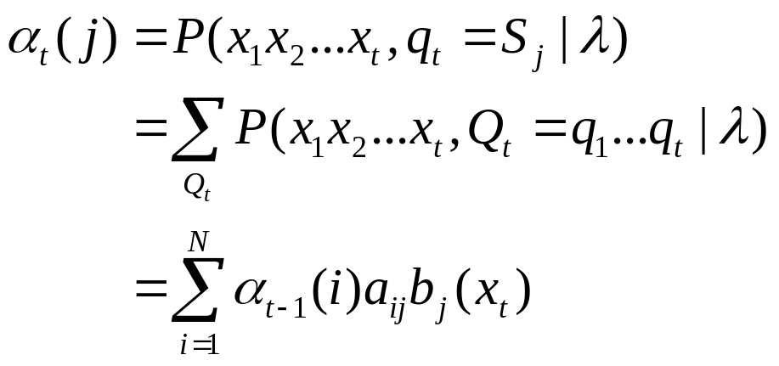
Forward Algorithm
Key idea
  Span a lattice of N states and T times
  Keep the sum of probabilities of all the paths coming to each state i at time t
Forward probability
A Tutorial on HMMs

Slide 46


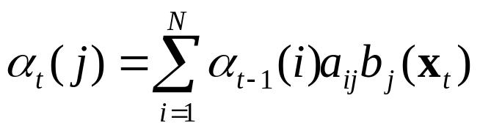

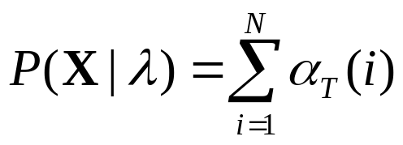
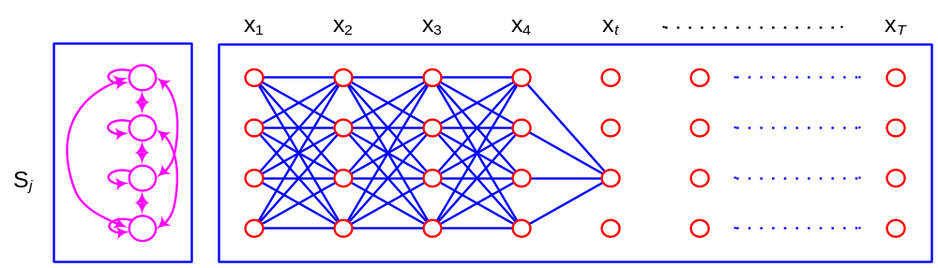
Forward Algorithm
Initialization
Induction
Termination
A Tutorial on HMMs

Slide 47
Numerical Example: P(RRGB|λ)
π =[1 0 0]^{T}
R
R
G
B
.5
R
G
B
.6
.2
.2
1×.6
.5×.6
.5×.2
.5×.2
.6
.18
.018
.0018
.4
.4×.2
.4×.5
.4×.3
.6
.1
.2
.5
.3
0×.2
.6×.2
.6×.5
.6×.3
.0
.048
.0504
.01123
.4
.1×.0
.1×.3
.1×.7
.4×.0
.4×.3
.4×.7
.0
.3
.7
0×.0
.0
.0
.01116
.01537
A Tutorial on HMMs

Slide 48
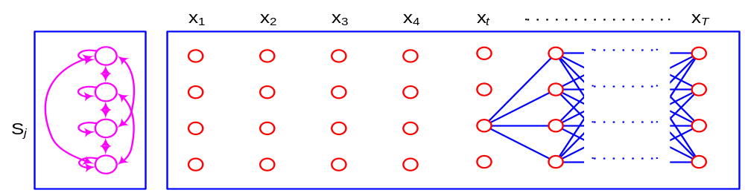
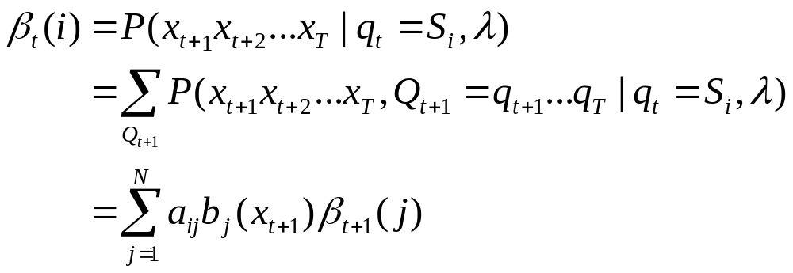
Backward Algorithm (1)
Key Idea
  Span a lattice of N states and T times
  Keep the sum of probabilities of all the outgoing paths at each state i at time t
Backward probability
A Tutorial on HMMs

Slide 49

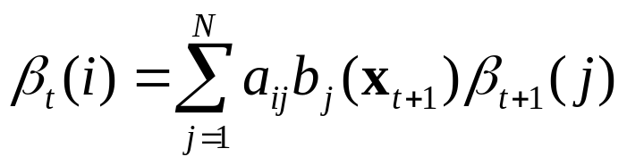

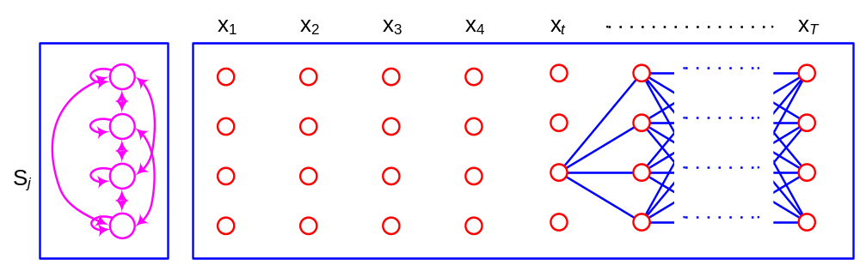
Backward Algorithm (2)
Initialization
Induction
A Tutorial on HMMs

Slide 50
Solution to
Path Decoding Problem
State sequence
Optimal path
Viterbi algorithm
Sequence segmentation

Slide 51
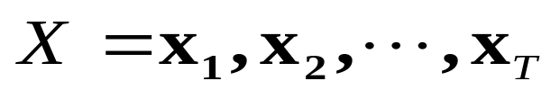

The Most Probable Path
Given a model λ
Observation sequence:
= ?
  (A path or state sequence: )
A Tutorial on HMMs

Slide 52
Viterbi Algorithm
Purpose
  An analysis for internal processing result
  The best, the most likely state sequence
  Internal segmentation
Viterbi Algorithm
  Alignment of observation and state transition
  Dynamic programming technique
A Tutorial on HMMs

Slide 53





Viterbi Path Idea
Key idea
  Span a lattice of N states and T times
  Keep the probability and the previous node of the most probable path coming to each state i at time t
Recursive path selection
  Path probability:
  Path node:
A Tutorial on HMMs

Slide 54






Viterbi Algorithm
Introduction:
Recursion:
Termination:
Path backtracking:
1
states
2
3
A Tutorial on HMMs

Slide 55
Numerical Example: P(RRGB,Q*|λ)
π =[1 0 0]^{T}
R
R
G
B
.5
R
G
B
.6
.2
.2
1×.6
.5×.6
.5×.2
.5×.2
.6
.18
.018
.0018
.4
.4×.2
.4×.5
.4×.3
.6
.1
.2
.5
.3
0×.2
.6×.2
.6×.5
.6×.3
.0
.048
.036
.00648
.4
.1×.0
.1×.3
.1×.7
.4×.0
.4×.3
.4×.7
.0
.3
.7
0×.0
.0
.0
.00576
.01008
A Tutorial on HMMs

Slide 56
Solution to
Model training Problem
HMM training algorithm
Maximum likelihood estimation
Baum-Welch reestimation

Slide 57



HMM Training Algorithm
Given an observation sequence
Find the model parameter
s.t.
  Adapt HMM parameters maximally to training samples
  Likelihood of a sample
NO analytical solution
Baum-Welch reestimation (EM)
  iterative procedures that locally
  maximizes P(X|λ)
  convergence proven
  MLE statistic estimation
State transition
is hidden!
P(X|λ)
λ:HMM parameters
A Tutorial on HMMs

Slide 58
Maximum Likelihood Estimation
MLE “selects those parameters that maximizes the probability function of the observed sample.”
[Definition] Maximum Likelihood Estimate
  Θ: a set of distribution parameters
  Given X, Θ* is maximum likelihood estimate of Θ if
  f(X|Θ*) = max_{Θ} f(X|Θ)
A Tutorial on HMMs

Slide 59



MLE Example
Scenario
  Known: 3 balls inside pot
  (some red; some white)
  Unknown: R = # red balls
  Observation: (two reds)
Two models
  P ( |R=2) =
  P ( |R=3) =
Which model?
  Model(R=3) is our choice
A Tutorial on HMMs

Slide 60
MLE Example (Cont.)
Model(R=3) is a more likely strategy,
unless we have a priori knowledge of the system.
However, without an observation of two red balls
  No reason to prefer P(λ_{R=3}) to P(λ_{R=2})
ML method chooses the set of parameters that maximizes the likelihood of the given observation.
It makes parameters maximally adapted to training data.
A Tutorial on HMMs

Slide 61


EM Algorithm for Training
With , estimate
EXPECTATION of following quantities:
  Expected number of state i visiting
  Expected number of transitions from i to j
With following quantities:
  Expected number of state i visiting
  Expected number of transitions from i to j
Obtain the MAXIMUM LIKELIHOOD of
A Tutorial on HMMs

Slide 62


Expected Number of S_{i} Visiting
A Tutorial on HMMs

Slide 63


Expected Number of Transition
A Tutorial on HMMs

Slide 64


Parameter Reestimation
MLE parameter estimation
  Iterative:
  convergence proven:
  arriving local optima
P(X|λ)
λ:HMM parameters
A Tutorial on HMMs

Slide 65
Other issues
Other method of training
  MAP (Maximum A Posteriori) estimation – for adaptation
  MMI (Maximum Mutual Information) estimation
  MDI (Minimum Discrimination Information) estimation
  Viterbi training
  Discriminant/reinforcement training
A Tutorial on HMMs

Slide 66
Other types of parametric structure
  Continuous density HMM (CHMM)
    More accurate, but much more parameters to train
  Semi-continuous HMM
    Mix of CHMM and DHMM, using parameter sharing
  State-duration HMM
    More accurate temporal behavior
Other extensions
  HMM+NN, Autoregressive HMM
  2D models: MRF, Hidden Mesh model, pseudo-2D HMM
A Tutorial on HMMs

Slide 67


Graphical DHMM and CHMM
Models for ‘5’ and ‘2’
A Tutorial on HMMs

Slide 68
Pattern Classification using HMMs
Pattern classification
Extension of HMM structure
Extension of HMM training method
Practical issues of HMM
HMM history
A Tutorial on HMMs

Slide 69





Pattern Classification
Construct one HMM per each class k
Train each HMM with samples
  Baum-Welch reestimation algorithm
Calculate model likelihood of with observation X
  Forward algorithm:
Find the model with maximum a posteriori probability
A Tutorial on HMMs

Slide 70
Extension of HMM Structure
Extension of state transition parameters
  Duration modeling HMM
    More accurate temporal behavior
  Transition-output HMM
    HMM output functions are attached to transitions rather than states
Extension of observation parameter
  Segmental HMM
    More accurate modeling of trajectories at each state, but more computational cost
  Continuous density HMM (CHMM)
    Output distribution is modeled with mixture of Gaussian
  Semi-continuous HMM (Tied mixture HMM)
    Mix of continuous HMM and discrete HMM by sharing Gaussian components
A Tutorial on HMMs

Slide 71

Extension of HMM Training Method
Maximum Likelihood Estimation (MLE)*
  maximize the probability of the observed samples
Maximum Mutual Information (MMI) Method
  information-theoretic measure
  maximize average mutual information:
  maximize discrimination power by training models together
Minimum Discrimination Information (MDI) Method
  minimize the DI or the cross entropy between pd(signal) and pd(HMM)’s
  use generalized Baum algorithm
A Tutorial on HMMs

Slide 72




Practical Issues of HMM
Architectural and behavioral choices
  the unit of modeling -- design choice
  type of models: ergodic, left-right, parallel path.
  number of states
  observation symbols;discrete, continuous; mixture number
Initial estimates
  A, : adequate with random or uniform initial values
  B : good initial estimates are essential for CHMM
ergodic
left-right
parallel path
A Tutorial on HMMs

Slide 73

Practical Issues of HMM (Cont.)
Scaling
  heads exponentially to zero: → scaling (or using log likelihood)
Multiple observation sequences
  accumulate the expected freq. with weight P(X(k)|l)
Insufficient training data
  deleted interpolation with desired model & small model
  output prob. smoothing (by local perturbation of symbols)
  output probability tying between different states
A Tutorial on HMMs

Slide 74
Practical Issues of HMM (Cont.)
HMM topology optimization
  What to optimize
    # of states
    # of Gaussian mixtures per state
    Transitions
  Methods
    Heuristic methods
      # of states from average (or mod) length of input frames
    Split / merge
      # of states from iterative split / merge
    Model selection criteria
      # of states and mixtures at the same time
      ML (maximum likelihood)
      BIC (Bayesian information criteria)
      HBIC (HMM-oriented BIC)
      DIC (Discriminative information criteria)
      ..
A Tutorial on HMMs

Slide 75
HMM applications and Software
On-line handwriting recognition
Speech applications
HMM toolbox for Matlab
HTK (hidden Markov model Toolkit)
A Tutorial on HMMs

Slide 76
HMM Applications
On-line handwriting recognition
  BongNet: HMM network-based handwriting recognition system
Speech applications
  CMU Sphinx : Speech recognition toolkit
  언어과학 Dr.Speaking : English pronunciation correction system
A Tutorial on HMMs

Slide 77
BongNet
Consortium of CAIR(Center for Artificial Intelligence Research) at KAIST
  The name “BongNet” from its major inventor, BongKee Shin
Prominent performance for unconstrained on-line Hangul recognition
Modeling of Hangul handwriting
  considers ligature between letters as well as consonants and vowels
    (initial consonant)+(ligature)+(vowel)
    (initial consonant)+(ligature)+(vowel)+(ligature)+(final consonant)
  connects letter models and ligature models using Hangul composition principle
  further improvements
    BongNet+ : incorporating structural information explicitly
    Circular BongNet : successive character recognition
    Unified BongNet : Hangul and alphanumeric recognition
    dictionary look-up
A Tutorial on HMMs

Slide 78

Network structure
A Tutorial on HMMs

Slide 79

A Modification to BongNet
16-dir Chaincode ➔ Structure Code Generation
Structure code sequence
  carries structural information
    not easily acquired using chain code sequence
    including length, direction, and vending
Distance Straightness Direction Real Rotation
18.213 96.828 46.813 1 1
45.934 87.675 146.230 1 1
41.238 99.997 0.301 1 0
45.796 97.941 138.221 1 1
18.299 98.820 8.777 1 0
16.531 88.824 298.276 1 -1
45.957 100.000 293.199 0 0
52.815 99.999 95.421 1 0
26.917 99.961 356.488 1 0
53.588 99.881 156.188 1 0
56.840 80.187 17.449 1 -1
  3 37 0 37 0 31
  54 11 28 15 5
A Tutorial on HMMs

Slide 80

Dr. Speaking
1
단어수준에서 발음연습 – 음소단위 오류패턴 검출
2
문장수준에서 발음연습 – 정확성, 유창성, 억양별 발음 평가
A Tutorial on HMMs

Slide 81
시스템 구조
Feature Extraction
&
Acoustic Analysis
Decoder
Score
Estimation
speech
Acoustic
Score
Evaluation
Score
Acoustic Model
(Phoneme Unit
of Native)
Language Model
(Phoneme Unit)
Target Speech DB spoken by
Native Speaker
Target Speech DB spoken by
Non-native Speaker
(mis-pronunciation)
Acoustic Model
(Phoneme Unit
of non native)
Target Pronunciation Dictionary
Target mis-Pronunciation
Dictionary
(Analysis Non native speech pattern)
A Tutorial on HMMs

Slide 82
Acoustic modeling
Language modeling
Native HMM
Non-Native HMM
A
B
C
standard
standard
deletion error modeling
error
error
replacement error modeling
insertion error modeling
A Tutorial on HMMs

Slide 83

단어수준 발음 교정
: 음소단위 오류패턴 검출 – 오류발음대치, 삽입, 삭제,
이중모음 분리, 강세, 장단오류
A Tutorial on HMMs

Slide 84

문장 발음 연습
시각적인 교정정보 및 수준별 학습 평가
1
정확성평가 - 정발음패턴과 다양한 유형의 오류발음 패턴을 기반으로 평가
2
억양평가 - 억양관련 음성신호 추출 후 표준패턴과 오류패턴을 기반으로 평가
3
유창성평가 - 연음여부, 끊어 읽기, 발화구간 등 다양한 평가요소를 기반으로 평가
A Tutorial on HMMs

Slide 85
Software Tools for HMM
HMM toolbox for Matlab
  Developed by Kevin Murphy
  Freely downloadable SW written in Matlab (Hmm… Matlab is not free!)
  Easy-to-use: flexible data structure and fast prototyping by Matlab
  Somewhat slow performance due to Matlab
  Download: http://www.cs.ubc.ca/~murphyk/Software/HMM/hmm.html
HTK (Hidden Markov toolkit)
  Developed by Speech Vision and Robotics Group of Cambridge University
  Freely downloadable SW written in C
  Useful for speech recognition research: comprehensive set of programs for training, recognizing and analyzing speech signals
  Powerful and comprehensive, but somewhat complicate
  Download: http://htk.eng.cam.ac.uk/
A Tutorial on HMMs

Slide 86
Summary
Markov model
  1-st order Markov assumption on state transition
  ‘Visible’: observation sequence determines state transition seq.
Hidden Markov model
  1-st order Markov assumption on state transition
  ‘Hidden’: observation sequence may result from many possible state transition sequences
  Fit very well to the modeling of spatial-temporally variable signal
  Three algorithms: model evaluation, the most probable path decoding, model training
HMM applications and Software
  Handwriting and speech applications
  HMM tool box for Matlab
  HTK
Acknowledgement
  본 HMM 튜토리얼 자료를 만드는데, 상당 부분 이전 튜토리얼 자료의 사용을 허락해주신 부경대학교 신봉기 교수님과 삼성종합기술원 조성정 박사님께 감사를 표합니다.
A Tutorial on HMMs

Slide 87
References
Hidden Markov Model
  L.R. Rabiner, “A Tutorial on Hidden Markov Models and Selected Applications in Speech Recognition”, IEEE Proc. pp. 267-295, 1989.
  L.R. Bahl et. al, “A Maximum Likelihood Approach to Continuous Speech Recognition”, IEEE PAMI, pp. 179-190, May. 1983.
  M. Ostendorf, “From HMM’s to Segment Models: a Unified View of Stochastic Modeling for Speech Recognition”, IEEE SPA, pp 360-378, Sep., 1996.
HMM Tutorials
  신봉기, “HMM Theory and Applications”, 2003컴퓨터비젼및패턴인식연구회 춘계워크샵 튜토리얼.
  조성정, 한국정보과학회 ILVB Tutorial, 2005.04.16, 서울.
  Sam Roweis, “Hidden Markov Models (SCIA Tutorial 2003)”, http://www.cs.toronto.edu/~roweis/notes/scia03h.pdf
  Andrew Moore, “Hidden Markov Models”,
  http://www-2.cs.cmu.edu/~awm/tutorials/hmm.html
A Tutorial on HMMs

Slide 88
References (Cont.)
HMM Applications
  B.-K. Sin, J.-Y. Ha, S.-C. Oh, Jin H. Kim, “Network-Based Approach to Online Cursive Script Recognition”, IEEE Transactions on Systems Man and Cybernetics Part B-Cybernetics, Vol. 29, No. 2, pp.321-328, 1999.
  J.-Y. Ha, "Structure Code for HMM Network-Based Hangul Recognition", 18th International Conference on Computer Processing of Oriental Languages, pp.165-170, 1999.
  김무중, 김효숙, 김선주, 김병기, 하진영, 권철홍, “한국인을 위한 영어 발음 교정 시스템의 개발 및 성능 평가”, 말소리, 제46호, pp.87-102, 2003.
HMM Topology optimization
  H. Singer, and M. Ostendorf, “Maximum likelihood successive state splitting,” ICASSP , 1996, pp. 601-604.
  A. Stolcke, and S. Omohundro, “Hidden Markov model induction by Bayesian model merging,” Advances in NIPS. 1993, pp. 11-18. San Mateo, CA: Morgan Kaufmann.
  0 A. Biem, J.-Y. Ha, J. Subrahmonia, "A Bayesian Model Selection Criterion for HMM Topology Optimization", International Conference on Acoustics Speech and Signal Processing, pp.I989~I992, IEEE Signal Processing Society, 2002.
  A. Biem, “A Model Selection Criterion for Classification: Application to HMM Topology Optimization,” ICDAR 2003, pp. 204-210, 2003.
HMM Software
  Kevin Murphy, “HMM toolbox for Matlab”, freely downloadable SW written in Matlab, http://www.cs.ubc.ca/~murphyk/Software/HMM/hmm.html
  Speech Vision and Robotics Group of Cambridge University, “HTK (Hidden Markov toolkit)”, freely downloadable SW written in C, http://htk.eng.cam.ac.uk/
  Sphinx at CMU
  http://cmusphinx.sourceforge.net/html/cmusphinx.php
A Tutorial on HMMs

