Slide 1
제 10장 그래프 알고리즘
강원대학교
하진영

Slide 2
주차별 수업 계획
주차 | 수업내용 | 교재 범위 및 과제물 | 비고
9 | 백트래킹1 | 제 8장 | 문제 59
10 | 백트래킹2 | 제 8장 | 문제 62
11 | 그래프 순회 | 제 9장 | 문제 65, 71
12 | 그래프 알고리즘 | 제 10장 | 문제 73, 74
13 | 동적 프로그래밍1 | 제 11장 | 문제 83, 84
14 | 동적 프로그래밍2 | 제 11장 | 문제 86, 87
15 | 기말고사 | 필기시험

Slide 3
서론
그래프 이론
  그래프 구조의 특징에 대한 연구
그래프 알고리즘
  최소 신장 트리
  최단 경로
  최대 흐름

Slide 4
Graph Theory
Graph theory
  invented by Euler in early 18th century
  the bridges of Königsberg problem
    asks if there is a walk around the city that crosses each bridge exactly once
    the residents doubted that it was possible, no one had proved its impossibility

Slide 5
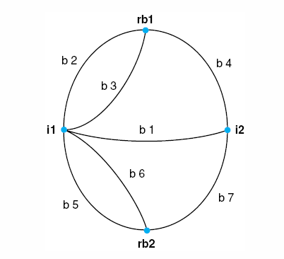
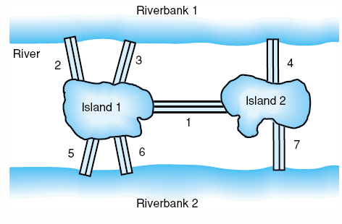
The Bridges of
Königsberg Problem
Graph representation
  preserves the essential structure of the bridge system, while ignoring extraneous features such as distance and direction

Slide 6
차수(Degree)
정점의 차수
  어떤 정점에 연결된 모서리의 개수
  중요 속성
    그래프에 있는 모든 정점의 차수 합은 모서리 개수의 두 배 → 차수가 홀수인 정점의 개수는 반드시 짝수
    방향성 그래프에서는 출력 차수(outdegree)의 합과 입력 차수(indegree)의 합은 동일
    트리 : 사이클이 없는 연결된 그래프
      잎(leaf): 차수가 1인 정점
      정점이 n개이면 모서리는 n-1개
신장 트리(spanning tree)
  그래프 G = (V, E)가 있을 때 E’ ⊂ E인 E’가 V로 구성된 트리인 경우 E’로 이루어진 부분 집합
  모든 연결 그래프에는 신장 트리 존재

Slide 7
연결성(Connectivity)
A graph is connected if there is an undirected path between every pair of vertices.
The existence of a spanning tree is sufficient to prove connectivity. A breadth-first or depth-first search-based connected components algorithm can be used to find such a spanning tree.
However, there are other notions of connectivity. The most interesting special case when there is a single weak link in the graph. A single vertex whose deletion disconnects the graph is called an articulation vertex; any graph without such a vertex is said to be biconnected. A single edge whose deletion disconnects the graph is called a bridge.

Slide 8
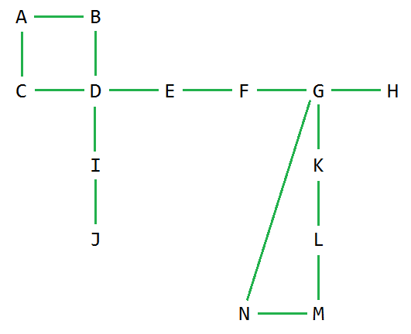
articulation vertices:
D, E, F, G, I

Slide 9
bridges:
D-I, I-J, D-E, E-F, F-G, G-H

Slide 10
Testing for articulation vertices or bridges is easy via brute force. For each vertex/edge, delete it from the graph and test whether the resulting graph remains connected. Be sure to add that vertex/edge back before doing the next deletion!
In directed graphs we are often concerned with strongly connected components, that is, partitioning the graph into chunks such that there are directed paths between all pairs of vertices within a given chunk. Road networks should be strongly connected, or else there will be places you can drive to but not drive home from without violating one-way signs.

Slide 11
그래프의 사이클(Cycles in Graphs)
All non-tree connected graphs contain cycles.
An Eulerian cycle is a tour which visits every edge of the graph exactly once. A mailman’s route is ideally an Eulerian cycle, so he can visit every street (edge) in the neighborhood once before returning home.
An undirected graph contains an Eulerian cycle if it is connected and every vertex is of even degree. Why?
The circuit must enter and exit every vertex it encounters, implying that all degrees must be even.

Slide 12
Finding an Eulerian Cycle
We can find an Eulerian cycle by building it one cycle at a time. We can find a simple cycle in the graph by finding a back edge using DFS. Deleting the edges on this cycle leaves each vertex with even degree. Once we have partitioned the edges into edge-disjoint cycles, we can merge these cycles arbitrarily at common vertices to build an Eulerian cycle.
A Hamiltonian cycle is a tour which visits every vertex of the graph exactly once. The traveling salesman problem asks for the shortest such tour on a weighted graph.
Unfortunately, no efficient algorithm exists for solving Hamiltonian cycle problems. If the graph is sufficiently small, it can be solved via backtracking.

Slide 13
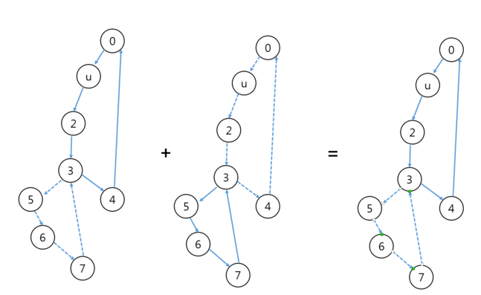
Eulerian Cycle Example
1
1
1
0→1→2→3→4→0
+
3→5→6→7→3
=
0→1→2→3→5→6→7→3→4→0

Slide 14
Eulerian Circuit Algorithm for undirected graph
Start with an empty stack and an empty circuit.
  If all vertices have even degree - choose any of them.
  Otherwise no Euler circuit exists.
If current vertex has no neighbors - add it to circuit, remove the last vertex from the stack and set it as the current one. Otherwise (in case it has neighbors) - add the vertex to the stack, take any of its neighbors, remove the edge between selected neighbor and that vertex, and set that neighbor as the current vertex.
Repeat step 2 until the current vertex has no more neighbors and the stack is empty.

Slide 15
최소 신장 트리(Minimum Spanning Trees)
A spanning tree of a graph G = (V,E) is a subset of edges from E forming a tree connecting all vertices of V .
For edge-weighted graphs, we are particularly interested in the minimum spanning tree, the spanning tree whose sum of edge weights is the smallest possible.
Minimum spanning trees are the answer whenever we need to connect a set of points (representing cities, junctions, or other locations) by the smallest amount of roadway, wire, or pipe.
We present Prim’s algorithm because it is simpler to program, and because it gives Dijkstra’s shortest path algorithm with very minimal changes.

Slide 16
Representing Weighted Graphs
We generalize the graph data structure to support edge-weighted graphs. Each edge-entry previously contained only the other endpoint of the given edge. We must replace this by a record allowing us to annotate the edge with weights:
typedef struct {
int v; /* neighboring vertex */
int weight; /* edge weight */
} edge;
typedef struct {
edge edges[MAXV+1][MAXDEGREE]; /* adjacency info */
int degree[MAXV+1]; /* outdegree of vertex */
int nvertices; /* number of vertices */
int nedges; /* number of edges in graph */
} graph;

Slide 17
Prim’s Algorithm
Prim’s algorithm grows the minimum spanning tree in stages starting from a given vertex. At each iteration, we add one new vertex into the spanning tree. We greedily add the lowest-weight edge linking a vertex in the tree to a vertex on the outside.
Our implementation keeps track of the cheapest edge from the tree to every non-tree vertex in the graph. The cheapest edge over all remaining non-tree vertices gets added in each iteration.
We must update the costs of getting to the non-tree vertices after each insertion.

Slide 18
  prim(graph *g, int start) {
  int i,j; /* counters */
  bool intree[MAXV]; /* is vertex in the tree yet? */
  int distance[MAXV]; /* vertex distance from start */
  int v; /* current vertex to process */
  int w; /* candidate next vertex */
  int weight; /* edge weight */
  int dist; /* shortest current distance */
  for (i=1; i<=g->nvertices; i++) {
  intree[i] = FALSE;
  distance[i] = MAXINT;
  parent[i] = -1;
  }
  distance[start] = 0;
  v = start;

Slide 19
  while (intree[v] == FALSE) {
  intree[v] = TRUE;
  for (i=0; i<g->degree[v]; i++) {
  w = g->edges[v][i].v;
  weight = g->edges[v][i].weight;
  if ((distance[w] > weight) && (intree[w]==FALSE)) {
  distance[w] = weight;
  parent[w] = v;
  }
  }
  v = 1;
  dist = MAXINT;
  for (i=2; i<=g->nvertices; i++)
  if ((intree[i]==FALSE) && (dist > distance[i])) {
  dist = distance[i];
  v = i;
  }
  }
  }

Slide 20
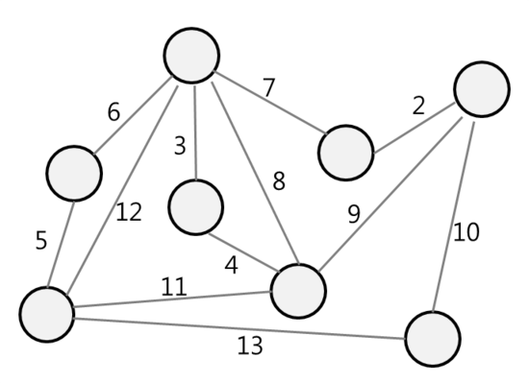
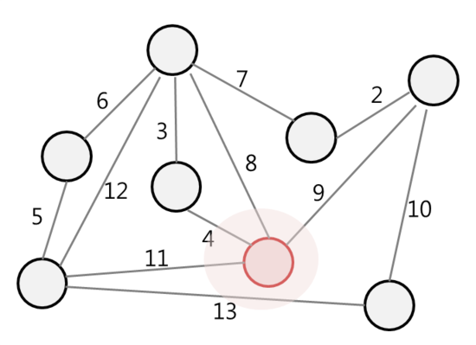
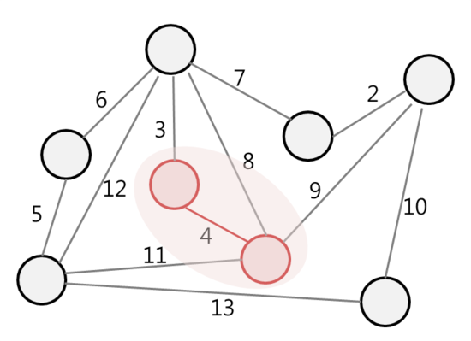
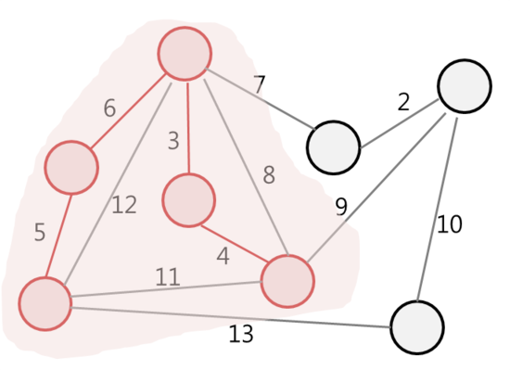
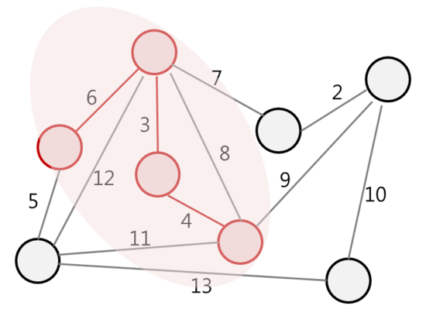
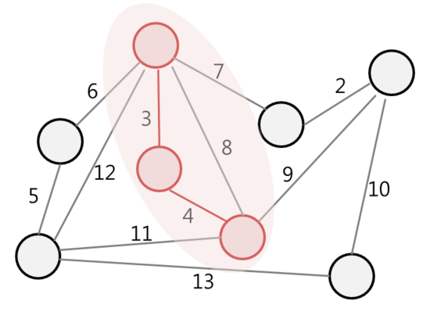
Prim’s Algorithm Example

Slide 21
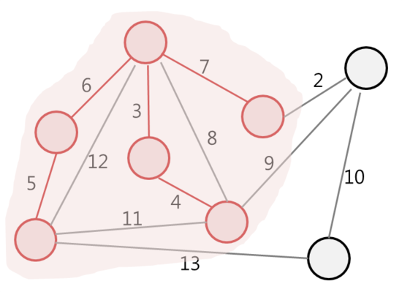
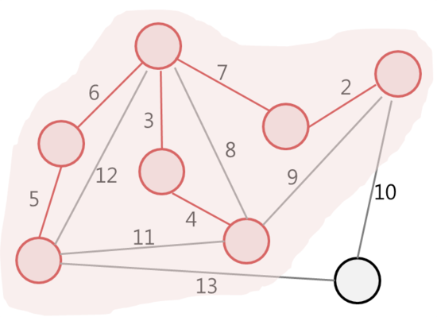
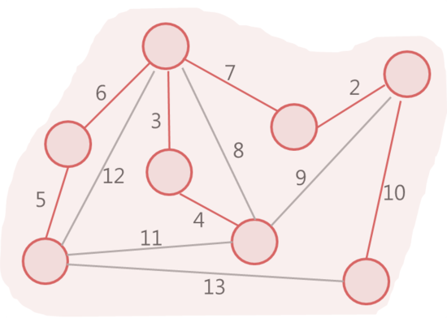

Slide 22
Kruskal’s Algorithm
Sort all the edges in non-decreasing order of their weight.
Pick the smallest edge. Check if it forms a cycle with the spanning tree formed so far. If cycle is not formed, include this edge. Else, discard it.
Repeat step#2 until there are (V-1) edges in the spanning tree.

Slide 23
What is the difference in Kruskal's and Prim's algorithm?
In Prim's, you always keep a connected component, starting with a single vertex. You look at all edges from the current component to other vertices and find the smallest among them. You then add the neighbouring vertex to the component, increasing its size by 1. In N-1 steps, every vertex would be merged to the current one if we have a connected graph.
In Kruskal's, you do not keep one connected component but a forest. At each stage, you look at the globally smallest edge that does not create a cycle in the current forest. Such an edge has to necessarily merge two trees in the current forest into one. Since you start with N single-vertex trees, in N-1 steps, they would all have merged into one if the graph was connected.

Slide 24
Use Prim's algorithm when you have a graph with lots of edges.
For a graph with V vertices E edges, Kruskal's algorithm runs in O(E log V) time and Prim's algorithm can run in O(E + V log V) amortized time, if you use a Fibonacci Heap.
Prim's algorithm is significantly faster in the limit when you've got a really dense graph with many more edges than vertices. Kruskal performs better in typical situations (sparse graphs) because it uses simpler data structures.

Slide 25
Dijkstra’s Algorithm for Shortest Paths
BFS does not suffice for finding shortest paths in weighted graphs, because the shortest weighted path from a to b does not necessarily contain the fewest number of edges.
Dijkstra’s algorithm is the method of choice for finding the shortest path between two vertices in an edge- and/or vertex-weighted graph. It finds the shortest path from start vertex s to every other vertex, including your desired destination t.
The basic idea is very similar to Prim’s algorithm. In each iteration, we are going to add exactly one vertex to the tree of vertices for which we know the shortest path from s.

Slide 26
The difference between Dijkstra’s and Prim’s algorithms is how they rate the desirability of each outside vertex. In shortest path, we want to include the outside vertex which is closest (in shortest-path distance) to the start. This is a function of both the new edge weight and the distance from the start of the tree-vertex it is adjacent to.
In fact, this change is very minor. Below we give an implementation of Dijkstra’s algorithm based on changing exactly three lines from our Prim’s implementation – one of which is simply the name of the function!
Unlike Prim’s, Dijkstra’s algorithm only works on graphs without negative-cost edges. But most applications do not feature negative-weight edges. . .

Slide 27
dijkstra(graph *g, int start) /* WAS prim(g,start) */
{
int i,j; /* counters */
bool intree[MAXV]; /* is vertex in the tree yet? */
int distance[MAXV]; /* vertex distance from start */
int v; /* current vertex to process */
int w; /* candidate next vertex */
int weight; /* edge weight */
int dist; /* shortest current distance */
for (i=1; i<=g->nvertices; i++) {
intree[i] = FALSE;
distance[i] = MAXINT;
parent[i] = -1;
}

Slide 28
distance[start] = 0;
v = start;
while (intree[v] == FALSE) {
intree[v] = TRUE;
for (i=0; i<g->degree[v]; i++) {
w = g->edges[v][i].v;
weight = g->edges[v][i].weight;
/* CHANGED */ if (distance[w] > (distance[v]+weight)) {
/* CHANGED */ distance[w] = distance[v]+weight;
parent[w] = v;
}
}
v = 1;
dist = MAXINT;
for (i=2; i<=g->nvertices; i++)
if ((intree[i]==FALSE) && (dist > distance[i])) {
dist = distance[i];
v = i;
}
}
}

Slide 29
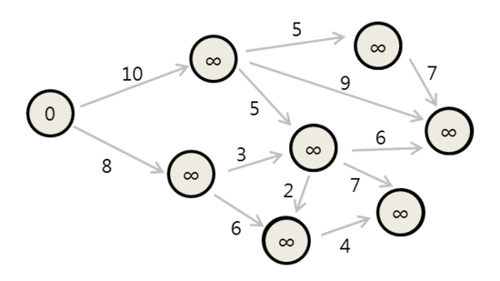
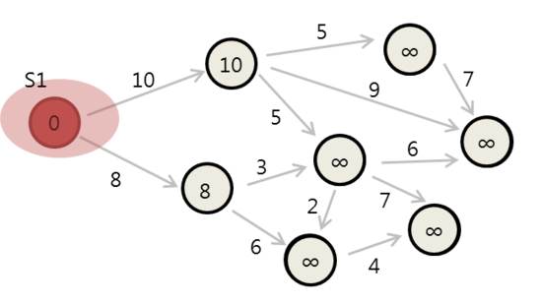
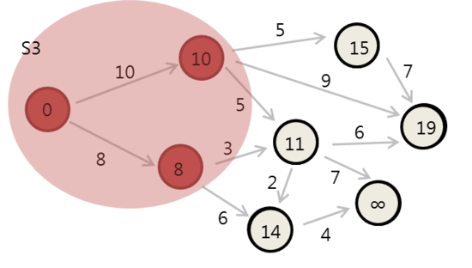
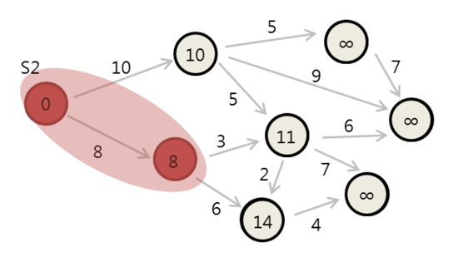
Dijkstra’s Agorithm Example

Slide 30
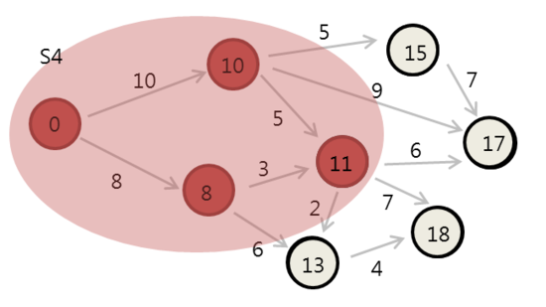
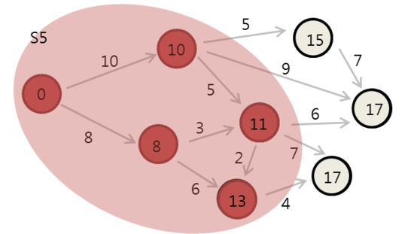
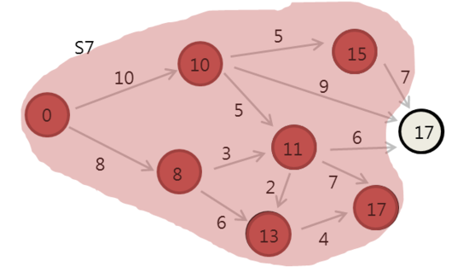
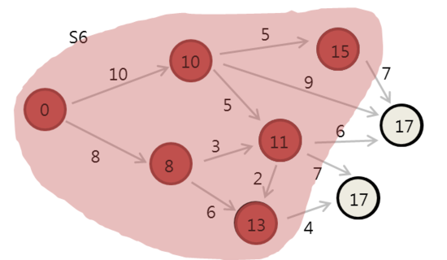
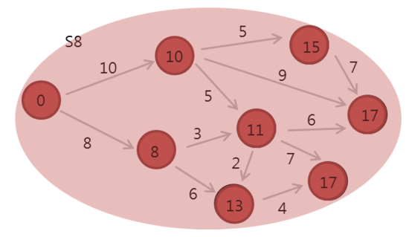

Slide 31
All-Pairs Shortest Path
Many applications need to know the length of the shortest path between all pairs of vertices in a given graph. For example, suppose you want to find the “center” vertex, the one which minimizes the longest or average distance to all the other nodes. This might be the best place to start a new business.
We could solve this problem by calling Dijkstra’s algorithm from each of the n possible starting vertices. But Floyd’s all-pairs shortest-path algorithm is an amazingly slick way to construct this distance matrix from the original weight matrix of the graph.

Slide 32
Floyd’s Algorithm
Floyd’s algorithm is best employed on an adjacency matrix data structure, which is OK since we have to store all n² pairwise distances anyway.
Our adjacency_matrix type allocates space for the largest possible matrix, and keeps track of how many vertices there are:
typedef struct {
int weight[MAXV+1][MAXV+1];/* adjacency/weight info */
int nvertices; /* number of vertices in graph */
} adjacency_matrix;

Slide 33
Initializing the Adjacency Matrix
A critical issue in any adjacency matrix implementation is how we denote the edges which are not present in the graph.
For unweighted graphs, a common convention is that graph edges are denoted by 1 and non-edges by 0.
This gives exactly the wrong interpretation if the numbers denote edge weights, for the non-edges get interpreted as a free ride between vertices. Instead, we should initialize each non-edge to MAXINT.

Slide 34
initialize_adjacency_matrix(adjacency_matrix *g)
{
int i,j; /* counters */
g -> nvertices = 0;
for (i=1; i<=MAXV; i++)
for (j=1; j<=MAXV; j++)
g->weight[i][j] = MAXINT;
}

Slide 35
Floyd’s Idea
Floyd’s algorithm numbers the vertices of G from 1 to n, using these numbers not to label the vertices but to order them.
We will perform n iterations, where the kth iteration allows only the first k vertices as possible intermediate steps on the path between each pair of vertices x and y.
Allowing the kth vertex as a new possible intermediary helps iff there is a short path that goes through k, so
W[i, j]^{k} = min(W[i, j]^{k−1},W[i, k] ^{k−1} +W[k, j] ^{k−1})

Slide 36
Implementation of Floyd’s Algorithm
floyd(adjacency_matrix *g)
{
int i,j; /* dimension counters */
int k; /* intermediate vertex counter */
int through_k; /* distance through vertex k */
for (k=1; k<=g->nvertices; k++)
for (i=1; i<=g->nvertices; i++)
for (j=1; j<=g->nvertices; j++) {
through_k = g->weight[i][k]+g->weight[k][j];
if (through_k < g->weight[i][j])
g->weight[i][j] = through_k;
}
}

Slide 37
Transitive Closure
Floyd’s algorithm has another important application, that of computing the transitive closure of a directed graph. In analyzing a directed graph, we are often interested in which vertices are reachable from a given node.
For example, consider the blackmail graph defined on a set of n people, where there is a directed edge (i, j) if i has sensitive-enough private information on j so that i can get him to do whatever he wants. You wish to hire one of these n people to be your personal representative. Who has the most power in terms of blackmail potential?

Slide 38
A simplistic answer would be the vertex of highest degree.
But Steve might only be able to blackmail Miguel directly, but if Miguel can blackmail everyone else then Steve is the man you want to hire.
The vertices reachable from any single node can be computed using breadth-first or depth-first search. But the whole batch can be computed as an all-pairs shortest-path problem.
If the shortest path from i to j remains MAXINT after running Floyd’s algorithm, you can be sure there is no directed path from i to j.

Slide 39
Network Flow
Any edge-weighted graph can be thought of as a network of pipes, where the weight of edge (i, j) measures the capacity of the pipe. For a given weighted graph G and two vertices s and t, the network flow problem asks for the maximum amount of flow which can be sent from s to t while respecting the maximum capacities of each pipe.
While the network flow problem is of independent interest, its primary importance is that of being able to solve other important graph problems. Classic examples are bipartite matching and edge/vertex connectivity testing.

Slide 40
Bipartite Graphs
Graph G is bipartite or two-colorable if the vertices can be divided into two sets, say, L and R, such that all edges in G have one vertex in L and one vertex in R.
Many naturally defined graphs are bipartite. For example, suppose certain vertices represent jobs to be done and the remaining vertices people who can potentially do them. The existence of edge (j, p) means that job j can potentially done by person p. Or let certain vertices represent boys and certain vertices girls, with edges representing compatible pairs.

Slide 41
Bipartite Matching
A matching in a graph G = (V,E) is a subset of edges E′ ⊂ E such that no two edges in E′ share a vertex. Thus a matching pairs off certain vertices such that every vertex is in at most one such pair.
Matchings in bipartite graphs have natural interpretations as job assignments or as marriages.
The largest possible bipartite matching can be found using network flow. The maximum weighted bipartite matching can be found using the Hungarian algorithm. See the textbook for details.

Slide 42
문제 73. 주근깨(Freckles)
딕 반 다이크 쇼라는 TV 프로그램에서, 딕의 아들 리치가 딕의 등에 있는 주근깨들을 연결하는 선을 그어서 자유의 종을 그리는 에피소드가 나온 적이 있다.
딕의 등 여러 (x, y) 위치에 주근깨가 있는 평면이라고 생각해보자. 지금 우리는 리치가 최소한의 잉크로 점들을 연결할 수 있는 방법을 알려줘야 한다. 리치는 점 사이에 직선을 긋는 식으로 점을 연결한다. 그리고 각 직선을 그을 때마다 펜을 등에서 뗀다. 이 일이 끝나고 나면 등에 있는 모든 주근깨가 연결되어야 한다.

Slide 43
입력
  첫 줄에는 테스트 케이스의 개수를 나타내는 양의 정수가 입력되고, 그 다음 줄은 빈 줄이다.
  각 테스트 케이스의 첫째 줄에는 0보다 크고 100 이하인 정수 n이 입력되는데, 이 정수는 딕의 등에 있는 주근깨 개수를 뜻한다. 각 주근깨마다 한 줄씩 그 주근깨의 위치를 나타내는 좌표가 입력된다.
  서로 다른 테스트 케이스 사이에는 빈 줄이 하나씩 입력된다.
출력
  각 테스트 케이스에 대해 모든 주근깨를 연결하기 위해 잉크로 연결해야 하는 선 길이의 합을 소수점 둘째 자리까지 출력한다. 서로 다른 테스트 케이스에 대한 결과 사이에는 빈 줄을 하나씩 출력한다.

Slide 44
입력 예
  1
  3
  1.0 1.0
  2.0 2.0
  2.0 4.0
출력 예
  3.41

Slide 45
문제 73. 힌트
이 문제는 각 점을 노드라고 생각하고, 모든 노드가 연결된 그래프에서 최소 신장 트리를 구하는 문제와 같다. 이 문제의 경우 언제나 모든 점들이 연결되어 있다고 생각할 수 있기 때문에, 크루스칼 알고리즘보다는 프림 알고리즘을 사용하는 것이 더 효율적이다.

Slide 46
// prob. 73: Freckles
// must use -lm option at the end of the command line like followings
// gcc -o prob73 prob73.c -lm
#include <stdio.h>
#include <math.h>
#define MAXN 100
static int n, check[MAXN];
static double dot[MAXN][2], minval[MAXN], result;
void input(void)
{
int i;
scanf("%d", &n);
for (i = 0; i < n; i++) {
scanf("%lf %lf", &dot[i][0], &dot[i][1]);
}
}

Slide 47
double dist(int a, int b)
{
return sqrt(pow(dot[a][0] - dot[b][0], 2) +
pow(dot[a][1] - dot[b][1], 2));
}
void solve(void)
{
int i, j, a;
result = 0;
for (i = 0; i < n; i++) {
check[i] = 0;
}
check[0] = 1;
for (i = 1; i < n; i++) {
minval[i] = dist(0, i);
}

Slide 48
for (i = 0; i < n-1; i++){
a = -1;
for (j = 0; j < n; j++) {
if (check[j]) continue;
if (a == -1 || minval[a] > minval[j])
a = j;
}
result += minval[a];
check[a] = 1;
for (j = 0; j < n; j++){
if (check[j]) continue;
double d = dist(a, j);
if (minval[j] > d)
minval[j] = d;
}
}
}

Slide 49
void main(void)
{
int i, t;
scanf("%d", &t);
for (i = 0; i < t; i++) {
input();
solve();
if (i > 0)
printf("\n");
printf("%0.2lf\n", result);
}
}

Slide 50
문제 74. 목걸이(The Necklace)
우리 막내 동생한테는 색색의 구슬로 만들어진 예쁜 목걸이가 있다. 각 구슬은 두 색으로 칠해져 있는데, 다음 그림과 같이 맞닿아 있는 부분은 색이 같다.
그런데 어느 날 목걸이가 끊어지면서 구슬이 전부 빠져서 바닥에 떨어졌다. 동생은 최선을 다해 구슬들을 주웠지만 전부 다 찾았는지는 확실치가 않아서 나에게 도와달라고 찾아왔다. 그녀는 원래 목걸이와 마찬가지로 구슬을 꿰어 목걸이를 다시 만들려고 한다. 그렇다면 구슬을 어떤 식으로 배치해야 할까?
이 문제를 해결하기 위한 프로그램을 만들자
녹색
빨간색
빨간색
하얀색
하얀색
녹색
녹색
파란색

Slide 51
입력
  첫번째 줄에는 테스트 케이스의 개수를 나타내는 정수 T가 입력된다.
  각 테스트 케이스의 첫번째 줄에는 동생이 찾아낸 구슬의 개수를 나타내는 정수 N(5≤N≤1,000)이 입력된다.
  그 밑으로는 N줄에 걸쳐서 구슬의 색을 나타내는 두 개씩의 정수가 입력된다. 색은 1에서 50까지의 정수로 표현된다.
출력
  각 테스트 케이스에 대해 출력 예에 나와있는 식으로 테스트 케이스의 번호를 출력한다.
  구슬을 제대로 꿸 수 없으면 “some beads may be lost”라고 출력한다. 구슬을 꿸 수 있으면 N개의 줄에 걸쳐서 각 줄에 하나씩 구슬을 나타내는 숫자들을 출력하는데, 1≤i≤N-1인 i에 대해 i번째 줄에 있는 두 번째 정수가 i+1번째 줄에 있는 첫번째 정수와 같아야 한다. 그리고 N번째 줄의 두 번째 정수는 첫번째 줄의 첫번째 정수와 같아야 한다. 답이 여러 개 나올 수 있는데, 그 중 어떤 것을 출력해도 괜찮다.
  서로 다른 테스트 케이스 사이에는 빈 줄을 하나씩 출력한다.

Slide 52
입력 예
  2
  5
  1 2
  2 3
  3 4
  4 5
  5 6
  5
  2 1
  2 2
  3 4
  3 1
  2 4
출력 예
  Case #1
  some beads may be lost
  Case #2
  2 1
  1 3
  3 4
  4 2
  2 2

Slide 53
문제 74. 힌트
이 문제는 얼핏 보면 Hamilton Cycle을 구하는 문제처럼 생각될지도 모르나, 문제를 약간 변형하면 Euler Cycle을 찾는 문제가 됨을 알 수 있다. 노드를 구슬 안에 있는 하나의 색으로 두고 두 색이 하나의 구슬 안에 들어 있으면 두 색을 연결하는 하나의 엣지를 그려준다. 이러한 모양의 그래프에서 오일러 사이클을 구할 수 있으면 하나의 목걸이로 만들 수 있을 것이다.
먼저 각 색이 나오는 횟수를 지정해서 홀수번 나오는 색이 있으면 목걸이를 만들 수 없는 경우다. 그렇지 않을 경우 오일러 사이클을 만들어야 하는데, 이 방법으로는 여러 개의 독립적인 오일러 사이클을 구해서 각 오일러 사이클을 합치는 방법을 이용하면 된다. 이 방법은 깊이 우선 탐색과 스택을 이용해 쉽게 구현이 가능하다. 자세한 것은 아래의 소스를 참고하길 바란다.

Slide 54
// prob. 74: The Necklace
#include <stdio.h>
#define MAXN 1000
#define MAXCOLOR 50
static int n, beads[MAXN][2], check[MAXN], color[MAXCOLOR + 1];
static int nn, necklace[MAXN][2], top, stack[MAXN][2];
// 하나의 사이클이 구해지면 다른 사이클을 구해서 이전 사이클과 합친다. O(n)
int euler(int a, int b)
{
int i, thistop;
thistop = top;
check[a] = 1;
if (b == 0)
{
stack[top][0] = beads[a][0];
stack[top++][1] = beads[a][1];
a = beads[a][1];
}

Slide 55
else {
stack[top][0] = beads[a][1];
stack[top++][1] = beads[a][0];
a = beads[a][0];
}
for (i = 0; i < n; i++) {
if (check[i]) continue;
if (a == beads[i][0]) {
euler(i, 0);
}
else if (a == beads[i][1]) {
euler(i, 1);
}
}
for (top = top - 1; top >= thistop; top--) {
necklace[nn][0] = stack[top][0];
necklace[nn++][1] = stack[top][1];
}
top = thistop;
return 0;
}

Slide 56
void main(void)
{
int i, j, possible, t;
scanf("%d", &t);
for (i = 1; i <= t; i++)
{
scanf("%d", &n);
for (j = 0; j < n; j++)
check[j] = 0;
for (j = 1; j <= MAXCOLOR; j++)
color[j] = 0;
for (j = 0; j < n; j++) {
scanf("%d %d", &beads[j][0], &beads[j][1]);
color[beads[j][0]]++;
color[beads[j][1]]++;
}
nn = top = 0;
possible = 1;

Slide 57
// 오일러 사이클의 조건에 의해 차수가 홀수인 노드가 존재하면 불가능
for (j = 1; j <= MAXCOLOR; j++)
if ((color[j])%2 == 1)
{
possible = 0;
break;
}
if (possible)
euler(0, 0);
printf("Case #%d\n", i);
if (nn == n)
for (j = n - 1; j >= 0; j--)
printf("%d %d\n", necklace[j][0],
necklace[j][1]);
else
printf("some beads may be lost\n");
printf("\n");
}
}

