Slide 1

32-bit x86 Binary
Vulnerability Checker
Boning Li & Lianting Wang

Slide 2
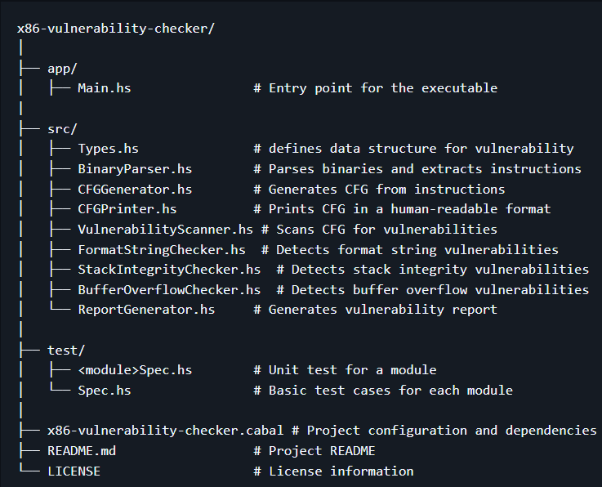
Project Structure

Slide 3



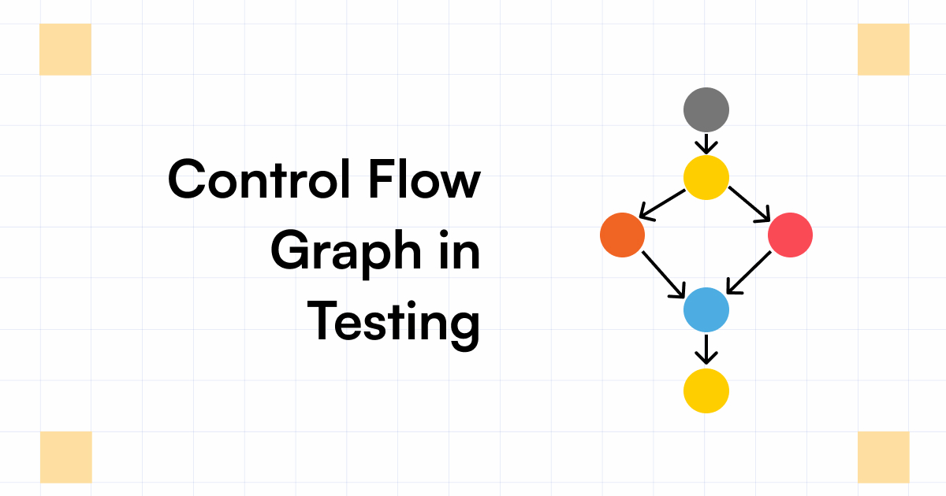
Workflow
Scanner
CFG
Vuls
Vul type, addr...
.bin
.exe
Ins
blocks
Report
Generator
Parser
CFG
Generator
B
S
F
Three
Checkers

Slide 4
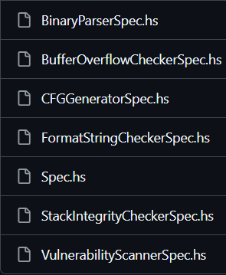
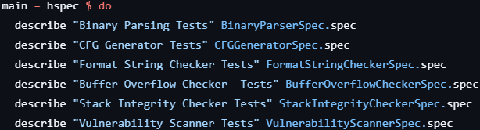
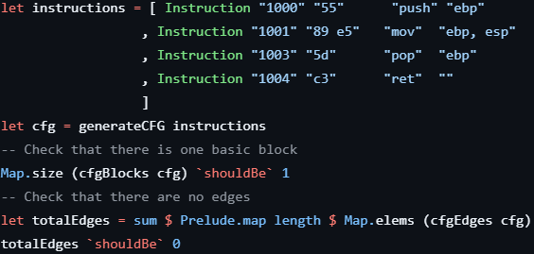
Unit Tests

Slide 5

Summary
Through this project, we
Reviewed the concepts of static control flow graph
Learnt how to detect vulnerabilities through CFG
Learnt how to write an effective program

