Slide 1
Kotlin as a first language
Tim Lavers

Slide 2
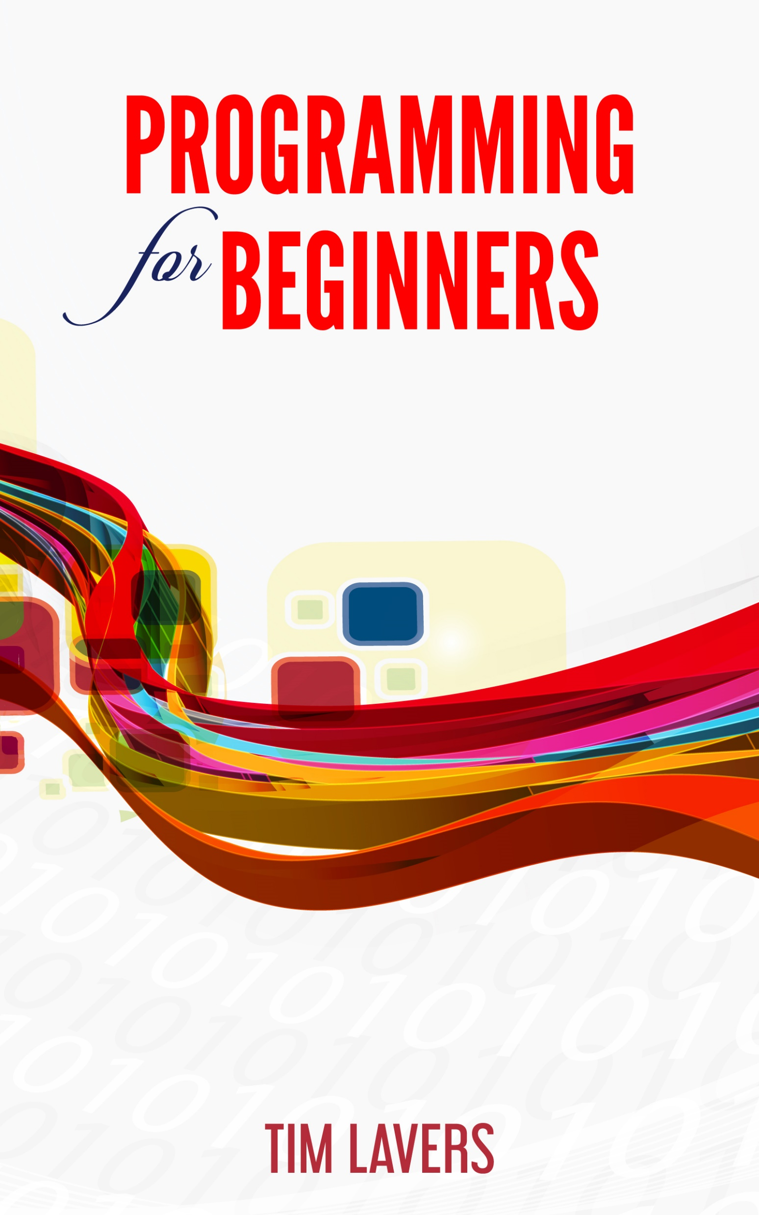
Introduction
Programming for Beginners, 2017
Kotlin-based
Why Kotlin?
What is good programming?
How do we learn best?
Overview of the book.

Slide 3
My background
Have been programming professionally for 20+ years.
Did not start learning to program until I was in my mid 20s
Have very strong recollections of how confused I was.
Remember being overwhelmed by complexity.

Slide 4
What is good software
As clearly written as possible
Does the job required of it
The two skills I really wanted to impart were Object-Oriented design and refactoring.
Syntax and libraries can be discovered on an as-needed basis.

Slide 5
Criteria
Allows the user to build OO models of the world.
Good refactoring tools.
General-purpose.
Multi-platform.
Needs file system and imaging libraries for the projects.
Unit testing easy.
Low effort to get started.

Slide 6
The importance of strong typing
Strong type systems allow us to reason about programs.
The IDE can be much more helpful in a strongly typed language.
Want to use the best tools possible.
As programming languages evolve, they get stronger type systems. C -> C++ -> STL Java -> Generics JS -> TypeScript

Slide 7
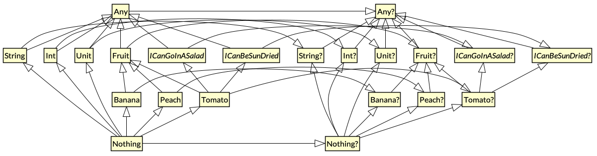
Kotlin has the best type system
http://www.natpryce.com/articles/000818.html

Slide 8
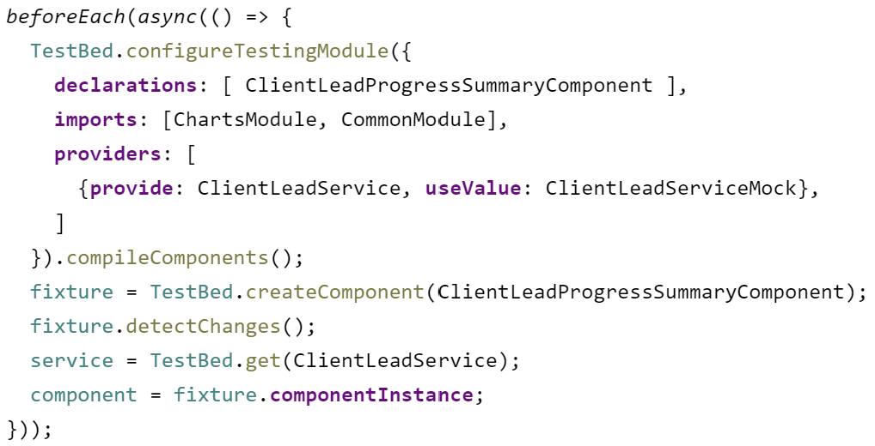
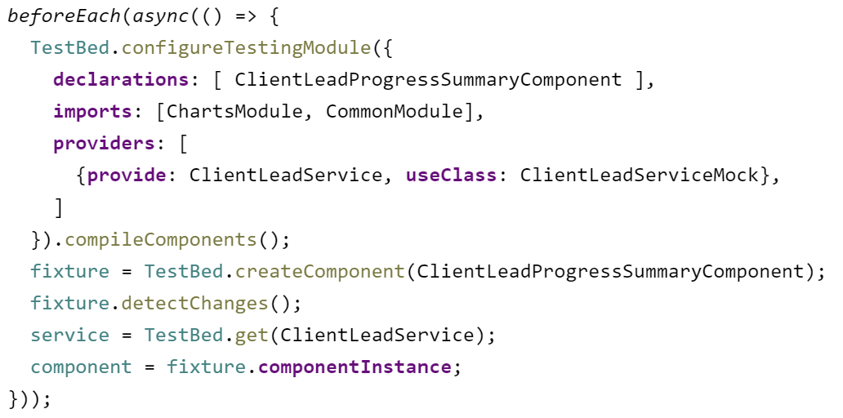
Prevention is better than cure
There’s lots of data on how much cheaper it is to find bugs early.
Best of all is if the IDE points bugs out to us straight away.
Example of hours wasted writing an Angular TypeScript test.

Slide 9
Choice of language
JS too horrible to consider. Type system weak. Undefined vs null.
Swift too limited. C# too.
C++ too complex.
Started out in Java. Got bogged down in explaining hash code, equals.
Java is not simple as it has many, many ways of doing the same thing.

Slide 10
Kotlin to the rescue
Great type system.
Clear syntax.
Consistent approach to iteration.
No need to get bogged down with primitive vs object types.
Data classes allow us to ignore hashCode, equals.
Can still use Java libraries.
Great tooling.

Slide 11
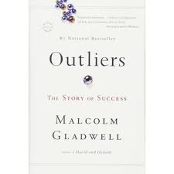
How we learn best
Programming is not a spectator sport.
Becoming an expert requires a lot of practice.
10,000 hours of focussed practice for music, sports, surgery, programming.

Slide 12
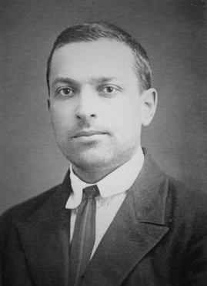
How should we practise programming?
Need lots of progressively harder problems.
Start with extremely basic ones.
Vygotsky’s “Zone of Proximal Development”.
That is, not too easy, not too hard.

Slide 13
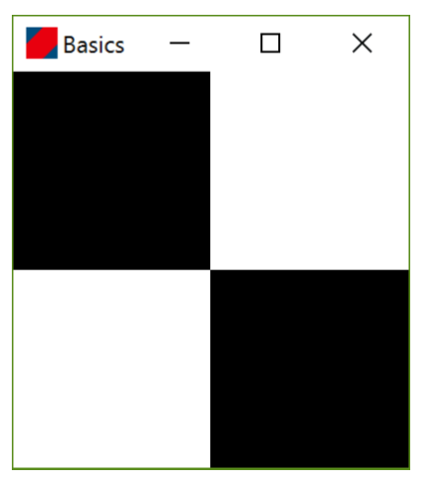
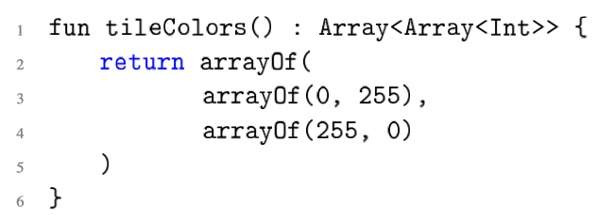
Overview of book
First program shows a pattern of squares.
The key piece of code is this:

Slide 14
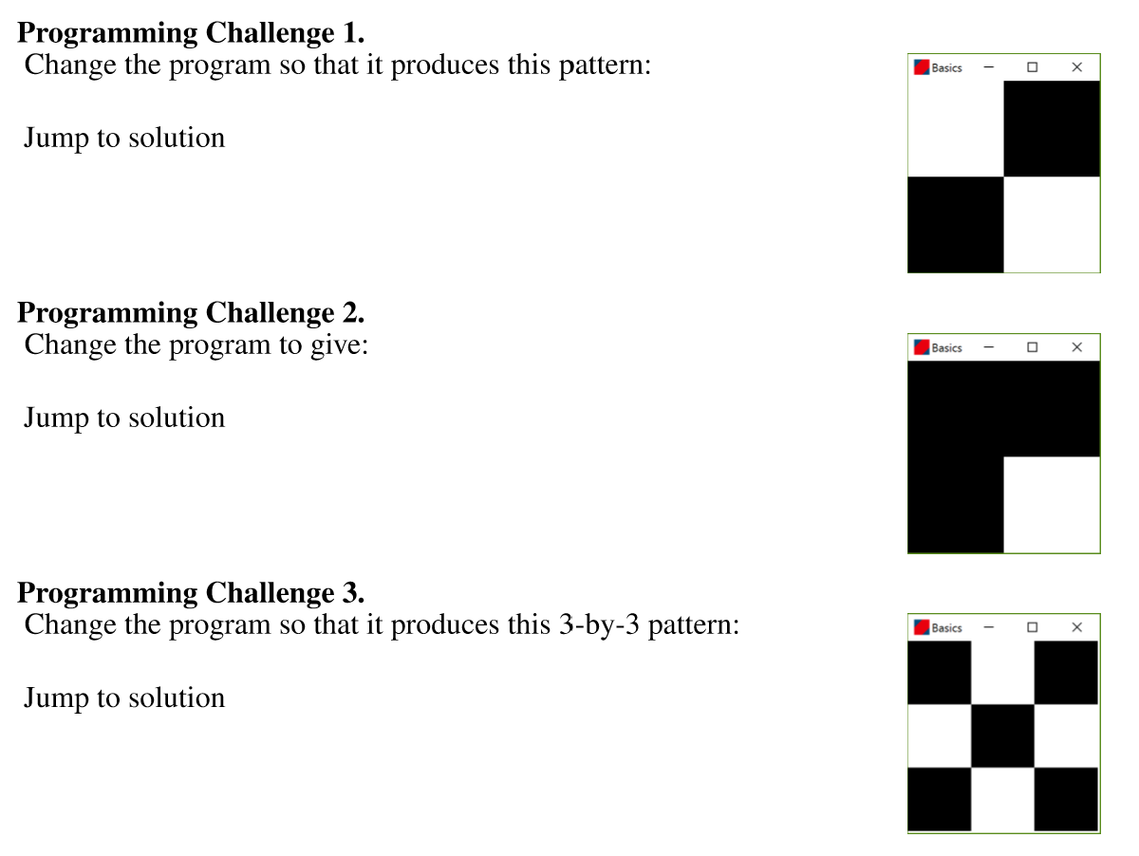
First steps

Slide 15
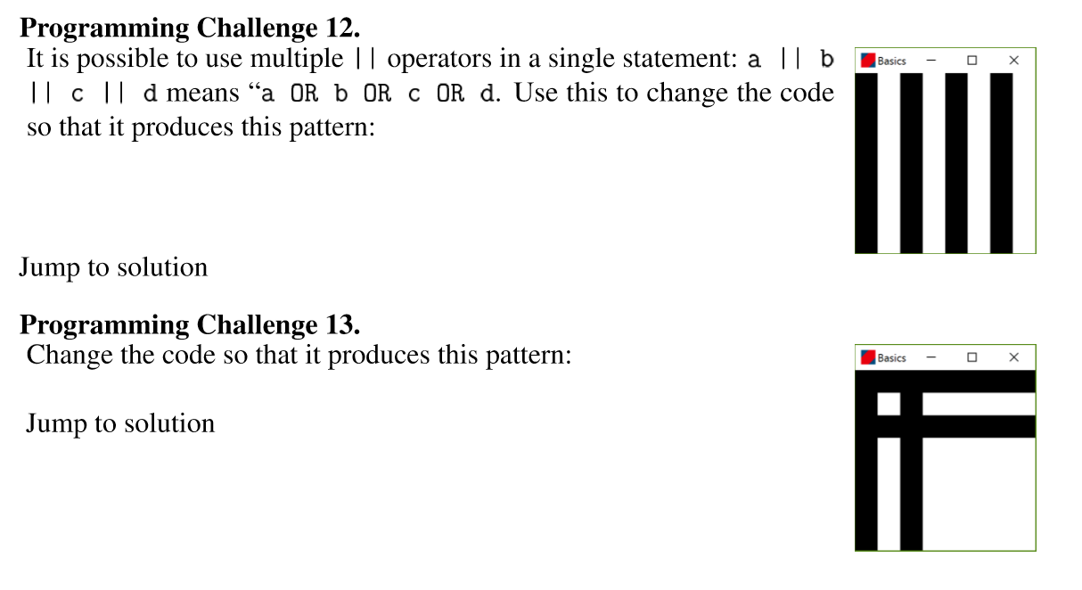
Loops and conditionals

Slide 16
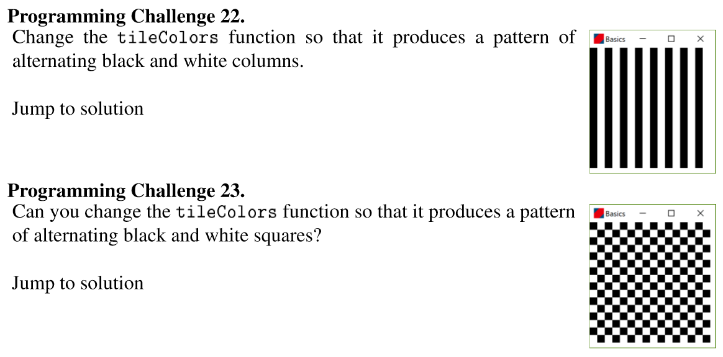
Integers

Slide 17
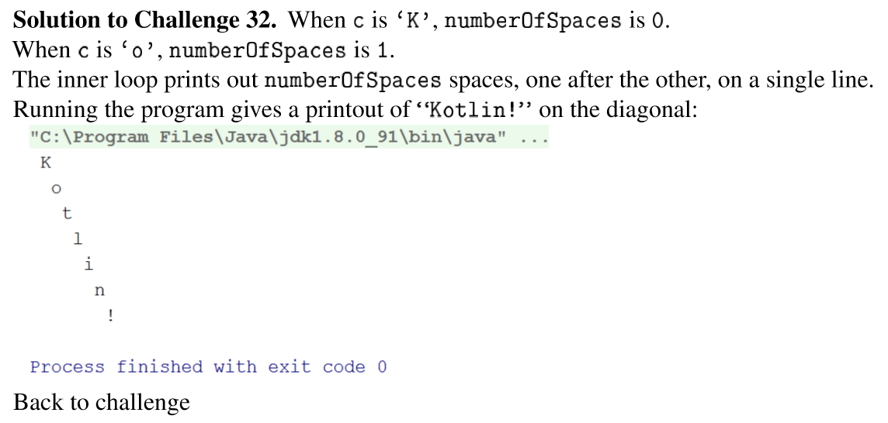
Concepts in first section
Boolean, Integer, String, Array.
Conditionals.
Loops.
Vals, vars, and scope.
Lists, Sets, Maps.
Null.
Reading and writing files.

Slide 18
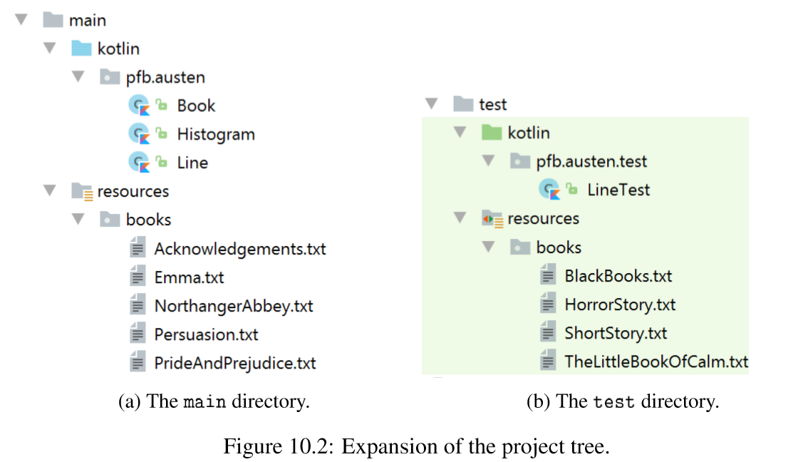
Part II of the book
Text-analysis projects to introduce OO concepts.
Unit testing is a big focus.
First project analyses the novels of Jane Austen.
Big emphasis on unit testing.

Slide 19
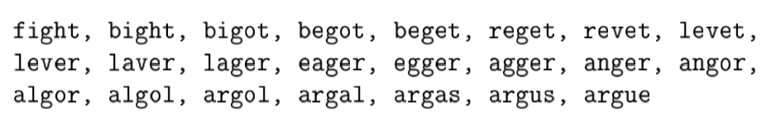
Other text projects
Find all anagrams of a word.
Find all English palindromes.
Discover word-to-word transformations from one word to another, one letter at a time.
Eg fight -> argue

Slide 20
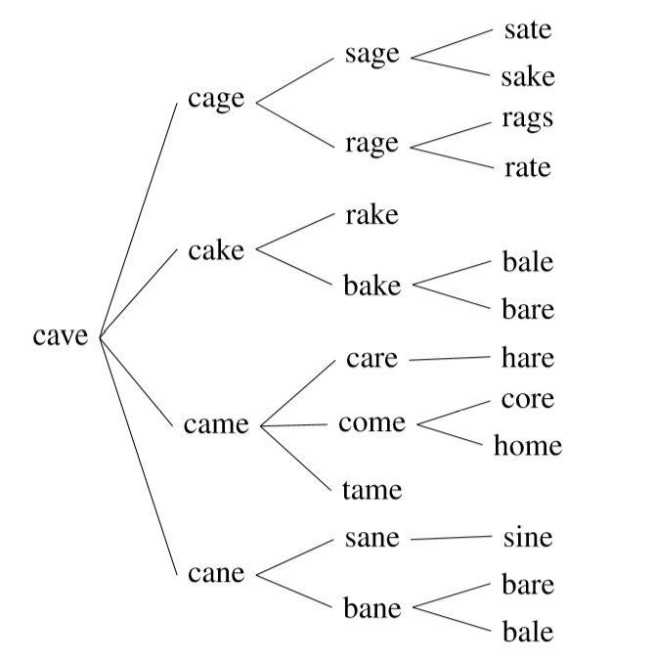
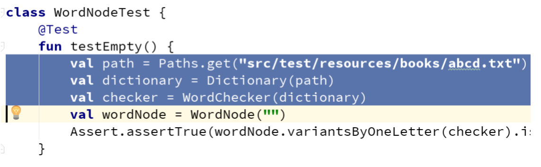
Tree structures.
Recursive data types.
Lots of unit testing and refactoring.

Slide 21
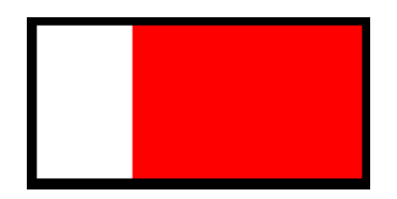
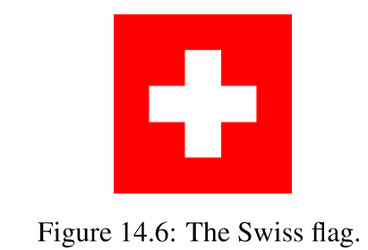
Part III
Image processing.
We discuss how colour is modelled in computer systems.
Challenges: drawing national flags

Slide 22


Transforming images
Pixel-by-pixel transformations are used to introduce functional programming concepts.

Slide 23
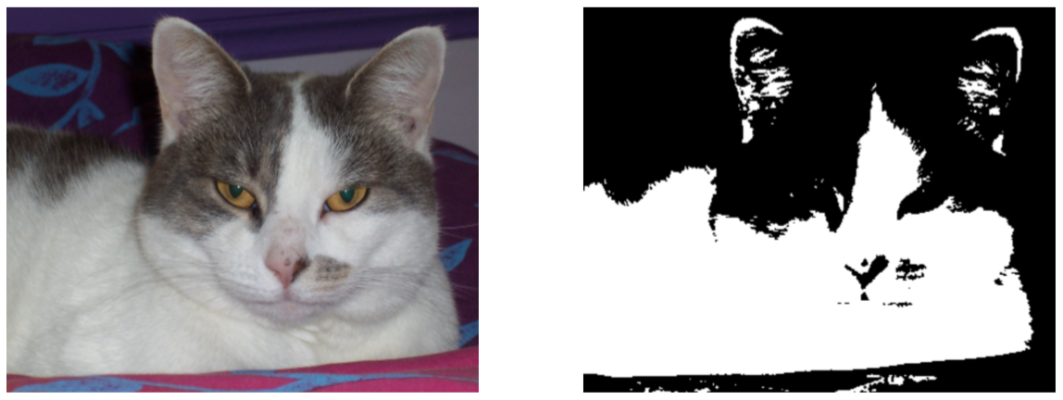

Slide 24
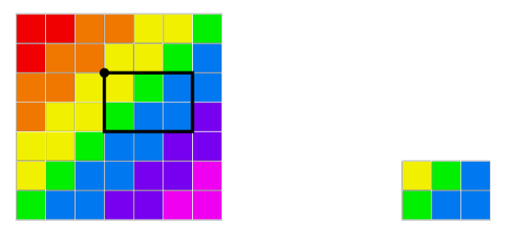
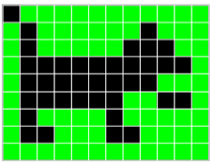
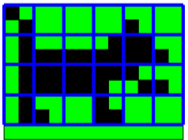

Image cropping and re-sizing.

Slide 25
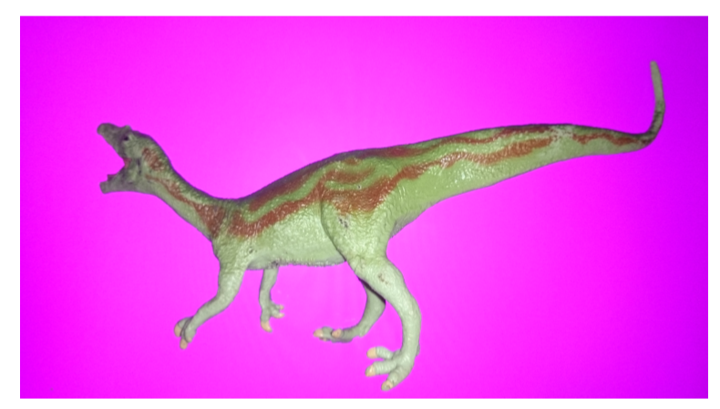

CGI

Slide 26
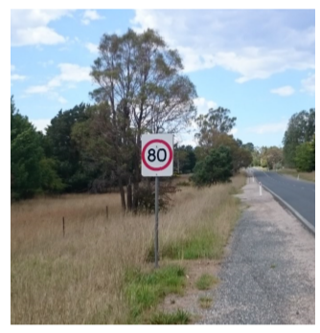
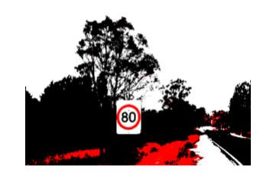
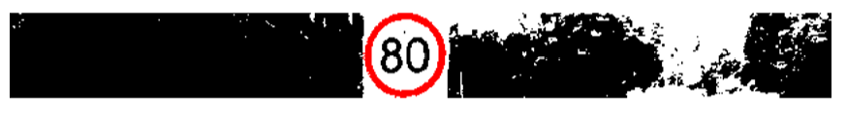
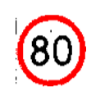
Part IV Computer vision
Finally introduce Floats.
Also the REPL.
Over a few chapters, we use the thresholding and image slicing techniques from previous chapters to build software for reading speed signs.

Slide 27
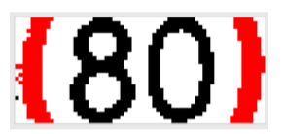
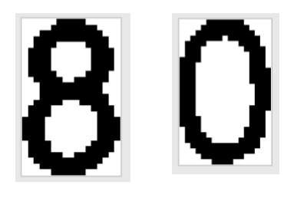
Continue slicing.
Finally, write code to translate black and white images of single digits to actual numbers.
The software is all fully unit-tested.

Slide 28
Summary
Kotlin has:
Consistent syntax
Really strong type system
Very low “noise” factor
This makes it possible to write a short introductory programming book that takes a reader from zero to computer vision.
Could not have done this so easily in other languages.

