Slide 1


Mid-Term Data Analysis ALY 6980: Mid-term presentation PROF. DR. JAY QI
Team: 2
Viquar Ahmed Mohammed
Syed Faizan
Sanket Parmar
Vishnu Prasad Nambiar
Krutika Patel
Pratham Chhabra

Slide 2

Time to Reach Highest TIMES Score and Its Implication for Success

Slide 3
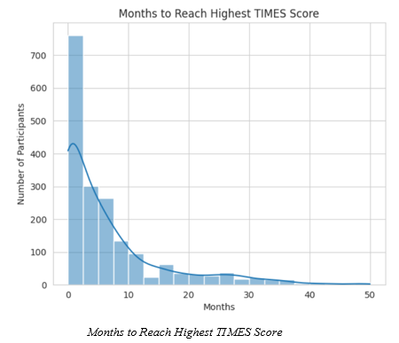
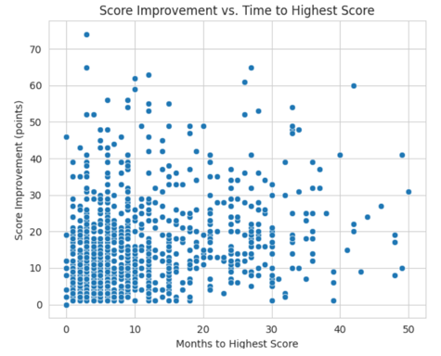
Months to Reach Highest TIMES Score
Analysis based on over 9,000 assessments from 1,863 participants.
33.2% of participants reached their peak score in the first month.
Indicates early stability or short-term program involvement.
Average time to peak score: 6.6 months.
Median time: 3 months.
Distribution is right-skewed, showing wide variation in engagement time.
Suggests that while some improve quickly, others need sustained support due to complex needs.
Score Improvement vs. Time to Highest Score
Demonstrates a moderate positive correlation (r = 0.521) between time and score improvement.
Participants who remained longer tended to show greater gains.
Indicates that extended engagement (6–12+ months) is linked to more substantial improvements.
Early improvements are possible, but deeper transformation often requires time and continuity in support.

Slide 4
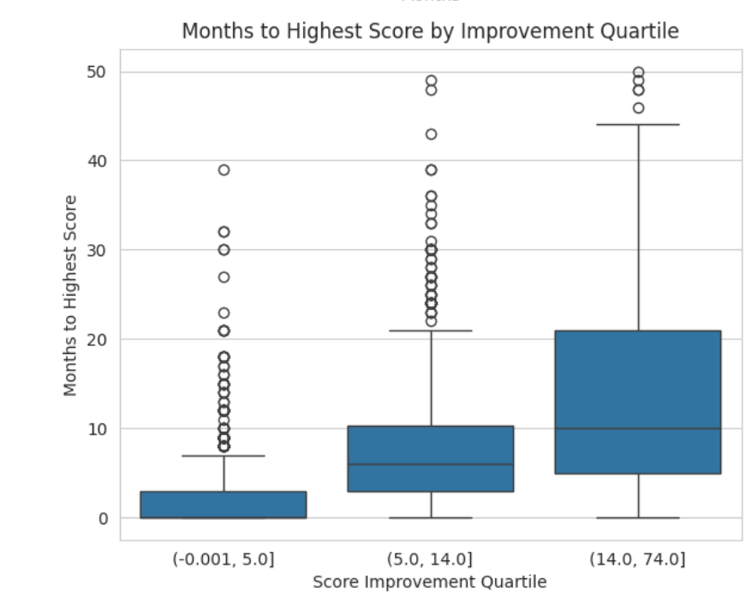
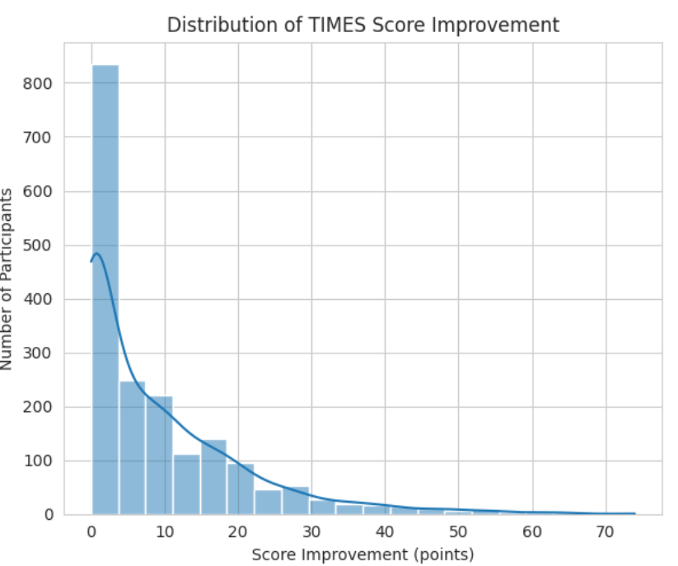
Months to Highest Score by Improvement Quartile
Boxplot groups participants by improvement quartiles (from lowest to highest).
Lowest quartile (0–5 pts) reached peak scores quickly, often in 1–3 months.
Top quartile (14–74 pts) took significantly longer, often 12+ months.
Clear pattern: Greater improvement requires more time.
Reinforces the importance of long-term engagement for meaningful progress.
Distribution of TIMES Score Improvement
Histogram shows how much participants improved over time.
Distribution is right-skewed, with most participants improving 0–15 points.
Average improvement: 9 points.
67.3% of participants experienced a positive gain in their TIMES score.
Indicates that the majority benefited measurably from program engagement.

Slide 5
Key Takeaways
Most participants benefit: 67.3% showed measurable improvement, with an average TIMES score gain of 9 points.
Early progress is common, but lasting change takes time: While one-third peaked in the first month, the average time to highest score was 6.6 months, showing varied pathways to progress.
Greater improvements require longer engagement: Participants with the highest gains (14–74 points) often took over a year to reach their peak score.
Sustained support drives transformational outcomes: Those engaged for 12+ months improved by an average of 19.2 points, highlighting the value of consistent, long-term services.
TIMES score is a powerful success indicator: Reflects meaningful, holistic growth across life domains—time to improvement mirrors personal development and program impact.

Slide 6

Service Effectiveness Across Population Groups

Slide 7
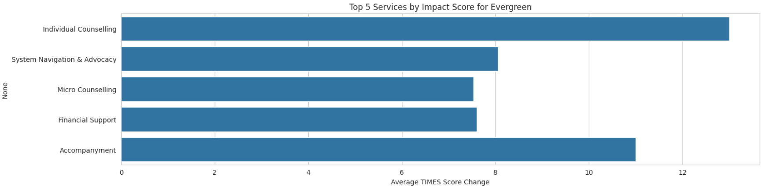
Top 5 Services – Evergreen (Vulnerable Youth)
Individual Counselling had the highest average TIMES score gain (+13.00), indicating strong emotional and relational impact.
System Navigation & Advocacy (+8.06) and Micro Counselling (+7.53) also performed well, underscoring the importance of trusted guidance.
Services centered on emotional support and life navigation are most effective for youth facing complex, unstable conditions.
Financial Support and Life Skills Coaching had comparatively lower impacts in this group.

Slide 8
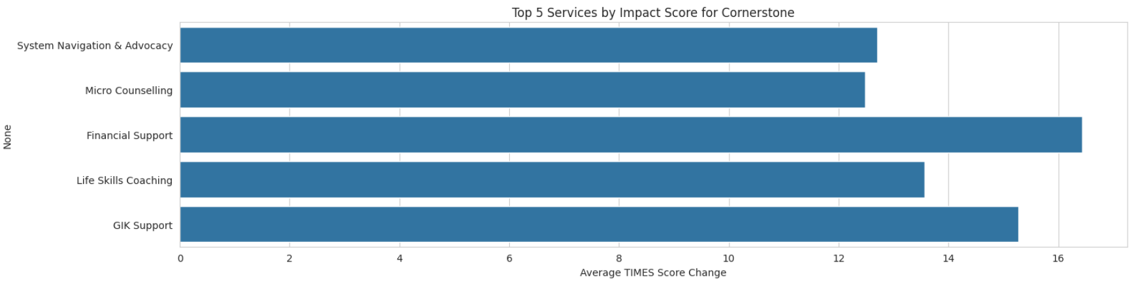
Top 5 Services – Cornerstone (Families)
Financial Support led to the largest average score improvement (+16.43), signaling its central role in family stability.
System Navigation & Advocacy (+12.70) and Micro Counselling (+12.48) were also key, emphasizing the need for comprehensive support.
Life Skills Coaching also showed a notable effect (+13.57), suggesting growing readiness for skills-building once basic needs are addressed.
Services addressing economic stability and guided support are essential for families in transition or crisis.

Slide 9
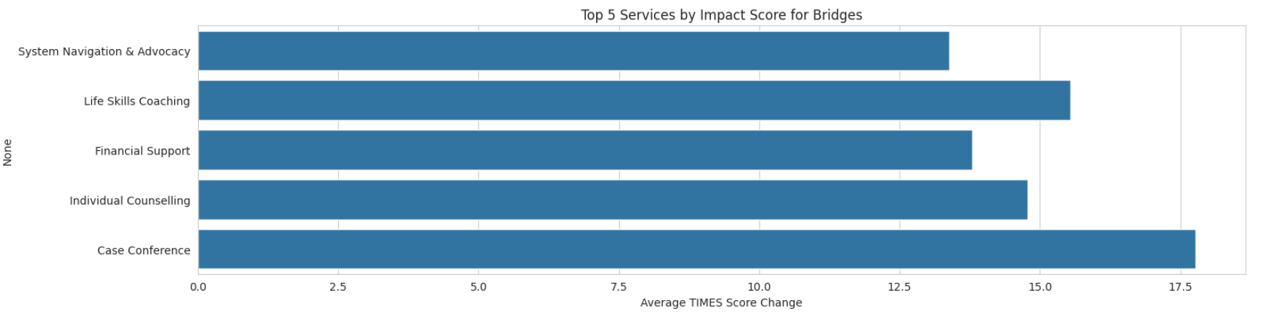
Top 5 Services – Bridges (Adults)
Case Conferences delivered the strongest results across all groups (+17.77), reinforcing the value of coordinated, team-based planning.
Life Skills Coaching (+15.55) and System Navigation & Advocacy (+13.39) also made significant contributions to adult outcomes.
Financial Support remained impactful here as well (+13.80), showing cross-cutting benefit.
Adults thrive with structured, skill-building, and collaborative services that drive long-term self-sufficiency.

Slide 10
Comparative Insights & Statistical Significance
Key Cross-Group Patterns
System Navigation & Advocacy: Almost top 3 across all groups; most effective in Bridges (13.39).
Financial Support: Highest impact for Cornerstone families (16.43); less for youth (7.60).
Life Skills Coaching: Strongest for adults (15.55); moderate for families (13.57); lower for youth (8.44).
Significant Differences (t-tests)
Life Skills Coaching: Adults > Youth (p = 0.029)
Financial Support: Families > Youth (p = 0.015)
Case Conferences: Adults > Youth (p = 0.047)
Implication Service effectiveness varies by population—proving the need for tailored interventions. These differences are statistically significant, reinforcing targeted investment decisions.

Slide 11
Key Takeaways: Service Effectiveness by Population Group
Different groups benefit from different services—one-size-fits-all approaches are less effective.
Youth (Evergreen): Emotional and relational support like Individual Counselling is most impactful.
Families (Cornerstone): Financial stability is the key driver of improvement, supported by navigation and counseling.
Adults (Bridges): Benefit most from collaborative planning (Case Conferences) and skills-based coaching.
System Navigation & Advocacy is effective across all groups, but most impactful for adults.
Statistically significant differences show the need for demographic-specific service design (e.g., Financial Support far more effective for families than youth).
Strategic recommendation: Prioritize services that align with each population's unique needs to drive greater, more meaningful change.

Slide 12

Analysis of High Baseline TIMES Participants

Slide 13
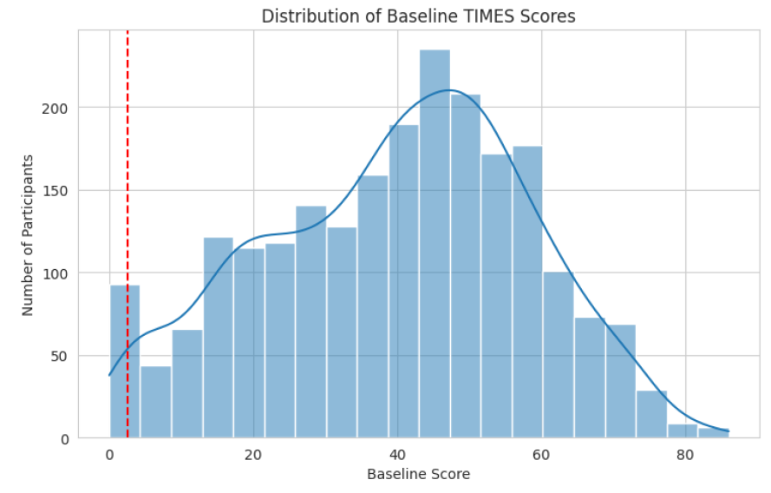
Baseline Score Distribution
Insight:
98% of participants (n = 2,211) started with TIMES scores ≥ 2.5, indicating moderate-to-high initial stability.
The distribution is skewed toward the middle-to-upper range.

Slide 14
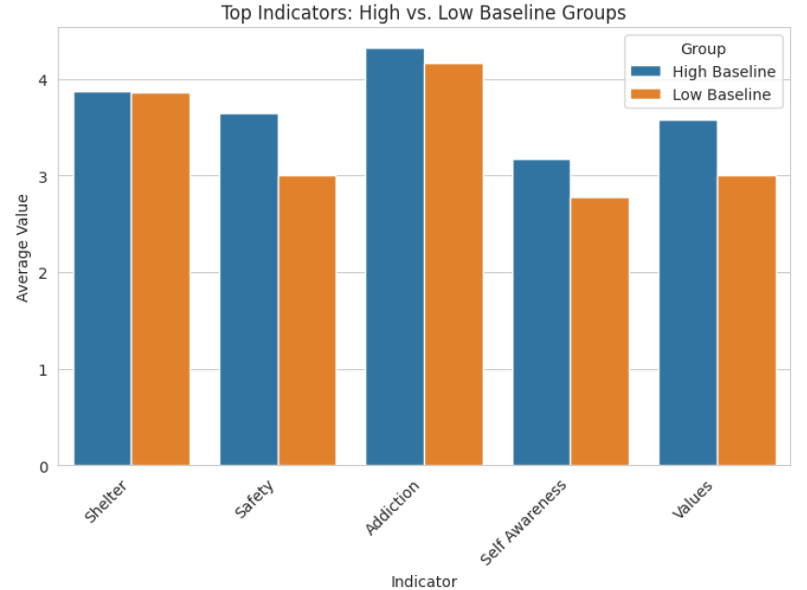
Participants with high baseline scores often had multiple strong indicators (rated 4 or 5).
The top five most commonly high indicators were:
Shelter – 56.9%
Safety – 46.6%
Addiction Stability – 40.5%
Self-Awareness – 39.5%
Values – 38.5%
These suggest strong housing security, safety, and emotional resilience, though differences with the low-score group were not statistically significant (p > 0.05).

Slide 15
Demographics
Analysis of demographic data revealed only one statistically significant difference:
Age: High baseline participants were older on average (33.3 vs. 29.9 years) with a significant p-value of 0.0261, suggesting that increased age may contribute to higher initial stability.
Other demographic factors such as race, gender, education, and income source 35 showed no consistent or statistically significant differences, although education level had interesting trends:
More high baseline participants held a college or university diploma (28.3%) compared to none in the low group.
A large portion of low baseline participants declined to answer (22.2%).

Slide 16
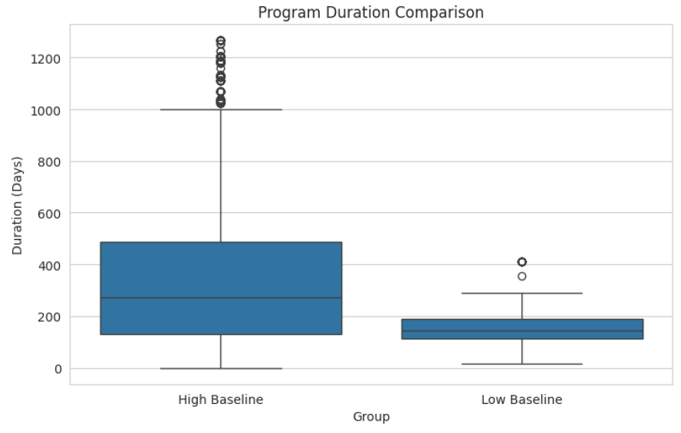
Program Duration Comparison
High Baseline Group: Average program engagement of 337.7 days
Low Baseline Group: Average program engagement of 166.4 days
Difference: +171.3 days (p < 0.05, statistically significant)
Key Insight: Higher-functioning individuals tend to stay in the program longer, likely to maximize support or pursue advanced goals (e.g., education, employment).

Slide 17
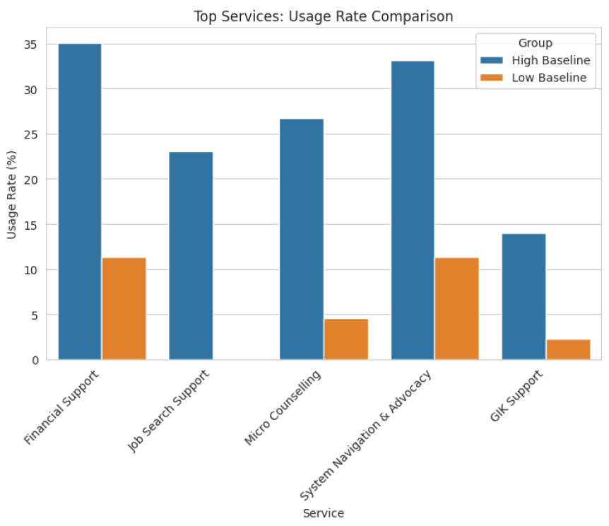
Services Most Frequently Used
This suggests that individuals with higher baseline scores were more proactive or better positioned to access and engage with services, particularly financial aid, employment help, and advocacy.

Slide 18

Predictive Factors of High Baseline Participants
Variable | High Avg | Low Avg | Δ
Total Services Used | 37.2 | 15.6 | +21.6
Age | 32.1 | 28.3 | +3.7
Program Duration | 293.6 | 210.9 | +82.7
Unique Services Used | 5.4 | 3.5 | +2.0
These Random Forest model results suggest that high baseline participants tend to:
Use a greater number of services
Stay in programs longer
Be older
Engage with diverse types of support
The model achieved a 99% accuracy, confirming the strength of these patterns.

Slide 19
Key Takeaways
Majority (98%) of participants began with relatively high TIMES scores (≥ 2.5).
Strongest indicators: Shelter, Safety, and Addiction Stability.
Older age and higher education correlated with stronger starting points.
Higher baseline individuals:
Used more services
Stayed in programs longer
Focused on advancement-oriented supports (e.g., employment, advocacy)
Predictive modeling confirms that greater engagement = greater initial and sustained stability.
Implication: Tailoring support based on baseline stability can enhance outcomes across diverse participant profiles.

Slide 20

Business Questions to aid YSM in the implementation of their programs.

Slide 21
What are the most significant predictors of successful program outcomes, and how can we optimize resource allocation accordingly?
Random Forest Predictive Model Development:
Built using participant demographics, service usage, and program characteristics.
Achieved high accuracy (ROC AUC: 0.998).
Key Predictors of TIMES Score Improvement:
Total service hours
Program duration
Number of services accessed
Diversity of service types
Enrollment in specific programs (e.g., Evergreen)
Main Findings:
Greater engagement and service variety are linked to better outcomes.
Consistent and prolonged service contact drives participant improvement.
Recommendations for YSM:
Prioritize extending program duration.
Encourage multi-service engagement.
Replicate successful program models (like Evergreen) to boost impact.

Slide 22

Which participant segments should be targeted with specialized interventions based on their distinct characteristics and needs?

Slide 23
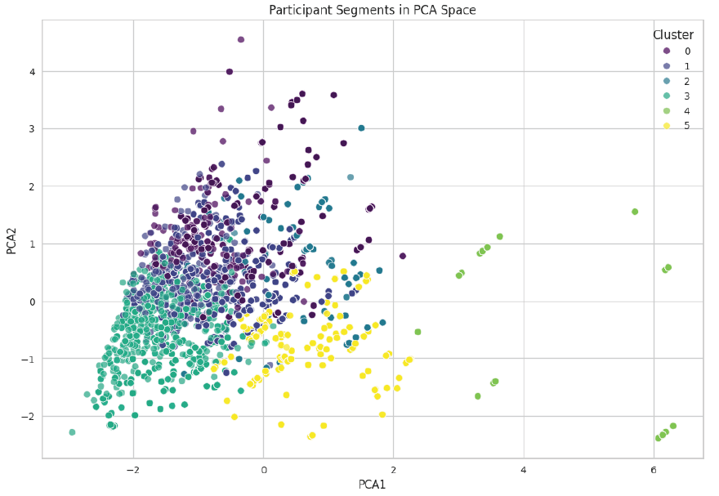
Participant Segmentation for Specialized Interventions
To optimize strategic program delivery, a K-Means clustering analysis was conducted using seven standardized participant features: age, service count, unique service types, total service hours, program duration, average TIMES score, and TIMES score change.

Slide 24
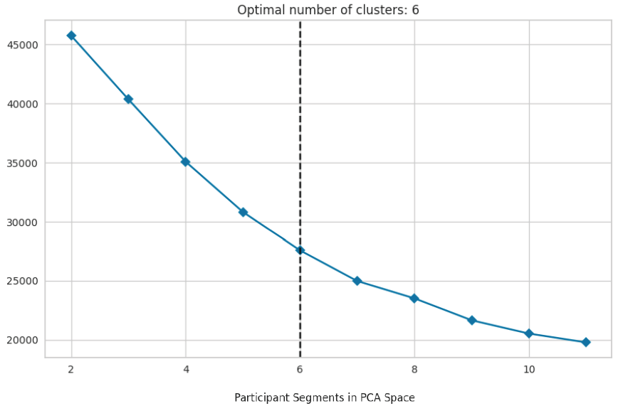
Optimal Clusters
Using the elbow method, the optimal number of clusters was determined to be six, balancing variance reduction with simplicity. These six clusters were visualized using PCA, confirming clear differentiation among participant types.

Slide 25
Summary of Participant Segments
Cluster | % of Participants | Key Traits | Implications
0 | 12.18% | Older, moderate service use, strong TIMES improvement | Responds well to current structure; continue steady support
1 | 31.31% | Youngest group, moderate services, highest baseline TIMES scores | Likely self-sufficient but may benefit from goal-oriented support (e.g. employment/education)
2 | 10.39% | High service usage, long program duration, strong outcomes | Effective engagement model—sustain and replicate where possible
3 | 18.45% | Low engagement, minimal TIMES gains | Critical segment for intervention—needs re-engagement or program redesign
4 | 5.77% | Most engaged, longest duration, greatest TIMES improvement | Model of success—leverage as a best-practice example
5 | 21.90% | Young, high service count, moderate outcomes | High input but only moderate gains—opportunity for service optimization
Key Takeaways
Cluster 3: Re-engage or redesign approach
Cluster 4: Leverage as success model
Cluster 5: Improve service efficiency
Cluster 1: Empower self-sufficiency with light support

Slide 26

How effectively are we reaching and engaging different demographic groups, and where are the key service gaps?
We analyzed six demographics (Gender, Age, Immigration Status, Housing, Education, Disability) using service count, engagement level, and TIMES score changes. ANOVA and Chi-square tests identified disparities and service gaps.

Slide 27
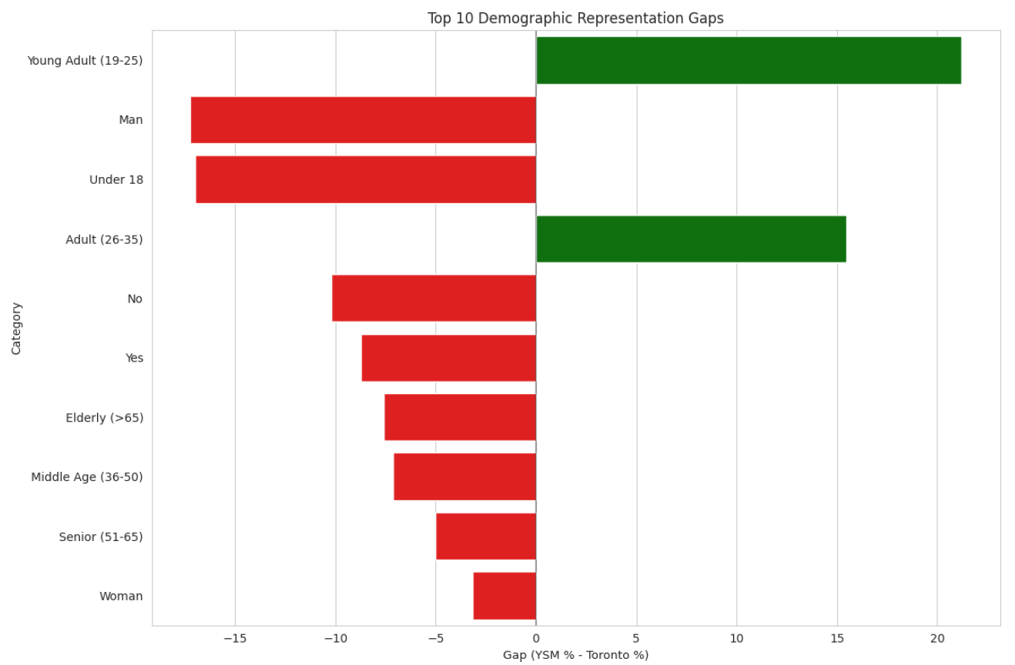
Demographic Representation vs. Toronto Population (Bar Chart: Green = Overrepresented | Red = Underrepresented)
Underrepresented Groups:
Youth (< 18) — Index < 0.25
Elderly (>65) — Index < 0.25
Men — Index = 0.64
Overrepresented Groups:
Young Adults (19–25) — Index = 3.12
Suggests outreach barriers or program accessibility issues for youth, seniors, and men

Slide 28
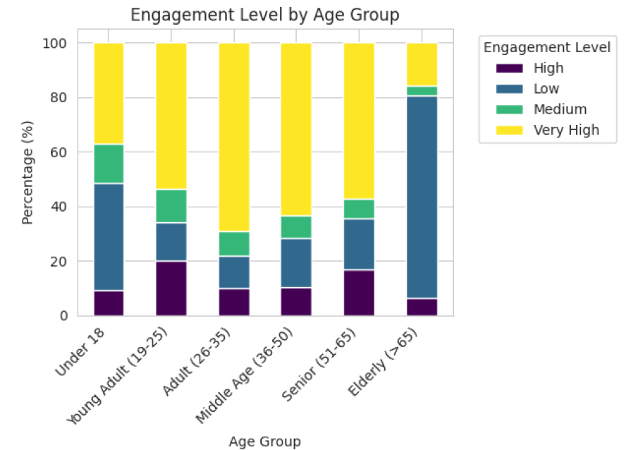
Engagement by Age Group
Youth (<18): Only 37.2% reached "Very High" engagement
Middle-aged adults (26–45): Over 60% reached "Very High"

Slide 29
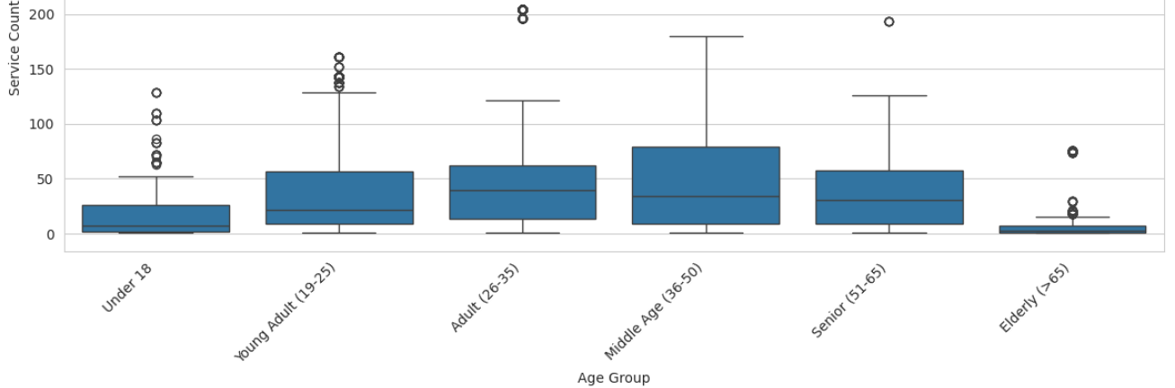
Service Count by Age
Youth (<18) and Elderly (>65) accessed fewer services
Middle-aged groups accessed the most services

Slide 30
Key Takeaways
Youth and Elderly are both underrepresented and less engaged → Need age-specific outreach and support models
Men remain significantly underrepresented → Consider targeted gender outreach
Young Adults (19–25) show strong representation but may need transition planning for long-term stability
Middle-aged adults are well-engaged → Could be leveraged as peer mentors or role models

Slide 31

Thank you!

