Slide 1
Evaluating Data Manipulation Threats in WiFi-based People Counting: Risks and Defenses
Anthony B.(UW)
Ishraq H. C.(Uniba)
Ibrahim K.(Uniba)

Slide 2
OFFENSIVE

Slide 3
OFFENSIVE “Privacy and Security Go Hand in Hand”

Slide 4
OFFENSIVE - REASONS
Simulating Potential Attacks
To see how devices behave
Risk Assessment
Safety Measures

Slide 5
OFFENSIVE - REASONS
Simulating Potential Attacks
To see how devices behave
Risk Assessment
Safety Measures
GDPR
(Compliance and Regulations)

Slide 6
OFFENSIVE – SIMULATING POTENTIAL ATTACKS
To identify vulnerabilities and weaknesses

Slide 7
OFFENSIVE – TO SEE HOW DEVICES BEHAVE
In Real World

Slide 8
OFFENSIVE – RISK ASSESSMENT
Getting information to make informed decision
Mitigating Risks

Slide 9
OFFENSIVE – SAFETY MEASURES
What are and What could?
Improvement of safety measures

Slide 10
OFFENSIVE – Compliance and Regulations
Ensures Compliance
Helps in avoiding potential legal and regulatory issues, (z. B. Data breach, Location Breach)

Slide 11
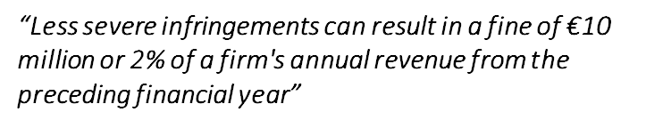
OFFENSIVE – Compliance and Regulations
Art. 83(4)
https://gdpr-info.eu/issues/fines-penalties/
https://www.eqs.com/compliance-blog/biggest-gdpr-fines/#:~:text=Less%20severe%20infringements%20can%20result,depending%20on%20what%20is%20higher.

Slide 12
OFFENSIVE – ZERO DAY

Slide 13

OFFENSIVE
FIG. WIRED ARTICLE
https://www.wired.com/story/99-phones-fake-google-maps-traffic-jam/

Slide 14
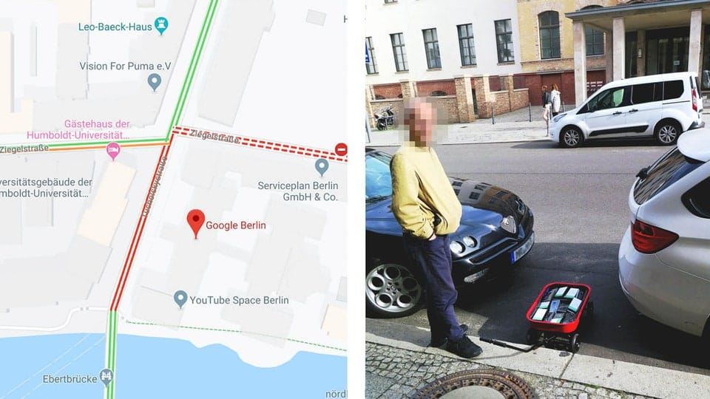

Slide 15
OFFENSIVE
Weckert says. “I don’t need the people. I just need their smartphones.”
FIG. WIRED ARTICLE
https://www.wired.com/story/99-phones-fake-google-maps-traffic-jam/

Slide 16
OFFENSIVE
Weckert says. “I don’t need the people. I just need their smartphones.”
“We don’t need the people. We just need to inject packets.”
FIG. WIRED ARTICLE
https://www.wired.com/story/99-phones-fake-google-maps-traffic-jam/

Slide 17
OFFENSIVE – ATTACK MODELS
MAC Spoofing
Probe Request Flooding
Relay Attacks/Replay Attacks
DoS (Future Aspect)

Slide 18
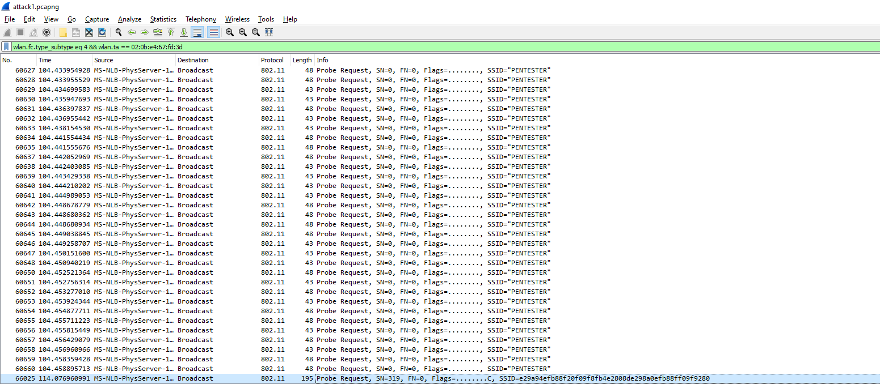
FIG. Probe Burst

Slide 19
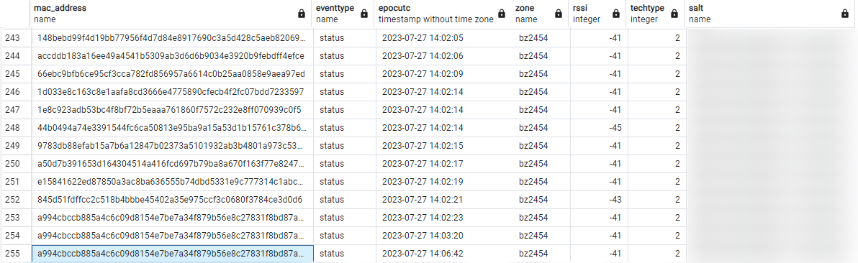
FIG. Injected Data in the Database

Slide 20
OFFENSIVE – FUTURE APPROACH
Attacking all sensor’s at once
Passing them through defense framework
Visualizing the data of “attack event’s”
Future Research to mitigate these attacks
(effective response)

Slide 21
Current Work For Defense Mechanism:
Generation of dummy dataset
Creation of a protection component/framework with protection mechanism
Protection mechanisms:
1. Input validation
2. Data sanitization
These two functions could also be implemented in Osysseus.
Anomaly protection mechanism against poisoning with unsupervised learning – Isolation Forest.
Isolation Forest is an unsupervised machine learning model for anomaly detection, the model is predicting every anomaly that we have tested so far, with an accuracy of 1.0.
DoS protection mechanism with online-learning or batch learning.

Slide 22
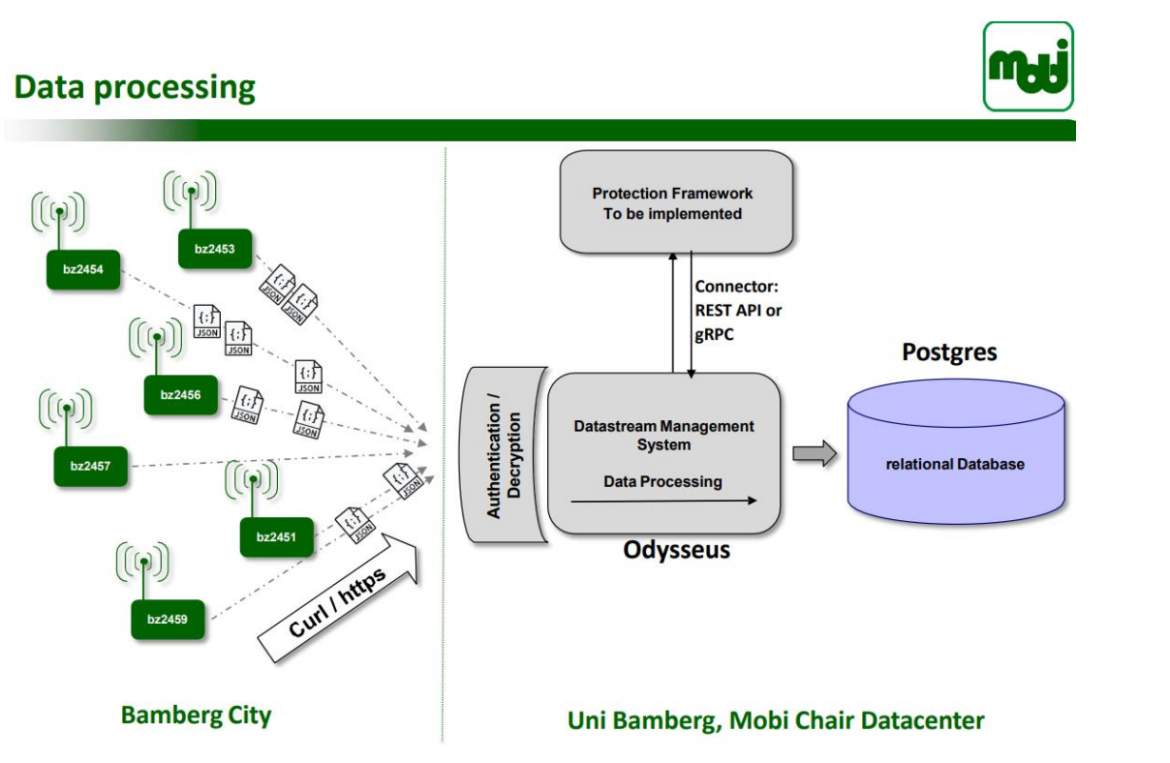
Intended Architecture

Slide 23
Input Validation
First step in the process
Ensure all incoming data is in proper format
eventtype: status/leave
epocutc: DD/MM/YYYY 00:00:00
zone: bz….
Log invalid inputs
This is a function we are coding, but it could be implemented also in Odysseus
Besides, we have an anomaly detection algorithm that can distinguish these patterns without through condition statements.

Slide 24
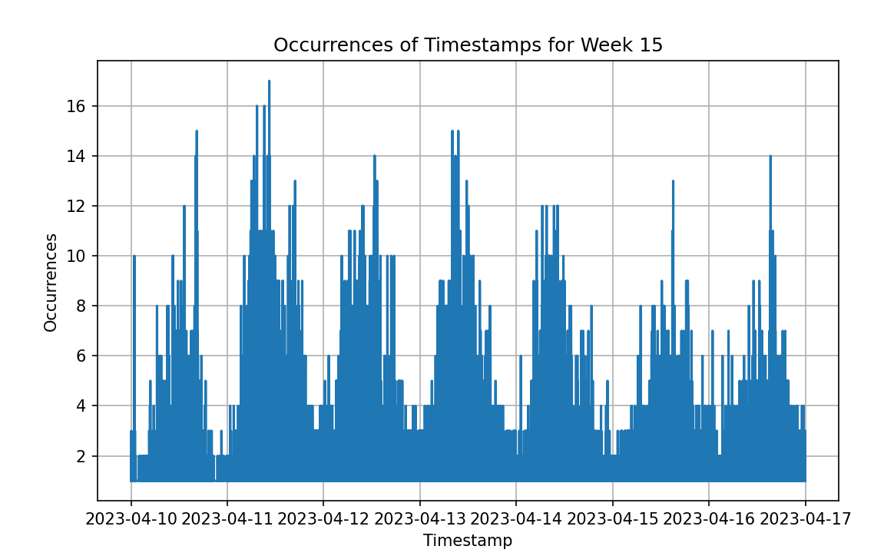
4. DoS protection mechanism with online-learning:
Currently we are still developing this part of the algorithm. We are trying to predict the
flow patterns in time. Our model would have the possibility to know the number of probe requests coming from the sensors, the number of diferente MACs per frame of time(5 mins) to expect,and other statistical predictions, and produce alerts/take actions accordingly. Besides, the model would be able to learn new patterns in the future if changes in the flow of traffic happen.

Slide 25
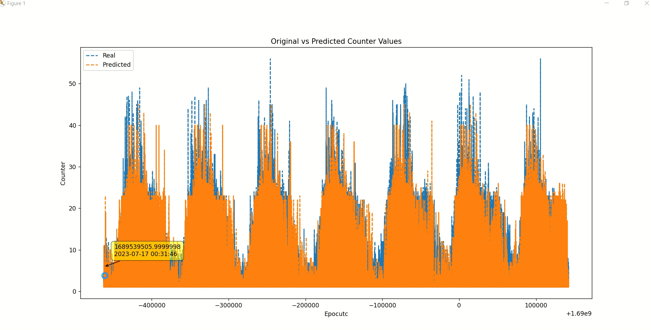
Prediction results for 2 weeks showing good alignment between real and predicted traffic.

Slide 26
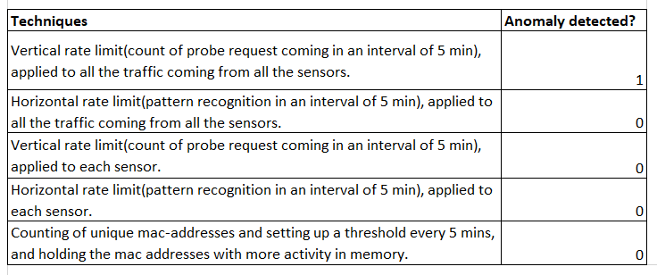
Techniques that we are using:

Slide 27
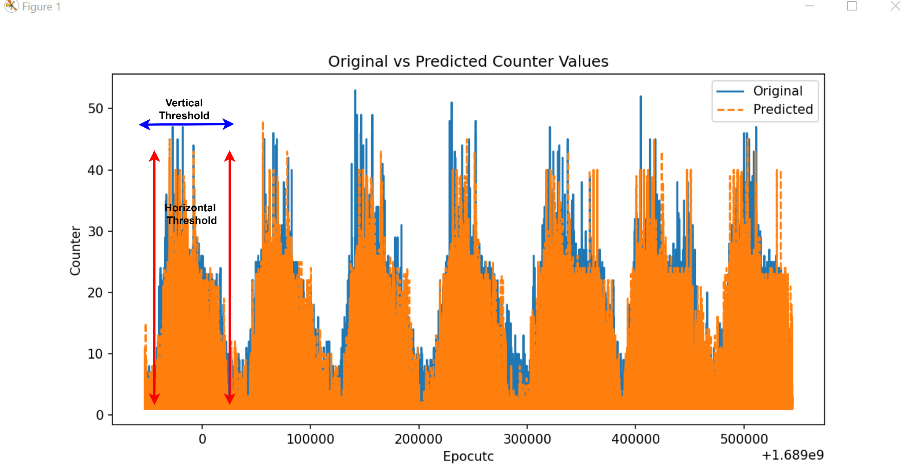
Rate limiting/Threshold technique

Slide 28
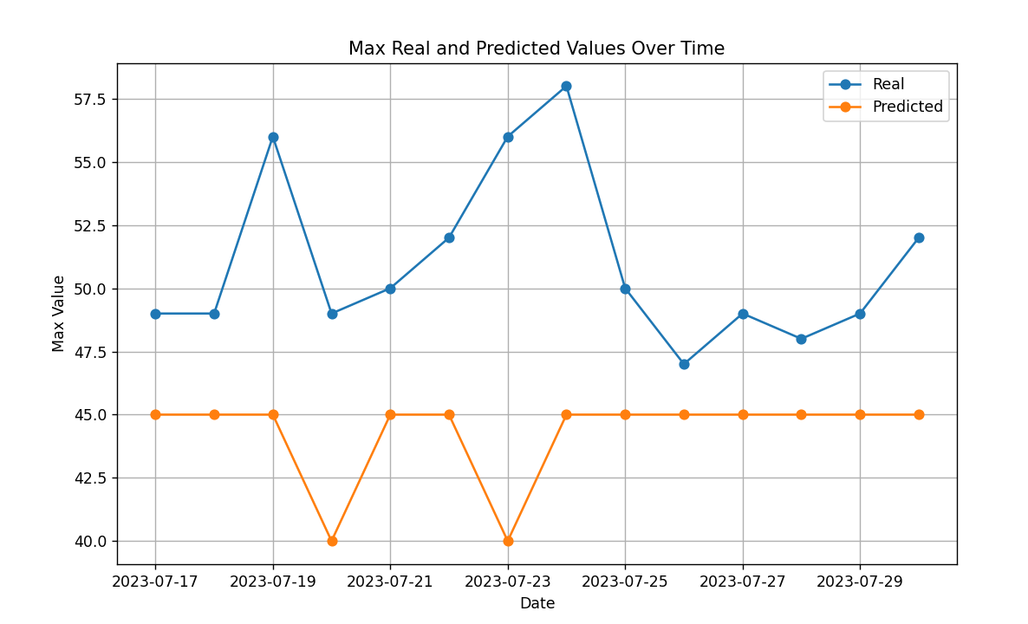
Data to set up a rate limit(Threshold),proposition: predicted plus 25%

Slide 29
Max Values
Date | Real value | Predicted value
7/17/2023 | 49 | 45
7/18/2023 | 49 | 45
7/19/2023 | 56 | 45
7/20/2023 | 49 | 40
7/21/2023 | 50 | 45
7/22/2023 | 52 | 45
7/23/2023 | 56 | 40
7/24/2023 | 58 | 45
7/25/2023 | 50 | 45
7/26/2023 | 47 | 45
7/27/2023 | 49 | 45
7/28/2023 | 48 | 45
7/29/2023 | 49 | 45
7/30/2023 | 52 | 45

Slide 30
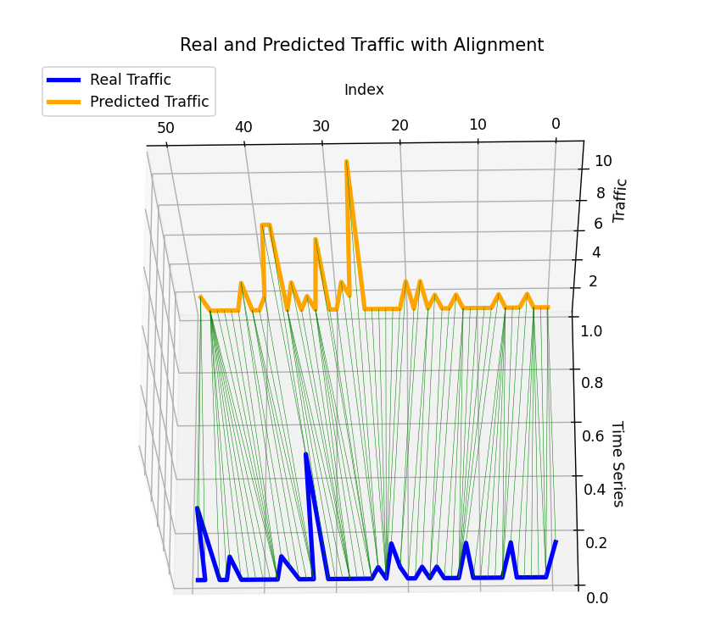
Pattern recognition:

Slide 31
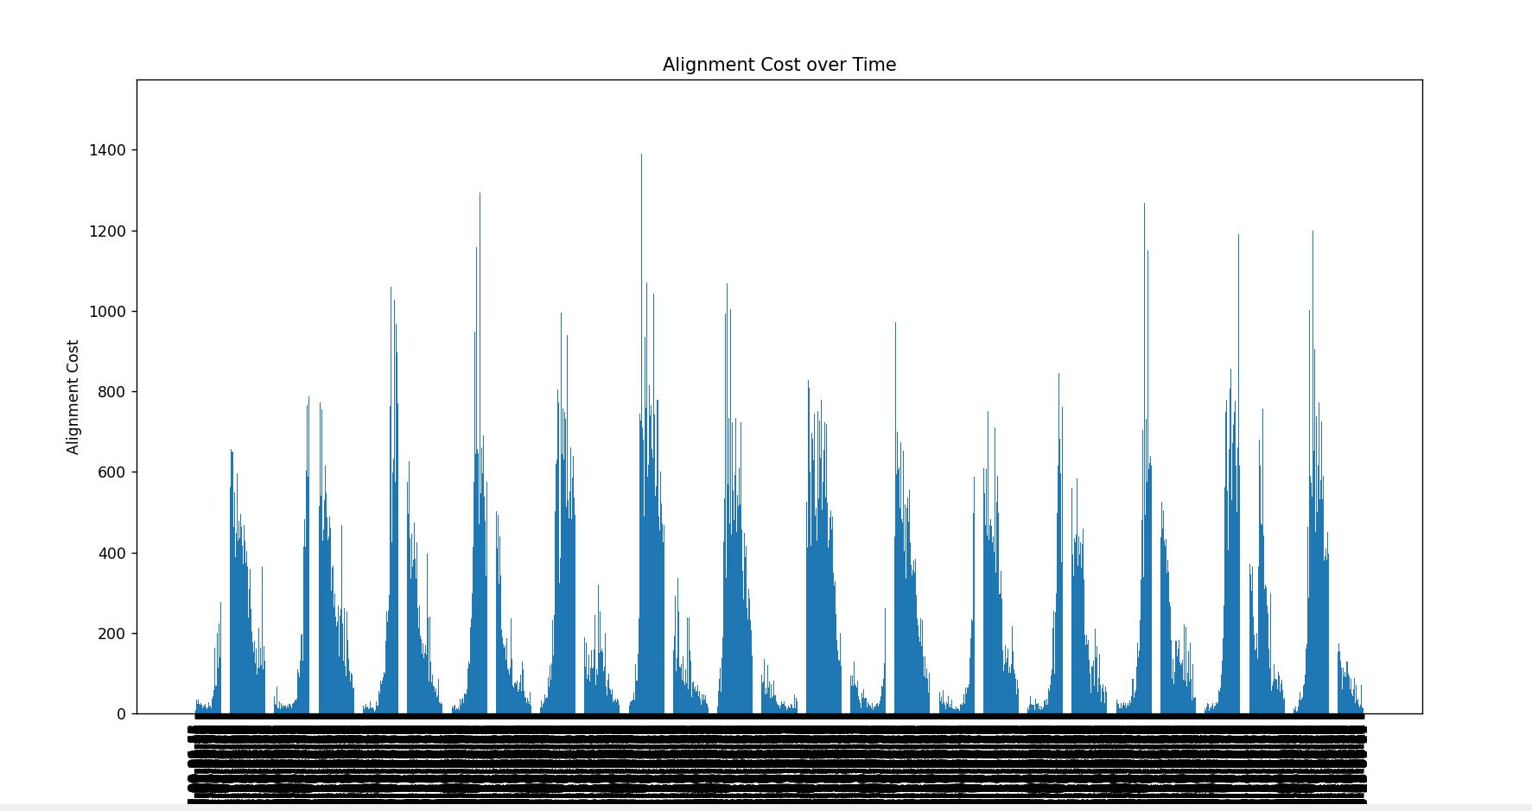
Alignment Cost

Slide 32
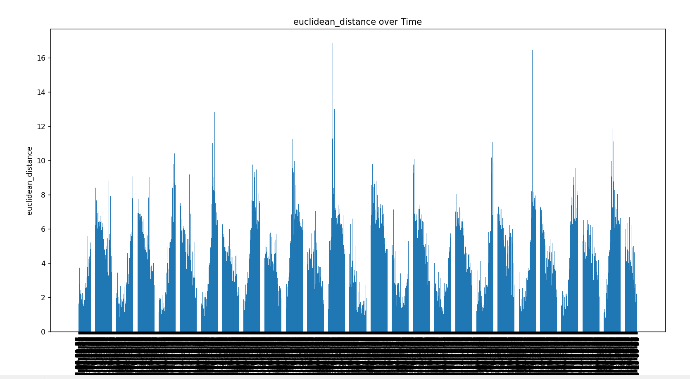
Euclidean Distance

Slide 33
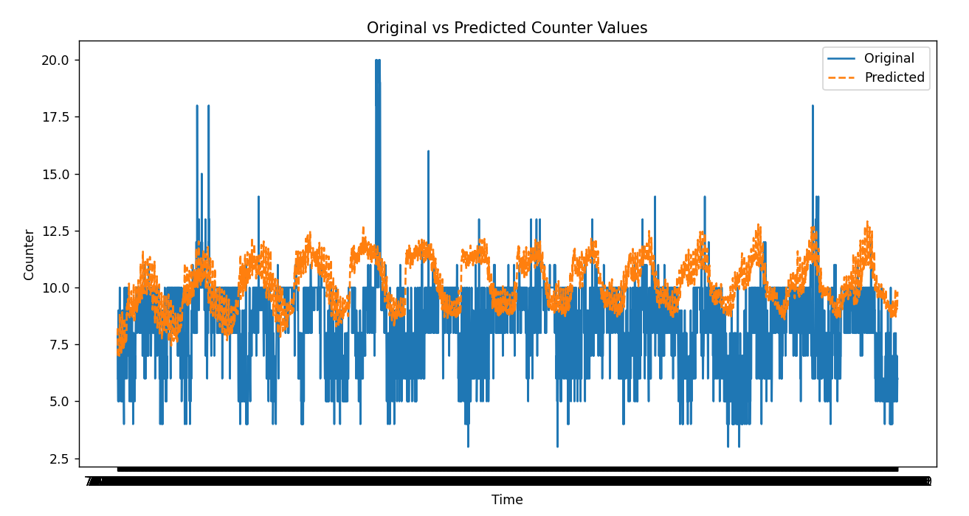
Max of unique MACs per 5min, thinking to set up a threshold over the real value(25%).

Slide 34
Logging
anomaly_type | date/time | zone | hashmac | description
anomaly type: invalid input, abnormal inflow, benign/malign data
associated zone and hashmac
data can be used my visualization team

Slide 35
Data Generation
Data Generated with the Python library Faker
Data replicates the original data from the data stream
Data are used to train the models to detect anomalies

Slide 36
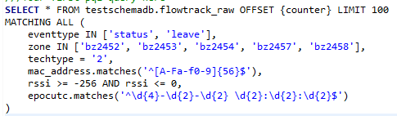
Injecting Anomaly Detection Functions with Odysseus Scripts
Initial attempt to create Odysseus functions but not possible with limited knowledge
Converting the code we have to PQL and injecting it to the sample of the original Odysseus script.

Slide 37
QUESTIONS

