Slide 1
RADAR: An In-Building RF-Based User Location and Tracking system
Paramvir Bahl and Venkata N. Padmanabhan
Microsoft Research
Presented by:
Ritu Kothari

Slide 2
Overview
Introduction
Related Work
Methodology
- The RADAR System
  - The RADAR Testbed
Algorithm and Experimental Analysis
- Empirical Method
- Radio Propagation Model
Enhancements to the Basic system
- Continuous User Tracking
- Profiling the Environment
- Effects of Multiple Floors
Conclusion

Slide 3
Introduction
User Location and Tracking (ULT)
  - User location problem
  - User Tracking problem
Issues in general
- Scalability
- Response Time
- Granularity
- Relocation
- Accuracy
Approach used in RADAR

Slide 4
Related Work
Location Tracking Systems Type:
  IR-Based Systems
  Active Badge
  Indoor RF Based
  Duress Alarm Location System
  3D-iD RF tag System
  Global Positioning System (GPS)
  Others
  Pulsed Magnetic Fields Based
  Ultra Sound Signals

Slide 5
The RADAR System
Implemented purely in software
Functional Components
- Base Stations (Access Points)
- Mobile Users
Fundamental Idea in RADAR
- Signal Strength is a function of the receiver’s location
- Road Maps
Techniques to build the Road Maps
- Empirical Method
- Radio Propagation Model
Search Techniques
- Nearest Neighbor in Signal Space (NNSS)
- NNSS Avg.
- Viterbi-like Algorithm

Slide 6
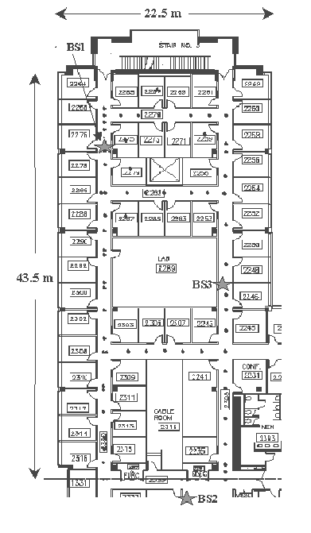
The RADAR Testbed
Base Station
- Pentium-based PC
- FreeBSD 3.0
Mobile Host
- Pentium Based laptop
- Windows 95
Enhanced RADAR
- Multiple Floors

Slide 7
Data Collection
Key Step in their approach
Records the Radio Signal as a function of the user location
Off-Line Phase
Real-Time Phase
Every packet received by the base station, the WiLIB extracts
- Signal Strength
- Noise floor at the transmitter
- Noise floor at the receiver
- MAC address of the transmitter

Slide 8
Data Processing
Traces collected from the off-line phase are unified into a table consisting of tuples of the format
[ x,y,d,ss(i),snr(i) ] I € {1,2,3}
Search Algorithm
- NNSS
- NNSS – Avg.
-Viterbi-like Algorithm
Layout Information

Slide 9
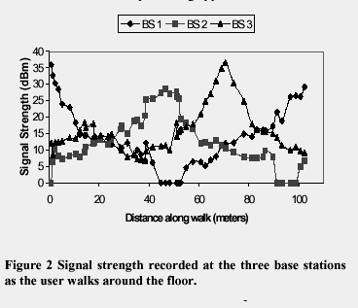
Algorithm and Experimental Analysis

Slide 10
Empirical Method
280 combinations of user location and orientation (70 distinct points, 4 orientations on each point)
Uses the above empirical data recorded in the off-line phase to construct the search space for the NNSS Algorithm
Algorithm (Emulates the user location problem)
1. Picks one location and orientation randomly
2. Searches for a corresponding match in the rest of the 69 points and orientations
Comparison with
- Strongest Base Station
- Random Selection

Slide 11
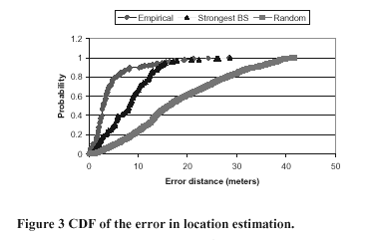
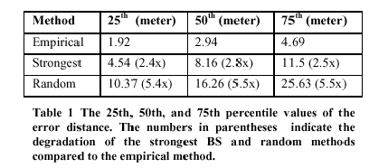
Error Distance Values

Slide 12
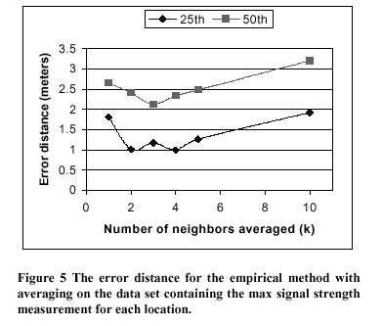
Empirical Method (Cntd.)
Multiple Nearest Neighbor
- Increases the accuracy of the Location Estimation
N1
T
G
N2
N3
Figure : Multiple Nearest Neighbors
T – True Location
G – Guess
N1,N2,N3 - Neighbors

Slide 13
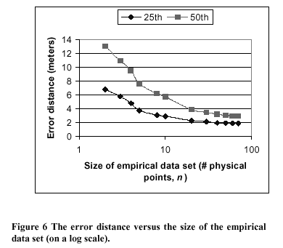
Empirical Method (Cntd. )
Impact of Number of Data Points

Slide 14
Empirical Method (Cntd. )
Impact of Number of Number of Samples
- Accuracy obtained by all the samples can be obtained if only a few samples are taken
No. Of Real-Time Samples | Error Distance degradation
1 | 30%
2 | 11%
3 | 4%
Impact of User Orientation
- Off-line readings for all orientations is not feasible
- Work around is to calculate the error distance for all combinations

Slide 15
Empirical Method (Cntd. )
Tracking a Mobile User
- Analogous to the user location problem
- New Signal Strength data set
- Window size of 10 samples
- 4 Signal Strength Samples every second
Limitation of Empirical Method
- To start off with needs an initial signal strength data set
- Relocation requires re-initialization of the initial data set.

Slide 16
Radio Propagation Model
Introduction
- Alternative method for extracting signal strength information
- Based on a mathematical model of indoor signal propagation
Issues
- Reflection, scattering and diffraction of radio waves
- Needs some model to compensate for attenuation due to obstructions
Models
- Rayleigh Fading Model : Infeasible
- Rician Distribution Model : Complex
- Wall Attenuation Factor

Slide 17

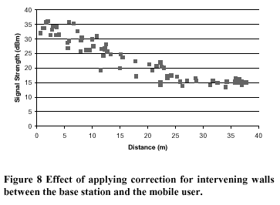
Wall Attenuation Factor

Slide 18
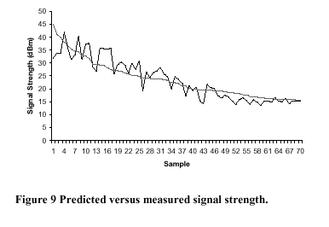
Radio Propagation Model (Cntd. )
Advantages:
- Cost Effective
- Easily Relocated

Slide 19
Future Work
User Mobility Profile
- Information about the likelihood of user’s current location based on old information
- Aliasing effect gets reduced to a large extent
Based Station based environmental profiling
- Adds robustness to the system
- Reduces inaccuracy
Effects of Multiple Floors
- Works Well
- One map for each floor
- Aliasing problem will increase

Slide 20
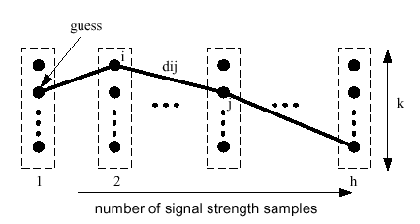
Continuous User Tracking
Viterbi-like Algorithm
1. NNSS search is done for k nearest neighbors in the signal space
2. History of depth h of k-NNSS is maintained
3. Weights are assigned to the edges, larger the edge weight lesser is the likelihood of the transition
Advantage
- Outperforms NNSS, NNSS-Avg.
- Reduces aliasing effect

Slide 21
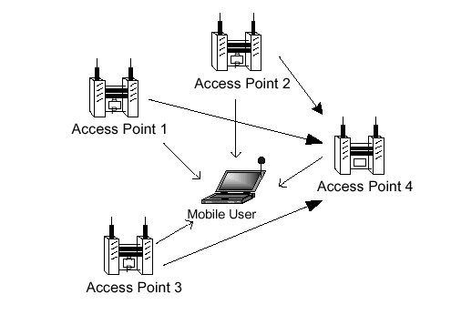
Profiling the Environment
Uses multiple Radio Maps based on different environments.

Slide 22
Conclusion
RF-based user location and tracking algorithm is based on
- Empirically measured signal strength model
-- Accurate
- Radio Propagation Model
-- Easily relocated.
RADAR could locate users with high degree of accuracy.
Median resolution is 2-3 meters, which is fairly good
Used to build “Location Services”
- printing to the nearest printer
- navigating through a building

Slide 23
Missing Pieces!!
No mention of the response time of the System
Not clear how well RADAR would work in a real-world
setting
Unsuitable for rapid development due to the initial infrastructure required
Security & Privacy Issues associated with localization.

Slide 24
Thanks!!

