Slide 1
計算機程式設計一: Unit 1

Slide 2
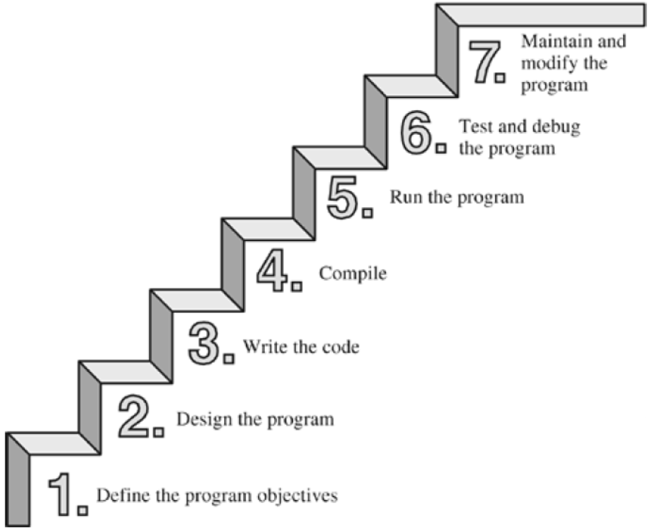
The seven steps of programming

Slide 3
Compiler and linker
Text editor
Compiler
  converts your source code to machine language code (object code)
Linker
  bring together object code into the executable file.
text editor
source code
hello.c
compiler (+ assembler)
object code
hello.obj
library code
linker
startup code
executable code
hello.exe

Slide 4
Programming in Integrated Development Environments
Open a new file
Write a “Hello world!”program
Compile the program
Run the program

Slide 5
C-Program Examples
Ex. 1: Print a string
Ex. 2: Print the sum of 1234 and 5678
Ex. 3: Read in an integer x from the keyboard, and print the integer x+1
Ex. 4: Read in two integers x and y from the keyboard, and print their sum
Ex. 5: An example that contains multiple functions
Ex. 6: Demonstrate the formatted outputs of integer and floating point numbers

Slide 6
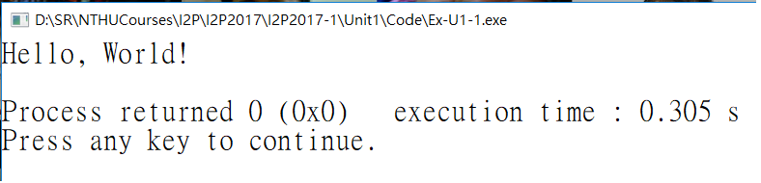
Ex. 1: Print a string
Note:
main function: The entry of a C program
  Return type: int for “integer” data type
  Parameters/arguments: void for “no”
A statement ends with a semicolon ‘;’.
  “…”: a C string
Header files:
  #include <stdio.h>
#include <stdio.h>
int main(void)
{
printf("Hello, World!\n");
return 0;
}
→ returns the 0 to OS to tell the OS that your program executed successfully

Slide 7
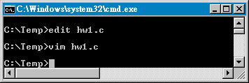

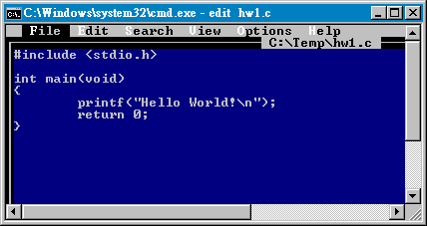
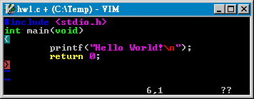
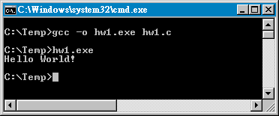
Compile in the command line

Slide 8
Ex. 2: Print the sum of 1234 and 5678
/* Can you understand the last example program? */
// Let’s try one more!
#include <stdio.h>
int main(void)
{
printf(“??\n", ?);
return 0;
}
Note:
Program comments
  /* */ or // (C99 or C++ one-line comment)
  Ignored by the compiler
  For human only
formatted output
  %d for an integer

Slide 9
Arithmetic Operators in C
Assume variable A holds 10 and variable B holds 20, then:
Operator | Description | Example
+ | Adds two operands | A + B will give 30
- | Subtracts second operand from the first | A - B will give -10
* | Multiplies both operands | A * B will give 200
/ | Divides numerator by de-numerator | B / A will give 2
% | Modulus Operator and remainder of after an integer division | B % A will give 0

Slide 10
Ex. 3: Read in an integer x from the keyboard, and print the integer x+1
#include <stdio.h>
int main(void)
{
int x=0;
scanf("??", ??);
printf("%d\n", x+1);
return 0;
}
Note:
Variable declaration
  Normally, at the beginning of a function
  int x -> x is a variable of “integer” data type
  The first character of a variable name must be a letter or an underscore. The other characters can also be digits
Assignment statement
  The = operator in C is used for assignment.

Slide 11
Ex. 4: Read in two integers x and y from the keyboard, and print their sum
#include <stdio.h>
int main(void)
{
int x,y;
scanf("%d",&x);
scanf("%d",&y);
printf("%d\n",x+y);
return 0;
}

Slide 12
Ex. 5: An example that contains multiple functions
#include <stdio.h>
int print(void);
int square(int);
int main(void)
{
print();
return 0;
}
int print(void)
{
printf("%d\n", square(5));
return 0;
}
int square(int x)
{
return x*x;
}
Note:
Function declarations (or prototyping) vs. function definitions
The sequential execution of functions

Slide 13
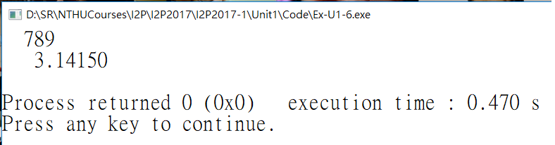
Ex. 6: Demonstrate the C formatted outputs
#include <stdio.h>
int main(void)
{
int x; // integer 32-bit
double y; // 64-bit double precision floating point number
x = 789;
y = 3.1415;
// formatted output
printf("%5d\n", x); // decimal
printf("%10.5f\n", y); // floating point
return 0;
}

