Slide 1
計算機程式設計一: Unit 10

Slide 2
Outline
Dynamic Memory Allocation: A Review
File Input/Output
String Utility Functions
C's Bitwise Operators

Slide 3
Outline
Dynamic Memory Allocation: A Review
File Input/Output
String Utility Functions
C's Bitwise Operators

Slide 4
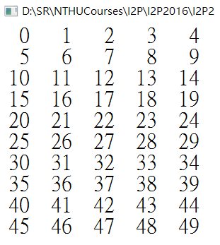
Dynamic Memory Allocation: malloc() and free()
#include <stdio.h>
#include <stdlib.h>
#define COLS 5
int main(void)
{
int i, j, rows=10;
int *a;//a is a pointer to an int
int (*b)[COLS];//b is a pointer to a 1-D array of COLS ints
a = (int *) malloc(rows * sizeof(int));
for (i = 0; i < rows; i++) a[i] = i;
b = (int (*)[COLS]) malloc(rows * COLS * sizeof(int));
for (i = 0; i < rows; i++) {
for (j = 0; j < COLS; j++) {
printf("%3d ", (b[i][j]=i*COLS+j));
}
printf("\n");
}
free(a);
free(b);
return 0;
}
Output：

Slide 5
Outline
Dynamic Memory Allocation
File Input/Output
String Utility Functions
C's Bitwise Operators

Slide 6
File Input/Output
C's standard I/O family of functions:
  fopen(), getc(), putc(), exit(), fclose()
  fprintf(), fscanf(), fgets(), fputs()
  rewind(), fseek(), ftell(), fflush()
  fgetpos(), fsetpos(), feof(), ferror()
  ungetc(), setvbuf(), fread(), fwrite()

Slide 7
#include <stdio.h>
void bubble_sort(int *, int);
int data[100000]; /* global array */
int main(void)
{
int num_data, i;
FILE *fin, *fout;
fin = fopen("data_50000.txt", "r");
/* 先讀出第一個數字 知道整個檔案總共包含幾筆資料 把這項資訊儲存在 num_data 中*/
fscanf(fin, "%d", &num_data);
/* 依序讀取檔案裏的每一筆資料 把資料存到 data 中*/
for (i = 0; i < num_data; i++) {
fscanf(fin, "%d", &data[i]);
}
See the next page

Slide 8
fclose(fin);
bubble_sort(data,num_data);
/* 把 data 陣列的內容儲存到檔案中 */
fout = fopen("data_50000_sorted.txt", "w");
for (i = 0; i < num_data; i++) {
fprintf(fout, " %d", data[i]);
}
fclose(fout);
return 0;
}

Slide 9
Outline
Dynamic Memory Allocation
File Input/Output
String Utility Functions
C's Bitwise Operators

Slide 10
C Library String Utility Functions
The C Library provides an extensive set of string utility functions, including functions for
  copying,
  concatenating,
  comparing, and
  searching strings.
Reference:
  http://www.gnu.org/software/libc/manual/html_node/String-and-Array-Utilities.html#String-and-Array-Utilities

Slide 11
String Comparison: strcmp, strncmp
int strcmp (const char *s1, const char *s2);
int strncmp (const char *s1, const char *s2, size_t size); //up to the first size characters
Note: The size_t type is whatever type the sizeof operator returns.
  C states that the sizeof operator returns an integer type, but it doesn't specify which integer type
  size_t can be unsigned int on one system and unsigned long on another

Slide 12
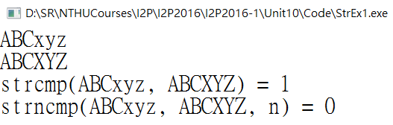
Note: the functions return
zero if the strings are the same;
less than zero if the first string is less than the second;
greater than zero if the first string is greater.
#include <stdio.h>
#include <string.h>
int main(void)
{
char str1[30];
char str2[30];
int n;
scanf("%29s", str1);
scanf("%29s", str2);
printf("strcmp(%s, %s) = %d\n", str1, str2, strcmp(str1, str2));
n = 3;
printf("strncmp(%s, %s, n) = %d\n", str1, str2, strncmp(str1, str2, n));
return 0;
}

Slide 13
String Copy: strcpy, strcat, strncpy
char * strcpy (char *restrict to, const char *restrict from);
char * strncpy (char *restrict to, const char *restrict from, size_t size);
char * strcat (char *restrict to, const char *restrict from);
You can use the restrict keyword as a qualifier for a function parameter that is a pointer.
  The compiler can assume that the pointer is the sole means to modify the pointed-to data within the body of the function.
  The compiler can try optimizations it might not otherwise use.

Slide 14
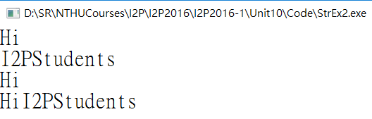
#include <stdio.h>
#include <string.h>
int main(void)
{
char str1[30];
char str2[30];
char str3[60] = "ABCDEFGHIJKL";
int n;
scanf("%29s", str1);
scanf("%29s", str2);
strcpy(str3, str1);
printf("%s\n", str3);
strcat(str3, str2);
printf("%s\n", str3);
return 0;
}
strcpy(s1, s2):
  This function copies the string (including the null character) pointed to by s2 to the location pointed to by s1.
  The return value is s1.
strcat(s1, s2):
  The string pointed to by s2 is copied to the end of the string pointed to by s1.
  The first character of the s2 string is copied over the null character of the s1 string.
  The return value is s1.

Slide 15
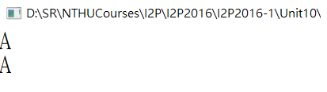
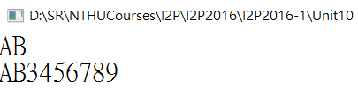
Case 1
#include <stdio.h>
#include <string.h>
int main(void)
{
char str1[30];
char str2[30] = "123456789";
int n;
scanf("%s", str1);
n = 2;
strncpy(str2, str1, n);
printf("%s\n", str2);
return 0;
}
Case 2
strncpy(s1, s2, n):
  This function copies to the location pointed to by s1 no more than n characters from the string pointed to by s2.
    If s2 is shorter than n characters, s1 is padded with null characters.
    If s2 has n or more characters, no null character is copied.
  The return value is s1.

Slide 16
memset, memcpy
void * memset (void *block, int c, size_t size);
  copies the value of c (converted to an unsigned char) into each of the first size bytes of the object beginning at block.
  It returns the value of block.
void * memcpy (void *restrict to, const void *restrict from, size_t size);
  copies size bytes from the object beginning at from into the object beginning at to.
  It returns the value of to.

Slide 17
Pointer-to-void 或 void *
C允許任何型別 (int, char, double, …) 的pointer被typecast成pointer-to-void。
pointer-to-void最常使用於傳遞generic參數給一個function。
  其用意是為了 “一般性”, 讓程式實際執行時, 各種被使用的 pointers (int, char, double等), 都可以被接受。

Slide 18
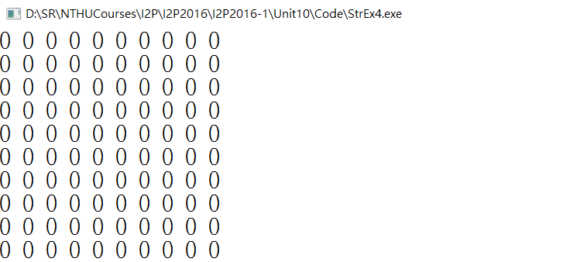
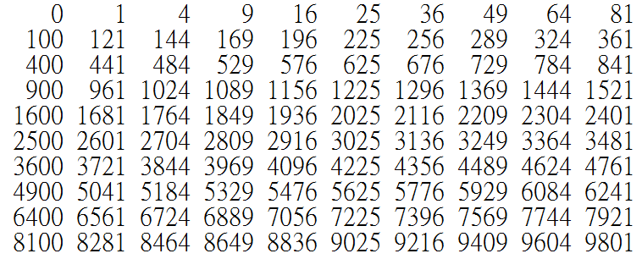
#include <stdio.h>
#include <string.h>
#define SIZE 100
int main(void)
{
int a[SIZE];
int b[SIZE];
int i;
memset(a, 0, SIZE*sizeof(int));
for (i=0; i<SIZE; i++) {
printf("%d ", a[i]);
if ((i+1)%10 == 0) printf("\n");
}
for (i=0; i<SIZE; i++) {
a[i] = i*i;
}
memcpy(b, a, SIZE*sizeof(int));
for (i=0; i<SIZE; i++) {
printf("%5d", b[i]);
if ((i+1)%10 == 0) printf("\n");
}
return 0;
}

Slide 19
Outline
Dynamic Memory Allocation
File Input/Output
String Utility Functions
C's Bitwise Operators

Slide 20
Bitwise Operators
All data are represented internally as sequences of bits
  Each bit can be either 0 or 1
  Sequence of 8 bits forms a byte
C offers bitwise logical operators and shift operators.

Slide 21
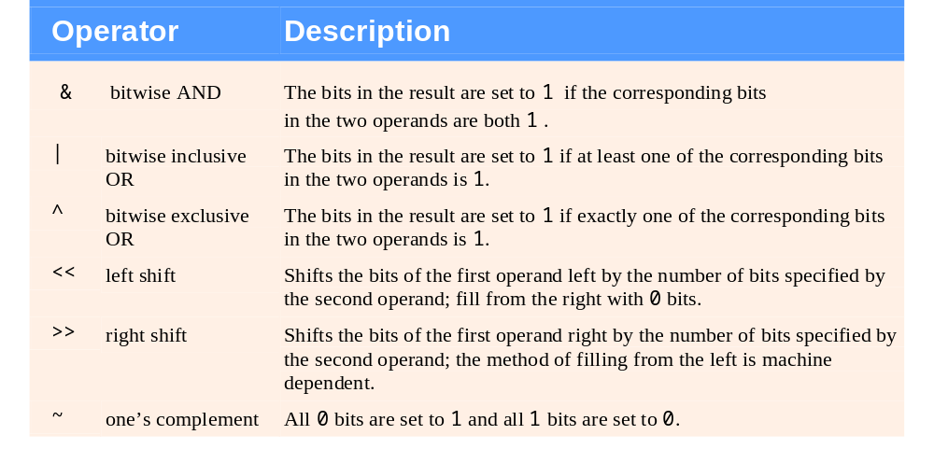
Bitwise Operators

Slide 22
& AND
0 & 0 = 0
0 & 1 = 0
1 & 0 = 0
1 & 1 = 1
00000000000000000000000001110100 -> 116
&
00000000000000000000000000101001 -> 41
----------------------------------------------------- 00000000000000000000000000100000 -> 32

Slide 23
| OR
0 | 0 = 0
0 | 1 = 1
1 | 0 = 1
1 | 1 = 1
00000000000000000000000001110100 -> 116
|
00000000000000000000000000101001 -> 41
----------------------------------------------------- 00000000000000000000000001111101 -> 125

Slide 24
^ XOR
0 ^ 0 = 0
0 ^ 1 = 1
1 ^ 0 = 1
1 ^ 1 = 0
00000000000000000000000001110100 -> 116
^
00000000000000000000000000101001 -> 41
----------------------------------------------------- 00000000000000000000000001011101 -> 93

Slide 25
~ NOT
~ 0 = 1
~ 1 = 0
~(00000000000000000000000000000011) -> 3
-----------------------------------------------------
(11111111111111111111111111111100) -> -4

Slide 26
Left Shift: <<
The left shift operator (<<)
  shifts the bits of the value of the left operand to the left by the number of places given by the right operand.
  The vacated positions are filled with 0s, and bits moved past the end of the left operand are lost.
(10001010) << 2 // expression
(00101000) // resulting value

Slide 27
Right Shift: >>
The right shift operator (>>)
  shifts the bits of the value of the left operand to the right by the number of places given by the right operand.
  For unsigned types, the places vacated at the left end are replaced by 0s.
  For signed types, the result is machine dependent:
    the vacated places may be filled with 0s, or
    they may be filled with copies of the sign (leftmost) bit.
(10001010) >> 2 // expression, signed value
(00100010) // resulting value, some systems
(10001010) >> 2 // expression, signed value
(11100010) // resulting value, other systems

Slide 28
Masking (1/3)
Masking using Bitwise &
  duplicate a part of a bit string while placing 0s in the nonduplicated part
  mask: indicate the bit positions to be duplicated with 1s and use 0s to indicate the nonduplicated positions
00010000
&
10111010
-------------
00010000

Slide 29
Masking (2/3)
Masking using Bitwise |
  duplicate a part of a bit string while putting 1s in the nonduplicated part
  mask: indicate the bit positions to be duplicated with 0s and use 1s to indicate the nonduplicated positions
11110000
|
10101010
-------------
11111010

Slide 30
Masking (3/3)
Masking using Bitwise ^
  A major use of the XOR operation is in forming the complement of a bit string.
  mask: XORing any byte with a mask of all 1s produces the complement of the byte.
11111111
^
10101010
-------------
01010101

Slide 31
A Masking Example: Power Set
Input
3
100 200 300
Output
空集合
100
200
100 200
300
100 300
200 300
100 200 300

Slide 32
A Masking Example: Power Set
 | mask: 001 | mask: 010 | mask: 100 | The subset
0: 000 | 000 | 000 | 000 | {}
1: 001 | 001 | 000 | 000 | {100}
2: 010 | 000 | 010 | 000 | {200}
3: 011 | 001 | 010 | 000 | {100, 200}
4: 100 | 000 | 000 | 100 | {300}
5: 101 | 001 | 000 | 100 | {100, 300}
6: 110 | 000 | 010 | 100 | {200, 300}
7: 111 | 001 | 010 | 100 | {100, 200, 300}
300
200
100

Slide 33
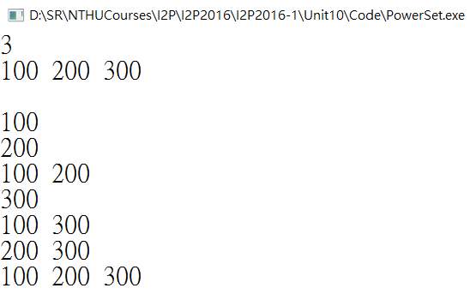
#include <stdio.h>
int mask[16] = {
0x00001, 0x00002, 0x00004, 0x00008,
0x00010, 0x00020, 0x00040, 0x00080,
0x00100, 0x00200, 0x00400, 0x00800,
0x01000, 0x02000, 0x04000, 0x08000 }; //support a set of up to 16 elements
int main(void)
{
int N, i, j, lim;
int num[16];
scanf("%d", &N);
for (i=0; i<N; i++) {
scanf("%d", &num[i]);
}
lim = 1<<N; //to get lim=2^N
for (i=0; i<lim; i++) {
for (j=0; j<N; j++) {
if ((i&mask[j])!=0) {
printf("%d ", num[j]);
}
}
printf("\n");
}
return 0;
}

