Slide 1
計算機程式設計一: Unit 3

Slide 2
Outline
Strings and Character Arrays
While-loop
Two-Dimensional Arrays

Slide 3
Outline
Strings and Character Arrays
While-loop
Two-Dimensional Arrays

Slide 4
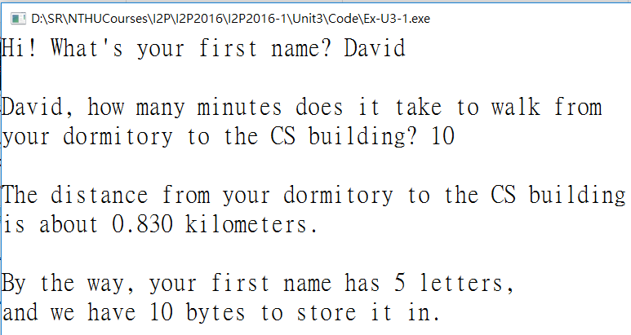
  #include <stdio.h>
  #include <string.h>
  #define SPEED 0.083
  int main(void)
  {
  float minutes, distance;
  int size, letters;
  char name[10];
  printf("Hi! What's your first name? ");
  scanf("%s", name);
  printf("\n%s, how many minutes does it take to walk from\n", name);
  printf("your dormitory to the CS building? ");
  scanf("%f", &minutes);
  size = sizeof(name);
  letters = strlen(name);
  distance = minutes * SPEED;
  printf("\nThe distance from your dormitory to the CS building\n");
  printf("is about %.3f kilometers.\n\n", distance);
  printf("By the way, your first name has %d letters,\n", letters);
  printf("and we have %d bytes to store it in.\n", size);
  return 0;
  }

Slide 5
Constants and the C Preprocessor
#define SPEED 0.083
int main (void)
{
distance = minutes * SPEED;
}
preprocessing
int main (void)
{
distance = minutes * 0.083;
}
compiling

Slide 6
Character Arrays vs. Strings
A string can be stored in a character array
  A string: “Stevie”
  A character array: char name[10];
  char name[10];
  name occupies 10-byte memory space, where each byte can store a character
  name itself also means the address of the memory space allocated to it (that is why we do not add ‘&’in front of name in scanf() )
  The null character ‘\0’ means the end of the string (with ASCII value 0)
S
t
e
v
i
e
\0

Slide 7
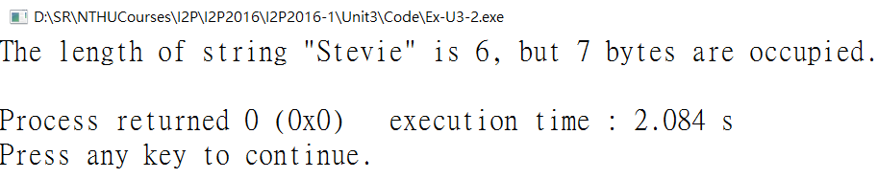
#include <stdio.h>
#include <string.h>
int main(void)
{
printf("The length of string \"%s\" is %d, but %d bytes are occupied.\n", "Stevie", strlen("Stevie"), sizeof("Stevie"));
return 0;
}

Slide 8
More on scanf()
For %d
  scanf() ignores the first Space or New Line characters，
  expects the first digit character，and starts to read in the integer，
  until the appearance of the first non-digit character, and stops，
  stores the integer (in decimal format) into the variable

Slide 9
More on scanf()
For %s
  scanf() ignores the first Space or New Line characters，
  starts reading from the first non-Space, non-New Line character，
  until the appearance of a Space or New Line character，and stores the collected string into the character array，
  also appends a null character '\0' at the end of the string in the character array，indicating the end of the string。

Slide 10
More on scanf(): A test program
#include <stdio.h>
int main(void)
{
char name[10];
int x = -1;
scanf("%d", &x);
scanf("%s", name);
printf("x = %d\n", x);
printf("name: \"%s\"\n", name);
return 0 ;
}

Slide 11
Outline
Strings and Character Arrays
While-loop
Two-Dimensional Arrays

Slide 12
While-loop
#include <stdio.h>
int main(void)
{
int n;
int i; //i is a counter for the while-loops
int x;
int sum;
int a[50];
printf("How many numbers? (n<50) ");
scanf("%d", &n);
i = 0;
while (i<n) {
printf("Input a[%d]: ", i);
scanf("%d", &x);
printf("The number is %d\n", x);
a[i] = x;
i = i + 1; //or i++;
}
i = 0;
sum = 0;
while (i<n) {
printf("%d + ", a[i]);
sum = sum + a[i];
i++;
}
printf("\b\b= %d\n", sum); //for what?
return 0;
}
How many numbers? (n<50) 5
Input a[0]: 10
The number is 10
Input a[1]: 20
The number is 20
Input a[2]: 30
The number is 30
Input a[3]: 40
The number is 40
Input a[4]: 50
The number is 50
10 + 20 + 30 + 40 + 50 = 150

Slide 13
Flow chart of “while” loop
Initial conditions
while (looping condition)
No
(looping condition is violated)
Statements after the loop
Yes (looping condition is satisfied)
/* do something */
update the states
of variables.

Slide 14
Flow chart of “while” loop
scanf("%d",&n);
i = 0;
while (i<n)
No
(i>=n)
return 0;
Yes (i<n)
printf("Input a[%d]:", i);
scanf("%d", &x);
printf("The number is %d\n", x);
a[i] = x;
i = i + 1;

Slide 15
While-loop
Note:
  “where you initialize the related variables”;
  “the entry condition of the loop logically correct?”;
  “the related variables updated correctly?” (otherwise, the loop will not stop successfully)

Slide 16
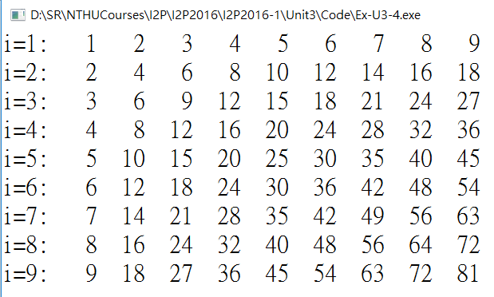
Nested While-loops
#include <stdio.h>
int main(void)
{
int i, j;
i = 1;
while (i<=9) {
printf("i=%d: ", i);
j = 1;
while (j<=9) {
printf("%3d ", i*j);
j++;
}
printf("\n");
i++;
}
return 0;
}

Slide 17
Flow chart of nested while
Initial conditions
while
(condition)
No
Statements after the loop
Yes
Original single layer loop
/* do something */
Initial conditions
No
while
(condition)
/* do something */
Yes
/* do something */

Slide 18
Outline
Strings and Character Arrays
While-loop
Two-Dimensional Arrays

Slide 19
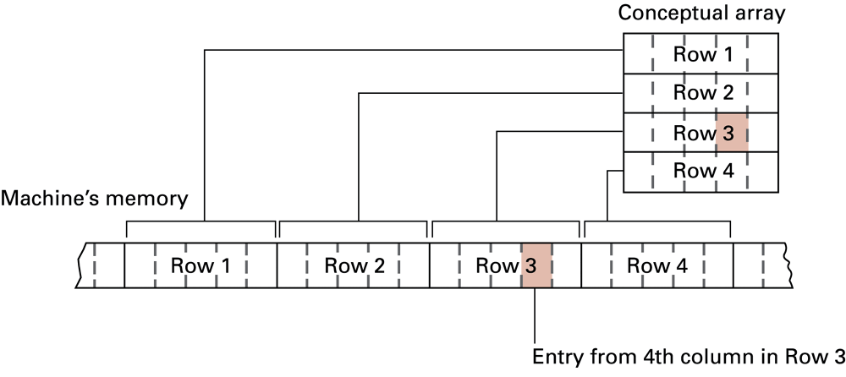
Two-Dimensional Arrays
int a[5][5]; //a 5-by-5 two-dimensional array
a[0][0] | a[0][1] | a[0][2] | a[0][3] | a[0][4]
a[1][0] | a[1][1] | a[1][2] | a[1][3] | a[1][4]
a[2][0] | a[2][1] | a[2][2] | a[2][3] | a[2][4]
a[3][0] | a[3][1] | a[3][2] | a[3][3] | a[3][4]
a[4][0] | a[4][1] | a[4][2] | a[4][3] | a[4][4]

Slide 20
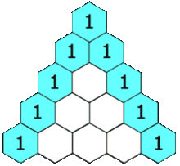
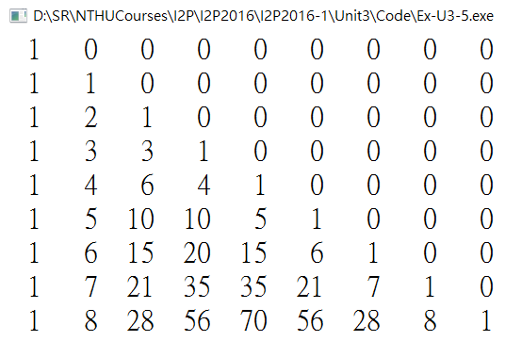
Ex: Pascal Triangle
#include <stdio.h>
int main(void)
{
int i, j; // for the two-layer while-loop
int a[10][10] = {1}; //The first element a[0][0] is initialized as 1 and all others as 0.
i = 1;
while (i<=9){
j = 1;
while (j<=9){
a[i][j] = a[i-1][j-1]+a[i-1][j];
j = j + 1;
}
i = i + 1;
}
/* show the content of a */
i = 1;
while (i<=9){
j = 1;
while (j<=9){
printf("%3d ", a[i][j]);
j = j + 1;
}
printf("\n");
i = i + 1;
}
return 0;
}

