Slide 1
計算機程式設計一: Unit 5

Slide 2
Outline
C Control Statements: Looping
C Control Statements: Branching
Logical Operators

Slide 3
Outline
C Control Statements: Looping
C Control Statements: Branching
Logical Operators

Slide 4
C Control Statements: Looping
Repeating a sequence of statements until some condition is met (looping)
  The while loop
  The for loop
  The do while loop

Slide 5
The while loop: review
#include <stdio.h>
int main(void)
{
int x;
while (scanf("%d", &x) != EOF) { /*Ctrl Z + Enter */
printf("x=%d\n", x);
}
return 0;
}
The return value of scanf()
  The function returns the number of items of the argument list successfully filled.
    This count can match the expected number of items or be less (even zero) due to a matching failure, a reading error, or the reach of the end-of-file.
  If the end-of-file is reached while reading, EOF is returned.

Slide 6
Exercise: What’s wrong with the code?
#include <stdio.h>
int main(void)
{
long num;
long sum = 0L;
int status;
printf("Please enter an integer to be summed ");
printf("(q to quit): ");
status = scanf("%ld", &num); /* %ld for long, status is the return value */
while (status = 1) {
sum = sum + num;
printf("Please enter next integer (q to quit): ");
status = scanf("%ld", &num);
}
printf("Those integers sum to %ld.\n", sum);
return 0;
}

Slide 7
The for loop
Form:
for (initialize ; test ; update)
statement
The loop is repeated until test becomes false or zero.

Slide 8
Flow chart of “for” loop
initialize
for (looping condition: test)
No
(looping condition is violated)
Statements after the loop
update
Yes (looping condition is satisfied)
Statement

Slide 9
#include <stdio.h>
int main(void)
{
char ch;
for (ch = 'a'; ch <= 'z'; ch++) {
printf("The ASCII value for %c is %d.\n", ch, ch);
}
return 0;
}

Slide 10
#include <stdio.h>
#define CODE 7
int main(void)
{
int num = 0;
for (printf("Keep entering numbers!\n"); num != CODE; ) {
scanf("%d", &num);
}
printf("Bingo!\n");
return 0;
}

Slide 11
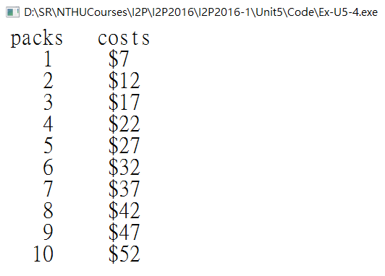
#include <stdio.h>
#define FIRST_PACK 7
#define NEXT_PACK 5
int main(void)
{
int n, cost;
printf(" packs costs\n");
for (n=1, cost=FIRST_PACK ; n<=10 ; n++, cost += NEXT_PACK) {
printf("%5d $%-5d\n", n, cost);
}
return 0;
}
More Assignment Operators: +=, -=, *=, /=, %=
  a += b is the same as a = a + b.
  a -= b is the same as a = a - b.
  a *= b is the same as a = a * b.
  a /= b is the same as a = a / b.
  a %= b is the same as a = a % b.

Slide 12
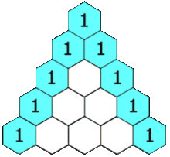
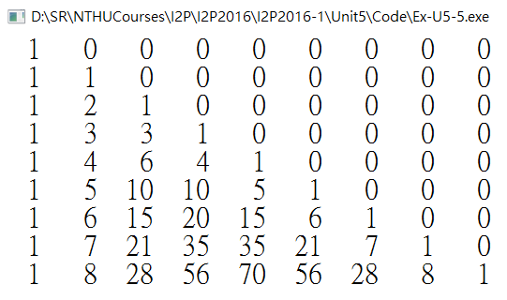
Nested for-loops: Pascal Triangle again
#include <stdio.h>
int main(void)
{
int i, j; // for the two-layer while-loop
int a[10][10] = {1}; //The first element a[0][0] is initialized as 1 and all others as 0.
i = 1;
while (i<=9){
j = 1;
while (j<=9){
a[i][j] = a[i-1][j-1]+a[i-1][j];
j = j + 1;
}
i = i + 1;
}
/* show the content of a */
i = 1;
while (i<=9){
j = 1;
while (j<=9){
printf("%3d ", a[i][j]);
j = j + 1;
}
printf("\n");
i = i + 1;
}
return 0;
}

Slide 13
The do while: An Exit-Condition Loop
The while loop and the for loop are both entry-condition loops.
  The test condition is checked before each iteration of the loop
C also has an exit-condition loop: do while loop
  The test condition is checked after each iteration of the loop
  guaranteeing that statements are executed at least once

Slide 14
#include <stdio.h>
#define CODE 13
int main(void)
{
int code_entered;
printf("Please enter the secret code number: ");
scanf("%d", &code_entered);
while (code_entered != CODE) {
printf("Please enter the secret code number: ");
scanf("%d", &code_entered);
}
printf("Bingo!\n");
return 0;
}

Slide 15
#include <stdio.h>
#define CODE 13
int main(void)
{
int code_entered;
do {
printf("Please enter the secret code number: ");
scanf("%d", &code_entered);
} while (code_entered != CODE);
printf("Bingo!\n");
return 0;
}

Slide 16
Outline
C Control Statements: Looping
C Control Statements: Branching
Logical Operators

Slide 17
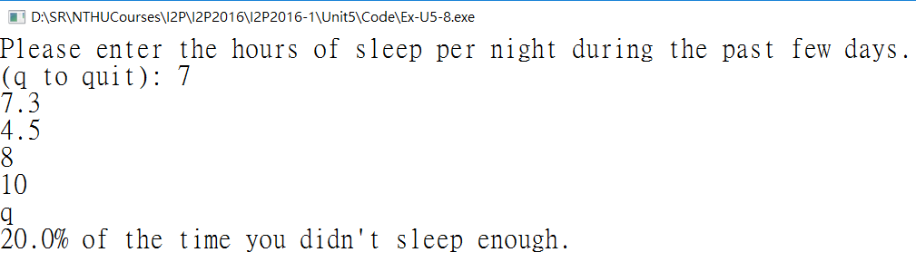
#include <stdio.h>
#define PAR 5
int main(void)
{
float hours;
int tired_days = 0;
int all_days = 0;
printf("Please enter the hours of sleep per night during the past few days.\n");
printf("(q to quit): ");
while (scanf("%f", &hours) == 1) {
all_days++;
if (hours < PAR) {
tired_days++;
}
}
if (all_days != 0)
printf("%.1f%% of the time you didn't sleep enough.\n",
100.0 * (float) tired_days / all_days);
if (all_days == 0)
printf("No data entered!\n");
return 0;
}

Slide 18
The if Statement
The if statement is called a branching statement or selection statement
  it provides a junction where the program has to select which of two paths to follow.
Form:
if (expression)
statement
  If expression evaluates to true (nonzero), statement is executed.
  Otherwise, it is skipped.

Slide 19
The if else Statement
  if (all_days != 0)
  printf("%.1f%% of the time you didn't sleep enough.\n",
  100.0 * (float) tired_days / all_days);
  if (all_days == 0)
  printf("No data entered!\n");
  if (all_days != 0)
  printf("%.1f%% of the time you didn't sleep enough.\n",
  100.0 * (float) tired_days / all_days);
  else
  printf("No data entered!\n");

Slide 20
The if else Statement
Form:
if (expression)
statement1
else
statement2
  If expression is true (nonzero), statement1 is executed.
  If expression is false or zero, statement2 following the else is executed.

Slide 21
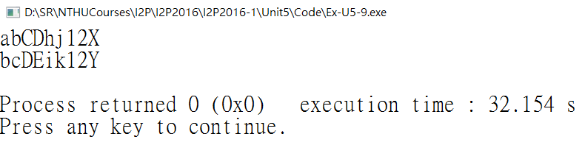
int getchar ( void ); //defined in stdio.h
  Get a character from the standard input (stdin)
  Returns the next character from stdin.
    promoted to an int value
int putchar ( int character ); //defined in stdio.h
  Write a character to the standard output (stdout)
  On success, the character written is returned.
#include <stdio.h>
#include <ctype.h>
int main(void)
{
char ch;
while ((ch = getchar()) != '\n') {
if (isalpha(ch)) /* if a letter, */
putchar(ch+1); /* change */
else /* otherwise, */
putchar(ch); /* print as is */
}
putchar(ch); /* What??? */
return 0;
}

Slide 22
The ctype.h Character-Testing Functions
Name | True If the Argument Is
isalnum() | Alphanumeric (alphabetic or numeric)
isalpha() | Alphabetic
isblank() | A standard blank character (space, horizontal tab, or newline) or any additional locale-specific character so specified
iscntrl() | A control character, such as Ctrl+B
isdigit() | A digit
isgraph() | Any printing character other than a space
islower() | A lowercase character
isprint() | A printing character
ispunct() | A punctuation character (any printing character other than a space or an alphanumeric character)
isspace() | A whitespace character (a space, newline, formfeed, carriage return, vertical tab, horizontal tab, or, possibly, other locale-defined character)
isupper() | An uppercase character
isxdigit() | A hexadecimal-digit character

Slide 23
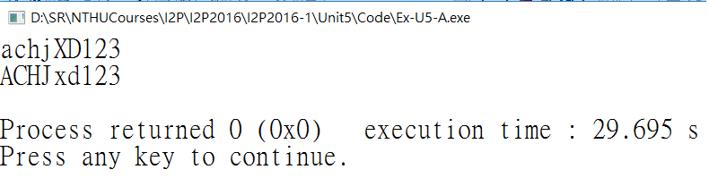
#include <stdio.h>
#include <ctype.h>
int main(void)
{
char ch;
while ((ch = getchar()) != '\n') {
if (isupper(ch)) { /* line 8 */
ch = tolower(ch); /* line 9 */
}
else if (islower(ch)) { /* line 10 */
ch = toupper(ch); /* line 11 */
}
putchar(ch);
}
putchar(ch);
return 0;
}

Slide 24
The ctype.h Character-Mapping Functions
Name | Action
tolower() | If the argument is an uppercase character, this function returns the lowercase version; otherwise, it just returns the original argument.
toupper() | If the argument is a lowercase character, this function returns the uppercase version; otherwise, it just returns the original argument.

Slide 25
Multiple Choice else if
Form:
if (expression1)
statement1
else if (expression2)
statement2
else
statement3
  If expression1 is true, statement1 is executed.
  If expression1 is false but expression2 is true, statement2 is executed.
  Otherwise, if both expressions are false, statement3 is executed.

Slide 26
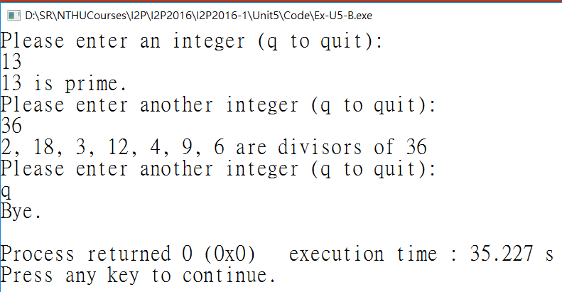
Problem: Find all divisors.
#include <stdio.h>
int main(void)
{
unsigned long num, div;
int isPrime; //flag
printf("Please enter an integer (q to quit): \n");
while (scanf("%lu", &num) == 1) {
for (div = ???, isPrime = ???; ???; ???) {
if (??? % ??? == 0) {
if ((div * div) != num)
printf("%lu, %lu, ", ???, ???);
else
printf("%lu, ", div);
isPrime = 0;
}
}
if (???==???)
printf("%lu is prime.\n", num);
else
printf("\b\b are divisors of %lu\n", num);
printf("Please enter another integer (q to quit): \n");
}
printf("Bye.\n");
return 0;
}

Slide 27
Outline
C Control Statements: Looping
C Control Statements: Branching
Logical Operators

Slide 28
Logical Operators
Operator Meaning
&& and
|| or
! not
Self-exercise: for x=5, y=3
x > 2 && y == 3
!(x < 2 || y == 3)
x != 0 && y
x == 0 || !y
x != y && (20/x) < y
!(y > 5 || y < 2) && !(x%5)
!x && x

Slide 29
A Math Problem
Find the smallest N that satisfies
N % x == a
N % y == b
N % z == c
For example,
if x=3, y=5, z=7, and a=2, b=3, c=4,
then, N is 53 since
53 % 3 == 2
53 % 5 == 3
53 % 7 == 4
and 53<=3*5*7.
Another test case:
Input:
23 29 37
10 20 30
Output:
14201
Chinese Remainder Theorem!

Slide 30
#include <stdio.h>
int main(void)
{
int x, y, z;
int a, b, c;
int i;
int found=0; //0 means not-found
scanf("%d%d%d", &x, &y, &z);
scanf("%d%d%d", &a, &b, &c);
for (i=1; i<=???; i++) {
if(???)
if (???) {
found=1; //An easier approach is: using break
printf("%d\n", i);
}
}
return 0;
}

