Slide 1
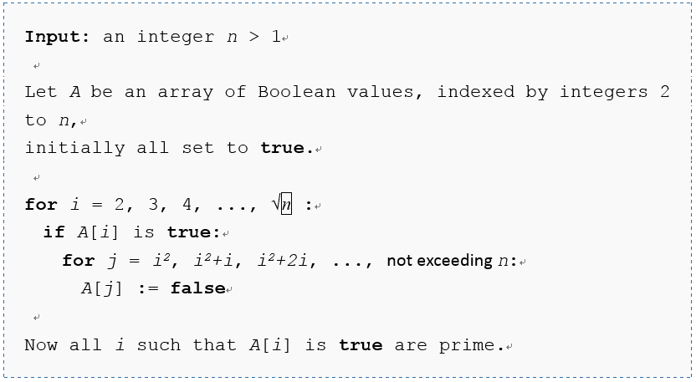
Problem: List the prime numbers between 2 and N.
Pseudo code
  From http://en.wikipedia.org/wiki/Sieve_of_Eratosthenes

Slide 2
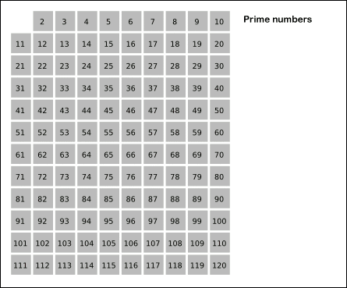
Problem: List the prime numbers between 2 and N.
  From http://en.wikipedia.org/wiki/Sieve_of_Eratosthenes

Slide 3
  #include <stdio.h>
  #define N 120
  int A[N+1];
  int main(void)
  {
  int i,j;
  for(i = 0;i<=N;i++)
  ???;
  for(i = ???;???;i++){
  if(???){
  for(j=???;j<=???;???){
  ???;
  }
  }
  }
  for(i = 2;i<=N;i++){
  if(???)
  printf("%d\n",i);
  }
  return 0;
  }

