Slide 1
Bubble Sort (氣泡排序)
< First Pass >
5
1
4
2
8
1
5
4
2
8
Step1:
Compare each pair of adjacent elements from the beginning to the end of the array and, if they are in reversed order, swap them.
Note: After each pass, the place of one number can be determined.
Step2:
Repeat Step1 for N-1 times.
1
4
5
2
8
1
4
2
5
8
< Second Pass >
1
4
2
5
8
1
4
2
5
8
1
2
4
5
8
< Third Pass >
1
2
4
5
8
1
2
4
5
8
< (5-1=4)-th Pass >
Done
1
2
4
5
8

Slide 2
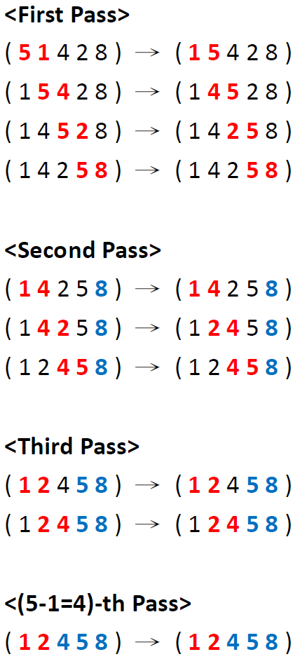
How to program bubble sort (1/2)
void bubblesort(int *ap, int n) {
int i, j, temp;
for (i = 0; i < ???; i++) { // needs n-1 passes
for (j = 0; j < ???; j++) {
// ???
}
}
}
Only the remaining numbers need to be compared.

Slide 3
How to program bubble sort (2/2)
void bubblesort (int *ap, int n) {
int i, j, temp;
for (i = 0; i < n-1; i++) {
for (j = 0; j < n-1-i; j++) {
if (ap[j] > ap[j + 1]) {
temp = ap[j];
ap[j] = ap[j + 1];
ap[j + 1] = temp;
}
}
}
}

