Slide 1
Introduction to Programming(II) Week 12: Design Pattern: Iterator
李哲榮

Slide 2
Makeup exam on 6/2
只考兩題，範圍是第二次期中考練習題加第二次期中考題，每題5分，共10分。
成績高於5分(包含)的人可以直接參加補考，期中考分數會是 Y+(1-Y)*X/20
Y: 原期中考的成績
X: 補考成績
成績低於5分的同學如果也想補考，請先給助教證明你期中考練習題和期中考題都有做，也都過了，才可以參加補考。

Slide 3
Written exam
There will be a written exam on 5/29.
The sample exam has been put on ilms.

Slide 4
Object-oriented design
Encapsulation (封裝): Data and methods to manipulate data (function) are tightly coupled, and others should not change them arbitrarily.
Inheritance (繼承): Data and functions should have a hierarchy so that the common part of data or actions (functions) can be reused.
Polymorphism (多型): which actions to take depends on which object (data) is involved in the runtime.

Slide 5
Linked List
The elements of Linked List are nodes
Assume each node has data and *next and the head of linked list is pointed by *head
To traverse a linked list
Users need to know the internal implementation of linked list, like head, data, next.
Bad encapsulation
for (Node* p=head; p!=nullptr; p=p->next)
// do some thing to p->data

Slide 6
Design Patterns
In software engineering, a design pattern is a general repeatable solution to a commonly occurring problem in software design. A design pattern isn't a finished design that can be transformed directly into code. It is a description or template for how to solve a problem that can be used in many different situations.
https://sourcemaking.com/design_patterns

Slide 7
Example: Iterators
Provide a way to access the elements of an aggregate object sequentially without exposing its underlying representation.
User program
Get iterator
Linked List
New
Begin
End?
Current element
Next element
Iterator

Slide 8
How does an iterator work?
User programs ask a Linked List object to create an iterator object.
User programs use the member functions of iterator to access the elements of Linked List.
first(): get the first element of Linked List
end(): check if the traversal is done
next(): get the next element
current_item(): get the current item

Slide 9
How to design an iterator?
Design an "iterator" class that can encapsulate traversal of the "collection" class.
Basically it should include those four functions
Grant the "iterator" class privileged access.
In C++, you can declare it as a friend class
In general, declare it as an nested class
Nested class
class OuterClass { class InnerClass { // .... }; };

Slide 10
Example: Linked List with Iterator
class LinkedList{
struct Node{ int data; Node *next;};
Node *head, *tail;
public:
friend class LLIterator;
class LLIterator {…};
LinkedList();
~LinkedList();
void pushBack(int in);
LLIterator begin();
LLIterator end();
};

Slide 11
Example: LLIterator
class LLIterator {
LinkedList::Node *curr;
public:
LLIterator() ;
LLIterator(LinkedList::Node *head);
LLIterator(const LLIterator& it);
~LLIterator();
LLIterator& operator=(const LLIterator&);
bool operator!=(const LLIterator& it);
LLIterator& operator++();
int& operator*();
};

Slide 12
Example: using Linked List
LinkedList L1;
for (int i=0; i<5; i++)
L1.pushBack(2*i);
LinkedList::LLIterator it;
for (it = L1.begin(); it != L1.end(); ++it){
cout << *it << " ";
}
cout << endl;

Slide 13
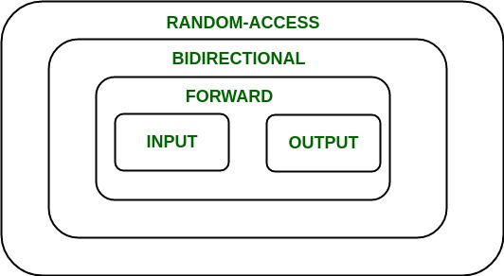
Iterators in C++
An iterator is an object (like a pointer) that points to an element inside the container.
Five categories of iterators

Slide 14
Types of iterators
Input: can only be used in a single-pass algorithms, for accessing elements.
Output: can only be used in single-pass algorithm, for being assigned elements.
Forward: can only move in forward direction.
Bidirectional: can move in both directions.
Random-Access: can randomly access any element inside the container.

Slide 15
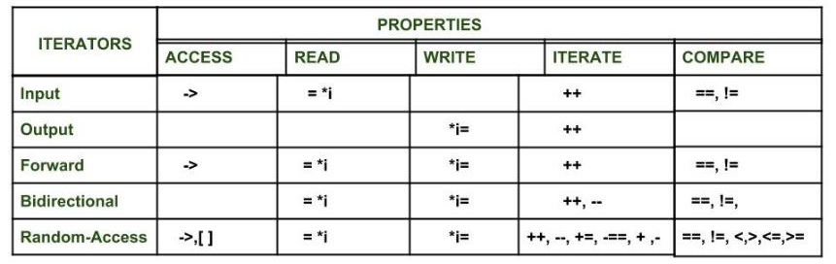
Properties of iterators

