Slide 1
Introduction to Programming(II) Week 16: Artificial Intelligence
李哲榮

Slide 2
Human vs. machine
Can machines fly?
Can machines swim?
Four goals in AI
Thinking rationally:
Thinking humanly:
Acting humanly:
Acting rationally:
Machines that think rationally.
Machines that act rationally
Machines that think like humans.
Machines that act like humans

Slide 3
Thinking rationally

Slide 4
Thinking Rationally
Goal: develop a program which can solve the problem itself - the ability to make decisions, draw conclusions (i.e., perform elementary reasoning activities)
Recall our problem solving methods
Ex: water pouring problem
Ex: your final project
Ex: 8 puzzle problem https://acm.cs.nthu.edu.tw/contest/1359/

Slide 5
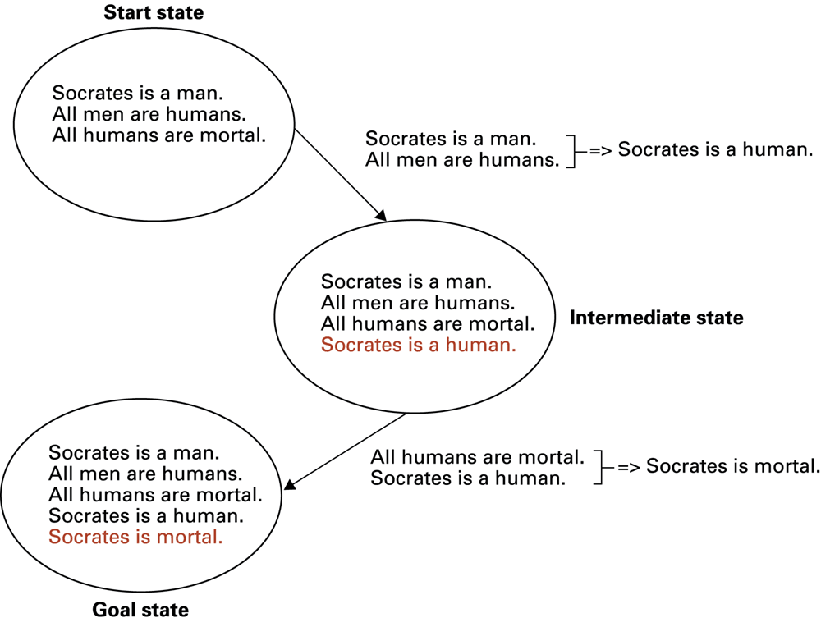
Logic Inference

Slide 6
Components of problem reasoning
A collection of states: start state, goal state, …
A collection of productions (rules, moves)
An operation to be performed to move from one state to another under some preconditions
The conditions must be satisfied
It has the logic to solve the problem
The start state ⇒ the goal state
It selects one of the allowable productions to be the next one

Slide 7
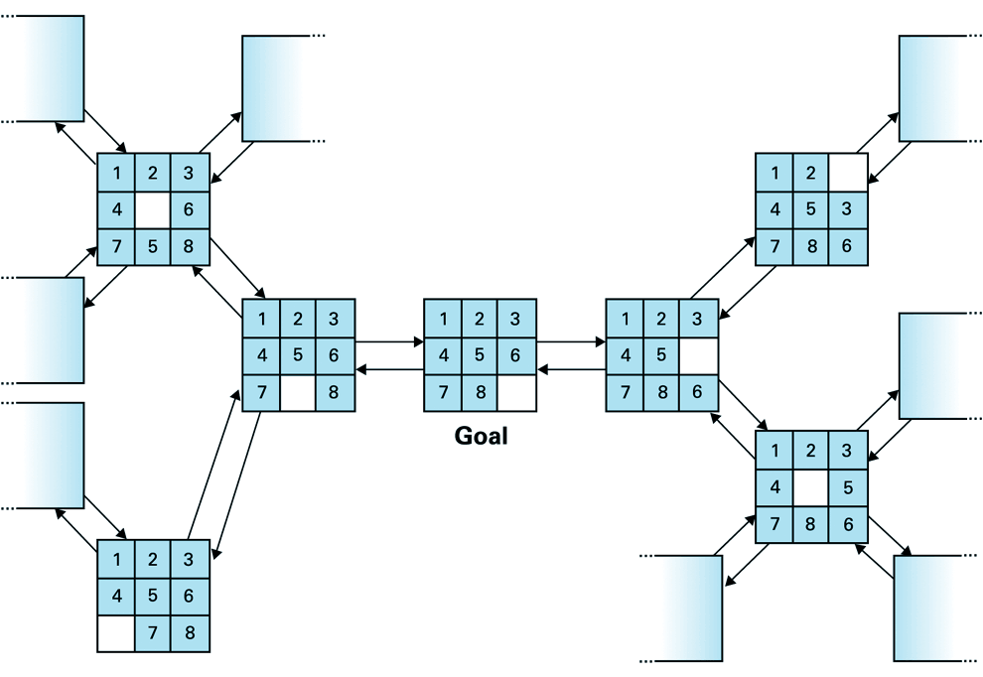
Ex: 8 puzzle problems

Slide 8
How to solve it?
How to represent the state of the game?
How to expand the current state?
How to show the solution?
Remember the path from the initial to the goal.
1 | 3 | 5
4 | 2
7 | 8 | 6
1 | 2 | 3
4 | 5 | 6
7 | 8
Final state
1 | 3
4 | 2 | 5
7 | 8 | 6
1 | 3 | 5
4 |  | 2
7 | 8 | 6
1 | 3 | 5
4 | 2 | 6
7 | 8

Slide 9
Production Systems
State graph = states, productions, and preconditions
Search tree = record of state transitions explored while searching for a goal state
Breadth-first search
Depth-first search
Best search
A* algorithm
…

Slide 10
How to implement it?
How to search all the possible states systematically?
Using BFS. Using queue to implement BFS
How to avoid the searching/expanding of repeated states?
Using set to remember visited states
How to record the path of the solution
Keep tracking the relation of parent state and the child state.

Slide 11
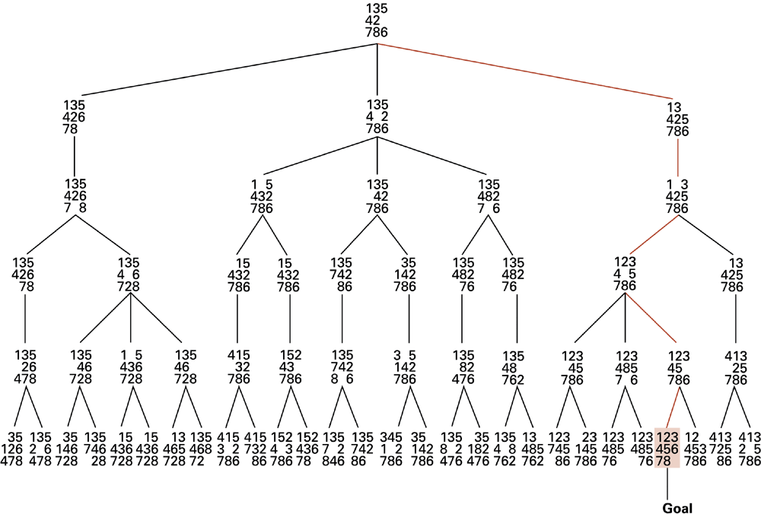
Example: 8 puzzle’ Search Tree

Slide 12
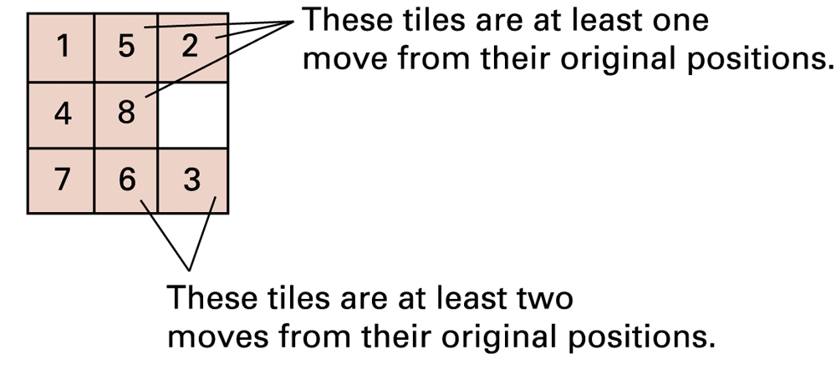
Heuristic Strategy
Requirements for good heuristics
Must be much easier to compute than a complete solution
Must provide a reasonable estimate of proximity to a goal
Ex: 8 puzzle distance to the goal is 3*1+2*2=7

Slide 13
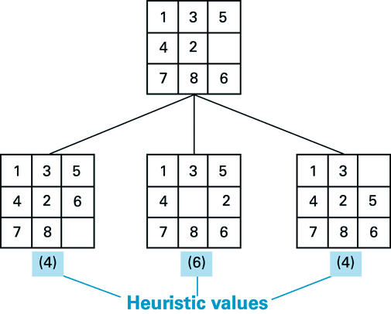
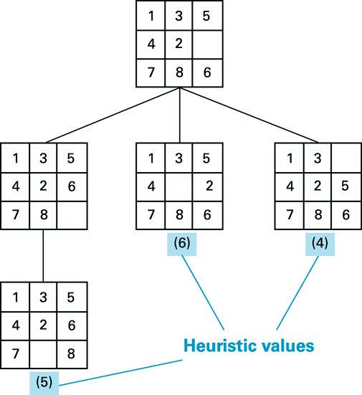
Example: best search (greedy)
Explore the states with the smallest heuristic value first

Slide 14
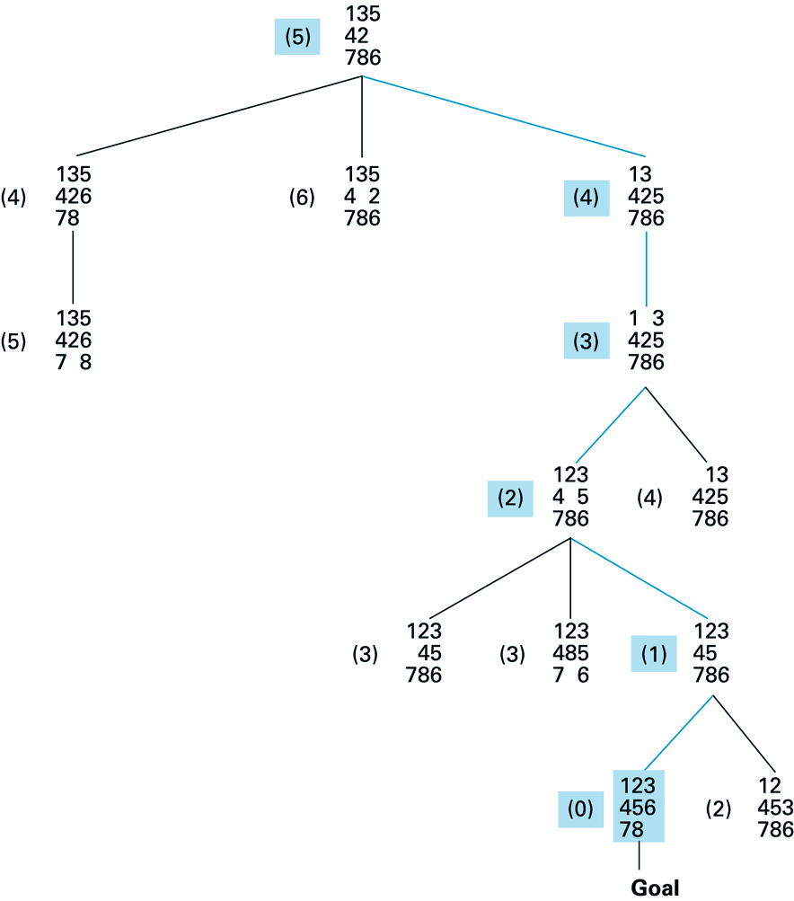
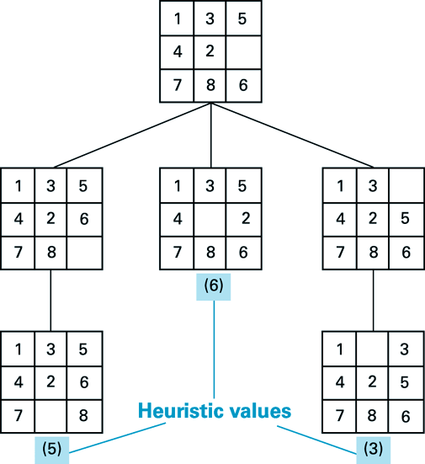

Slide 15
A* algorithm
A* is a best-first search, which selects the path that minimizes
f(n)=g(n)+h(n)
n is the next node on the path,
g(n) is the cost of the path from the start node to n,
h(n) is a heuristic function that estimates the cost of the cheapest path from n to the goal.

Slide 16
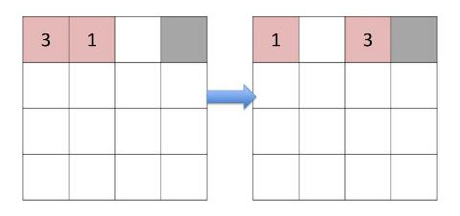
Heuristic function h(n)
If the heuristic function is admissible, meaning that it never overestimates the actual cost to get to the goal, A* is guaranteed to return a least-cost path from start to goal.
For the n²-1 slide game, there are several admissible heuristics
Manhattan distance
Linear conflict
Patten database search
…
https://www.slideserve.com/sofia/heuristic-search

Slide 17
Priority queue
Best search algorithms usually use priority queue to find the next candidate
Operations:
Push, top (return the highest priority element), pop (remove the top element).
Applications: mostly are greedy algorithms
Sorting, scheduling, A* search, Huffman coding, …
Graph algorithms: such as shortest path algorithm

Slide 18
Priority queue implementations
Operation | find-min | delete-min | insert | decrease-key | meld
Binary^{[5]} | Θ(1) | Θ(log n) | O(log n) | O(log n) | Θ(n)
Leftist | Θ(1) | Θ(log n) | Θ(log n) | O(log n) | Θ(log n)
Binomial^{[5][6]} | Θ(1) | Θ(log n) | Θ(1)^{[a]} | Θ(log n) | O(log n)^{[b]}
Fibonacci^{[5][7]} | Θ(1) | O(log n)^{[a]} | Θ(1) | Θ(1)^{[a]} | Θ(1)
Pairing^{[8]} | Θ(1) | O(log n)^{[a]} | Θ(1) | o(log n)^{[a][c]} | Θ(1)
Brodal^{[11][d]} | Θ(1) | O(log n) | Θ(1) | Θ(1) | Θ(1)
Rank-pairing^{[13]} | Θ(1) | O(log n)^{[a]} | Θ(1) | Θ(1)^{[a]} | Θ(1)
Strict Fibonacci^{[14]} | Θ(1) | O(log n) | Θ(1) | Θ(1) | Θ(1)
2-3 heap^{[15]} | O(log n) | O(log n)^{[a]} | O(log n)^{[a]} | Θ(1) | ?
https://en.wikipedia.org/wiki/Priority_queue

Slide 19
Thinking Humanly

Slide 20
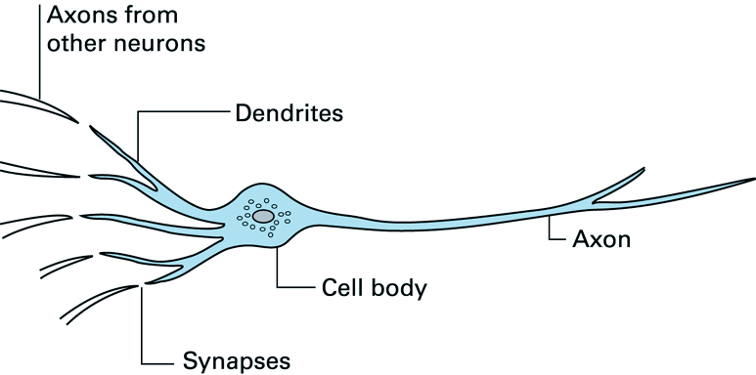
Thinking humanly
The interdisciplinary field of cognitive science brings together computer models from AI and experimental techniques from psychology to try to construct precise and testable theories of the workings of the human mind.

Slide 21
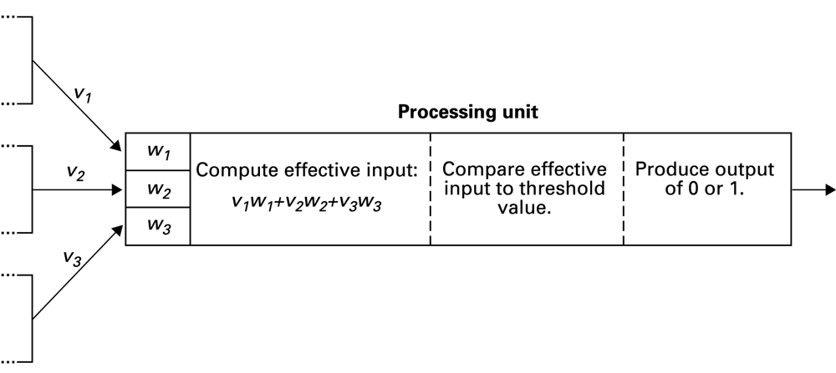
Artificial neural networks
Artificial neuron
Each input is multiplied by a weighting factor.
Output is 1 if sum of weighted inputs exceeds a threshold value; 0 otherwise.

Slide 22
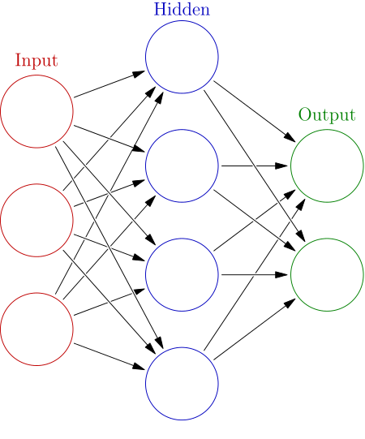
Artificial neural networks
Network is programmed by adjusting weights using feedback from examples
A.K.A. learning

Slide 23
Statistical learning
Feature space: each input is represented by a vector of features
Statistical learning is to find a classification function in the feature space based on statistical model.
Ex: girl/boy
Features: height, hair length
Linear prediction function
Hair
length
Height

Slide 24
Single layer perceptron
Activation function:
x is an input
w is the weight
Output:
θ is a threshold;
{0,1} are labels of inputs

Slide 25
Training single layer perceptron
Least square error for N inputs and a given w:
Training = find w and θ to minimize errors
A linear least square problem

Slide 26
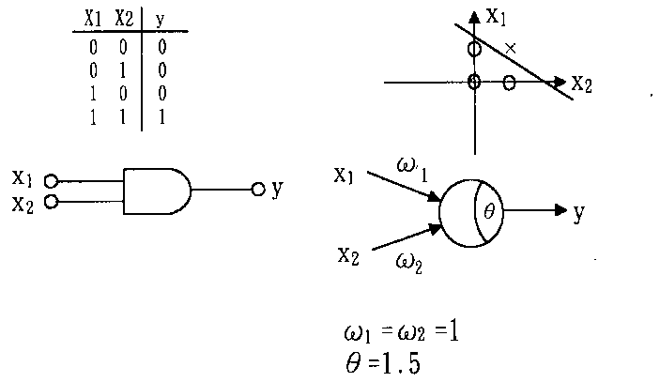
Example: the logic AND function

Slide 27
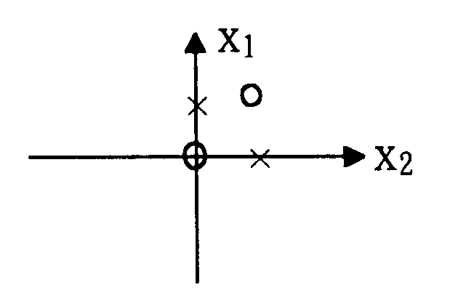
How about XOR function?
Cannot be computed (classified) by any single layer perceptron.
X1 | X2 | Y
0 | 0 | 0
0 | 1 | 1
1 | 0 | 1
1 | 1 | 0

Slide 28
Multi-layer perceptron
Hidden layers: the layers between input and output layer
Can recognize the XOR function
1
1
0
1
x₁
1
2
-2
1
y
x₂
1
0
1
1
1

Slide 29
Deep learning
Multilayer perceptron is a computational architecture (network) for deep learning
The example shows more layers more powerful of the learning ability.
Many other learning methods that consist of complex network are also called deep learning computing architecture.
Ex: deep belief networks

Slide 30
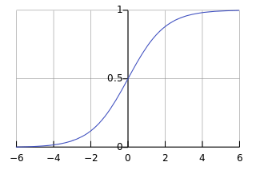
Training deep neural networks
The optimization problem is hard to solve
Activation functions are not differentiable.
The number of variables is increased rapidly.
Use sigmoid functions to approximate the step function
Optimization is still hard. (Vanishing gradient problem)

Slide 31

2018 Turing Award winners
（Geoffrey Hinton）
（Yann LeCun）
（Yoshua Bengio）

Slide 32
Other classifications

Slide 33
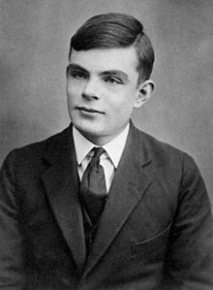
Turing Test
Proposed by Alan Turing in 1950
模仿遊戲的電影主角
Benchmark for progress in artificial intelligence
Test setup: Human interrogator communicates with test subject by typewriter
Test: Can the human interrogator distinguish whether the test subject is human or machine?

Slide 34

Master Algorithm
「機器學習」的五大門派
符號理論學派（Symbolists）
類神經網路學派（Connectionists）
演化論學派（Evolutionaries）
貝氏定理學派（Bayesians）
類比推理學派（Analogizers）

Slide 35
Genetic Algorithms
Based on the spirit of natural evolution
Operates on a population of chromosomes
Represents an encoding of the problem
A fitness value determines the goodness and the survival ability of the chromosome
Produces newer generations iteratively. Offspring are generated through crossover and mutation
Replacing chromosomes in the population with a probability consistent with their fitness values

Slide 36
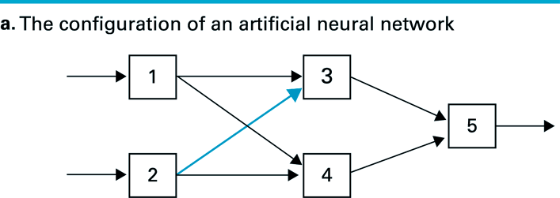
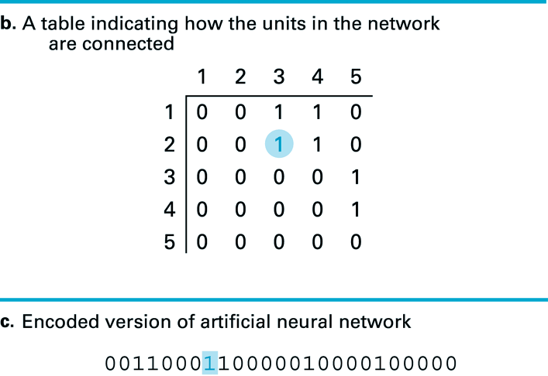
Example: neural network topology
Transform the states to a code

Slide 37
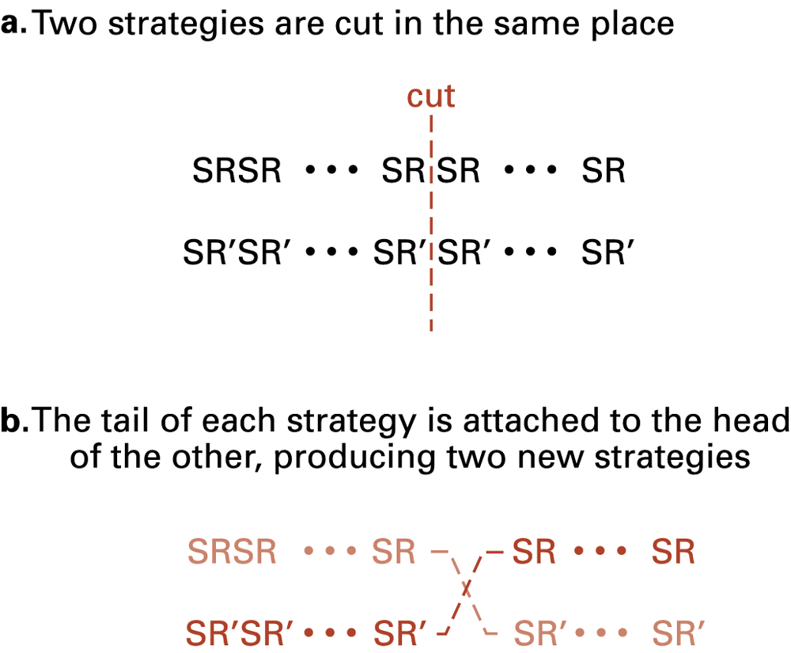
Crossing Two Strategies

Slide 38
Bayesian Classification
A statistical classifier: performs probabilistic prediction, i.e., predicts class membership probabilities
Incremental: Each training example can incrementally increase/decrease the probability that a hypothesis is correct — prior knowledge can be combined with observed data

Slide 39
Bayesian Classification
Let X be a data sample: class label is unknown
Let H be a hypothesis that X belongs to class C
Classification is to determine P(H|X), the probability that the hypothesis holds given the observed data sample X
Predicts X belongs to C_{i} iff the probability P(C_{i}|X) is the highest among all the P(C_{k}|X) for all the k classes

Slide 40
Prior and Posteriori Probability
P(H) (prior probability), the initial probability
E.g., X will buy computer, regardless of age, …
P(X): probability that sample data is observed
P(X|H) (posteriori probability), the probability of observing the sample X, given that the hypothesis holds
E.g., Given that X will buy computer, the prob. that X is 31..40, medium income

Slide 41
Bayesian Theorem
Given training data X, posteriori probability of a hypothesis H, P(H|X), follows the Bayes theorem
Informally, this can be written as
posteriori = likelihood x prior/evidence
Practical difficulty: require initial knowledge of many probabilities, significant computational cost

Slide 42
Simplified Assumption
A simplified assumption: attributes are conditionally independent (i.e., no dependence relation between attributes):
This greatly reduces the computation cost: Only counts the class distribution

Slide 43
Example: buying computer

Slide 44
Example: Training
P(buys_computer = “yes”) = 9/14 = 0.643
P(buys_computer = “no”) = 5/14= 0.357
Compute P(X|C_{i}) for each class
P(age = “<=30” | buys_computer = “yes”) = 2/9
P(age = “<= 30” | buys_computer = “no”) = 3/5
P(income=“medium”|buys_computer=“yes”)=4/9
P(income =“medium”|buys_computer=“no”)=2/5
P(student = “yes” | buys_computer = “yes) = 6/9
P(student = “yes” | buys_computer = “no”) = 1/5
P(credit_rating=“fair”|buys_computer=“yes”)=6/9
P(credit_rating=“fair”|buys_computer = “no”)=2/5

Slide 45
Example: Testing
X = (age <= 30, income=medium, student = yes, credit_rating = fair)
P(X|buys_computer=“yes”)=0.22x0.44x0.67x0.67= 0.044
P(X|buys_computer = “no”) = 0.6x0.4x0.2x0.4 = 0.019
P(X|C_{i})*P(C_{i}) :
P(X|buys_computer = “yes”)* P(buys_computer = “yes”) = 0.028
P(X|buys_computer = “no”)*P(buys_computer = “no”) = 0.007
Therefore, X belongs to “buys_computer=yes”

Slide 46
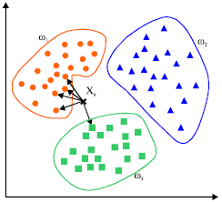
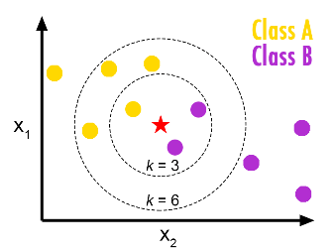
K-Nearest Neighbor Algorithm
All instances correspond to points in the n-D space
For discrete-valued, k-NN returns the most common value among the k training examples nearest to x_{q}.

Slide 47
Key Questions
How to measure the distance?
Not all data are in the Euclidean space
Not all attributes can be measured
How to find the k-nearest neighbor efficiently?
Linear search
Space partition methods
Approximation methods (the curse of dimensionality)

