Slide 1
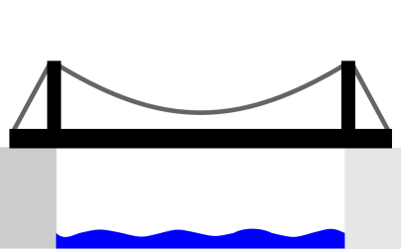


:00
here
there
1
2
5
10

Slide 2
:02
here
1
2
there
5
10

Slide 3
:02
here
there
5
10
1
2

Slide 4
:03
here
1
5
10
there
2

Slide 5
:03
here
there
1
5
10
2

Slide 6
:13
here
5
10
1
there
2

Slide 7
:13
here
there
1
2
5
10

Slide 8
:15
here
2
1
there
5
10

Slide 9
:15
here
there
1
2
5
10

Slide 10
:17
here
1
2
there
5
10

Slide 11
:17
here
there
1
2
5
10

Slide 12
struct State {
vector<int> here;
vector<int> there;
int direction;
State() { }
State(vector<int> ini): here(ini.size()), there(ini.size()), direction {1} {
for(int& i : here)
{
i = 1;
}
}
State(const State& s): here{s.here}, there{s.there}, direction{s.direction} { }
State& operator=(const State & s)
{
State localstate{s};
swap(here, localstate.here);
swap(there, localstate.there);
direction = localstate.direction;
return *this;
}
bool operator<(const State & s) const
{
return (here < s.here) || ((here == s.here) && (there < s.there))
|| ((here == s.here) && (there == s.there) && direction < s.direction);
}
void show()
{
for (auto t : here) {
cout << t << " ";
}
cout << "| ";
for (auto t : there) {
cout << t << " ";
}
if (direction == 1)
cout << " Left\n";
else
cout << " Right\n";
}
};

