Slide 1
Descartes 3
Truth, Error and God

Slide 2
Meditations 3-5
In these Meditations, with the Demon doubt re-imposed, Descartes develops a complex argumentative strategy to remove the most radical form of the Demon doubt, though without yet establishing the existence of the external world. (That will come in Meditation 6.)
So far, Descartes has shown that certain individual, and even certain kinds of propositions, cannot be doubted. Now he proposes a general rule for determining what is certainly true ((a “criterion” in the traditional sense).
This leads to a further skeptical questions: can the rule be trusted?
To answer this question, Descartes purports to prove (a) that God exists and (b) error when following the rule would be inconsistent with Divine benevolence.
In Meditations 4-5, he deals with some problems raised by this argument and draws some further consequence. He is also led to a second proof of God’s existence.
This whole argument is problematic in many ways.

Slide 3
Generalising Certainty
In Meditation 2, Descartes asked an answered two questions.
Are there any propositions that resist even the “hyperbolic” Demon doubt? Yes: “I am” and “I think”.
How must “I am” be understood to be as certain as I know that it is? Answer: I must conceive myself (only) as a thinking thing.
Now he poses a third question. Do these questions teach a general lesson about certainty?

Slide 4
The Rule
Re-imposing the Demon doubt, Descartes reviews what he really knows. He knows he exists as a thinking thing. He knows that sensing and imagining exist as modes of thought (ways of being conscious). But he does not know that they accurately represent things in the external world, if there even is such a world.
So what is so special about the things he knows? Only this: a clear and distinct perception of what I affirm.”
So he proposes Rule (criterion of knowledge): Everything I clearly and distinctly perceive is certainly true.

Slide 5
Clear and Distinct.
The Rule does not mean if something powerfully strikes me as right it must be right.
Clarity is objective certainty. A proposition is “clearly” perceived when attempts to doubt it break down. “Sum” and “cogito” are the original and paradigm examples.
Distinctness is precise and exact understanding of a proposition: knowing exactly what it means (or must mean, given its peculiar certainty). In the case of a basic certainty, you can’t have a precise understanding of the proposition involved and still be in doubt as to its truth.
The crucial point: the Rule is derived from the example of the cogito. If the Rule were invalid, the cogito would not be certain in the way that it is.

Slide 6
Doubting the Rule
Consider some of Descartes’s previous beliefs—that there are external things resembling his ideas. Theses have a powerful “natural” appeal and may be true. But their truth is not given through “the strength of [Descartes’s] perception”. He can understand them perfectly and still wonder whether they are true.
Could the Demon put Descartes in the same position even with respect to simple mathematical propositions, such as ‘2 + 3 = 5.’ These seem to be clearly and distinctly perceived. But could the Demon just make it seem that way?

Slide 7
Defining the Question
Since Descartes has no reason to think there is a Demon (or for that matter a God), the doubt is “slight and metaphysical.” But we are in quest of absolute certainty, so it must be removed.
A vital point: not even the Demon doubt can undermine the certainty of a clearly and distinctly perceived proposition while Descartes’s attention is focused on it. The doubt arises only at the reflective level (when Descartes thinks about the reliability of his faculties, rather than the truth of particular propositions).

Slide 8
The Divine Guarantee
Descartes examines whether there is a God. He gives two (or perhaps one and a half) arguments. Both depend on the unique character of the idea of God.
The central idea: only God’s actual existence could account for Descartes’s having the idea of God. This arguments provides D with a “bridge” to something that transcends his own subjectivity.
The argument in Meditation 3 is a Cosmological Argument: its key premise depends on the existence of a natural phenomenon (the existence of the idea of God, or on that of Descartes as having such an idea).

Slide 9
Ideas
Descartes classifies his thoughts.
Properly speaking, ideas are “as it were the images of things”: i.e. mental representations. (Concepts and “images” in the narrower sense.)
There are also mental acts/states: willing, fearing, affirming/denying. These have an object plus an attitude. (Today, these are called ‘propositional attitudes.’) Two kinds: volitions/emotions; judgments.

Slide 10
Error
Ideas (as concepts), considered in themselves, and not referred to anything beyond them, cannot be true or false. Nor can emotions or volitions.
Truth and falsity belong to judgments. Most common source of error: judging things to resemble one’s ideas. (The correspondence theory of truth.)
Some, e.g. thing (‘substance’) or truth, appear to be innate. Others (hearing a noise, feeling the fire) seems to come from “outside.”
But all could be innate, adventitious, or even made up.

Slide 11
“Natural” Belief
With respect to sensory ideas (experiences), the urge to judge that they they correspond to things is “natural.” Such judgments are typically involuntary and automatic.
It seems “natural” to think that a thing “transmits its likeness” to the mind (a subtle reference to Aristotle).
But habit is not “the natural light” (of Reason). Involuntariness is not a definitive proof of external origin.
Contrast the two “ideas” (conceptions) of the Sun: commonsensical and scientific.

Slide 12
Reality
As modes of thought, all ideas seem on a par. They have the same level or degree of “formal reality.” But they differ in “objective reality”: i.e. the degree of reality of their “objects” (what they represent or are about).
There are three degrees of reality: modes/accidents; finite substances; and infinite substance (God). The degrees correspond to the capacity for independent existence. (Cf. the Cheshire Cat.)

Slide 13
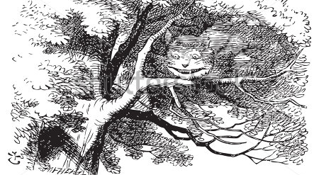
A Cat Without a Grin

Slide 14
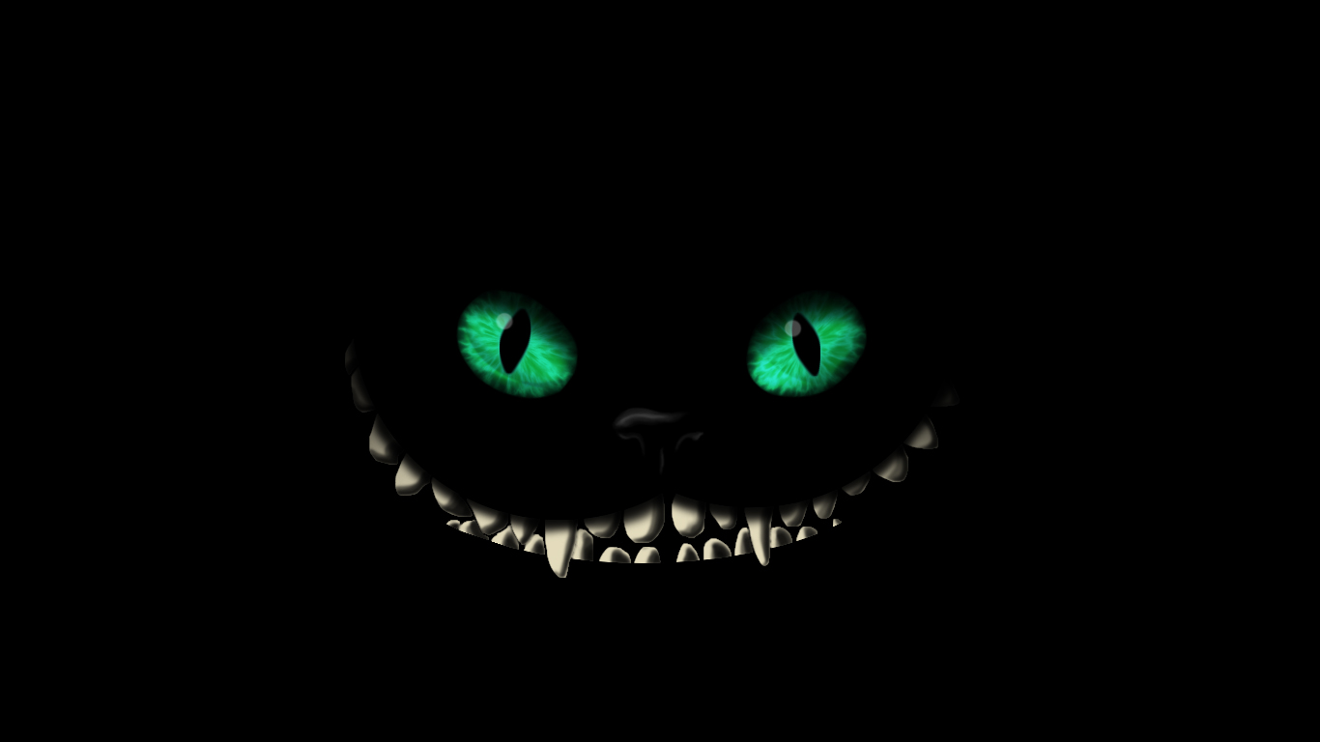
Another One

Slide 15
Causal Principles
The Causal Principle: the cause of a given effect must contain “formally or eminently” as much reality, formal or objective, as the effect. (i.e. must be on the same level or a higher level).
There can be no infinite regress of merely objectively real causes: the ultimate cause of an idea must be something with a sufficient degree of formal (actual) reality. (Ideas are modes of thought.)

Slide 16
Where Do Ideas Come From?
Ideas of finite living beings could in principle be put together from ideas D has of himself.
Ideas of (non-living) bodies. Their geometrical-temporal-kinematic properties are clearly and distinctly perceived. Other properties (color, taste, smell) seem ”confused.” (Why?) They may be “materially false,” representing non-things as things: e.g. heat and cold. Cold may be nothing but the absence of heat. (Another clash between science and ordinary experience, taken at face-value.) These don’t need any special cause.
Clear and distinct ideas. The “metaphysical” concepts (e.g. substance) may be contained in D’s own nature. The rest (the mathematical), even if they are not contained in his nature formally (since so far as he knows he is essentially only a thinking thing), they may be contained in his nature “eminently” (i.e. in a higher form).

Slide 17
God: from Idea to Existence
The idea of God is unique by virtue of God’s absolute infinity. Only God himself could be the ultimate source of such an idea. The (positive) idea of absolute perfection is presupposed by D’s capacity to recognize his own imperfections (limitations). Cf. Plato on the Forms.
As the most clear and distinct, the idea of God could not be materially false. (But note, there is much about God that Descartes does not, perhaps cannot, grasp.)
Is the idea of God an idealization (through gradual improvement) of Descartes’s actual capacities? No; the idea of improvement implies imperfection (limitation).
Conclusion: only God’s actual (formal) existence can account for there being the idea of God.

Slide 18
The Ground of All Being
Could Descartes, who has the idea of God, exist if God did not? No.
(i) If Descartes were the cause of his own existence (causa sui), he would not be so imperfect.
(ii) His continued existence is contingent (dependent): the distinction between continuation and creation is merely conceptual. Descartes’s thus existence depends on God’s concurrence.
(iii) Other causes (e.g. his parents)? No. On pain of infinite regress, there must be an ultimate cause.

Slide 19
Understanding
In the argument just presented, “ultimate” does not mean first in time. It means fundamental in the ordo essendi (the order of Being) thus the order of explanation. (it may not be the first thing we discover: first in the ordo cognoscendi.)
To understand is to grasp necessity: to see why things must be as they are. Sometimes, we explain a particualr fact in terms of some further fact (say a law plus initial conditions). But why is everything the way it is, given that it could have been different?

Slide 20
God as Causa Sui
To halt an infinite regress of causes, avoiding an appeal to an unexplained explainer, we must identify a cause that causes itself: something that is causa sui. (A self-explanatory principle.) This is God.
This argument appeals implicitly to the Principle of Sufficient Reason. Everything has a reason: nothing “just is.” Ex nihilo nihil fit. “In the beginning was the Word.” (En arche en o logos.)
This is perhaps Rationalism’s most fundamental epistemological/metaphysical commitment vital Rationalist idea. (Remember this when we get to Leibniz and Spinoza and Leibniz.)

Slide 21
Knowledge of God: Satisfactions
Descartes’s existence cannot depend wholly on partial causes (distinct perfections) since unity is one of God’s chief perfections.
This is another appeal to PSR.)
Descartes’s parents do not sustain his existence. There is only a distinction of reason between creation and sustenance.
His parents did not (could not) create his mind. (Metaphysical Dualism.)
The idea of God must be innate. Descartes’s existence, as a being with such an idea, implies the (formal) reality (real existence) of God.
This knowledge of God anticipates the joys of Heaven.

Slide 22
Divinity and Deception
In Meditation 4, Descartes draws important consequences from his theological argument and addresses some problems.
Deception implies trickery and malice, which are defects. Deception is thus incompatible with God’s absolute perfection.
Since God cannot intend to deceive, Descartes’s God-given faculty of judgment cannot be such as to lead him astray, when correctly used. But if so, why does D ever fall into error? (This is an epistemological version of the Problem of Evil or Theodicy.)
Descartes is finite, i.e. limited (midway between the absolute plenitude of God and its polar opposite, absolute nothingness). There is no need to postulate a faculty of error, just limited cognitive powers.

Slide 23
Knowledge of God: Limits
Why are Descartes’s powers limited, when they could have been more extensive?
We cannot penetrate (in detail) into the purposes of God, which is why it is useless to appeal to final causes in physics. Also, the existence of various limited beings may contribute (in some way I do not fully grasp) to the perfection of the whole.
The point about final causes in physics is presented as an aside but is of major philosophical significance: it implies (a) that the material world is to be understood exclusively in terms of efficient causes, which for Descartes means in mechanical terms; thus (b) the total independence of physical science from theology.

Slide 24
Reason and the Will
Investigating further, we see that error depends on two faculties: intellect and will. The intellect formulates (and grasps the content of) ideas: here propositions. But judgment (assent to a proposition/holding it to be true) is a further, voluntary step.
The will is unlimited, even for finite Descartes: it is the pure power of choice. (Of course, we may be limited in the options we are presented with, but this is not a limitation on the power of choice itself. Freedom is not indifference but self-determination (absence of external constraint).
The scope of the will exceeds that of understanding. Descartes should not—as he was tempted to do at the end of Meditation 1, deem his previous beliefs false: the correct response is to suspend judgment.

Slide 25
The Origin of Error
Error results from judging in the absence of sufficient reasons, and is thus Descartes’s own fault. Again, D cannot complain about his finitude.
It still seems possible that God could have made Descartes so that he had a clear and distinct perception of everything he was ever likely to deliberate about. So this argument, too, has to be buttressed by an appeal to the greater good of a whole.
We can know that God’s creation is wholly perfect, but the details necessarily escape us.
Does this justify an appeal to Divine purpose in First Philosophy, though not in physics?

