Slide 1

Online Advertising Performance Analysis
A Key InsighT From Company X's Campaign Data
-By ANKIT SANKAR

Slide 2
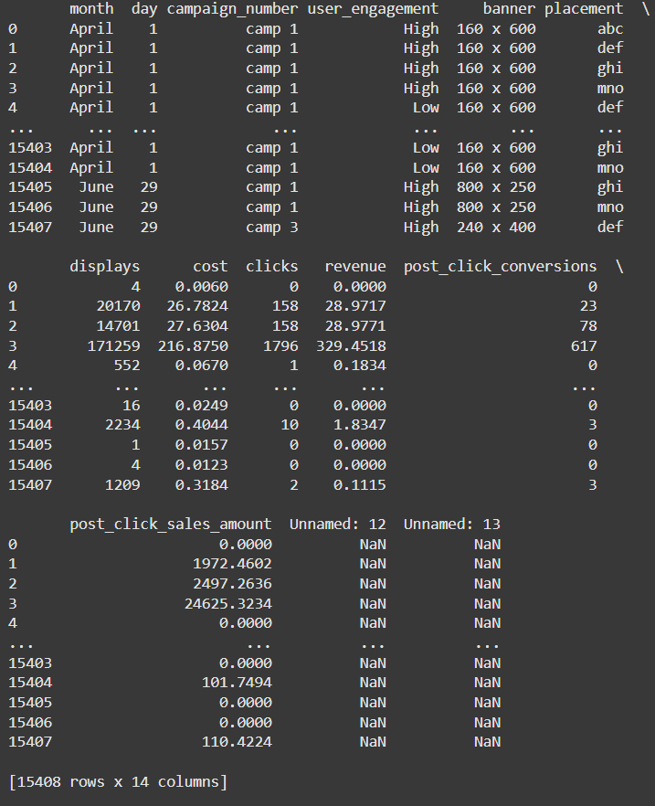
OVERVIEW OF DATASET
The data set contains the following(Fig 1.1):
Campaign Period(April to June)
Key Metrics such as: Displays, costs, revenue, sales amounts
Has 15408 rows and 14 Columns
From this we can grasp a basic understanding of the data given i.e revenue generated by online ad campains by company x during a given period of time
Purpose of analysis:
Identifying trends
Effectiveness of campaign
Cost and revenue generated
Fig 1.1

Slide 3
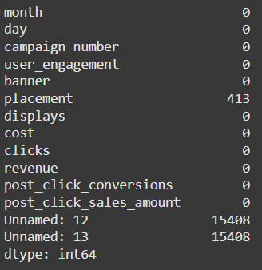
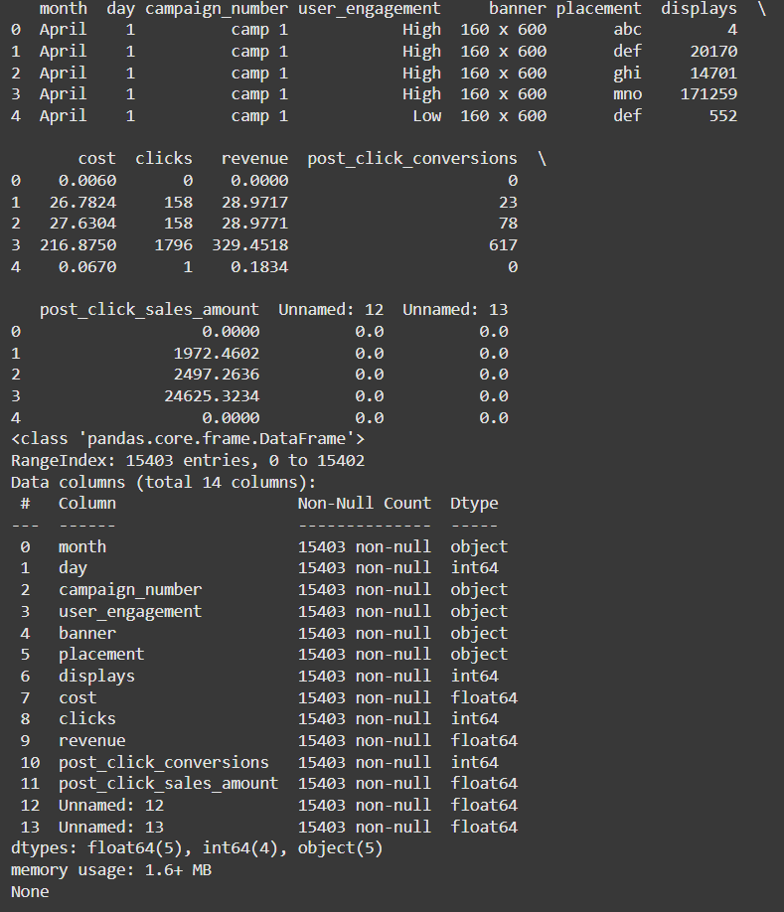
Data cleaning(Feature Engineering)
From the data given we can see some fields are empty(Fig1.2) so,
Removed duplicates and handled missing data.
Converted columns to appropriate data types.
Created new metrics like CPC, Conversion Rates, ROI.(Fig 1.3)
Stored the data into a new CSV file for further Analysis
Fig1.2(Before Cleaning)
Fig1.3(After Cleaning)

Slide 4
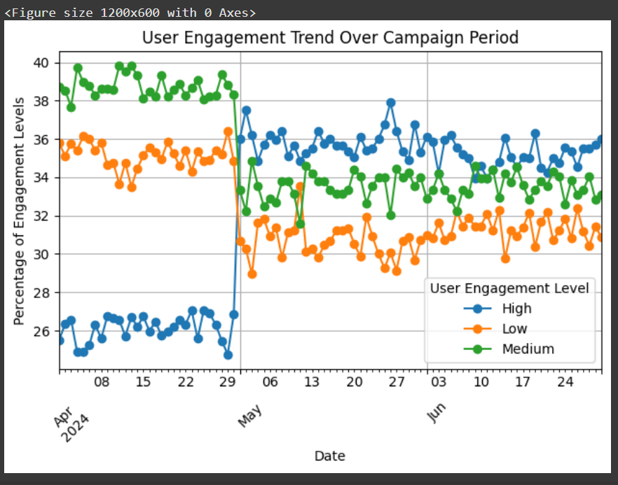
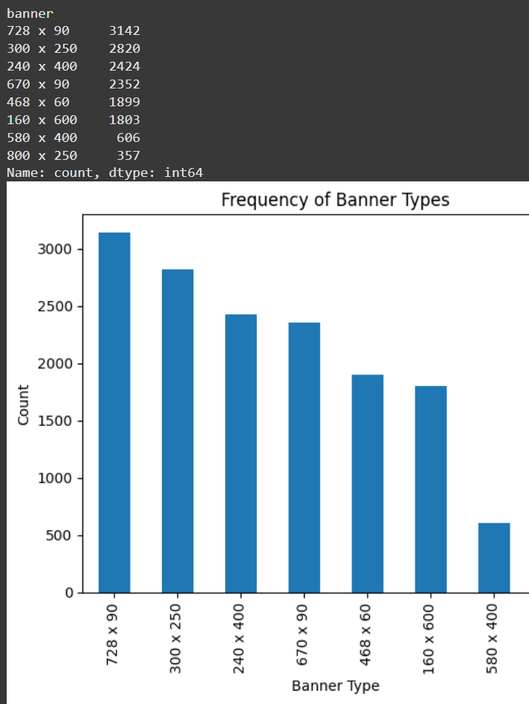
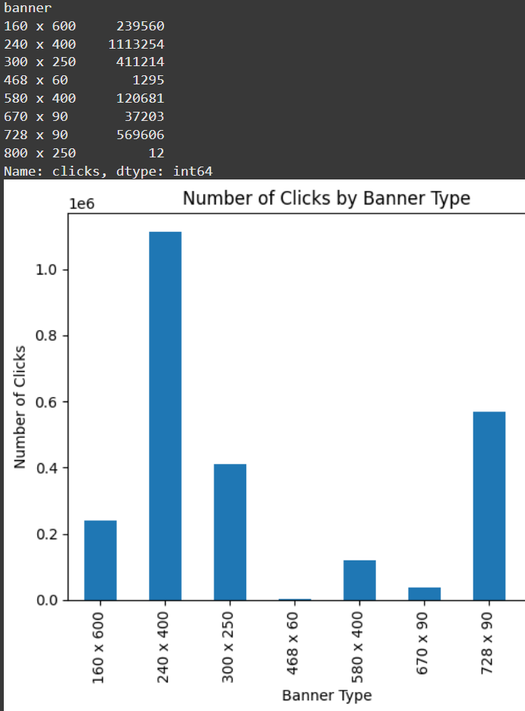
Key findings
Fig2.1
The campaign slowly becomes successful as more people are finding the campaign to be relevant, (Fig 2.1)
A significant change occurs around late April to early May, where:
High engagement increases.
Low engagement decreases.
Medium engagement remains relatively stable.
An improvement in high engagement and a reduction in low engagement post-May, suggesting the campaign's positive impact on user interaction.
Top Performers:
240 x 400: Attracts the most clicks, indicating it is highly engaging or well-placed.
728 x 90 and 300 x 250: Also effective in generating significant user clicks.
Low Performers:(Fig2.2)
800 x 250 and 468 x 60: Extremely low click counts suggest poor design, placement, or audience fit.
670 x 90 also shows limited engagement.
Medium-sized banners like 240 x 400 and 728 x 90 appear to be more effective.
Larger banners like 800 x 250 and unconventional dimensions like 468 x 60 perform poorly and may need reconsideration in campaigns.
Fig2.2

Slide 5
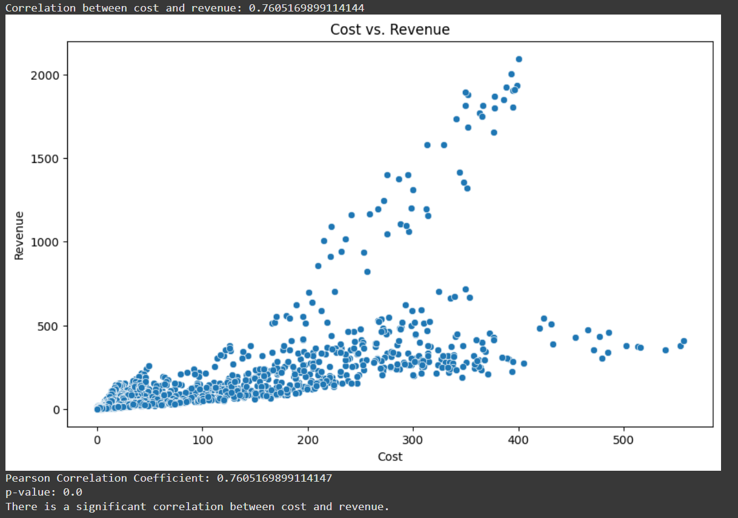
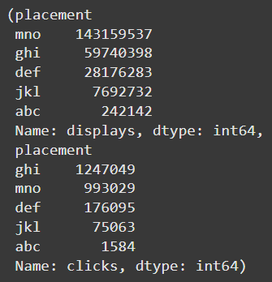
Placement and revenue
Highest Displays:(Fig2.3)
mno: 143,164,944 displays,
ghi: 59,740,415 displays,
def: 28,177,492 displays
Highest Clicks:
ghi: 1,247,049 clicks,
mno: 993,044 clicks,
def: 176,097 clicks
The correlation between the cost of serving ads and the revenue generated from clicks is approximately 0.76, indicating a strong positive relationship. Higher advertising costs are generally associated with higher revenues.(Fig 2.4)
Fig 2.4
Fig 2.3

Slide 6
Recommendations for campaign optimization
1. Focus on High-Performing Banners
Top Banners:
240x400: Highest clicks and engagement.
728x90: Strong performance in both clicks and ROI.
Action: Prioritize these banner sizes for future campaigns.
3. Optimize for ROI
Insights:
High ROI banners like 468x60 and 160x600 should be scaled where relevant.
Focus on cost-efficient campaigns like Camp 2 with low CPC.
Action: Identify and replicate strategies from high-ROI campaigns.
2. Leverage Effective Placements
Top Placements:
ghi: Best performance in displays, clicks, and conversions.
mno: Second-best placement across metrics.
Action: Increase allocation of ads to these placements.
4. Time-Based Optimization
Conversion Trends:
Tuesdays: Highest conversion rates.
Weekends: Better engagement rates.
Action: Schedule campaigns strategically to align with these trends.

Slide 7
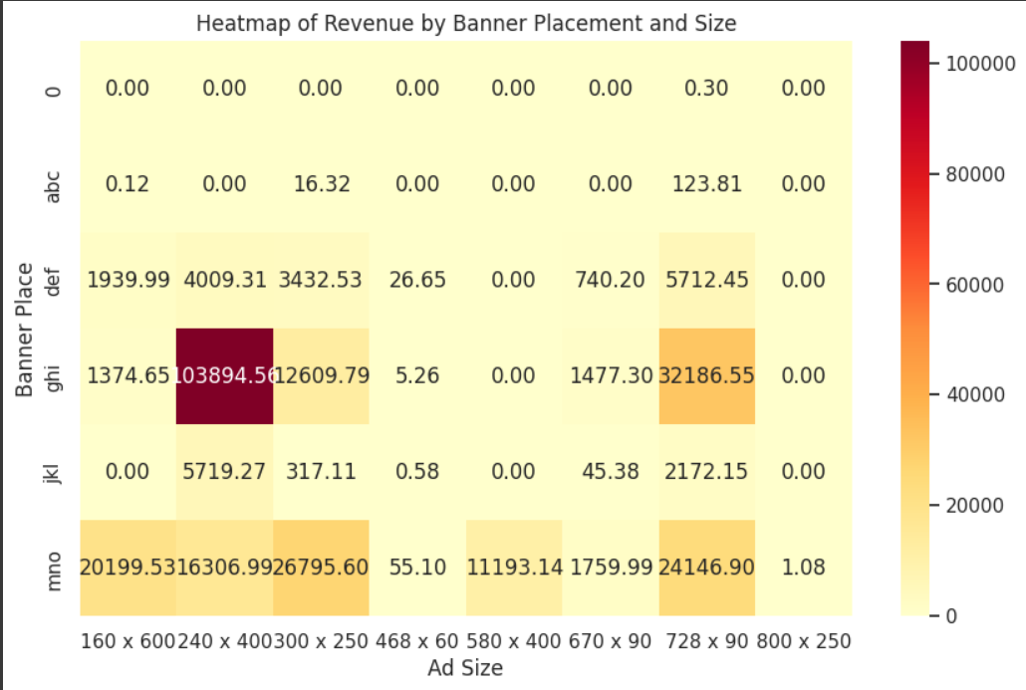
Heatmap of revenue generated by placement and size
Placement ghi:
Ad size 240 × 400 has the highest clicks (~866,275) and revenue (~103,894.56), making it the most effective combination.
Placement mno:
Ad sizes 300 × 250 and 728 × 90 perform well in clicks (~251,888 and ~247,106) and generate significant revenue (~26,795.60 and ~24,146.90).
Overall:
Larger ad sizes (240 × 400, 300 × 250, 728 × 90) perform better, especially in placements ghi and mno.

Slide 8
Summary and conclusion
1. Summary of Insights
Campaign performance showed improvement over time:
Increased high engagement levels and revenue correlation.
Top-performing combinations identified:
Banners: 240x400, 728x90.
Placements: ghi, mno.
Strong correlation between cost and revenue (0.76) highlights the importance of strategic budget allocation.
2. Recommendations Recap
Focus resources on top banners and placements.
Leverage time-based trends (e.g., Tuesdays and weekends) for optimal conversions.
Reallocate budget from low-performing elements.
3. Next Steps
Implement findings into upcoming campaigns.
Monitor campaign performance continuously.
Perform additional testing on low-performing placements or banners to explore improvement opportunities.

Slide 9

Thank you

