Slide 1
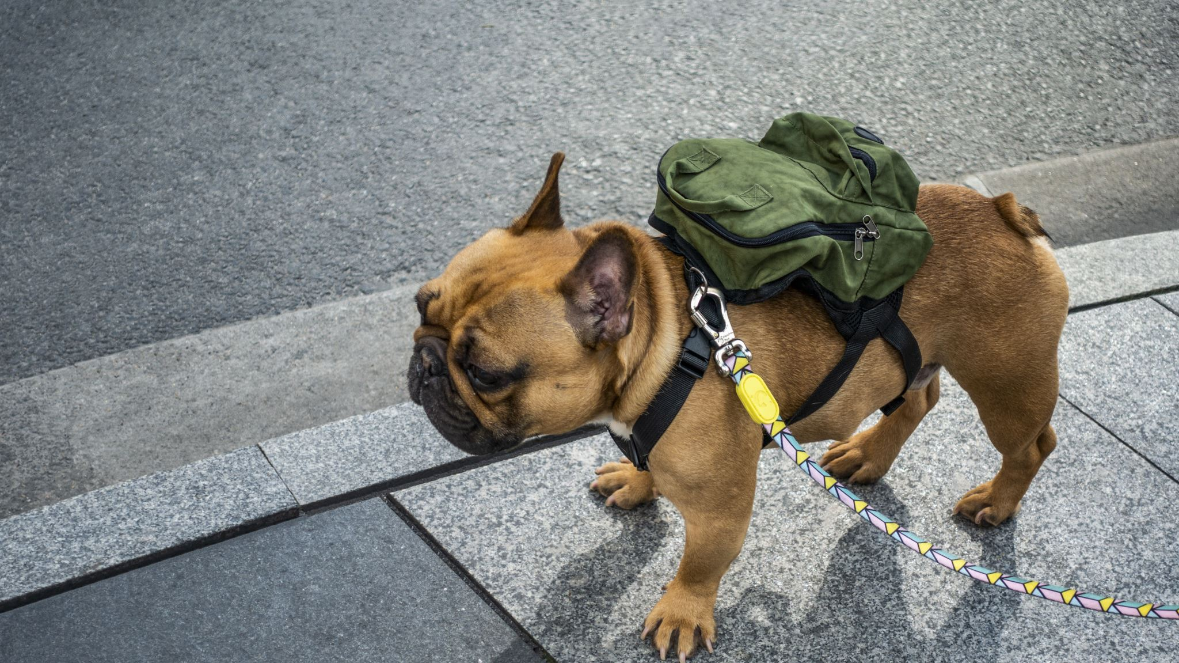
bag hunter
Farfetch.com
Notes:
Hi everyone, my name is Sabrina Yang, ,(CLICK) and I’m here to present my project –BAG HUNTER

Slide 2
Intro

Slide 3
E-commerce
Have you ever shopped online?
Online Shoppers
Marketplace
YES
Millennial
85% of growth in 2017
expected 45% by 2025
Amazon (B2C)
eBay (C2C)
Shopify (B2B)
Notes:
What’s e commerce? Have you ever shopped online? If you say Yes, and I believe most of us do, then we all have been involved in e-commerce.
Millennial online shoppers accounted for about 85% of growth in 2017 and are expected to account for 45% of luxury-category spending by 2025. I believe this number increases even more after this pandemic hit.
Marketplace such as Amazon, eBay, Shopify

Slide 4
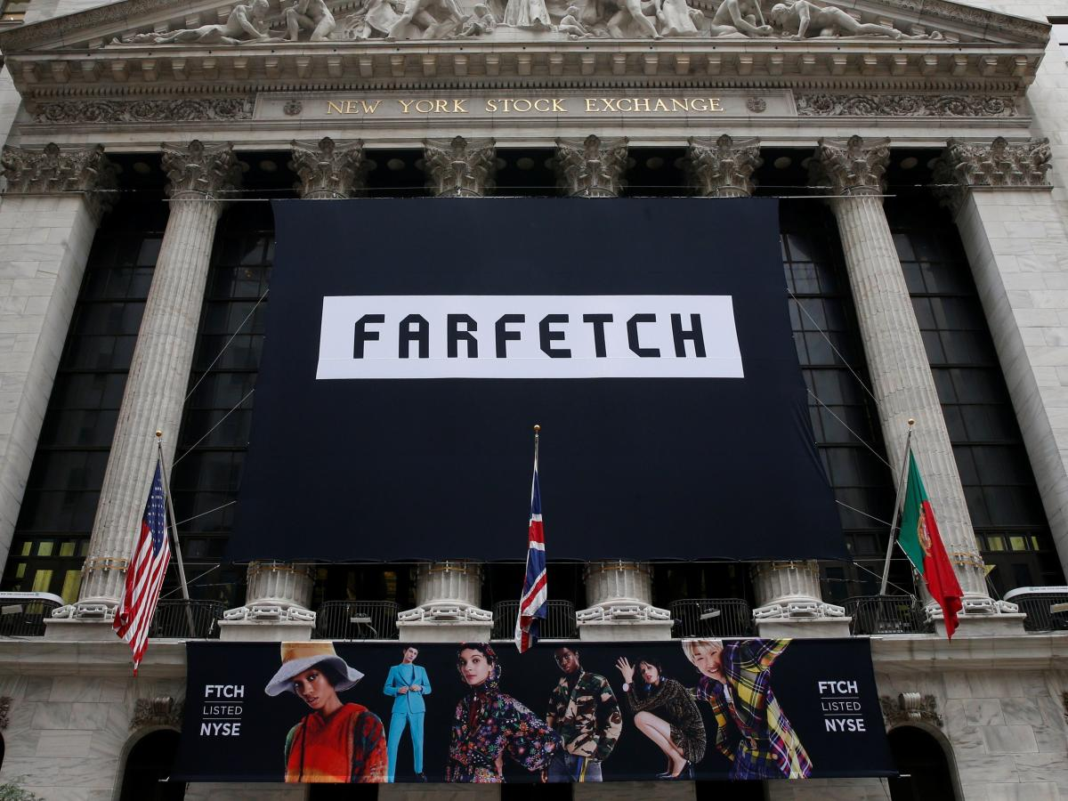
FARFETCH
UK luxury retail company
Global platform sell over 700 boutiques brands
Founded in 2007
IPO in 2018 (Ticker “FTCH”)
Founder José Neves coding background
Notes:
Farfetch is online luxury fashion retail platform that sells products from over 700 boutiques and brands from around the world.
It was founded in 2007, got IPO in 2018(see this pic), and this founder has coding background
The aim of this company is “redefining how fashion is bought and sold” through technology, data and innovation.

Slide 5
DATA
Notes:
So what data do they have?

Slide 6
Data Acquisition
API Json
MongoDB
Bag Section
Data size 400,000
↓
21,000 (669 brands)
↓
1670 (5 brands)
Notes:
Here is how I get my data. I made an API through python code to pull json from their website and store in MongoDB. And I want to focus on Bag sections since it’s a big part of luxury market.
But one thing I wasn’t expected in this project was the data size is not as big as i thought. (CLICK)
original data size was 400,000 -> and 21,000 are bags /w 669 brands -> I pick the top list 5 brands -> unfortunately the final size is only 1670

Slide 7
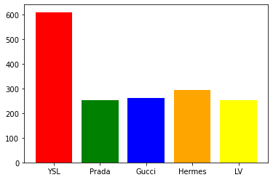
EDA 5 brands distribution
Notes:
Here is the distributions of 5 brands – YSL, Prada, Gucci, Hermes, LV
look at the chart for each data size – YSL has ard 600 items and the others has ard 2 to 3 hundres.

Slide 8
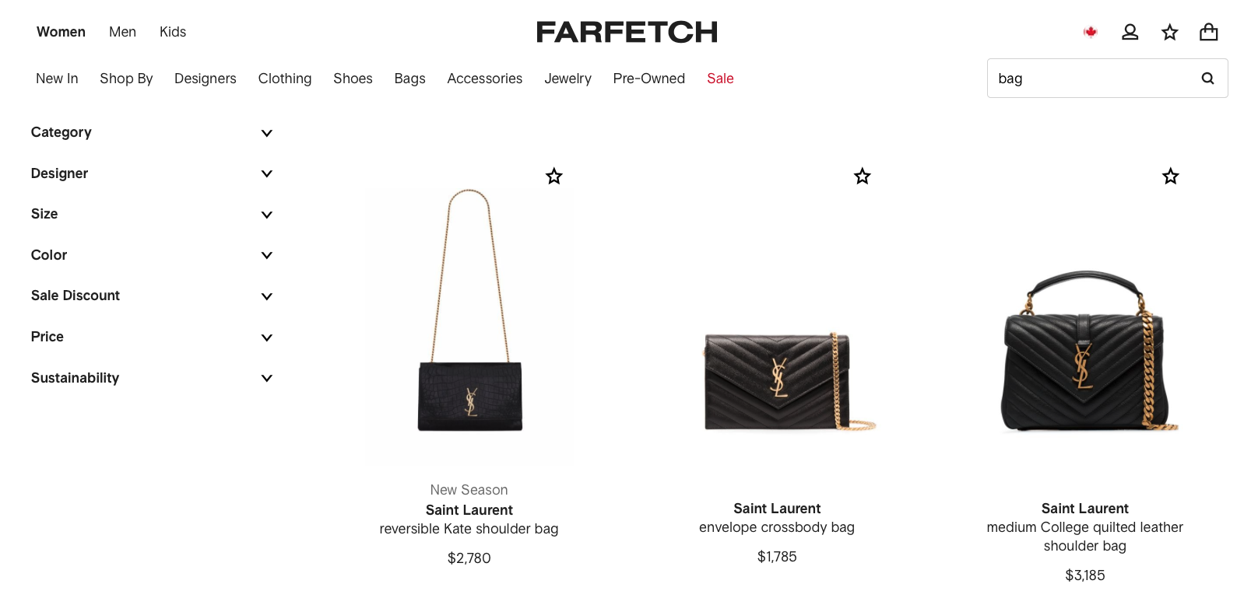
YSL
API – webscrap
Bag sections : BAGS REAL PICTURES
Notes:
I also want to show you how these brands of bags looks like .YSL – the metal chain

Slide 9
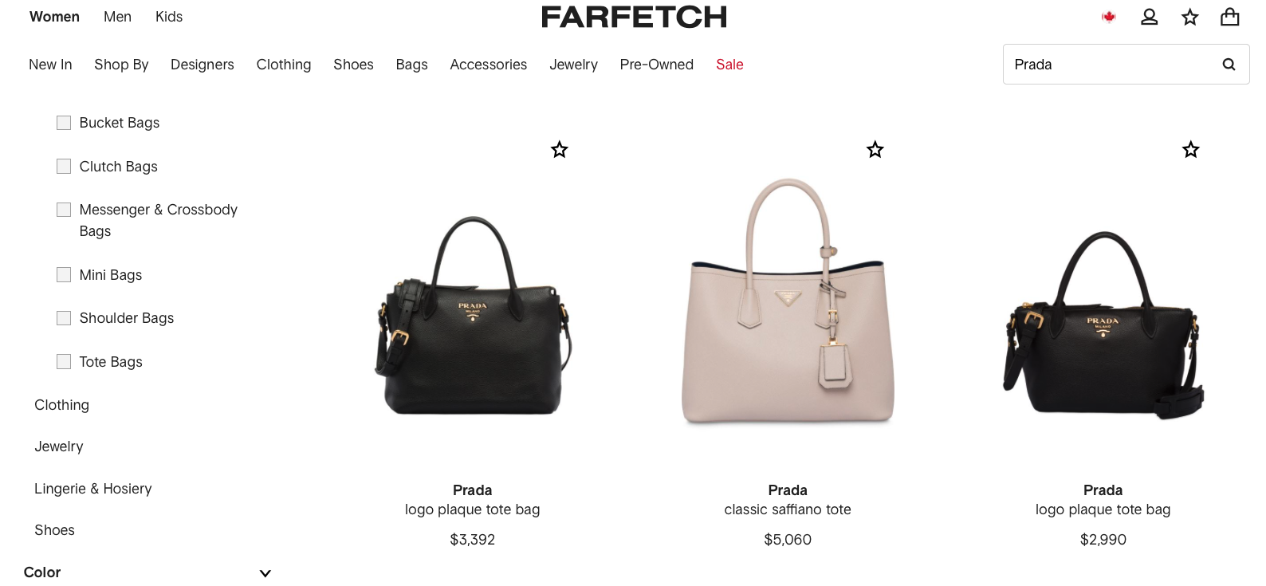
Prada
Notes:
Prada – triangle logo and the bag handle

Slide 10
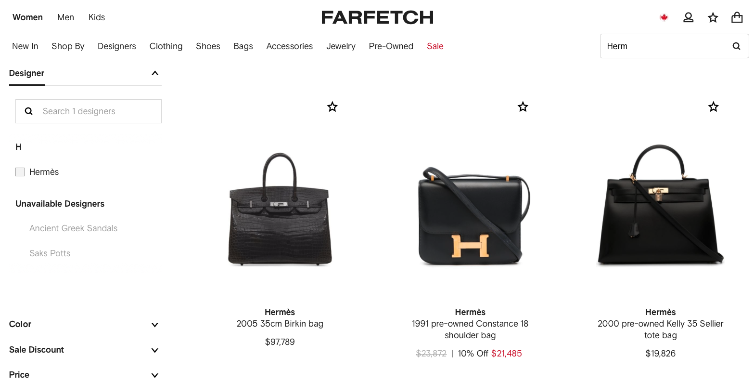
Hermès
Notes:
Hermes
I wont say they look exactly same but they do have a bit of similarity.

Slide 11
Approach
Notes:
So now you understand how my data looks like, let’s dive into approach

Slide 12
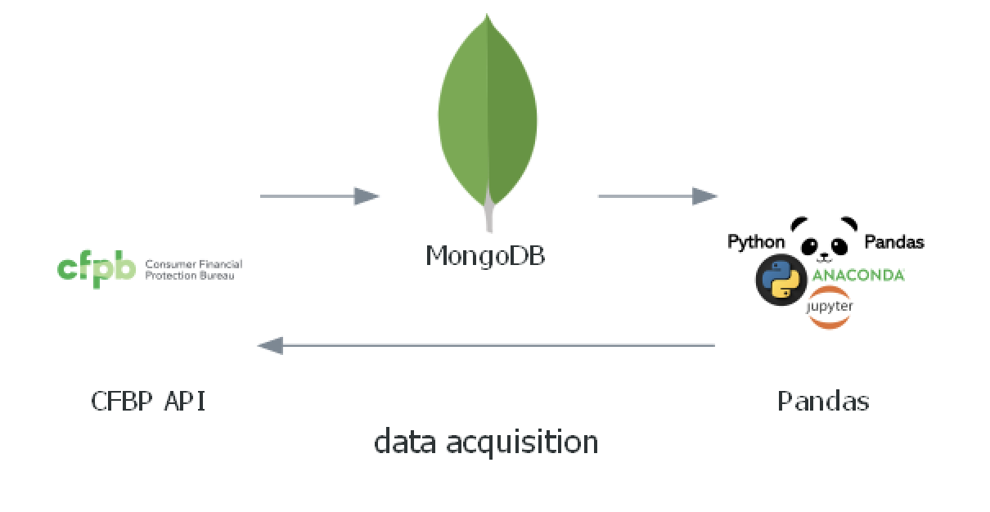
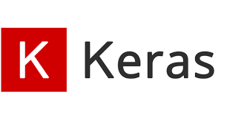
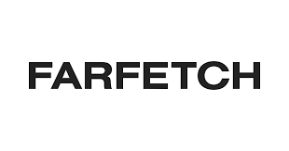

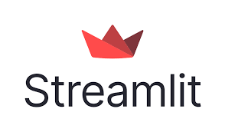


Workflow
Deep learning
Quarterly re-train model
Bi-weekly update
App deployment
Notes:
First, use a Python wrapper of an API to pull JSON from Farfetch and stored data in NoSQL MongoDB.
Next, I use jupyter lab download products url images from MongoDB. Since my data are images, I use Google Colab GPU to do Keras deep learning.
And I use streamlit to make Bag Hunter app from my training model.
I want to make sure that my code can ingest new data, so I schedule a bi-weekly update to pull new data, and retrain my model every quarter.
The decision was made based on the renewal is not frequent and the new items will always be added on the first page– this pipeline can be run in the balance of time and database quality

Slide 13
Deep Learning
Transfer learning
Image augmentation
Notes:
For Deep Learning, I tried Transfer Learning and Image Augmentation.
(VGG16) performed not bad and I got round 70 -80 % of accuracy, but I want to try image augmention to increase the data size since my data is small, but the result wasn’t well. So I still chose Transfer Learning as my final model base.
(I guess it’s because if you flip a bag around, and it’s still a bag.)
batch size = 32
2 Dense layers -> 3 Dense Layers +
epochs = 10 -> 20
or epochs = 100 + callbacks.EarlyStopping + callbacks.ReduceLROnPlateau
**4. **
since the dataset is small so i use this method to flip to increase dataset size
preprocessing 1: do image dataset train-test-split via data directory
preprocessing 2: ImageDataGenerator on training dataset for augmentation(rotation = 40, horizontal flip)

Slide 14
Future WORK

Slide 15
Future Work
Bag Sections Improvement
More product lines
Logo detection
add more products close-up details pictures
to detect knockoff and authentic products
sneakers, watches
cv2/Object Detection/YOLO
Notes:
In the future work,
I want to feed more bag details pictures to my model in order to detect knockoff versus authentic products
Or I’d like to add more product line such as watches, sneakers.
And the logo filter box from object detection ( You only look Once)

Slide 16
Deployment

Slide 17
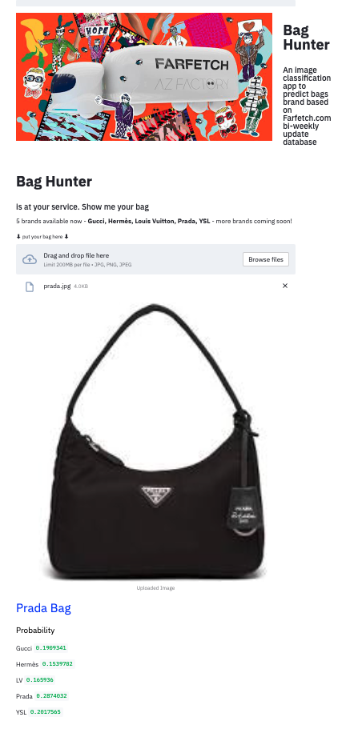
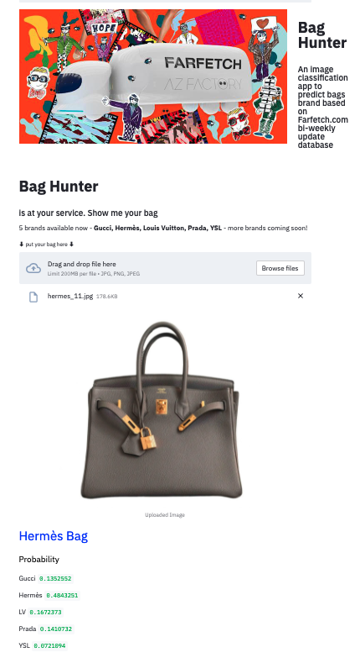
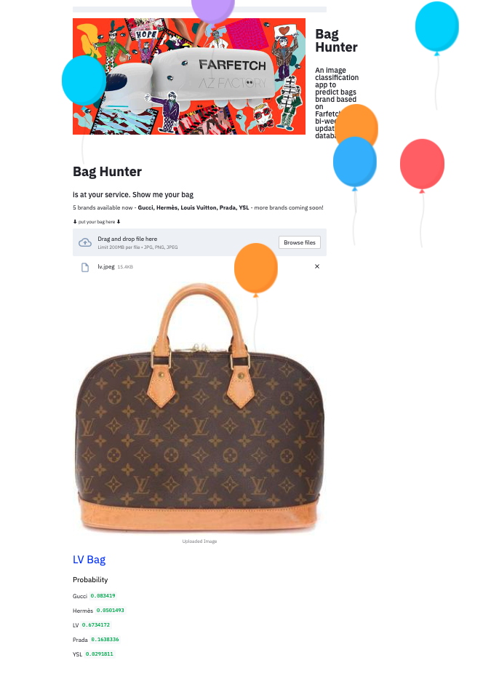
Notes:
Now I’m going to show my app demo

Slide 18

App recording

Slide 19
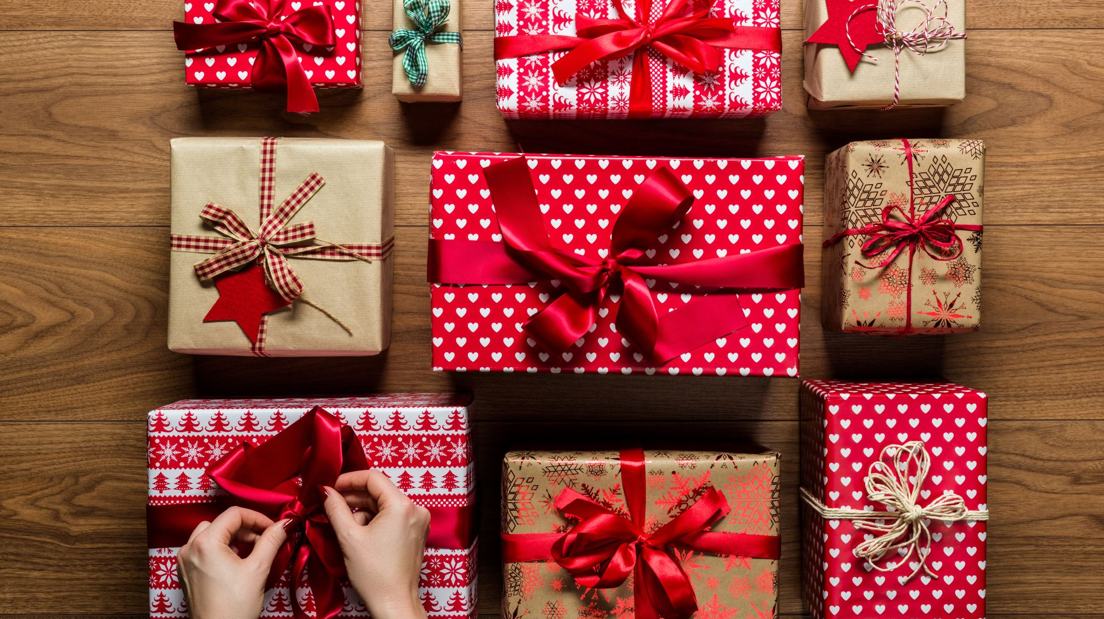
THANK YOU
Notes:
Thank you for listening to my presentation

Slide 20
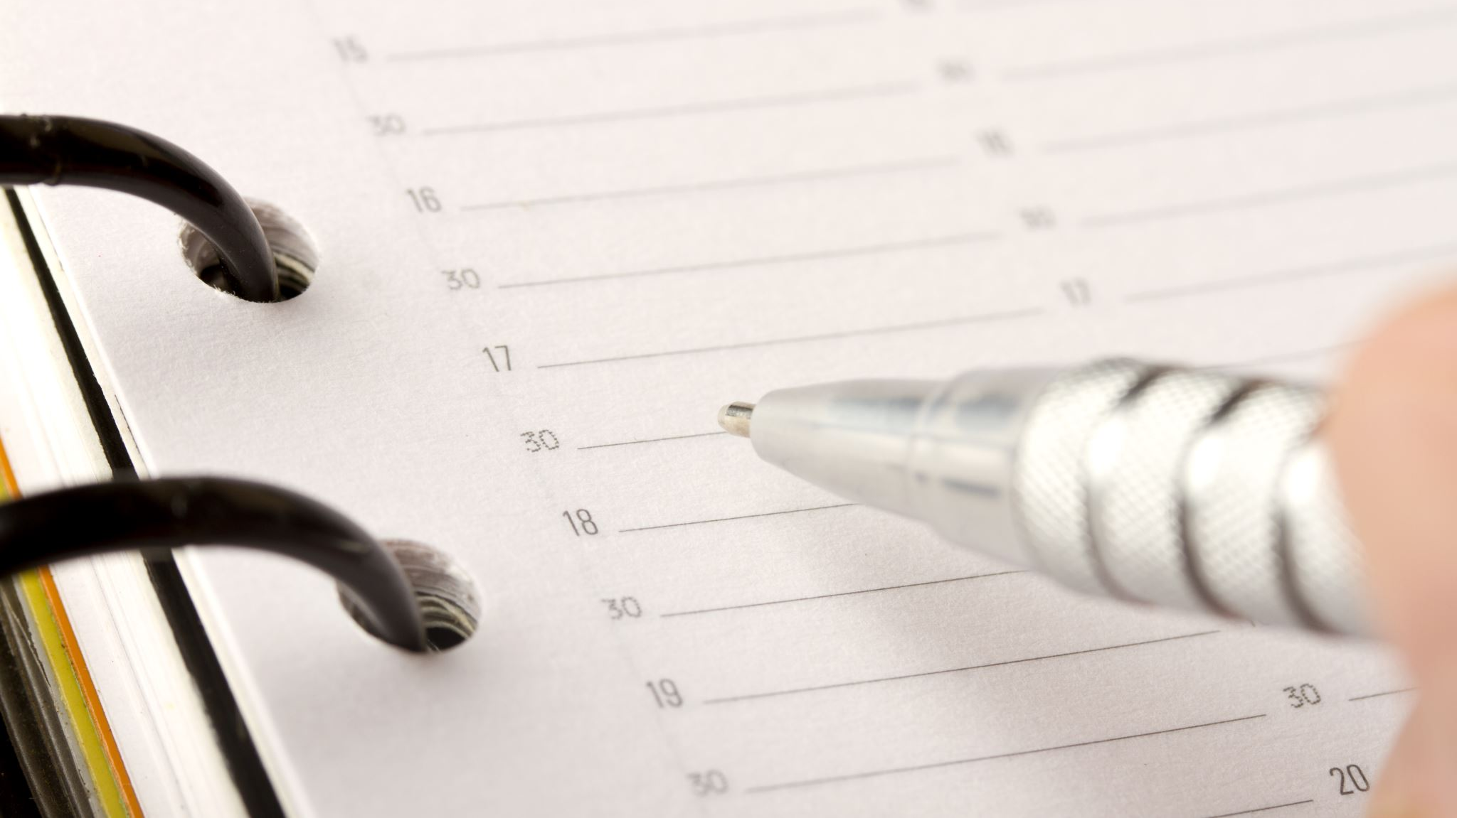
Appendix

Slide 21
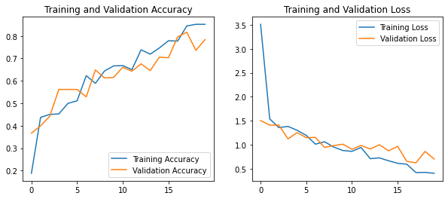
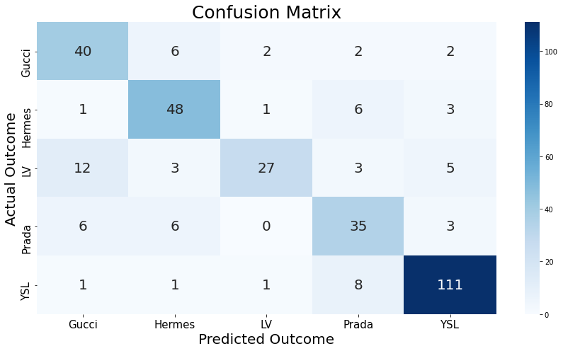
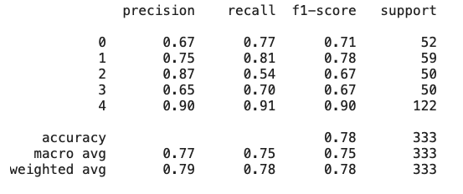
model predict outcome

Slide 22
bag hunter
Farfetch.com

