Slide 1
Hard Drives, Botnets, and how to legally build your own lab

Slide 2

How do you build your skills and tools? Don’t commit crimes, don’t be unethical… ever. Period. End of discussion.
“Do not practice anything this is of no use”
Instead of paying for expensive lab equipment, implants, courses, software… why not just Live off the Land to start?
Having to create and devise your own tools and techniques makes you appreciate the craft and makes you an infinitely better hacker.
You never have depend on a tool or a “thing” or the ones you do never go away.
LEARN THE OSI MODEL & TCP/IP STACK.
This is how we got our start. These are great rules for learning the craft of hacking & Living off the Land.

Slide 3
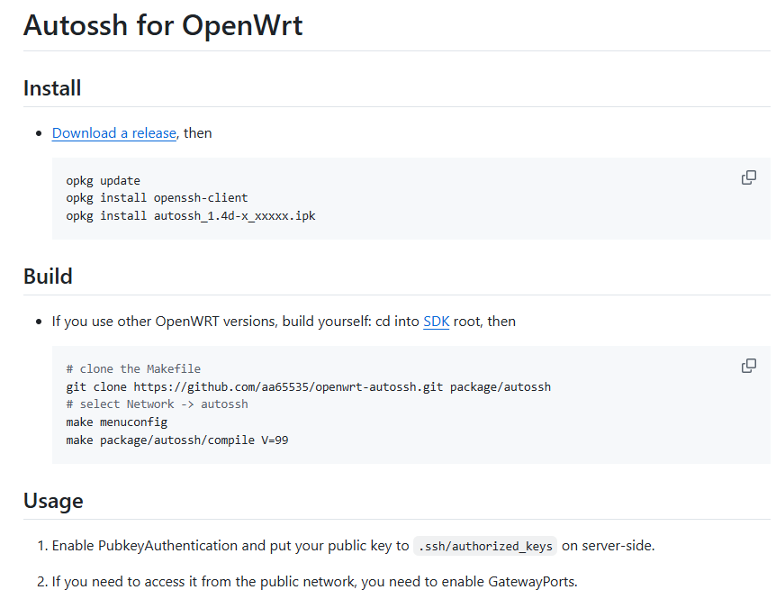
Living off the Land – Minimal Tools, Maximum Creativity
Use the tools / services / physical implants you are able to source…
“What’s around you?”
Cloud Devices and IoT are usually just embedded
clients / reverse tunnels / backdoor local recovery.
Most commercial implants are usually just embedded clients / reverse tunnels / backdoor local recovery.
Doing this yourself and learning the “how” and “why” is what makes you *elite*
It is not difficult.

Slide 4
Living off the Land -
"Living off the land" (LotL):
Attackers use legitimate tools and features already present on a target system to carry out malicious activities, rather than deploying custom malware or hacking tools.
Using Built-in Tools: Attackers leverage native operating system utilities like:
PowerShell (Windows)
Windows Management Instrumentation (WMI)
Command prompt utilities (cmd.exe)
Bash and system utilities (Linux/Unix)
Administrative tools like PsExec, netsh, or scheduled tasks
Advantages for Attackers:
Stealth: Harder to detect since these are legitimate tools
Bypass Security: Less likely to trigger antivirus alerts
No Malware Needed: No need to upload suspicious files
Persistence: Can maintain access using legitimate system features
Common IoT LotL Techniques:
Built-in Linux Utilities Most IoT devices run stripped-down Linux versions with basic tools that attackers exploit:
BusyBox: A single binary containing many Unix utilities (wget, telnet, tftp)
Shell scripts: Using sh/ash for command execution
Netcat: For network connections and data transfer
Cron: For persistence and scheduled tasks
Legitimate Protocols
Telnet/SSH: Default or weak credentials exploitation
TFTP/FTP: Downloading additional payloads
HTTP/HTTPS: Command and control communications
DNS: Covert channels for C2 communications

Slide 5
IoT Botnets – Myth vs Reality
IoT botnets extensively use Living off the Land techniques because IoT devices typically have limited resources and security controls, making them ideal targets for LotL attacks.
Resource Efficiency
No need to upload large malware files to memory-constrained devices
Uses existing binaries, saving precious storage space
Minimal CPU usage by leveraging native tools
Detection Evasion
IoT devices rarely have antivirus or EDR solutions
Limited logging capabilities make forensics difficult
Network traffic appears legitimate (using standard protocols)
Real-World Examples:
Mirai and Variants - Used built-in wget/tftp to download stages / Leveraged BusyBox utilities for spreading / Employed legitimate networking tools for DDoS attacks
Hide and Seek (HNS) - Used native peer-to-peer communication capabilities / Leveraged built-in scripting for self-propagatio

Slide 6
Solution - Building your Skillset and Lab on a Budget
Build it yourself. No legal issues, no internet issues, you can choose to learn / hack on something you know exists.
Vendor Firmware – Known Vulnerable, Not easy to find. (Good for learning / hacking / recreation) How to manually update firmware on a Wireless Plus or GoFlex Satellite | Seagate US
OpenWRT – Upgrade / Reflash using a firmware built for this. (Good for building a lab, stealth implants, fewer vulnerabilities) [OpenWrt Wiki] Seagate GoFlexHome
Debian – Upgrade / Reflash using a firmware built for this. (Good for offensive implants / simulating IoT botnets / honing your linux LotL skills)

Slide 7
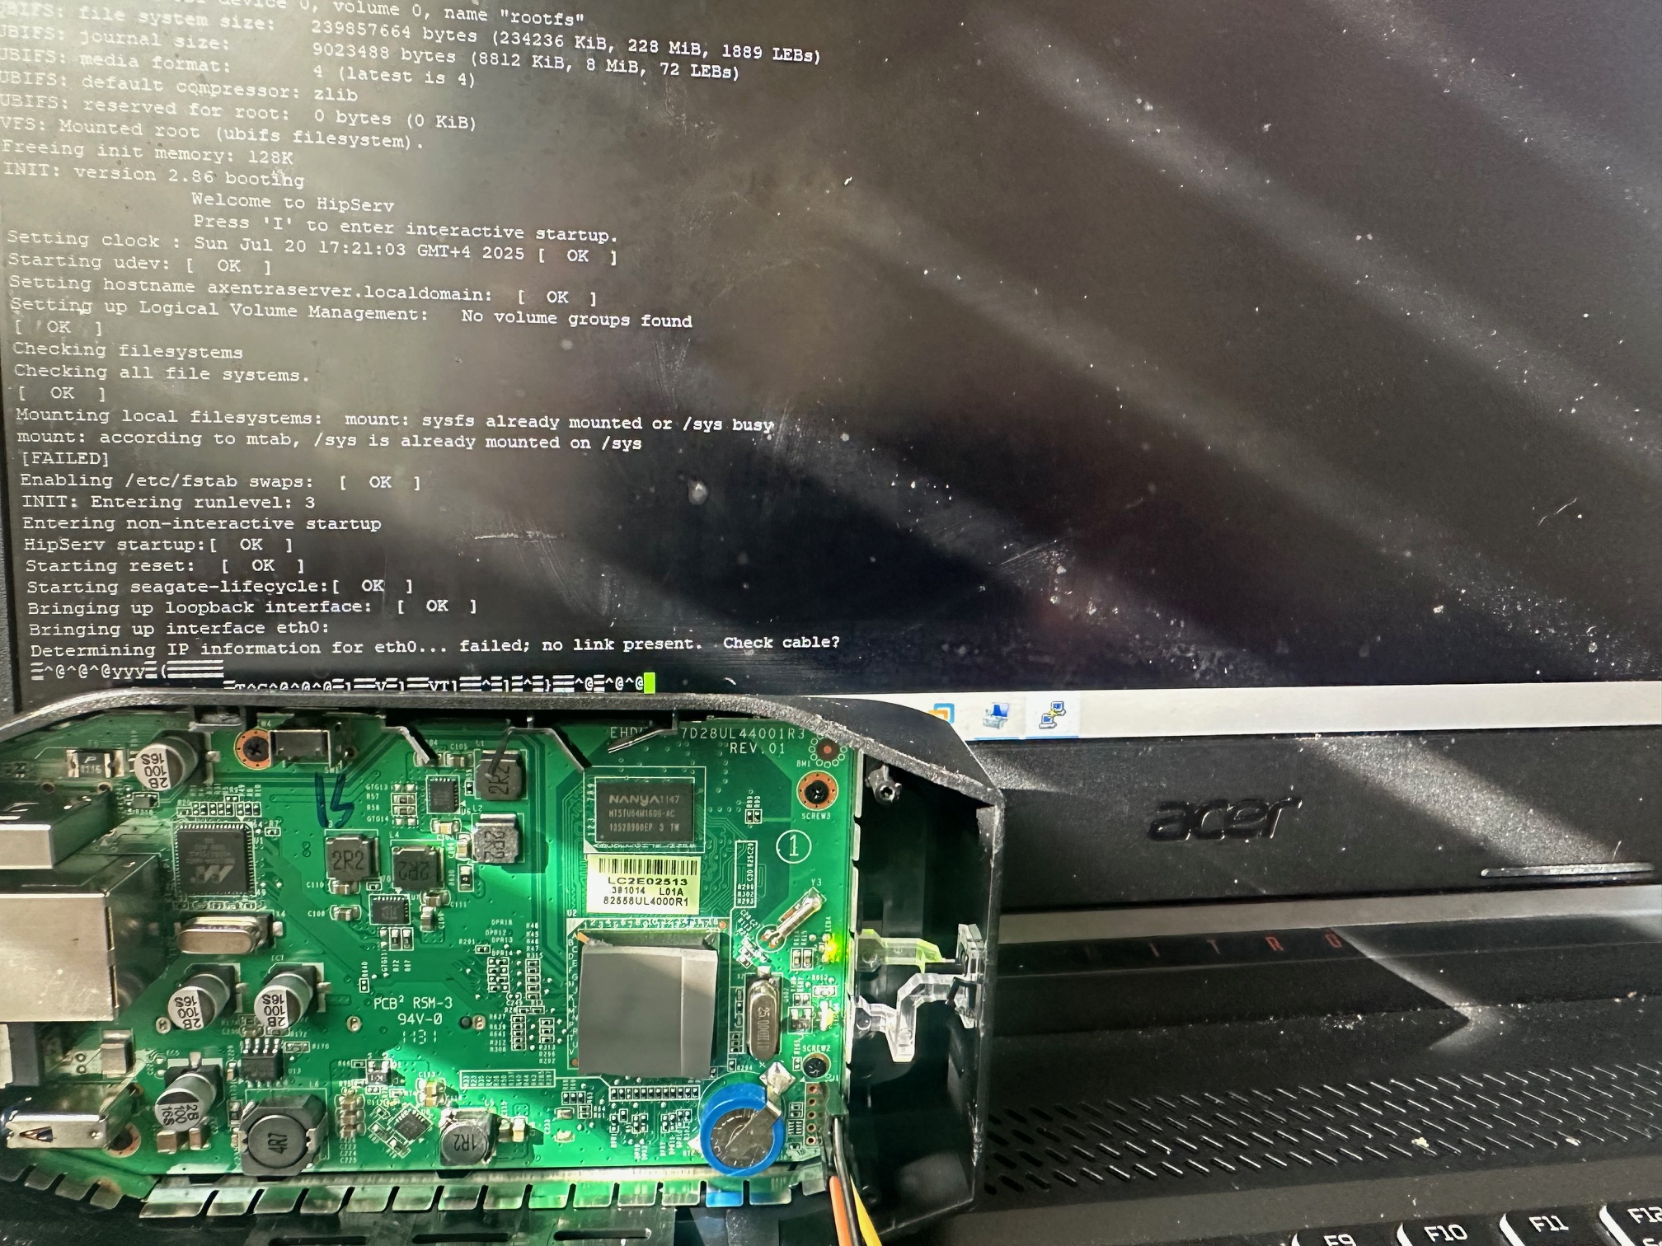
Awesome Implants & Stealth
How many people would *seriously* notice or think a portable hard drive is a physical implant device?
Devices are minimal, infinitely hackable, nearly impossible to completely brick. If you want to learn IoT hacking and basic hardware skills, it’s a great platform.
Low wattage, high storage, small form factor, modular.
Built in cryptosupport and wireless in certain configurations.
Nearly infinite supply of these – UPCYCLE! REDUCE E-WASTE
“Hiding in network plain sight” – Fun with old DDnS networks and Domains

Slide 8
Sources to Find Them:
Various vendors have EOL’d the drives.
There is still a healthy after market:
eBay / closeout resellers
Second Hand Stores, Recyclers, Market Listings
Amazon
They’re already proven vulnerable, have a lot of types of issues, can be flashed to anything you need… doesn’t break the law or get you in trouble*.
*Funny story.

Slide 9
Go to my Github and download these files
We will be booting / opening the devices and taking them apart.
TFTP Server
Firmware / Linux Distros
Uboot.kwb

Slide 10
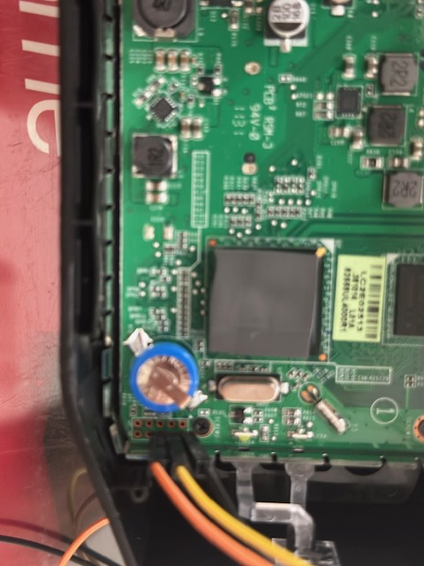
Let’s GO! Installing U-Boot and OpenWRT
TFTP and Serial – Learning about how IoT works and is designed
Devices are built for ease of maintenance, reliability, servicing in bulk.
Access / recovery is straightforward.
Serial Access / Recovery Booting / Soft Bricking
One of the best features of these specific devices is that they’re very flexible / hard to kill!

Slide 11
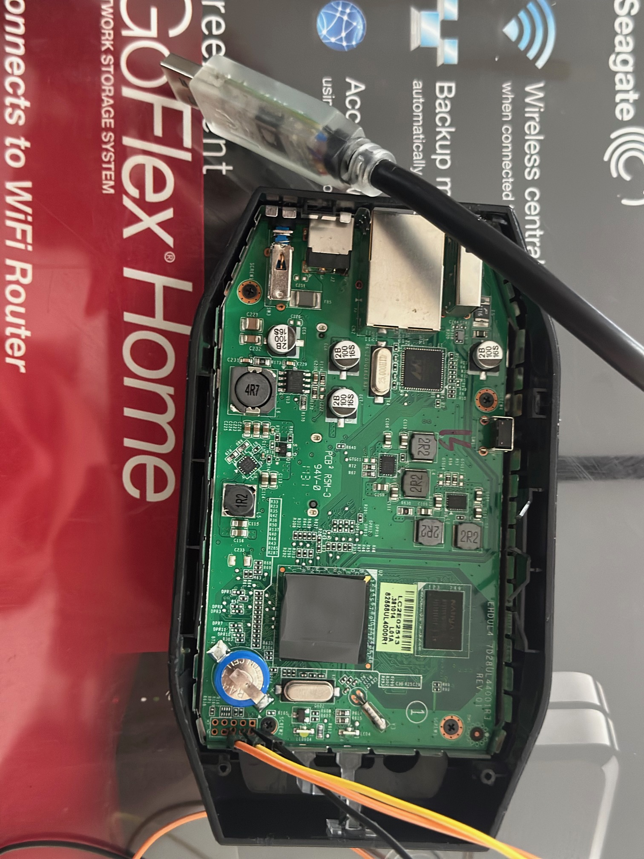
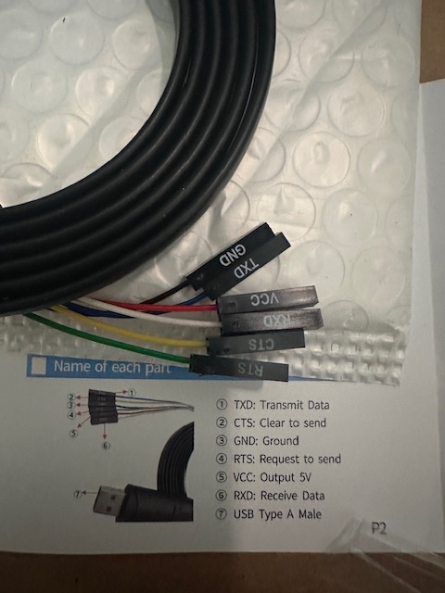
FTDI / Serial Cable
You may have an FTDI or Serial cable. MAKE SURE TO CHECK!
Select / Identify the TX / RX / GND wires.
They are typically labeled on the ends.

Slide 12
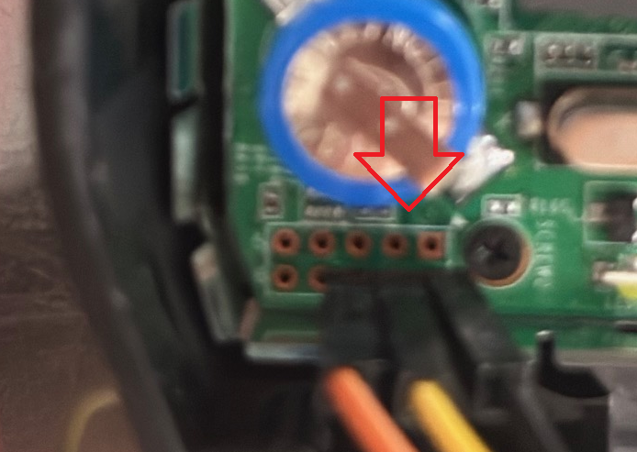
Use these Pins (Serial) – 115200 8-n-1
The drives have a SERIAL connection / header available without pins.
This allows direct console access, firmware flashing & recovering, replacement of bootloader, access to the operating system.
“Which pins do I use?”
Good question, this is part of the adventure*.
Don’t hook anything up, examine the picture here. (Hint: Black is GND.)
Only concern yourself with those pins in that orientation.
*One of the things you will have to become comfortable with is finding the answer to this question. This is not made “easy” for a reason.

Slide 13
BE VERY CAREFUL FROM HERE ON.
Even though all of this is recoverable and we’re working live… it takes some time to recover things. Be careful. This is a controlled environment. Practice good habits.
Do not brick or break the devices. Measure twice, cut once.

Slide 14
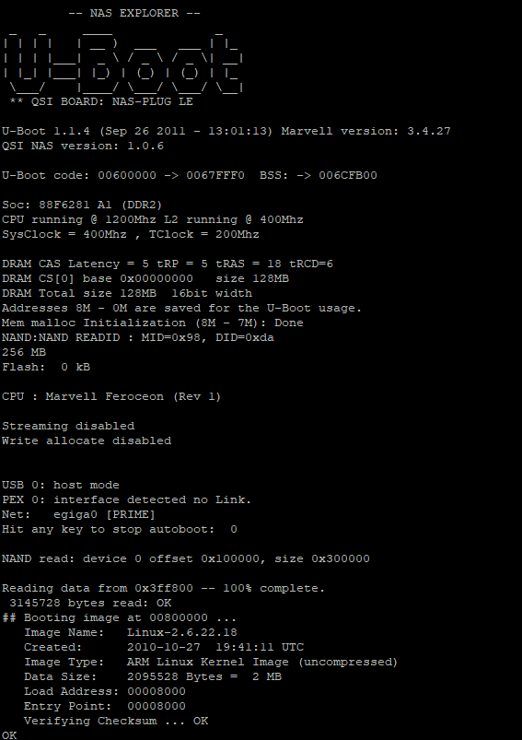
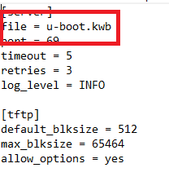
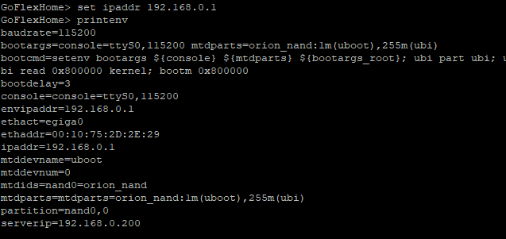
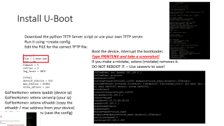
Install U-Boot
Download the python TFTP Server script or use your own TFTP server.
Run it using –create-config.
Edit the FILE for the correct TFTP file.
Boot the device, interrupt the bootloader.
Type PRINTENV and take a screenshot!
If you make a mistake, setenv (mistake) removes it.
DO NOT REBOOT IT. – Use saveenv to save!
GoFlexHome> setenv ipaddr (device ip) GoFlexHome> setenv serverip (your ip)
GoFlexHome> setenv ethaddr (copy the ethaddr / mac address from your device)
GoFlexHome> saveenv (save the config)

Slide 15
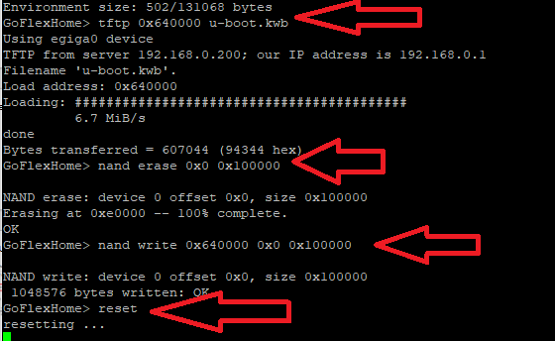
DO NOT REBOOT THE DEVICE DURING THIS OR RESET*.
Download the TFTP file:
tftp 0x640000 u-boot.kwb
Erase the current nand:
nand erase 0x0 0x100000
Write the new U-Boot:
nand write 0x640000 0x0 0x100000
Reset the device:
reset
*If you make a mistake, we will need to recover U-BOOT. It’s a good lesson in hardware recovery.

Slide 16
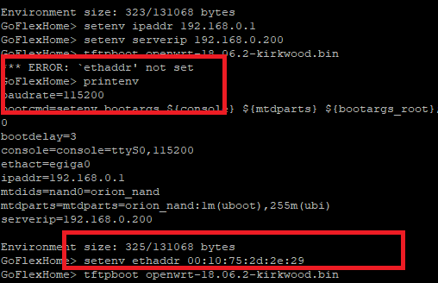
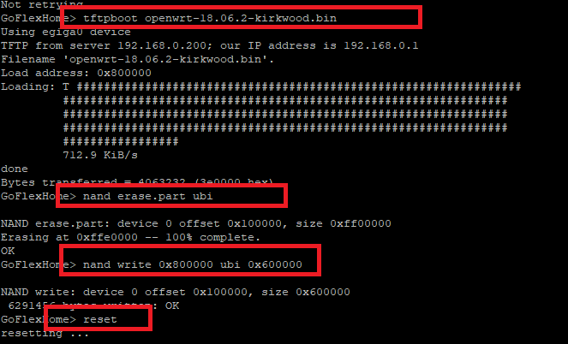

Install OpenWRT
Boot in U-Boot / break the bootloader.
Set the following variables:
Setenv ipaddr (ip of device)
Setenv serverip (your ip)
Setenv ethaddr (device MAC)
Tftpboot (name of the OpenWRT file)
Nand erase.part ubi
Nand write 0x800000 ubit 0x600000
reset
Remember that screenshot?
You’ll need the MAC address:

Slide 17
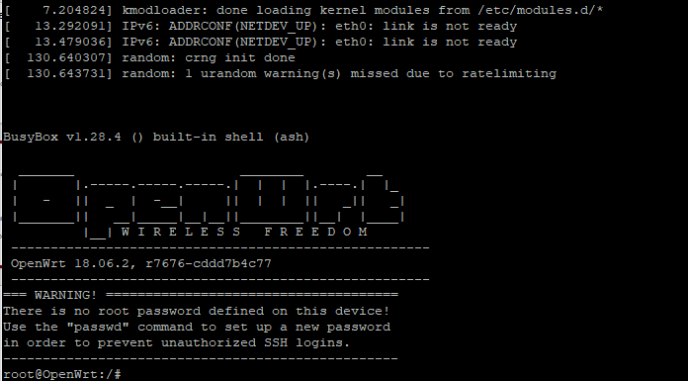
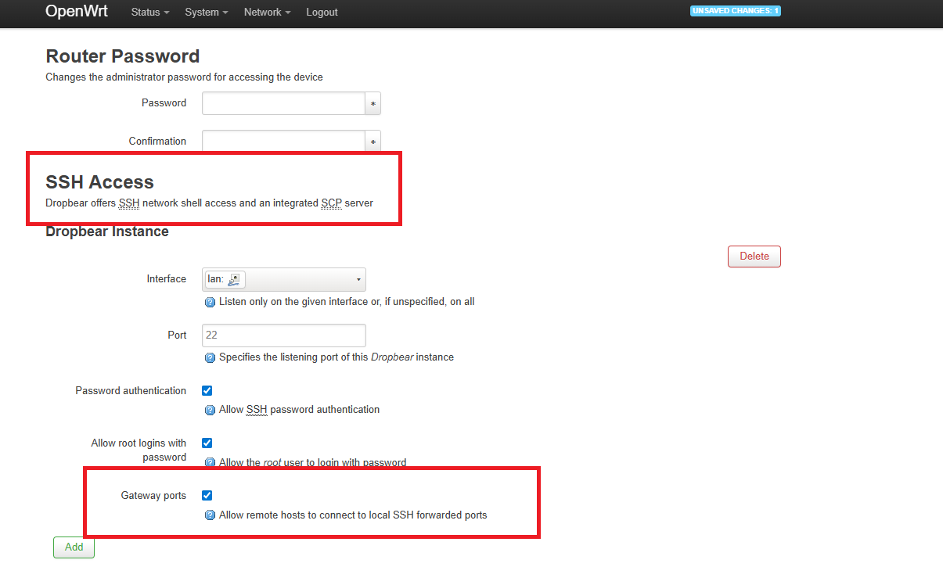
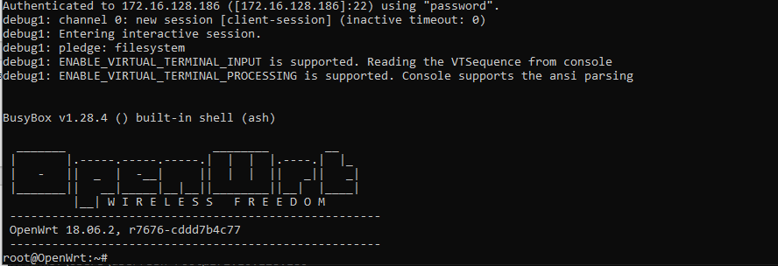
OpenWRT is installed! Remember to set your password / reboot.

Slide 18
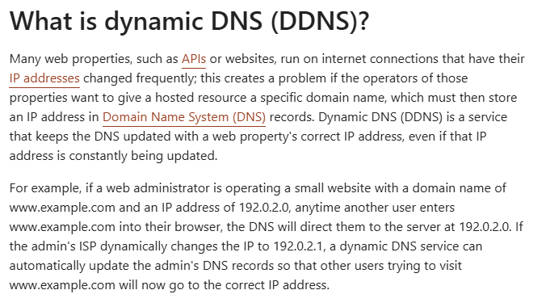
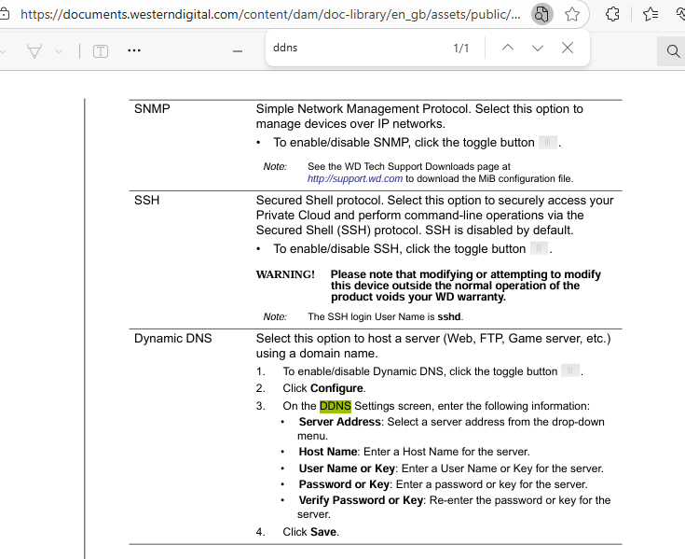
OK, who cares? You installed OpenWRT….
You have an embedded linux system that you can stage as an embedded systems exploration and hardware hacking lab.
You have the ability to simulate IoT botnets / cross load other operating systems and components.
You have the ability to customize implants focused on the same capabilities as most commercial implants for little to no money and higher storage / stealth.
You have the ability to use DDNS networks, self-registering services used by these devices for infiltration, exfiltration, pivoting, without arousing much suspicion.
SOCKS Proxy SSH Tunnels on OpenWRT | Chris Swan's Weblog
My Cloud Personal Storage Drive User Manual

Slide 19
THINK LIKE AN APT. THINK LIKE YOUR ADVERSARIES.
Get resourceful, pragmatic… USE WHAT IS AROUND YOU.

Slide 20
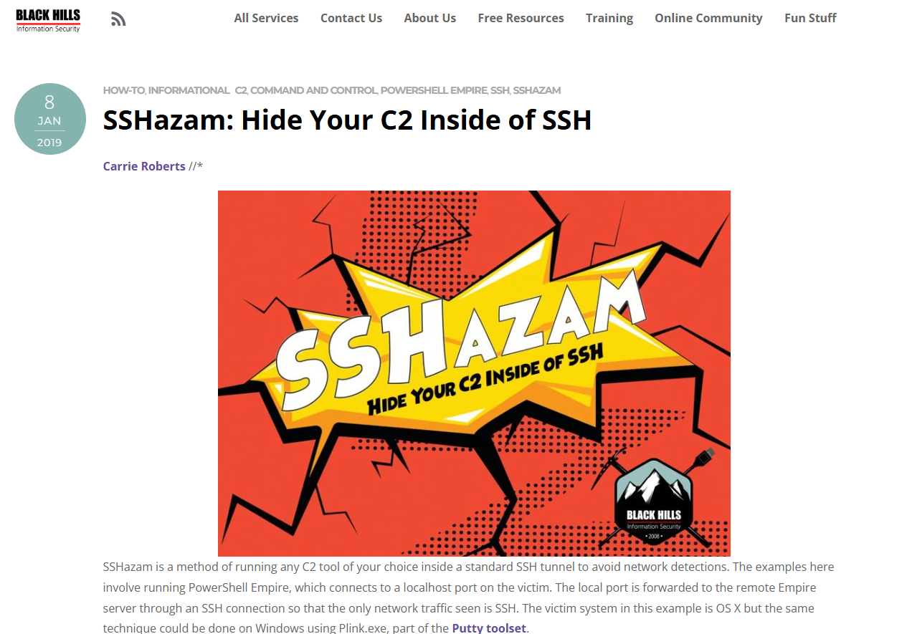
C2 Frameworks & Tools
There are an endless number of C2 frameworks, tools, reverse SSH handlers, proxies, and RMM tools available for little to no money.
You now have devices to test with, simulate with, isolate in a lab and safely, ethically & LEGALLY.
You can target vulns, specific items, setup your own capabilities, refine your techniques, come up with new ideas.
Better… if you want to start crafting your own implants / tools / techniques for pentesting, you now have a factory / method to do it yourself and customize it!
Let’s go back to the beginning…

Slide 21
Living off the Land -
"Living off the land" (LotL):
Attackers use legitimate tools and features already present on a target system to carry out malicious activities, rather than deploying custom malware or hacking tools.
Using Built-in Tools: Attackers leverage native operating system utilities like:
PowerShell (Windows)
Windows Management Instrumentation (WMI)
Command prompt utilities (cmd.exe)
Bash and system utilities (Linux/Unix)
Administrative tools like PsExec, netsh, or scheduled tasks
Advantages for Attackers:
Stealth: Harder to detect since these are legitimate tools
Bypass Security: Less likely to trigger antivirus alerts
No Malware Needed: No need to upload suspicious files
Persistence: Can maintain access using legitimate system features
Common IoT LotL Techniques:
Built-in Linux Utilities Most IoT devices run stripped-down Linux versions with basic tools that attackers exploit:
BusyBox: A single binary containing many Unix utilities (wget, telnet, tftp)
Shell scripts: Using sh/ash for command execution
Netcat: For network connections and data transfer
Cron: For persistence and scheduled tasks
Legitimate Protocols
Telnet/SSH: Default or weak credentials exploitation
TFTP/FTP: Downloading additional payloads
HTTP/HTTPS: Command and control communications
DNS: Covert channels for C2 communications

Slide 22
What are some techniques & ideas that advanced APT groups leverage that you now have at your disposal?
Funny you should ask….

Slide 23
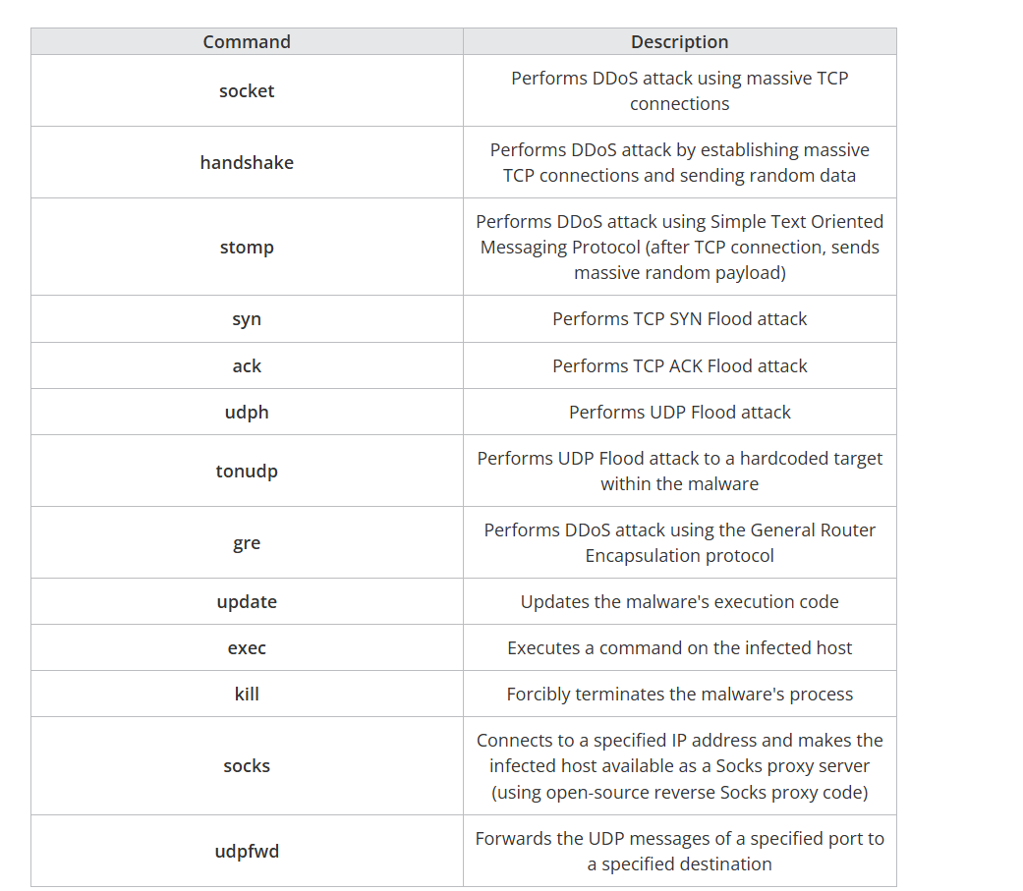
IoT Botnets – Genius use of Low Resource Hacking and Building Your Own Protocols
IoT Botnets are NOT exotic or overly complex. The best are simple, effective, efficient, pragmatic!
Commands
The command messages are text messages with a message length of two bytes added at the beginning, and use the following structure:
<Message Length 2 bytes>.<Text Message>
The text message portion is a string that represents the command and arguments separated by spaces (for example, a message like "syn xxx.xxx.xxx.xxx 0 0 60 1"). This command means that it will perform a SYN Flood attack for 60 seconds on a random port number (0 meaning random) of the attack target IP address indicated by xxx.xxx.xxx.xxx.
We found that the commands shown in Table 1 may be used. From the identified commands, we discovered that hosts infected with this malware may not only participate in DDoS attacks, but could also be used as part of an underground proxy service. Table 1 shows the commands that were identified through the analysis.
IoT Botnet Linked to Large-scale DDoS Attacks Since the End of 2024 | Trend Micro (US)

Slide 24
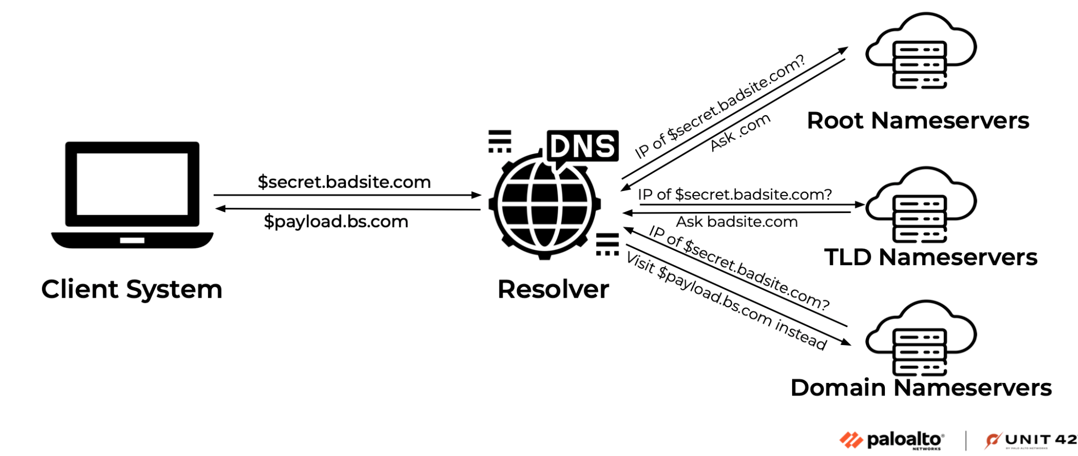
DNS Tunneling and DDNS Based Beaconing inside Device Self-Registration Services
“Bad actors use DNS tunneling to get data through firewalls. DNS tunneling encodes command and control (C&C) messages or small amounts of data into inconspicuous DNS responses and queries. Since DNS messages can only contain a small amount of data, any commands must be small and data exfiltration happens slowly. Suspicious DNS traffic can be difficult to detect because DNS is a noisy protocol, making it harder to distinguish a normal host query and normal DNS traffic from malicious activity.”
How it works:
The bad actor has a server running malware on it, with a domain pointing to that server.
The attacker uses a host they have infected with malware to query for the attacker-controlled domain.
When the DNS resolver routes the query, it creates a tunnel from the attacker to their target, allowing them to get data, remotely control the host, or otherwise take the next step in the attack chain.
DNS Tunneling Attack: Definition, Examples, and Prevention | ExtraHop
Another good source:
DNS Tunneling attack - What is it, and how to protect ourselves? - ClouDNS Blog
Picture Credit: Palo Alto Unit 42

Slide 25
GET HACKING.

