Slide 1

AVA-SH Test Review
Team f5
SYSC 3010 Cheung, Charlebois, Garlough, Van Kerkhoven

Slide 2
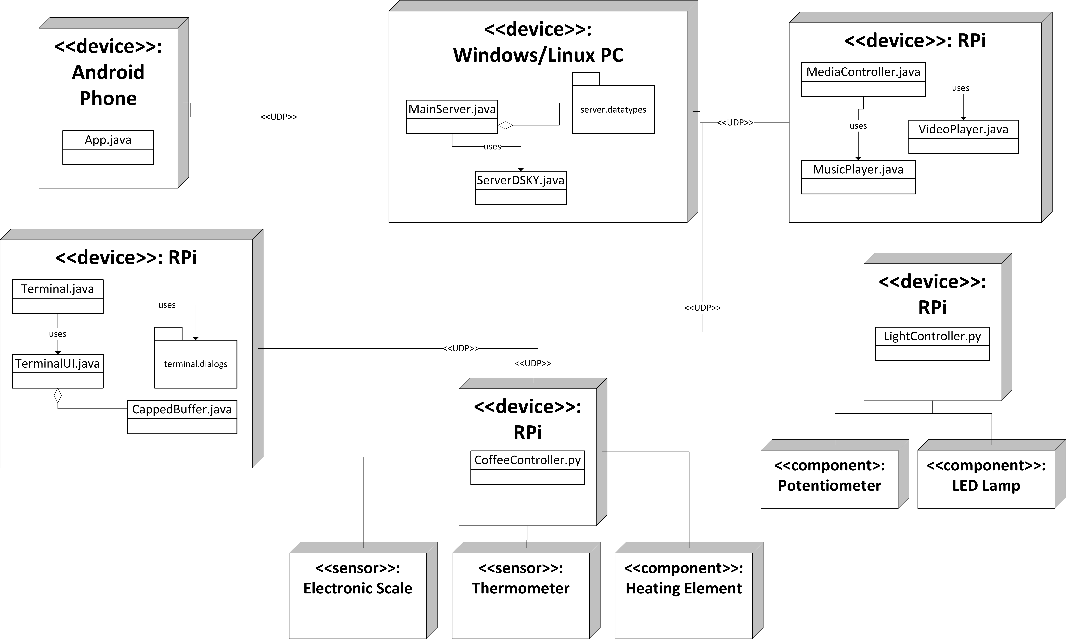
SYSC 3010 Cheung, Charlebois, Garlough, Van Kerkhoven
Notes:
Windows/Linux PC:
-will be acting as server, using a MainServer class, the DSKY interface and custom made datatypes
-able to communicate with all modules using UDP
Media Controller
-used to play music, and possibly video
-Has database of music and video the user can play
Light Controller:
-RPi will communicate with 1 component
1. LED’s: used to slowly brighten room
-will be controlled using PWM on a GPIO pin
-also has a speaker used to play an alarm (using the 3.5mm jack on the RPi)
Coffee Maker:
-RPi will communicate with 3 components:
1. Electronic Scale: used to weigh cup before and during coffee making to make sure proper amounts of coffee are made
-interfaced using USB port on RPi
2. Thermometer: used to monitor water temp
-interfaced using AD converted on Gertboard
3. Heating Element: used to heat water
-interfaced via RPi GPIO connected to a simple transistor
Terminal:
-GUI for user to enter commands to AVA

Slide 3
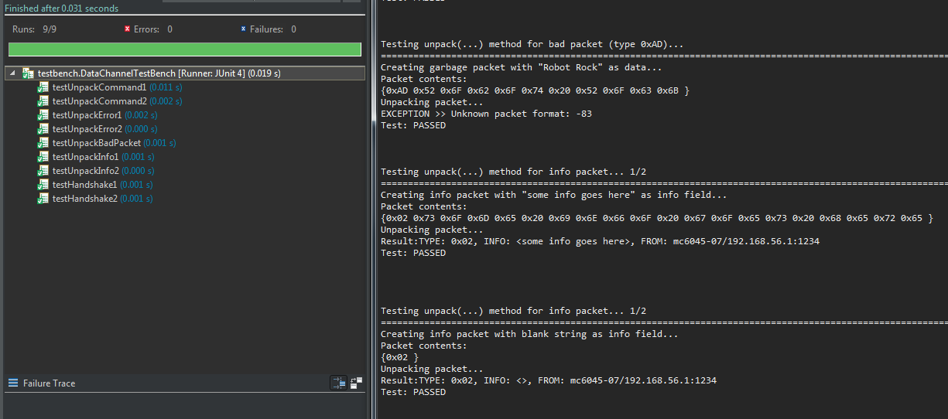
Unit Testing: General Utility Class
DataChannel.java
SYSC 3010 Cheung, Charlebois, Garlough, Van Kerkhoven

Slide 4

testUnpackBadPacket
Description:
Creates a non-valid packet with
Type: 0xAD
DataChannel detects the invalid opcode during packet unpacking
Results in a thrown NetworkException
SYSC 3010 Cheung, Charlebois, Garlough, Van Kerkhoven

Slide 5

testUnpackCommand1
Description:
Creates a command packet with
Command Key: “new alarm”
Extra Info: “{hour: 7, minute: 00, name: wake_up}”
DataChannel assembles and sends the command packet
DataChannel receives the packet and unpacks
Received data should have identical Type, Command Key and Info
SYSC 3010 Cheung, Charlebois, Garlough, Van Kerkhoven

Slide 6
testUnpackCommand2
Description:
Creates a command packet with
Command Key: “toggle light”
Extra Info: “”
DataChannel assembles and sends the command packet
DataChannel receives the packet and unpacks
Received data should have identical Type, Command Key and Info
SYSC 3010 Cheung, Charlebois, Garlough, Van Kerkhoven

Slide 7

testUnpackError1
Description:
Creates an error packet with
Error Message: “you’ve broken something”
DataChannel receives the packet and unpacks
Received data should have identical Type and Error Message
SYSC 3010 Cheung, Charlebois, Garlough, Van Kerkhoven

Slide 8
testUnpackError2
Description:
Creates an error packet with
Error Message: “”
DataChannel receives the packet and unpacks
Received data should have identical Type and Error Message
SYSC 3010 Cheung, Charlebois, Garlough, Van Kerkhoven

Slide 9

testUnpackInfo1
Description:
Creates an info packet with
Info Message: “some info goes here”
DataChannel receives the packet and unpacks
Received data should have identical Type and Error Message
SYSC 3010 Cheung, Charlebois, Garlough, Van Kerkhoven

Slide 10
testUnpackInfo2
Description:
Creates an info packet with
Info Message: “”
DataChannel receives the packet and unpacks
Received data should have identical Type and Error Message
SYSC 3010 Cheung, Charlebois, Garlough, Van Kerkhoven

Slide 11

testHandshake1
Description:
Creates a handshake packet with Type 0x00
Handshake Key: “Handshake Test”
Device name: “Terminal”
DataChannel receives the packet and unpacks
Received data should have identical Key and Device
SYSC 3010 Cheung, Charlebois, Garlough, Van Kerkhoven

Slide 12
testHandshake2
Description:
Creates a handshake packet with Type 0x00
Handshake Key: “”
Device name: “”
DataChannel receives the packet and unpacks
Received data should have identical Key and Device
SYSC 3010 Cheung, Charlebois, Garlough, Van Kerkhoven

Slide 13
No. | Title | Context | Inputs | Expected Outputs
1 | testUnpackBadPacket | PacketWrapper, DataException | Type: 0xAD | Network Exception
2 | testUnpackCommand1 | PacketWrapper, DataException | Command Key: “new alarm” Extra Info: “{hour: 7, minute: 00, name: wake_up}” | Identical Type, Command Key and Info
3 | testUnpackCommand2 | PacketWrapper, DataException | Command Key: “toggle light” Extra Info: “” | Identical Type, Command Key and Info
4 | testUnpackError1 | PacketWrapper, DataException | Error Message: “you’ve broken something” | Identical Type and Error Message
5 | testUnpackError2 | PacketWrapper, DataException | Error Message: “” | Identical Type and Error Message
6 | testUnpackInfo1 | PacketWrapper, DataException | Info Message: “some info goes here” | Identical Type and Info Message
7 | testUnpackInfo2 | PacketWrapper, DataException | Info Message: “” | Identical Type and Info Message
8 | testHandshake1 | PacketWrapper, DataException | Handshake Key: “Handshake Test” Device name: “Terminal” | Identical Type, Handshake Key and Device Name
9 | testHandshake2 | PacketWrapper, DataException | Handshake Key: “” Device name: “l” | Identical Type, Handshake Key and Device Name
SYSC 3010 Cheung, Charlebois, Garlough, Van Kerkhoven

Slide 14
Unit Testing: Embedded Unit Test
No. | Title | Description | Context | Inputs | Expected Outputs
SYSC 3010 Cheung, Charlebois, Garlough, Van Kerkhoven

Slide 15
Unit Testing: Distributed System Unit Test
No. | Title | Description | Context | Inputs | Expected Outputs
SYSC 3010 Cheung, Charlebois, Garlough, Van Kerkhoven

Slide 16
Acceptance Testing & Distributed System Scenarios
System Requirements:
Allow the user to schedule multiple system actions to occur at a certain time
Respond to user commands from both a mobile app and computer terminal in a timely manner
The system should be highly modular
SYSC 3010 Cheung, Charlebois, Garlough, Van Kerkhoven
Notes:
The system will need to be able to execute certain actions at pre-defined times, such as brightening the wake-up lamp a certain time before wake-up
The system will need to answer and execute user commands quickly, with little perceived delay
The system should be highly modular, to make adding new modules easy, as well as encourage the use of modules

Slide 17
Setting an alarm from the App
User selects “New Alarm” Button
Command packet created with
Command Key: “new alarm”
Extra Info: “{hour: 7, minute: 00, name: wake_up}”
Server interprets the command

Slide 18

Milestone Name | Scheduled Completion Date | Actual Completion Data
Basic Server Framework | February 12th | February 21st
Terminal Functionality | February 19th | February 10th
Communication Protocol Finalized + Implemented | February 26th | February 20th
Testing Server-Terminal Communication on separate machines | February 28th | February 26th
Scheduling Timed Events | March 4th | N/A
App Functionality | March 4th | N/A
Full System Test with at least one module | March 12th | N/A
SYSC 3010 Cheung, Charlebois, Garlough, Van Kerkhoven
Notes:
-Both Terminal and Server complete
-App has a framework, without any backend implementation
-Hardware has been ordered and most has arrived
-integration of arrived sensors in underway

