Slide 1

AVA-SH Test Review
Team f5
SYSC 3010 Cheung, Charlebois, Garlough, Van Kerkhoven

Slide 2
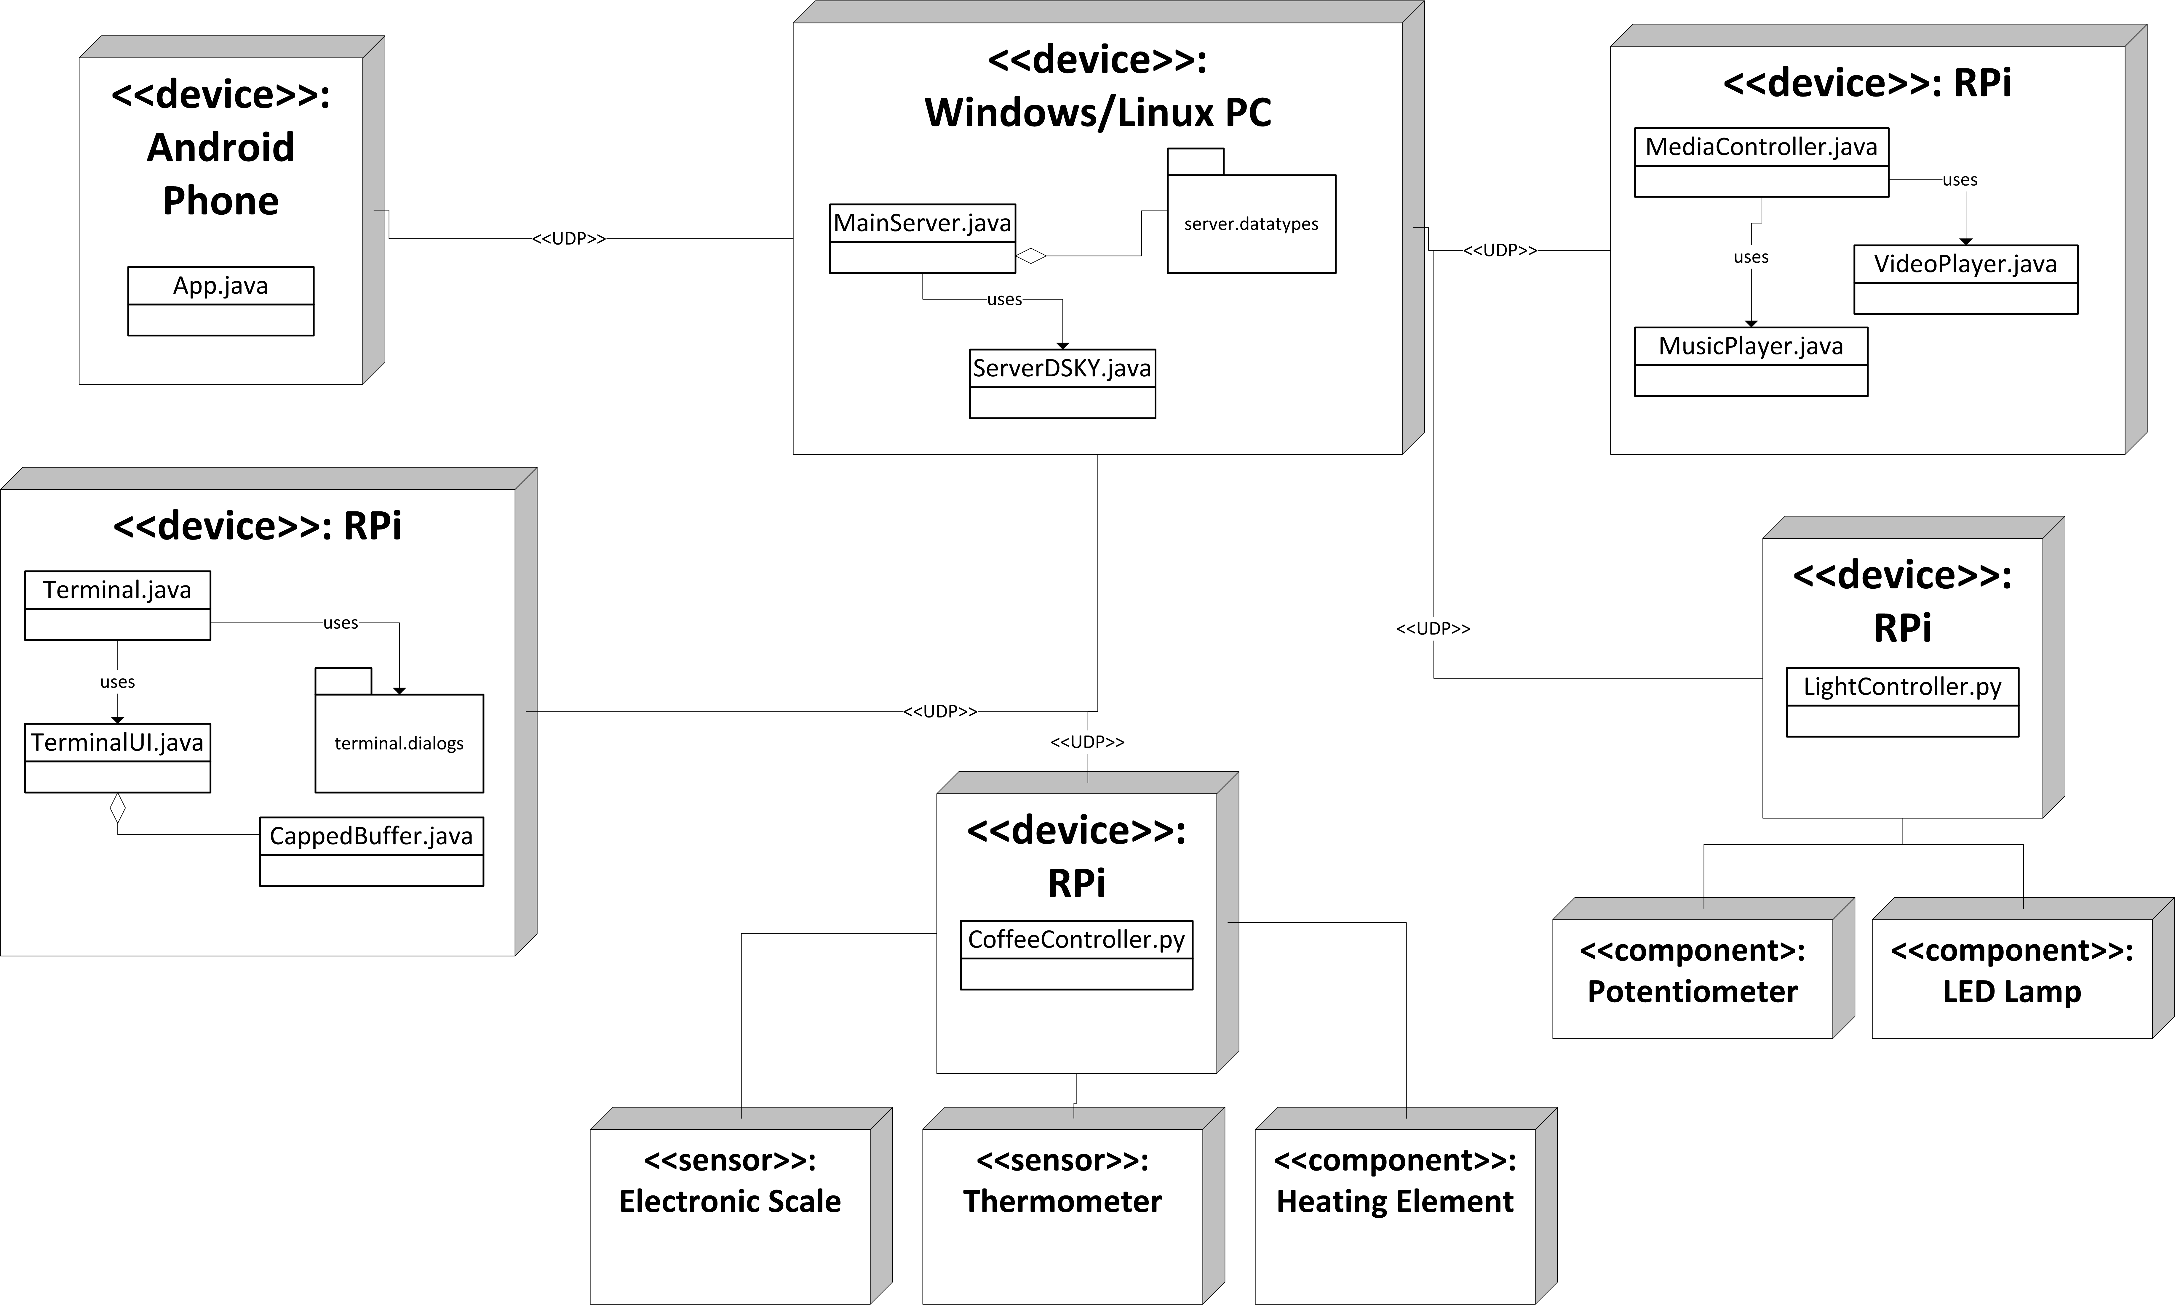
SYSC 3010 Cheung, Charlebois, Garlough, Van Kerkhoven
Notes:
Windows/Linux PC:
-will be acting as server, using a MainServer class, the DSKY interface and custom made datatypes
-able to communicate with all modules using UDP
Media Controller
-used to play music, and possibly video
-Has database of music and video the user can play
Light Controller:
-RPi will communicate with 1 component
1. LED’s: used to slowly brighten room
-will be controlled using PWM on a GPIO pin
-also has a speaker used to play an alarm (using the 3.5mm jack on the RPi)
Coffee Maker:
-RPi will communicate with 3 components:
1. Electronic Scale: used to weigh cup before and during coffee making to make sure proper amounts of coffee are made
-interfaced using USB port on RPi
2. Thermometer: used to monitor water temp
-interfaced using AD converted on Gertboard
3. Heating Element: used to heat water
-interfaced via RPi GPIO connected to a simple transistor
Terminal:
-GUI for user to enter commands to AVA

Slide 3
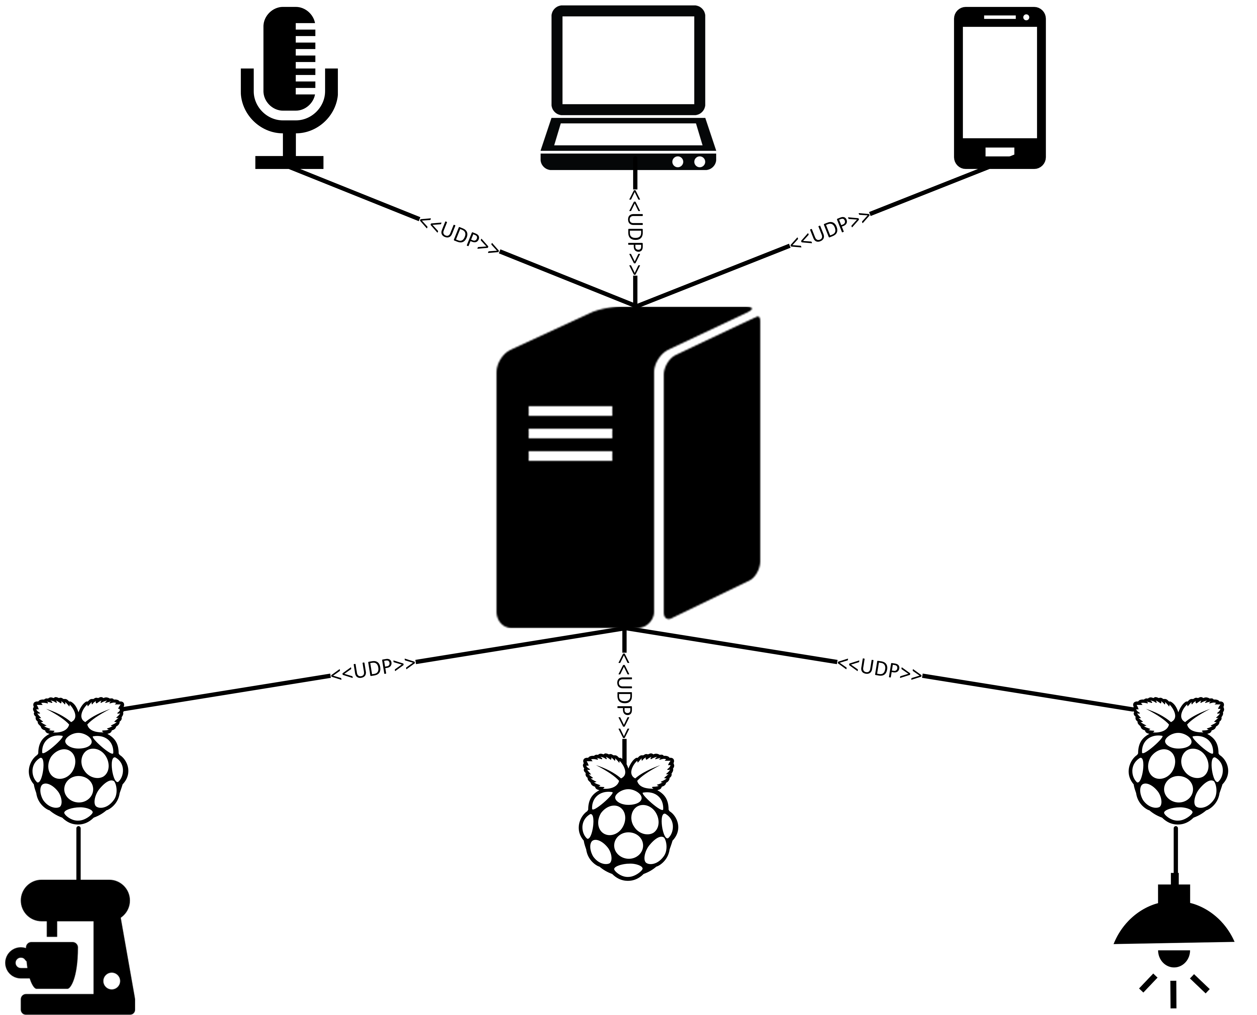
User Interfaces
Voice Interface
Terminal on RPi
Android App
Central AVA Server
Modules
Smart Coffee Machine
Smart TV/Sound-System
Alarm
SYSC 3010 Cheung, Charlebois, Garlough, Van Kerkhoven
Notes:
Network Diagram of the AVA-SH
The user interfaces do not communicate directly with the modules, they only communicate with the server which can then pass the commands to the modules
The modules also should not communicate directly with each other, to maintain high modularity
Uses Client-Server design, wherein the modules/interfaces are the clients and the server is the main AVA serve

Slide 4
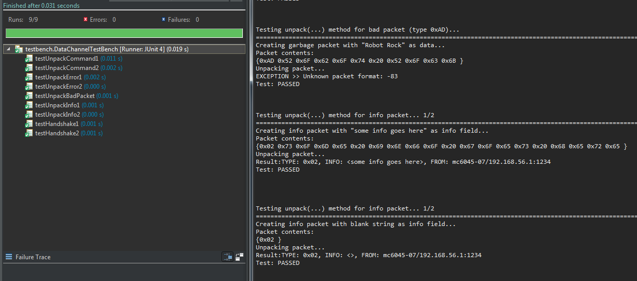
Unit Testing: General Utility Class
DataChannel.java
SYSC 3010 Cheung, Charlebois, Garlough, Van Kerkhoven
Notes:
-Automatically packs and unpacks packets
-Ease of formatting
-Used globally throughout the system
-UDP packets
For all tests we use TWO instances of DataChannel
One for sending+packing packets
One for receiving+unpacking packets
Sender DataChannel packs the data and sends it to the local address on socket 1234
Receiver DataChannel receives the data on socket 1234 and unpacks it The unpacked data is then compared to the original data
Total of 9 tests total Describe picture
Use of JUnitTest framework for quick test summaries (left side of image)
Use of printing detailed logs for debugging if tests fail (right side of image)

Slide 5

testUnpackBadPacket
Description:
Creates a non-valid packet with
Type: 0xAD
DataChannel detects the invalid opcode during packet unpacking
Results in a thrown NetworkException
SYSC 3010 Cheung, Charlebois, Garlough, Van Kerkhoven
Notes:
Document on packet types and uses @ → https://github.com/SYSC-3010-F5/AVA-SH/blob/master/docs/Packet-Format.txt
Testing a packet send with invalid opcode
Packet with bad opcode is manually constructed as a byte array and sent to the receiving data channel
Receving DataChannel attempts to unpack the packet
Detects an invalid opcode and throws a NetworkException

Slide 6

testUnpackCommand1
Description:
Creates a command packet with
Command Key: “new alarm”
Extra Info: “{hour: 7, minute: 00, name: wake_up}”
DataChannel assembles and sends the command packet
DataChannel receives the packet and unpacks
Received data should have identical Type, Command Key and Info
SYSC 3010 Cheung, Charlebois, Garlough, Van Kerkhoven
Notes:
-Command packets contain two fields of data, they are used to tell the server and modules to do a task
-Command Key
-Extra Info
-These fields change for each type of command we wish to send
-The sender inputs the parameters, Command Key and Extra Info
- Sending data channel constructs a packet with these information fields and sends it
- Receiving data channel receives the packet, unpacks it, and returns the information
- Returned command key and extra info are compared to the original command key and extra info

Slide 7
testUnpackCommand2
Description:
Creates a command packet with
Command Key: “toggle light”
Extra Info: “”
DataChannel assembles and sends the command packet
DataChannel receives the packet and unpacks
Received data should have identical Type, Command Key and Info
SYSC 3010 Cheung, Charlebois, Garlough, Van Kerkhoven
Notes:
Similar test to the previous
The extra info field is empty, ie two 0x00 bytes after the command key
Sender packs and sends the packet
Reciever gets and unpackets the packet
Orignal data is compared to received data

Slide 8

testUnpackError1
Description:
Creates an error packet with
Error Message: “you’ve broken something”
DataChannel receives the packet and unpacks
Received data should have identical Type and Error Message
SYSC 3010 Cheung, Charlebois, Garlough, Van Kerkhoven
Notes:
Error packets contain one field of data
-Error msg
Used to denote an error has occurred in some form
The sender calls its sendError() method with a string as the parameter
Sender packs and sends
The receiving data channel gets and unpacks the packet
We check to make sure DataChannel recognized the packet as an error type, and parsed out the error message correctly

Slide 9
testUnpackError2
Description:
Creates an error packet with
Error Message: “”
DataChannel receives the packet and unpacks
Received data should have identical Type and Error Message
SYSC 3010 Cheung, Charlebois, Garlough, Van Kerkhoven
Notes:
Same concept as previous test, but with an empty error message
sendError() method called again with an empty string for the parameter
Same process of packing, sending, receiving, unpacking
Check to make sure the type and error message are the same from start to end

Slide 10

testUnpackInfo1
Description:
Creates an info packet with
Info Message: “some info goes here”
DataChannel receives the packet and unpacks
Received data should have identical Type and Error Message
SYSC 3010 Cheung, Charlebois, Garlough, Van Kerkhoven
Notes:
Info packets contain one field of data, they are used to send information on objects/status updates between server and modules
- info field
Sender called the sendInfo() method with a string as the parameter
The data is packed and sent by the Sender DataChannel
Received by receiving data channel and unpacked
Packet type and fields are checked

Slide 11
testUnpackInfo2
Description:
Creates an info packet with
Info Message: “”
DataChannel receives the packet and unpacks
Received data should have identical Type and Error Message
SYSC 3010 Cheung, Charlebois, Garlough, Van Kerkhoven
Notes:
Empty info packets are used in our system as an acknowledgment
Ie if I set a timer to go off in an hour, the server will send back an empty info packet to confirm the timer has seen set
sendInfo() method called and given a 0 length string
Packed, sent, received, unpacked
Original data compared to end data

Slide 12

testHandshake1
Description:
Creates a handshake packet with Type 0x00
Handshake Key: “Handshake Test”
Device name: “Terminal”
DataChannel receives the packet and unpacks
Received data should have identical Key and Device
SYSC 3010 Cheung, Charlebois, Garlough, Van Kerkhoven
Notes:
Every device in our system must be registered with the server under some name
Upon startup, each device sends server a handshake packet in order to begin a connection and register
Two fields to correctly pack data into
- Handshake Key → a string key that must match the copy server has for a device to be register
- Device Name → the name we register under
sendHandshake() method is called from sender with valid strings for both parameters
Packet is constructed and sent
Receiver gets packet, and unpacks it
We check to confirm that the resulting data contains the correct type, key, and device name

Slide 13
testHandshake2
Description:
Creates a handshake packet with Type 0x00
Handshake Key: “”
Device name: “”
DataChannel receives the packet and unpacks
Received data should have identical Key and Device
SYSC 3010 Cheung, Charlebois, Garlough, Van Kerkhoven
Notes:
If a device completes its registration correctly (ie the key it provided was valid), server responds with an empty handshake packet (2 0x00 bytes)
We call the sendHandshake() method with empty strings for both parameters
Data is packed, sent, received, and unpacked
Check to confirm unpacking works even with empty fields

Slide 14
No. | Title | Context | Inputs | Expected Outputs
1 | testUnpackBadPacket | PacketWrapper, DataException | Type: 0xAD | Network Exception
2 | testUnpackCommand1 | PacketWrapper, DataException | Command Key: “new alarm” Extra Info: “{hour: 7, minute: 00, name: wake_up}” | Identical Type, Command Key and Info
3 | testUnpackCommand2 | PacketWrapper, DataException | Command Key: “toggle light” Extra Info: “” | Identical Type, Command Key and Info
4 | testUnpackError1 | PacketWrapper, DataException | Error Message: “you’ve broken something” | Identical Type and Error Message
5 | testUnpackError2 | PacketWrapper, DataException | Error Message: “” | Identical Type and Error Message
6 | testUnpackInfo1 | PacketWrapper, DataException | Info Message: “some info goes here” | Identical Type and Info Message
7 | testUnpackInfo2 | PacketWrapper, DataException | Info Message: “” | Identical Type and Info Message
8 | testHandshake1 | PacketWrapper, DataException | Handshake Key: “Handshake Test” Device name: “Terminal” | Identical Type, Handshake Key and Device Name
9 | testHandshake2 | PacketWrapper, DataException | Handshake Key: “” Device name: “l” | Identical Type, Handshake Key and Device Name
SYSC 3010 Cheung, Charlebois, Garlough, Van Kerkhoven
Notes:
Summary of the 9 tests run on DataChannel.java class

Slide 15
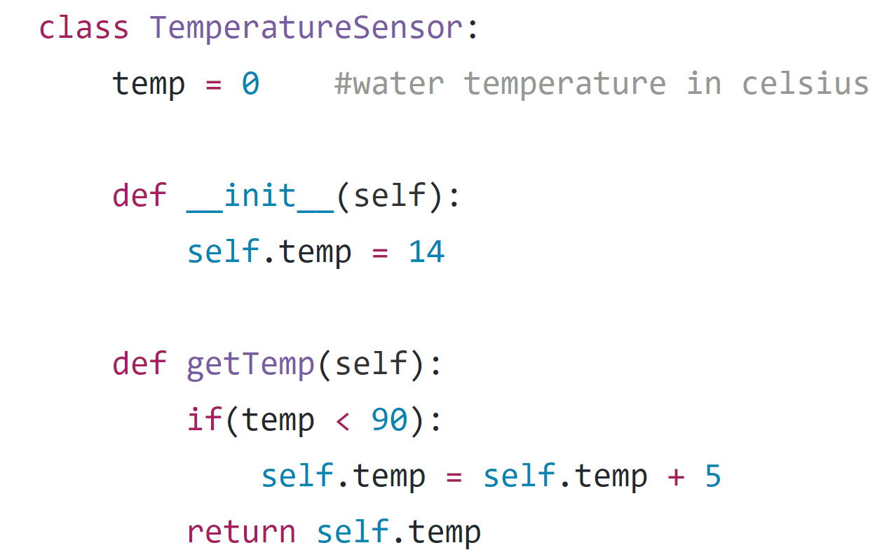
Temperature Sensor Stub
SYSC 3010 Cheung, Charlebois, Garlough, Van Kerkhoven

Slide 16
testCoffeeEvent
Description:
Sends a command to make coffee at a specified time in the future
Command Key: “sch event”
Extra info: JSON formatted text containing trigger time and command
DataChannel receives the packet and unpacks
CoffeeController parses the JSON and sets a ServerEvent at the trigger time
Once the trigger time is reached, turn on the coffee machine and begin polling the temperature sensor
Temperature sensor should return higher and higher temps
SYSC 3010 Cheung, Charlebois, Garlough, Van Kerkhoven

Slide 17
testPeriodicCoffee1
Description:
Schedules coffee to be made repeatedly
Command Key: “sch event”
Extra info: JSON file, with trigger times as 7 AM every day
DataChannel receives the packet and unpacks
CoffeeController creates the ServerEvent
CoffeeController turns on coffee machine at 7 AM
CoffeeController turns on coffee machine again at 7 AM the next day
SYSC 3010 Cheung, Charlebois, Garlough, Van Kerkhoven

Slide 18
testPeriodicCoffee2
Description:
Schedules coffee to be made repeatedly
Command Key: “sch event”
Extra info: JSON file, with trigger times as 7 AM every Wednesday and Friday
DataChannel receives the packet and unpacks
CoffeeController creates the ServerEvent
CoffeeController turns on coffee machine at 7 AM, Wednesday
CoffeeController turns on coffee machine again at 7 AM the next Friday
SYSC 3010 Cheung, Charlebois, Garlough, Van Kerkhoven

Slide 19
Unit Testing: Embedded Unit Test
No. | Title | Context | Inputs | Expected Outputs
1 | testCoffeeEvent | CoffeeController, DataChannel | Command Key: “sch event” Extra Info: JSON file | Temp. sensor heats up at trigger time
2 | testPeriodicCoffee1 | CoffeeController, DataChannel | Command Key: “sch event” Extra Info: JSON file | Temp. sensor heats up at trigger times
3 | testPeriodicCoffee2 | CoffeeController, DataChannel | Command Key: “sch event” Extra Info: JSON file | Temp. sensor heats up at trigger times
SYSC 3010 Cheung, Charlebois, Garlough, Van Kerkhoven

Slide 20
Unit Testing: Distributed System Unit Test
No. | Title | Inputs | Expected Outputs
1 | testPing | Command packet with key: “ping” | Empty info packet
2 | testSchEvent | Command packet with key: “sch event”, extra info describing event parameters | Empty info packet, event triggering at set time
3 | testSetTimer | Command packet with key: “set timer”, extra info describing timer parameters | Empty info packet, timer sounding after set time
4 | testNewAlarm | Command packet with key: “new alarm”, extra info describing alarm parameters | Empty info packet, alarm sounding at set time
5 | testReqTime | Command packet with key: “time” | Info packet with time
6 | testReqIp | Command packet with key: “req ip”, extra info: “<STR>” | Info packet with IP of module registered under <STR>
7 | testNp-Events | Command packet with key: “req np-events” | Info packet with all non-periodic events (like timers)
SYSC 3010 Cheung, Charlebois, Garlough, Van Kerkhoven
Notes:
no star denotes packet from an interface to server
* denotes packet from server to alarm
** denotes packet from server to coffee maker
*** denotes packet from coffee maker to server
What we got so far, will be increased.
Due to the high degree of modularity in the system, this list will change. Wee keep an updated list on our git. It describes all commands, parameters and expected outputs.
Empty info pack=succesfull

Slide 21
Unit Testing: Distributed System Unit Test
No. | Title | Inputs | Expected Outputs
8 | testReqP-Events | Command packet with key: “p-events” | Info packet with all periodic events (like alarms)
9 | testDelNp-Events | Command packet with key: “del np-event”, extra info: “<STR>” | Empty info packet, non-periodic event with name <STR> removed from scheduling (will not trigger)
10* | testLedOn | Command packet with key: “led on” | RPi-Alarm LED turns on
11* | testLedOff | Command packet with key: “led off” | RPi-Alarm LED turns off
12* | testLEDPWM | Command packet with key: “led pwm”, extra info: seconds until max | Alarm LED PWM starts, LED starts at minimum brightness, takes x seconds to reach maximum brightness
13* | testAlarmOn | Command packet with key: “alarm on” | RPi-Alarm plays alarm tone on speaker
SYSC 3010 Cheung, Charlebois, Garlough, Van Kerkhoven
Notes:
no star denotes packet from an interface to server
* denotes packet from server to alarm
** denotes packet from server to coffee maker
*** denotes packet from coffee maker to server

Slide 22
Unit Testing: Distributed System Unit Test
No. | Title | Inputs | Expected Outputs
14* | testAlarmOff | Command packet with key: “alarm off” | RPi-Alarm stops alarm tone from being played on speaker
15** | testCoffeeOn | Command packet with key: “coffee on” | Coffee Machine turns on
16** | testCoffeeOff | Command packet with key: “coffee off” | Coffee Machine turns off
17*** | testCoffeeReady | Info packet with info: “coffee ready” | Push notification on App / Dialog print on Terminal
SYSC 3010 Cheung, Charlebois, Garlough, Van Kerkhoven
Notes:
Commands can be seen @ → https://github.com/SYSC-3010-F5/AVA-SH/blob/master/docs/AVA-Command-Manifest.txt
no star denotes packet from an interface to server
* denotes packet from server to alarm
** denotes packet from server to coffee maker
*** denotes packet from coffee maker to server

Slide 23
Acceptance Testing & Distributed System Scenarios
System Requirements:
Allow the user to schedule multiple system actions to occur at a certain time
Respond to user commands from both a mobile app and computer terminal in a timely manner
The system should be highly modular
SYSC 3010 Cheung, Charlebois, Garlough, Van Kerkhoven
Notes:
The system will need to be able to execute certain actions at pre-defined times, such as brightening the wake-up lamp a certain time before wake-up
The system will need to answer and execute user commands quickly, with little perceived delay
The system should be highly modular, to make adding new modules easy, as well as encourage the use of modules
-Server stress tester ensures, timely delivery

Slide 24
Setting an alarm
User selects “New Alarm” Button App-side
Command packet sent to the server with
Command Key: “new alarm”
Extra Info: “{hour: 7, minute: 00, name: wake_up}”
Server interprets the command and sets a “Server Event Timer”
Event expires and a packet is sent to the alarm RPi with
Command Key: “alarm on”
Extra Info: “”
Alarm blares
Alarm can be silenced by any button on the RPi
SYSC 3010 Cheung, Charlebois, Garlough, Van Kerkhoven
Notes:
-Delegation to modules
Server Event Timer:
-Thread that sleeps until the required time

Slide 25
Start Coffee Maker
User selects “Start Coffee” Button App-side
Command packet sent to the server with
Command Key: “coffee on”
Extra Info: “”
Server interprets the command and sends a “Start” packet to the dedicated coffee based RPi
Coffee is started and completed when the Scale prompts the RPi
SYSC 3010 Cheung, Charlebois, Garlough, Van Kerkhoven
Notes:
The RPi relays control a 120V rated relay that connects the coffee maker to a 120V AC wall voltage.
A 330 ohm resistor combined with an LED demonstrates that current is present.
Water is boiled by a heating element.

Slide 26
Create a wake alarm
User selects “Wake Alarm” Button App-side
Command packet sent to the server with
Command Key: “wake alarm”
Extra Info: “{hour: 7, minute: 00, pwm: 60(seconds) name: wake_alarm}”
Server creates two “Scheduled Events”
One to send the alarm RPi a packet with
Command Key: “led pwm”
Extra Info: “{time: 60(seconds)}”
The LED wake light starts to brighten
Once fully lit another packet is sent to the alarm RPi with
Command Key: “alarm on”
Extra Info: “”
Alarm can be silenced by any button on the RPi
SYSC 3010 Cheung, Charlebois, Garlough, Van Kerkhoven

Slide 27

Milestone Name | Scheduled Completion Date | Actual Completion Data
Basic Server Framework | February 12th | February 21st
Terminal Functionality | February 19th | February 10th
Communication Protocol Finalized + Implemented | February 26th | February 20th
Testing Server-Terminal Communication on separate machines | February 28th | February 26th
Scheduling Timed Events | March 4th | March 3rd
App Functionality | March 4th | March 2nd
Full System Test with at least one module | March 12th | N/A
SYSC 3010 Cheung, Charlebois, Garlough, Van Kerkhoven
Notes:
-Both Terminal and Server complete
-App functional
-Server can schedule events to occur at various times
-Half of the coffee maker hardware is built

