Slide 1

AVA-SH Design Review
Team f5
SYSC 3010 Cheung, Charlebois, Garlough, Van Kerkhoven

Slide 2
User’s Perspective
Connect and synchronize the user’s home devices
Automatically perform certain tasks at specified times
Allow personal customization
SYSC 3010 Cheung, Charlebois, Garlough, Van Kerkhoven
Notes:
The Automated Virtual Assistant Smart Home (AVA-SH) system will connect the user’s home devices together in such a way to synchronize them to the user’s personal schedule
It will automate menial tasks and aid the user in their day-to-day life
The AVA-SH will also have a profile system, to allow multiple people to use the same AVA system

Slide 3
System Requirements
Allow the user to schedule multiple system actions to occur at a certain time
Respond to user commands from both a mobile app and computer terminal in a timely manner
The system should be highly modular
SYSC 3010 Cheung, Charlebois, Garlough, Van Kerkhoven
Notes:
The system will need to be able to execute certain actions at pre-defined times, such as brightening the wake-up lamp a certain time before wake-up
The system will need to answer and execute user commands quickly, with little perceived delay
The system should be highly modular, to make adding new modules easy, as well as encourage the use of modules

Slide 4
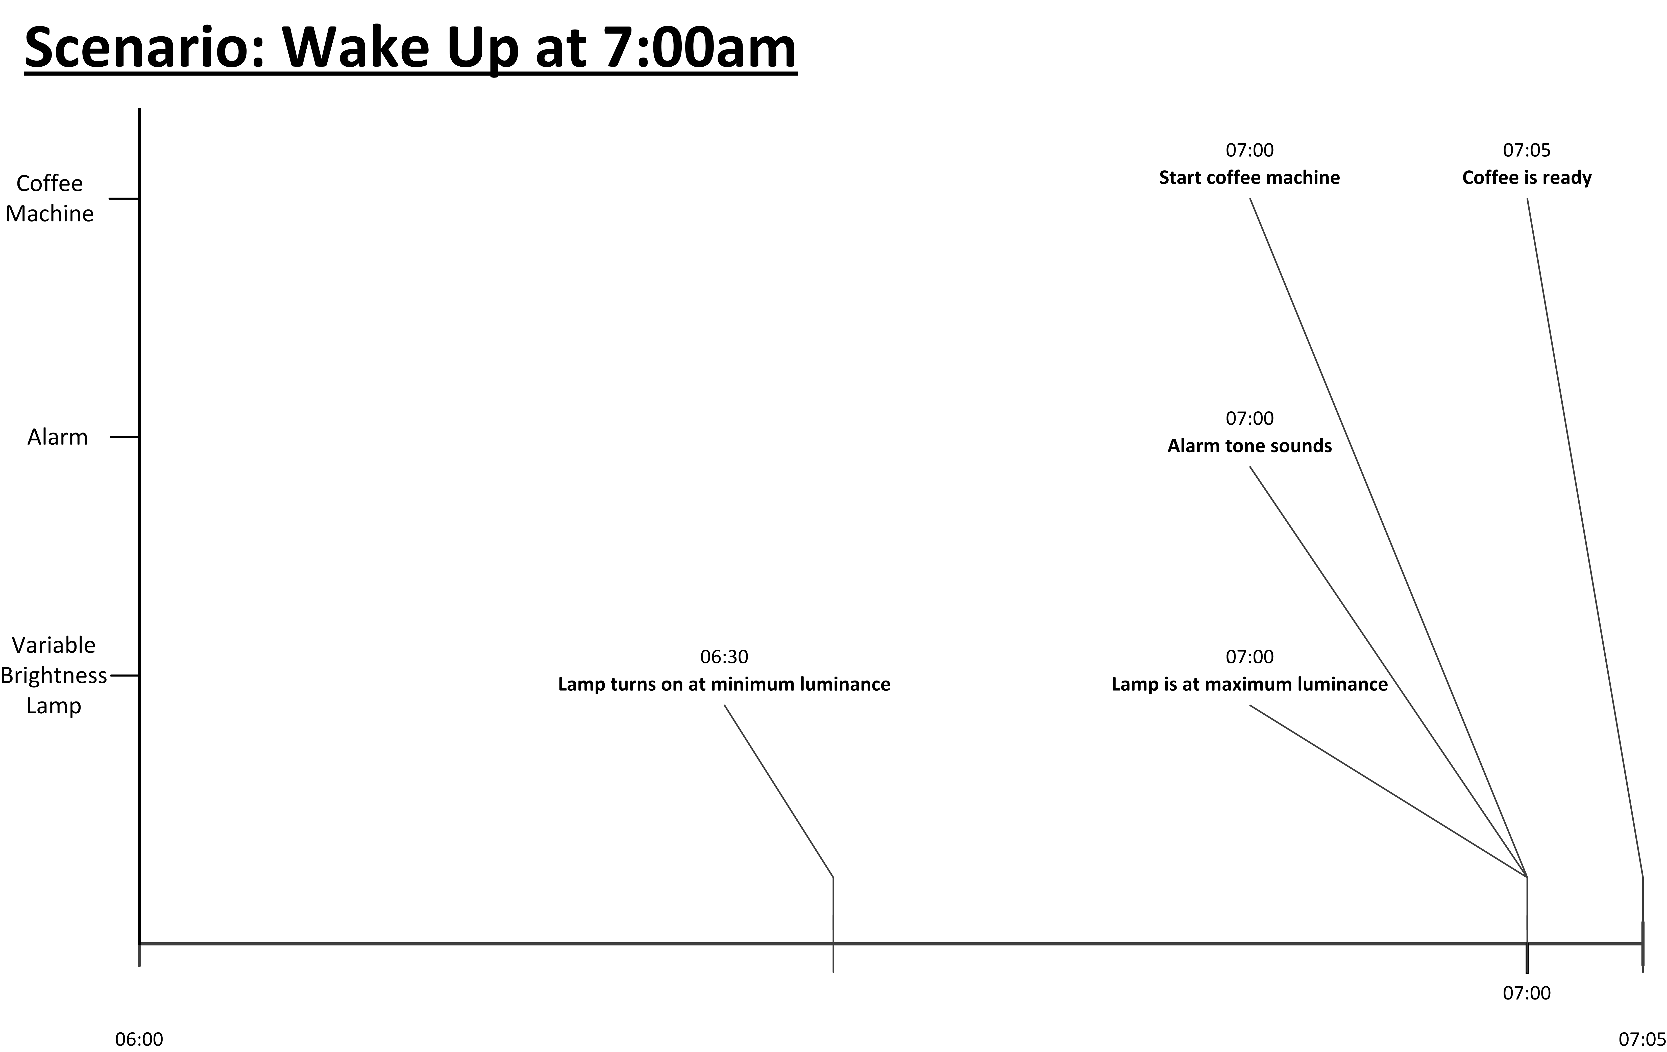
SYSC 3010 Cheung, Charlebois, Garlough, Van Kerkhoven
Notes:
Describing how the scenario of someone waking up will play out with AVA. The user would schedule their wakeup time to be at 7:00am
1.
Some time before the set alarm time, the wake-up lamp will start up and slowly brighten
Max brightness will be reached at the same time as the alarm
2.
Alarm is triggered 7:00am, the user’s wake up time
At this time, the light is at maximum brightness
The coffee machine starts making the user’s coffee
3.
The coffee machine stops making coffee when the cup is full (5min after the wakeup in this scenario)_

Slide 5
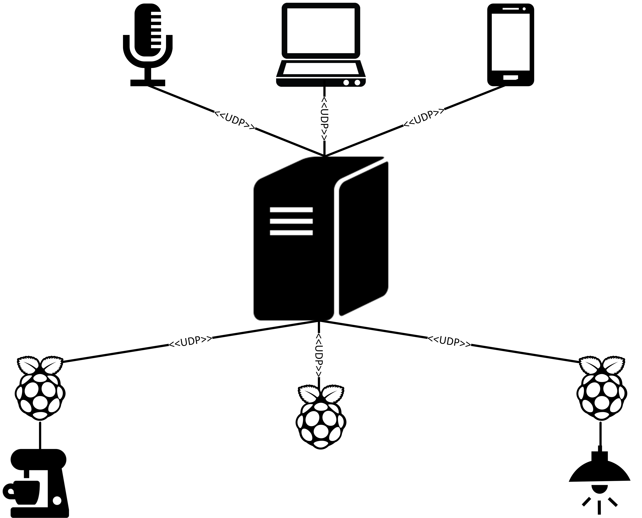
User Interfaces
Voice Interface
Terminal on RPi
Android App
Central AVA Server
Modules
Smart Coffee Machine
Smart TV/Sound-System
Dimmable Lamp
SYSC 3010 Cheung, Charlebois, Garlough, Van Kerkhoven
Notes:
Network Diagram of the AVA-SH
The user interfaces do not communicate directly with the modules, they only communicate with the server which can then pass the commands to the modules
The modules also should not communicate directly with each other, to maintain high modularity
Uses Client-Server design, wherein the modules/interfaces are the clients and the server is the main AVA serve

Slide 6
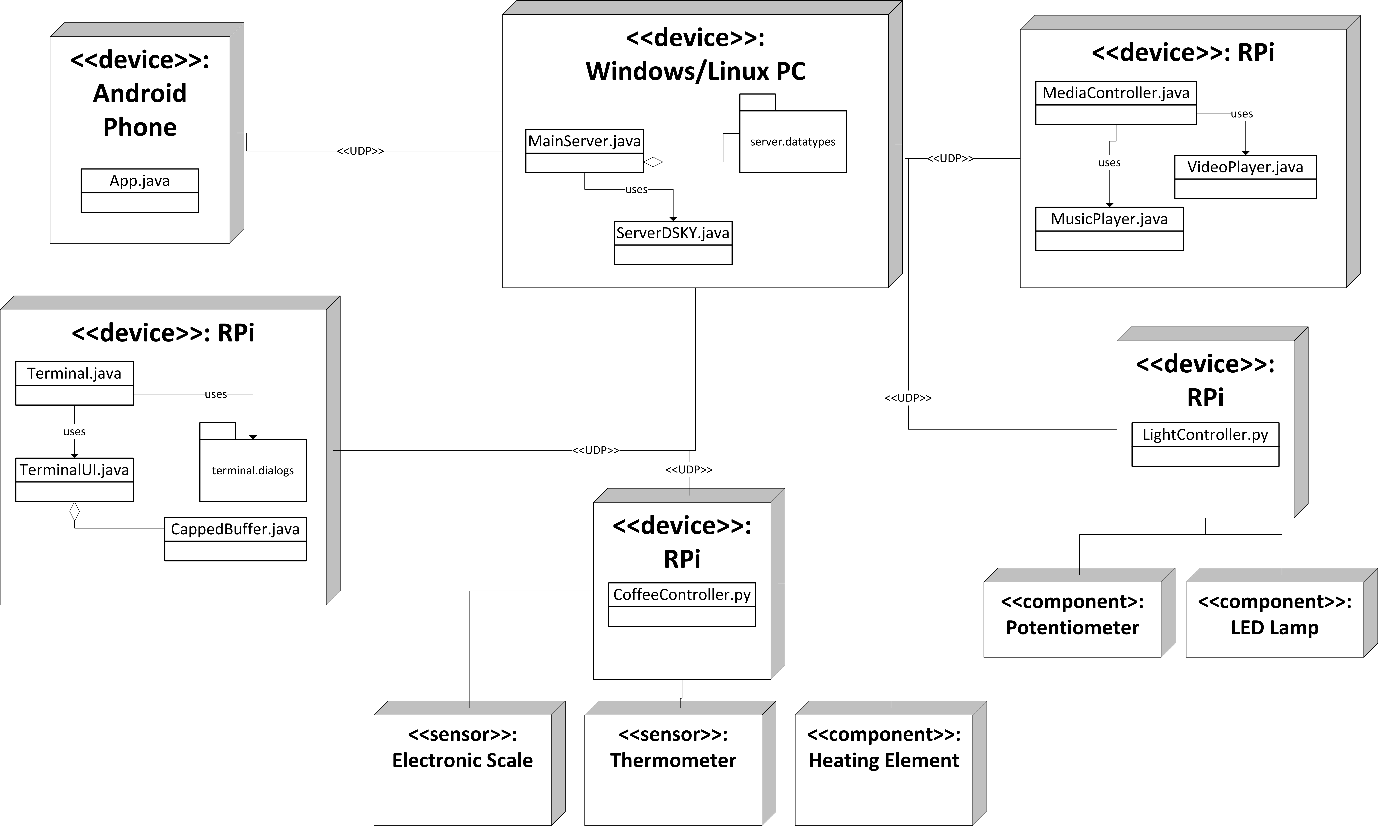
SYSC 3010 Cheung, Charlebois, Garlough, Van Kerkhoven
Notes:
Windows/Linux PC:
-will be acting as server, using a MainServer class, the DSKY interface and custom made datatypes
-able to communicate with all modules using UDP
Media Controller
-used to play music, and possibly video
-Has database of music and video the user can play
Light Controller:
-RPi will communicate with 1 component
1. LED’s: used to slowly brighten room
-will be controlled using PWM on a GPIO pin
-also has a speaker used to play an alarm (using the 3.5mm jack on the RPi)
Coffee Maker:
-RPi will communicate with 3 components:
1. Electronic Scale: used to weigh cup before and during coffee making to make sure proper amounts of coffee are made
-interfaced using USB port on RPi
2. Thermometer: used to monitor water temp
-interfaced using AD converted on Gertboard
3. Heating Element: used to heat water
-interfaced via RPi GPIO connected to a simple transistor
Terminal:
-GUI for user to enter commands to AVA

Slide 7





Communication Protocol
Type 0x00 Handshake
Type 0x01 Command
Type 0x02 Info
Type 0x03 Error
SYSC 3010 Cheung, Charlebois, Garlough, Van Kerkhoven
Notes:
General
------------
Packet max size is 1kB
Packets are self contained, that is, data does not span multiple packets
Packets all start with an 1-byte opcode, effectively making the amount of data that can be encapsulated 1023B
4 types of packet
0x00 bytes used to denote the termination of a field with variable length (DEVICE_NAME, COMMAND_KEY, etc)
Data encoding is done using UTF-8, all complex information (ex an object) should be encoded using JSON style
Handshake
------------
Used to register module/interface with server under a particular name
Modules/interface must register before they can communicate with the server
HANDSHAKE_KEY field is some arrangement of Bytes known to server and all approved modules/interfaces
DEVICE_NAME is what String the module/interface is saved under in the registry (along with its IP/socket)
Command
------------
COMMAND_KEY denotes what server should do, UTF-8 encoding
EXTRA_INFO optional, stores additional information needed for command, UTF-8 in JSON format
Info
------------
INFO contains some information, UTF-8 encoding -- in JSON format if complex object
Error
------------
Same as Info, but the information contained is an error message
**full document on protocol and currently added commands @ https://github.com/SYSC-3010-F5/AVA-SH/tree/master/docs

Slide 8
Design Challenges
Communicating between the Clients and the Server
Server and Module deadlocks
Hardware interfacing on the coffee maker module
Testing the integration of various modules
SYSC 3010 Cheung, Charlebois, Garlough, Van Kerkhoven
Notes:
Communication Problem
- solution is using the custom protocol outlined before
- protocol is enforced by helper classes (DataChannel.java)
- when sending data, you don’t have to worry about the protocol, DataChannel.java will automatically format your packets and unpack your packets
Deadlock Problem
- all modules/server should have timeouts
- after timeout, module/server returns to a stable or ready state
- Server should always be prepared to handle unexpected packet formats, and should never crash from being an unexpected packet
Coffee Maker Interfacing
- Coffee maker will be modified from a store bought drip coffee maker
- Using a scale to determine when the coffee cup if full (ie when to stop the machine)
- Using a breadboard attached to the side of the coffee maker for all additional wiring for the sensors/components
- Replacing the physical switch on a coffee machine to turn it on with a transistor
> we will first measure the current the heating element draw and get a transistor that can handle that amount of amperage
> transistor should be in saturation (fully “on”) with a gate voltage of 3.3V (logic 1 on RPi)
- Temperature sensor max output is 1.75V and min output 0.1V, A-D converted on the Gertboard has a max input of 3.3V
Intergradation of modules
- Agile testing method
- Each module is tested individually using a test bench class
- Modules are connected one at a time to the server and tested
- Modules are then connected all at once to the server

Slide 9
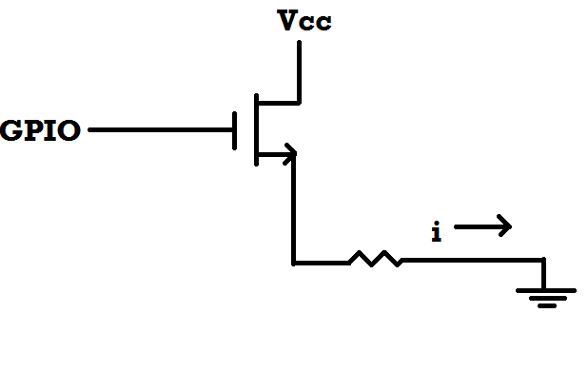
Coffee-Machine Solutions
NMOS Transistor
Threshold Voltage max 3.3V
Must be able to handle current of i amps
SYSC 3010 Cheung, Charlebois, Garlough, Van Kerkhoven
Notes:
Shows how we will turn the coffee machine on or off
Vcc will be the voltage used inside the coffee maker to power the heating element
**Note the logic 1 signal on a RPi GPIO pin is 3.3V, logic 0 is 0V

Slide 10
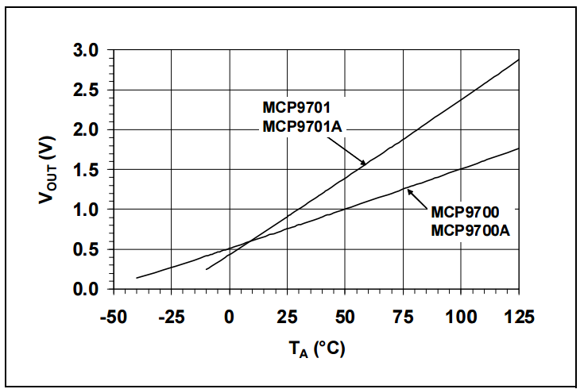
Coffee-Machine Solutions
SYSC 3010 Cheung, Charlebois, Garlough, Van Kerkhoven
Notes:
Graph showing our temperature sensor output voltage vs ambient temperature
We will use the cheaper 9700 model, as it suits our needs fine
Shows how the output voltage of the temp sensor vs the ambient temperature measured
Since Gertboard A-D converter can handle 0V to 3.3V, we will plug the sensor output (max of 1.5V) directly into the Gertboard
> this only makes use of about half our possible granularity
> quick calculation has our sensor at an estimated theoretical granularity of 0.2 degrees C (will have to test this value to confirm)
> probably only going to be accurate to the nearest degree or two in reality

Slide 11
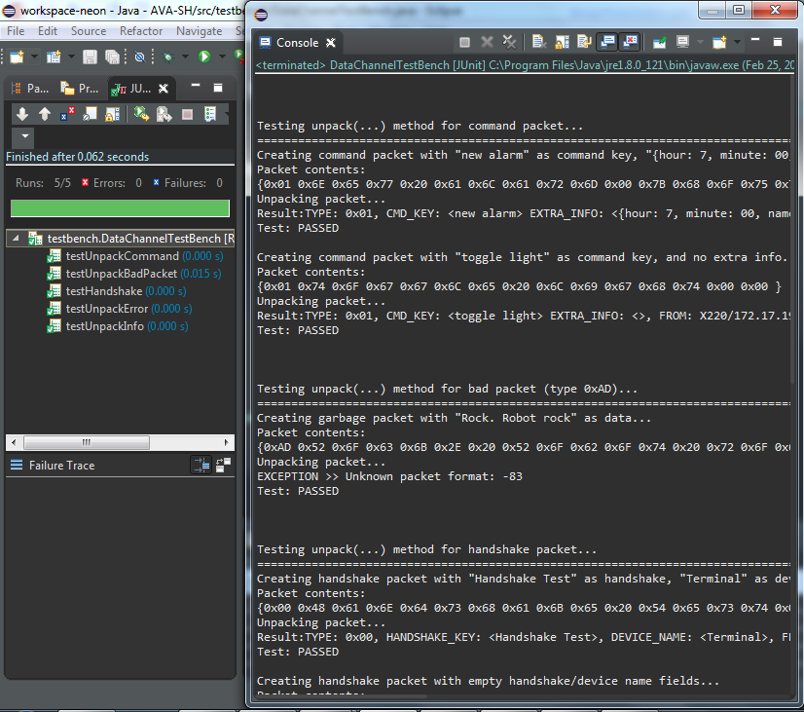
Testing Solutions
SYSC 3010 Cheung, Charlebois, Garlough, Van Kerkhoven
Notes:
Testing for a single module (server communications)
JUnitTests → summary as runs, errors, failures (above the green bar)
Detailed log printed for debug

Slide 12

Milestone Name | Scheduled Completion Date | Actual Completion Data
Basic Server Framework | February 12th | February 21st
Terminal Functionality | February 19th | February 10th
Communication Protocol Finalized + Implemented | February 26th | February 20th
Testing Server-Terminal Communication on separate machines | February 28th | February 26th
Scheduling Timed Events | March 4th | N/A
App Functionality | March 4th | N/A
Full System Test with at least one module | March 12th | N/A
SYSC 3010 Cheung, Charlebois, Garlough, Van Kerkhoven
Notes:
-Both Terminal and Server complete
-App has a framework, without any backend implementation
-Hardware has been ordered and most has arrived
-integration of arrived sensors in underway

Slide 13
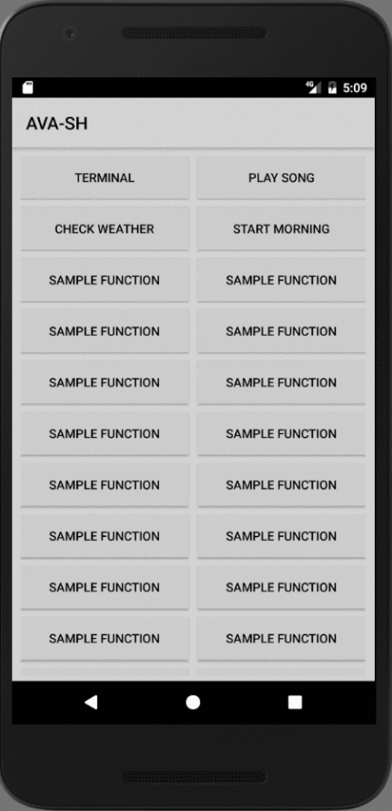
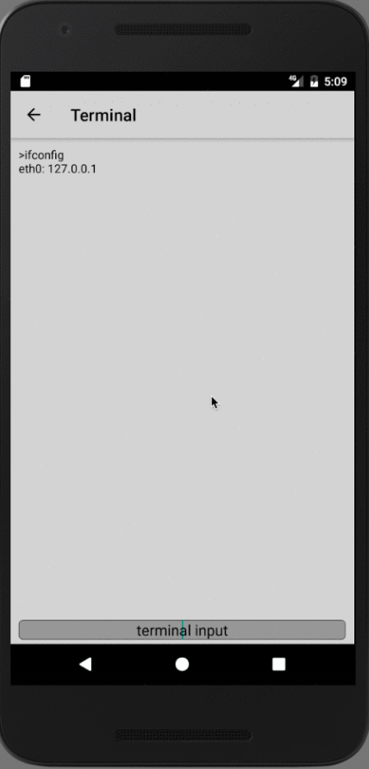
Main Menu
General App Flow[GIF]
Terminal Function
SYSC 3010 Cheung, Charlebois, Garlough, Van Kerkhoven
Notes:
Quick few second view of our prototype phone app
App design details:
-Each Activity conforms to the Model-View-Controller Model
For instance, the Main Menu:
-The Model and View are the MainActivity.java class
-The Controller is a custom ButtonListener
-Utilizes a custom ButtonAdapter which populates, with buttons, a gridlayout wrapped around a relativeLayout
Regarding Adapters, they are, in essence, the bridge between UI components and data sources.
-Elegant solution to common view latency bottlenecks
The ideology driving the App design was to reduce the amount of commands a user must know.
Each button besides the Terminal will potentially launch custom prompt to be encoded into a command packet.
Should the command be successfully received and enacted, the user will be displayed a “Command successful” notification.
For our teams agile debugging and testing the terminal input is needed as it extends the range of input.

Slide 14
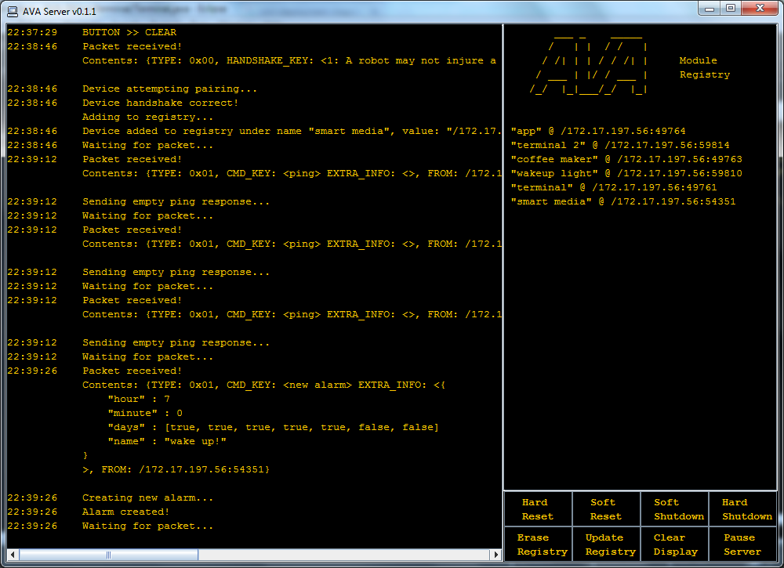
SYSC 3010 Cheung, Charlebois, Garlough, Van Kerkhoven
Notes:
Quick few second view of our v0.1.1 AVA server
Minimal input should be needed on the server
The buttons are there as a “last resort” option
Uses a MCV model
> MainServer.java for control
> Various hashmaps and custom data types as model
> ServerDSKY.java for view

Slide 15
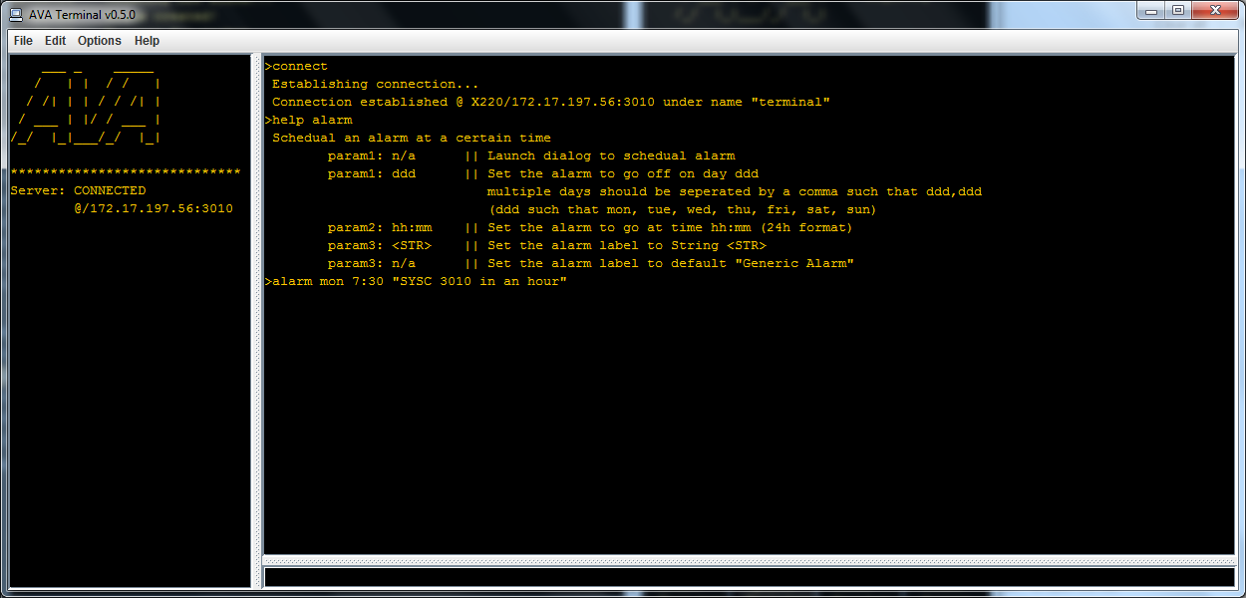
SYSC 3010 Cheung, Charlebois, Garlough, Van Kerkhoven
Notes:
Quick few second view of our v0.5.0 Terminal
Linux style command line input
Makes use of some custom dialogs for more complex input
Uses MVC model
> Terminal.java for control
> TerminalUI.java for view
> as it is an interface, it does not have any data large enough to be considered a model

