Slide 4

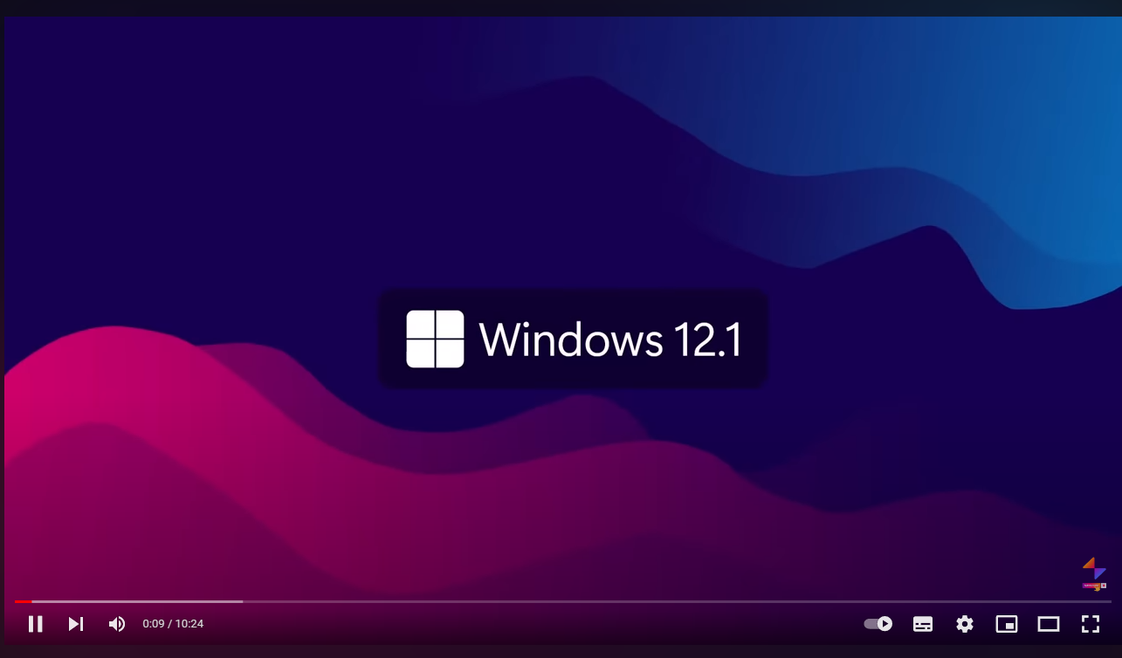
Windows 12.1

Slide 5
Windows 12.1
English (United States)
Language to install:
English (United States)
Time & currency format:
US
Keyboard or input method:
Emer your preferences then dick “Next” to continue
Next
©Microsoft Corporation. All rights reserved

Slide 6
Windows 12.1
English (United States)
Language to install:
English (United States)
Time & currency format:
US
Keyboard or input method:
Emer your preferences then dick “Next” to continue
Next
©Microsoft Corporation. All rights reserved

Slide 7
Windows 12.1
Install now
Repair your PC
©Microsoft Corporation. All rights reserved

Slide 9



Slide 11
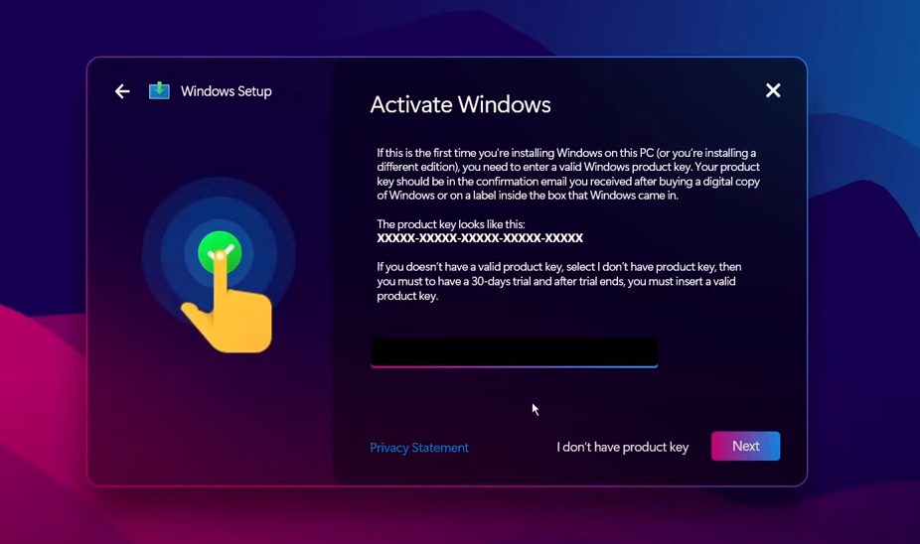
Windows Setup
Activate Windows
If this is the first time you’re installing Windows on this PC (or you’re installing a
Different edition), you need to enter a valid Windows product key. Your product
Key should be in the confirmation email you received after buying a digital copy
of Windows or on a label inside the box that Windows came in.
The product key looks like this:
XXXXX-XXXXX-XXXXX-XXXXX-XXXXX
If you doesn’t have a valid product key, select l don’t have product key, then
you must to have a 30-days trial and after trial ends, you must insert a valid
product key.
Privacy Statement I don’t have product key
Next
1 2
Collecting information Installing Windows

Slide 12

Windows Setup
Activate Windows
If this is the first time you’re installing Windows on this PC (or you’re installing a
Different edition), you need to enter a valid Windows product key. Your product
Key should be in the confirmation email you received after buying a digital copy
of Windows or on a label inside the box that Windows came in.
The product key looks like this:
XXXXX-XXXXX-XXXXX-XXXXX-XXXXX
If you doesn’t have a valid product key, select l don’t have product key, then
you must to have a 30-days trial and after trial ends, you must insert a valid
product key.
Privacy Statement I don’t have product key
Next
1 2
Collecting information Installing Windows

Slide 13
Windows Setup
Activate Windows
If this is the first time you’re installing Windows on this PC (or you’re installing a
Different edition), you need to enter a valid Windows product key. Your product
Key should be in the confirmation email you received after buying a digital copy
of Windows or on a label inside the box that Windows came in.
The product key looks like this:
XXXXX-XXXXX-XXXXX-XXXXX-XXXXX
If you doesn’t have a valid product key, select l don’t have product key, then
you must to have a 30-days trial and after trial ends, you must insert a valid
product key.
XGH8J-T4PH9-33UQI-V6SL1-O2IAN
Privacy Statement I don’t have product key
Next
1 2
Collecting information Installing Windows

Slide 14
Windows Setup
Choose your edition
1 editions are available
Windows 12.1 Pro
Next
1 2
Collecting information Installing Windows

Slide 15
Windows Setup
Choose your edition
1 editions are available
Windows 12.1 Pro
Next
1 2
Collecting information Installing Windows

Slide 16
Windows Setup
Choose your edition
1 editions are available
Windows 12.1 Pro
Next
1 2
Collecting information Installing Windows

Slide 17
Windows Setup
License Terms
MICROSOFT SOFTWARE LICENSE TERMS
WINDOWS ORERATING SYSTEM
IF YOU LIVE IN (OR IF YOUR PRINCIPAL PLACEOF
BUSINESS IS IN) THE UNITED STATES, PLEASE READ
THE BINDING ARBITRATION CLAUSE AND CLASS
ACTION WAIVER IN SECTION 11. IT AFFECTS HOW
DISPUTES ARE RESOLVED.
Thank you for choosing Microsoft!
I accept the license terms
Next
1 2
Collecting information Installing Windows

Slide 18
Windows Setup
License Terms
MICROSOFT SOFTWARE LICENSE TERMS
WINDOWS ORERATING SYSTEM
IF YOU LIVE IN (OR IF YOUR PRINCIPAL PLACEOF
BUSINESS IS IN) THE UNITED STATES, PLEASE READ
THE BINDING ARBITRATION CLAUSE AND CLASS
ACTION WAIVER IN SECTION 11. IT AFFECTS HOW
DISPUTES ARE RESOLVED.
Thank you for choosing Microsoft!
I accept the license terms
Next
1 2
Collecting information Installing Windows

Slide 19
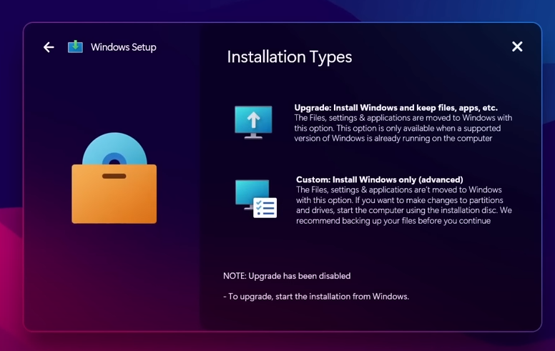
Windows Setup
Installation Types
Upgrade: Install Windows and keep files, apps, etc.
The Files, settings & applications are moved to Windows with
this option, This option is only available when a supported
version of Windows is already running on the computer
Custom: Install Windows only (advanced)
The Files, settings & applications are’t moved to Windows
with this option. If you want to make changes to partitions
and drives, start the computer using the installation disc. We
recommend backing up your files before you continue
NOTE: Upgrade has been disabled
-To upgrade, start the installation from Windows.
1 2
Collecting information Installing Windows

Slide 20
Windows Setup
Installation Types
Upgrade: Install Windows and keep files, apps, etc.
The Files, settings & applications are moved to Windows with
this option, This option is only available when a supported
version of Windows is already running on the computer
Custom: Install Windows only (advanced)
The Files, settings & applications are’t moved to Windows
with this option. If you want to make changes to partitions
and drives, start the computer using the installation disc. We
recommend backing up your files before you continue
NOTE: Upgrade has been disabled
-To upgrade, start the installation from Windows.
1 2
Collecting information Installing Windows

Slide 21
Windows Setup
Installation Types
Upgrade: Install Windows and keep files, apps, etc.
The Files, settings & applications are moved to Windows with
this option, This option is only available when a supported
version of Windows is already running on the computer
Custom: Install Windows only (advanced)
The Files, settings & applications are’t moved to Windows
with this option. If you want to make changes to partitions
and drives, start the computer using the installation disc. We
recommend backing up your files before you continue
NOTE: Upgrade has been disabled
-To upgrade, start the installation from Windows.
1 2
Collecting information Installing Windows

Slide 22
Windows Setup
Select a partition to Install
Name Total size Free space Type
Windows 12.1 1024.00 GB 1024.00 GB
+
New Delete Format
Load Driver Extend
Next
1 2
Collecting information Installing Windows

Slide 23
Windows Setup
Select a partition to Install
Name Total size Free space Type
Windows 12.1 1024.00 GB 1024.00 GB
+
New Delete Format
Load Driver Extend
Next
1 2
Collecting information Installing Windows

Slide 24
Windows Setup
Select a partition to Install
Name Total size Free space Type
Windows 12.1 1024.00 GB 1024.00 GB
+
New Delete Format
Load Driver Extend
Next
1 2
Collecting information Installing Windows

Slide 25
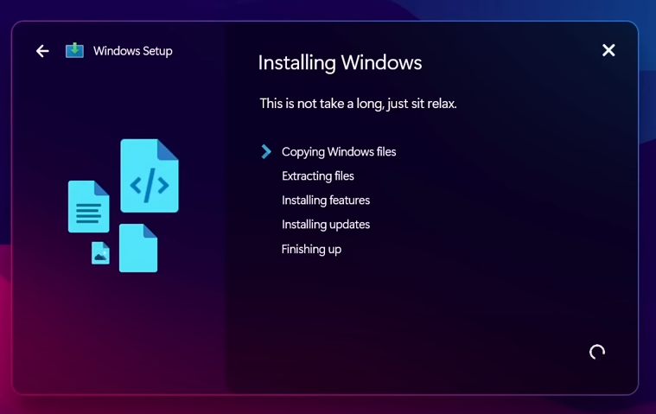
Windows Setup
Installing Windows
This is not take a long, just sit relax.
Copying Windows files
Extracting files
Installing features
Installing updates
Finishing up
1 2
Collecting information Installing Windows

Slide 26
Windows Setup
Installing Windows
This is not take a long, just sit relax.
Copying Windows files
Extracting files
Installing features
Installing updates
Finishing up
1 2
Collecting information Installing Windows

Slide 27
Windows Setup
Installing Windows
This is not take a long, just sit relax.
Copying Windows files
Extracting files
Installing features
Installing updates
Finishing up
1 2
Collecting information Installing Windows

Slide 28



Windows Setup
Installing Windows
This is not take a long, just sit relax.
Copying Windows files
Extracting files
Installing features
Installing updates
Finishing up
1 2
Collecting information Installing Windows

Slide 29
Windows Setup
Installing Windows
This is not take a long, just sit relax.
Copying Windows files
Extracting files
Installing features
Installing updates
Finishing up
1 2
Collecting information Installing Windows

Slide 30

Windows Setup
Installing Windows
This is not take a long, just sit relax.
Copying Windows files
Extracting files
Installing features
Installing updates
Finishing up
1 2
Collecting information Installing Windows

Slide 31
Windows Setup
Installing Windows
This is not take a long, just sit relax.
Copying Windows files
Extracting files
Installing features
Installing updates
Finishing up
1 2
Collecting information Installing Windows

Slide 32
Windows Setup
Restart
Windows needs to restart to continue the setup
Restart now
1 2
Collecting information Installing Windows

Slide 35
Setup is updating registry settings

Slide 36
Getting ready

Slide 37

Setup is starting services…

Slide 39
Windows Setup
Installing Windows
This is not take a long, just sit relax.
Copying Windows files
Extracting files
Installing features
Installing updates
Finishing up
1 2
Collecting information Installing Windows

Slide 40
Windows Setup
Installing Windows
This is not take a long, just sit relax.
Copying Windows files
Extracting files
Installing features
Installing updates
Finishing up
1 2
Collecting information Installing Windows

Slide 41
Setup is applying system services..

Slide 45
Windows 12.1
Get ready to running your PC for first use

Slide 46
Windows 12.1
Checking your performance

Slide 47
Windows 12.1 Pro
Set Up Windows
Just a moment…

Slide 48
Windows 12.1 Pro
Set Up Windows
Thank you!
Thank you for your participate in this Windows 12.1 setup.
Your Windows 12.1 is ready for use now. Let’s go!
Finish

Slide 49
Windows 12.1 Pro
Just a moment…

Slide 50
Windows 12.1 Pro
Now we prepare your desktop…
This might take a few minutes
Don’t turn off or unplug your device

Slide 51
Windows 12.1 Pro
Getting ready…
This might take a few minutes
Don’t turn off or unplug your device

Slide 52
Windows 12.1 Pro
Almost ready…
This might take a few minutes
Don’t turn off or unplug your device

Slide 53
Windows 12.1 Pro
Almost ready.

Slide 54


Windows
…
Welcome to Windows
Welcome to your new OS, Windows 12.1, we have a lot of a
changes and the new features! So, let’s get started!
20° Sunny
Jan 30th 12:00 PM
1

Slide 55
20° Sunny
Jan 30th 12:00 PM
1

Slide 56
20° Sunny
Jan 30th 12:00 PM
1

Slide 57



















12:00 PM
Monday, January 30th
Good Afternoon,Abdi
Documents Pictures Music
Pinned
All appa
Type here to search
A
C
E
F
Edge Word Excel PowerPoint Mail Store
A
Access
Calculator
Camera
Clock
Excel
Photos Settings Media Player Solitaire Paint Clock
Your last activities
Soc more
Youtube.com
OneDrive> Documents
20° Sunny
Jan 30th 12:00 PM
1

