Slide 1
高光谱去噪
汇报人：唐孝培

Slide 2
目录
整体框架
数据
模型
训练
结果
Pytorch多GPU训练

Slide 3
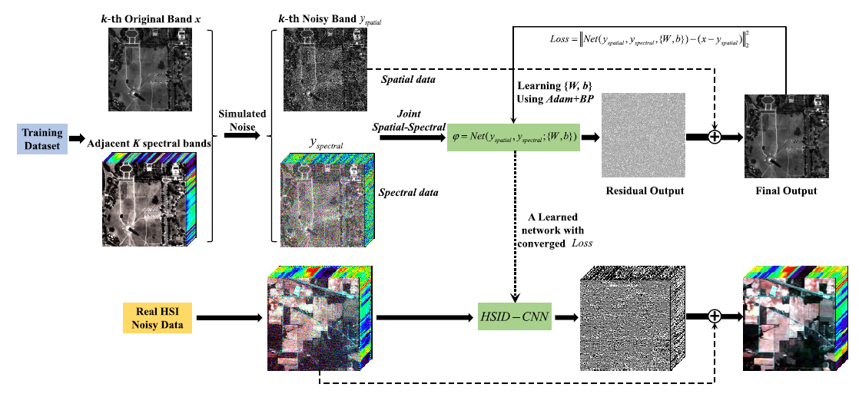
整体框架
CNN-Model

Slide 4
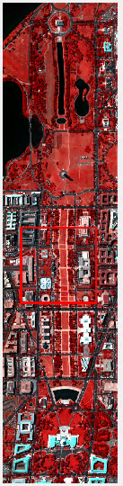
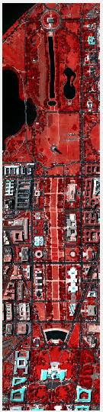
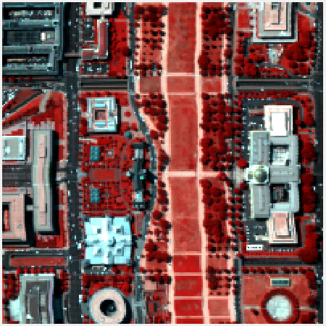
数据
DC Washington
200×200×191
1280×307×191

Slide 5
模型
Spatial
(40×40×1)
Spectral
(40×40×32)

Slide 6
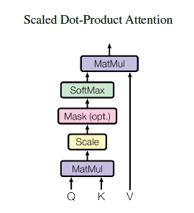
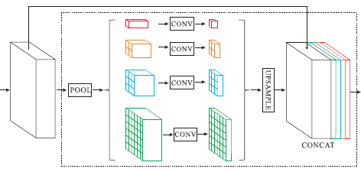
3D-Convolution
Attention Module
Tran D, Bourdev L, Fergus R, et al. Learning spatiotemporal features with 3d convolutional networks[C]//Proceedings of the IEEE international conference on computer vision. 2015: 4489-4497.
Multi-Scale Fusion
Vaswani A, Shazeer N, Parmar N, et al. Attention is all you need[C]//Advances in neural information processing systems. 2017: 5998-6008.
Zhao H, Shi J, Qi X, et al. Pyramid scene parsing network[C]//Proceedings of the IEEE conference on computer vision and pattern recognition. 2017: 2881-2890.

Slide 7
训练
Epoch: 200
Batch-size: 32
Leaning rate: 1e-3
lr_schedule: base_lr * ((1 - iter/max_iter) ** power)
Optimizer: Adam
beta: 0.9, 0.999
Loss function: MSE

Slide 8
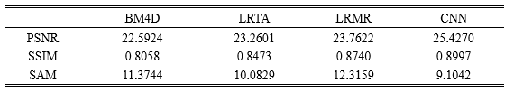
结果

Slide 9
Pytorch多GPU训练
https://github.com/vacancy/Synchronized-BatchNorm-PyTorch

