Slide 1
学习进度汇报
地理科学与规划学院 杨桃汝 16305183
2019年8月31日

Slide 2
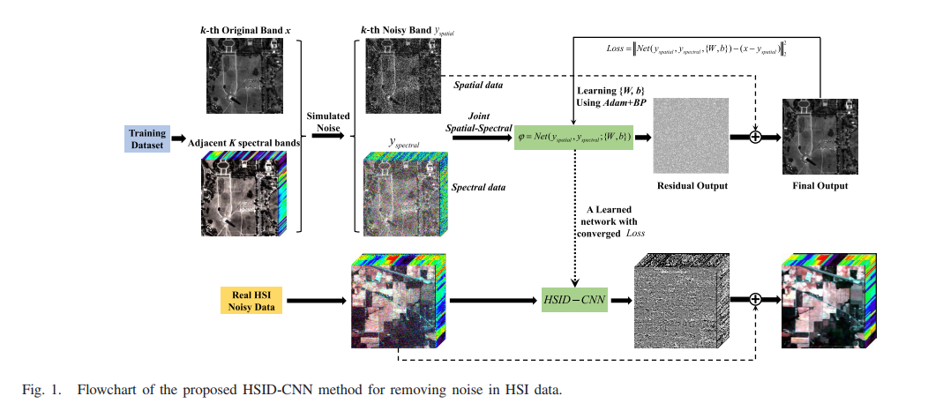
主要工作
1.复现HSID-CNN对高光谱遥感图像进行去噪
2.复现G-FRN对potsdam数据集进行语义分割
3.尝试对G-FRN进行改进

Slide 3
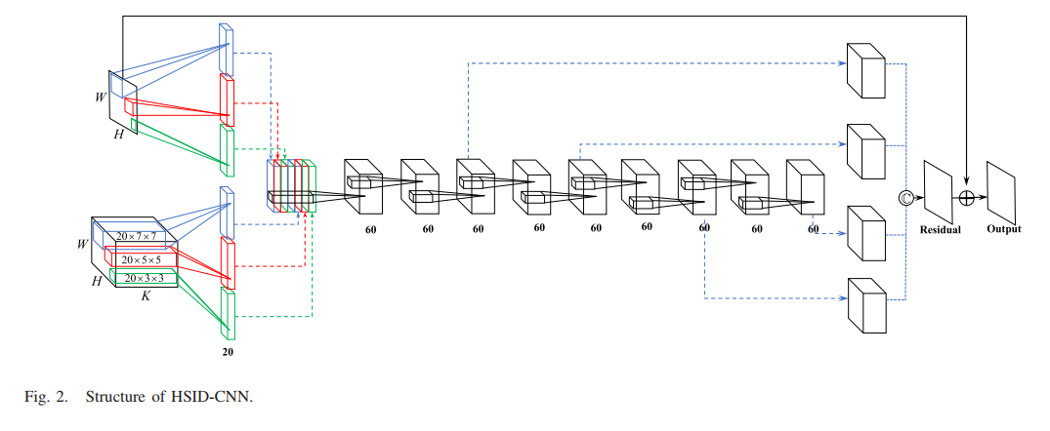
基于高光谱图像的深度残差网络 Hyperspectral Image Denoising with a Deep Convolutional Neural Network (HISD-CNN)
Qiangqiang Y , Qiang Z , Jie L , et al. Hyperspectral Image Denoising Employing a Spatial-Spectral Deep Residual Convolutional Neural Network[J]. IEEE Transactions on Geoscience and Remote Sensing, 2018:1-14.

Slide 4
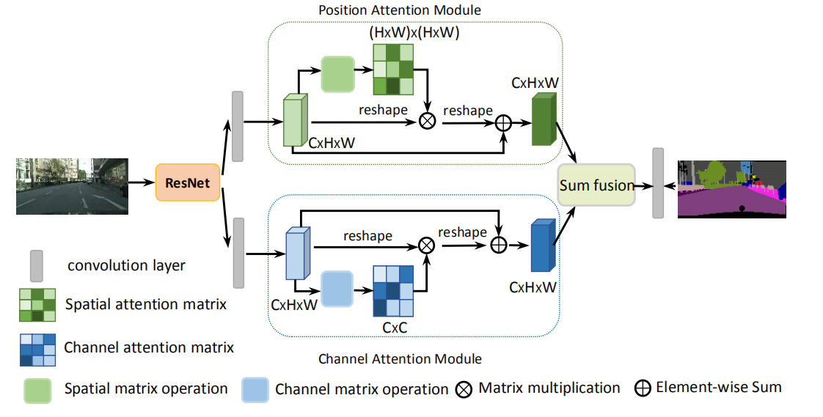
Dual Attention Module
Fu J , Liu J , Tian H , et al. Dual Attention Network for Scene Segmentation[J]. 2018.

Slide 5
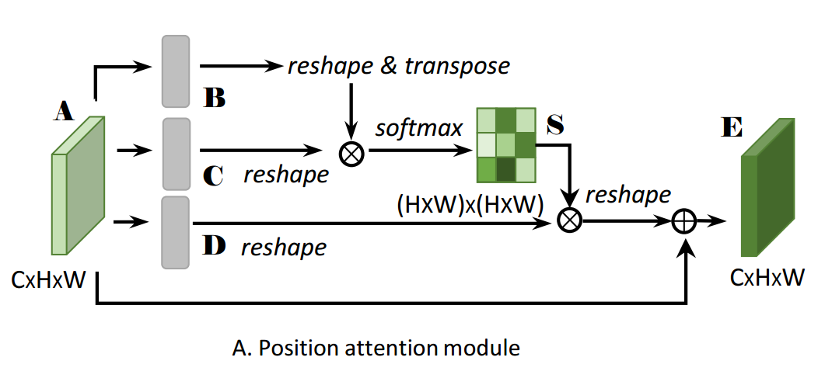

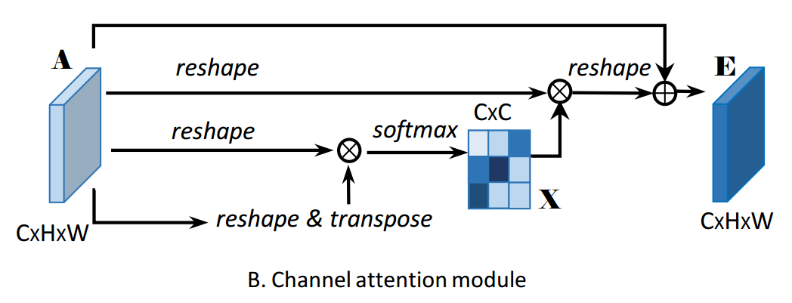
模型改进
DAN_mid

Slide 6
模型改进 DAN_final

Slide 7
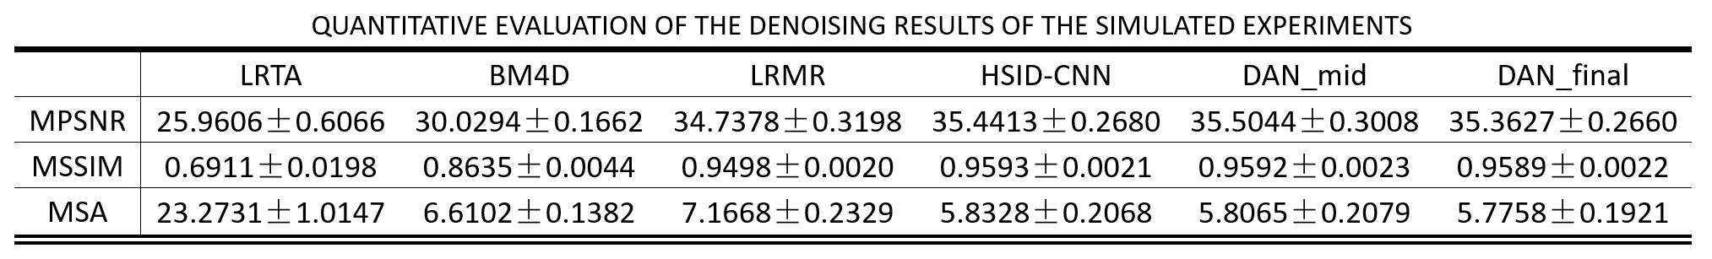
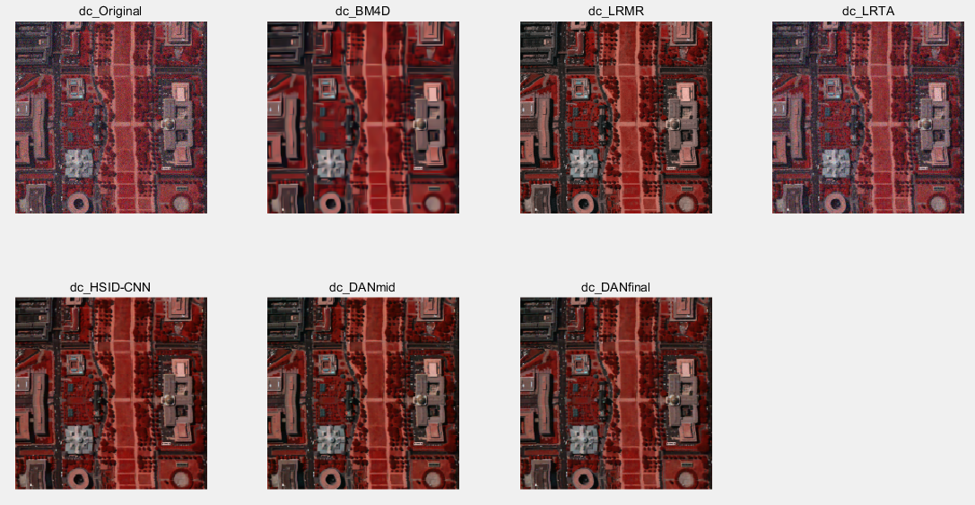
模拟噪声去噪

Slide 8
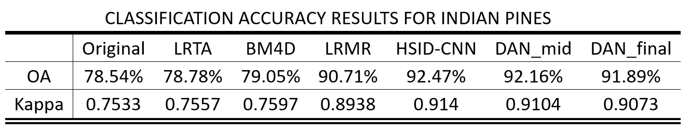
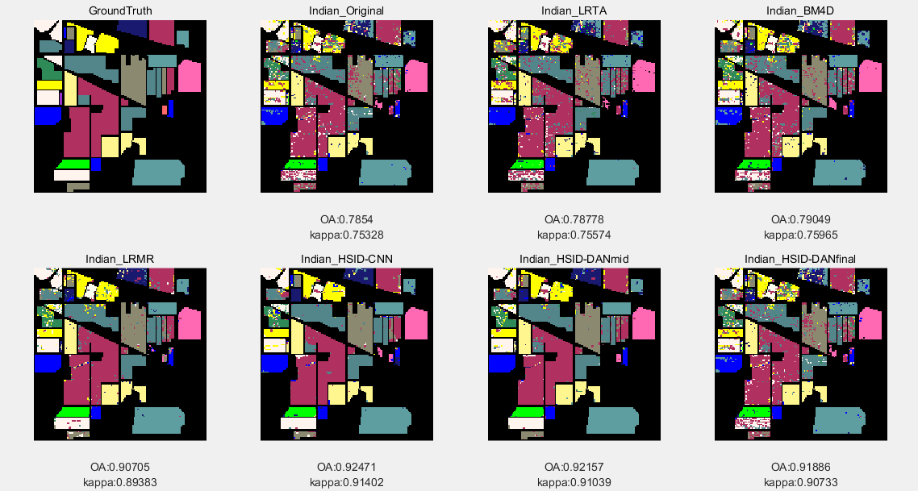
真实图像去噪后分类 Indian Pines

Slide 9
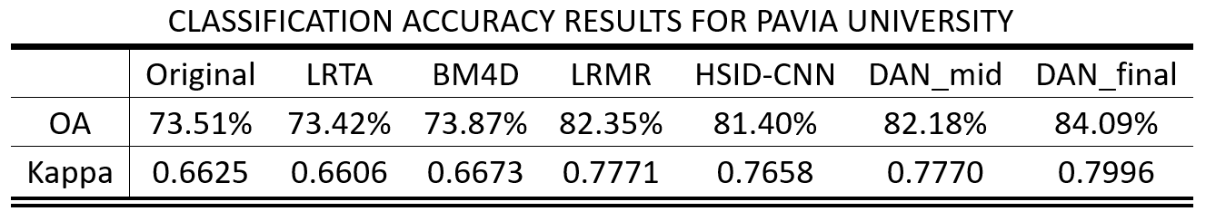
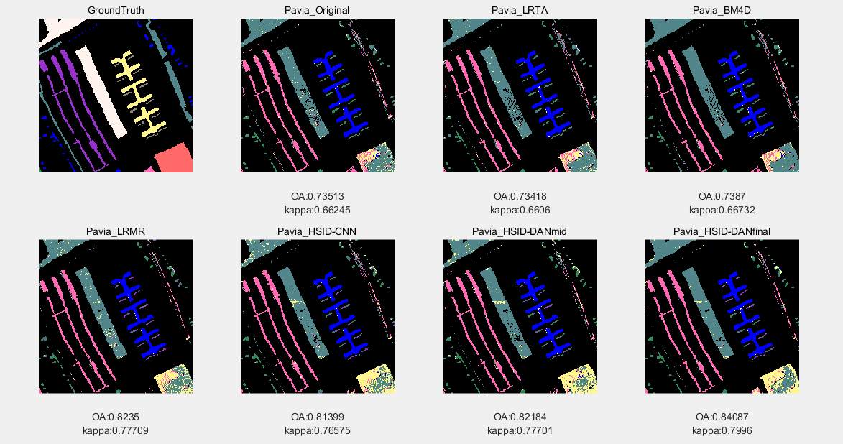
真实图像去噪后分类 Pavia University

Slide 10
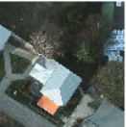
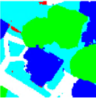
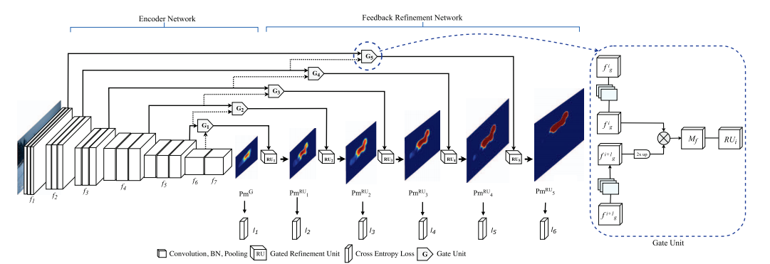
主要工作
1.复现HSID-CNN对高光谱遥感图像进行去噪
2.复现G-FRN对potsdam数据集进行语义分割
3.尝试对G-FRN进行改进
G-FRNet

Slide 11
Gated Feedback Refinement Network (G-FRNet)
Amirul Islam M, Rochan M, Bruce N D B, et al. Gated feedback refinement network for dense image labeling[C]//Proceedings of the IEEE Conference on Computer Vision and Pattern Recognition. 2017: 3751-3759.

Slide 12
实验结果
unet
AA | 0.7859
OA | 0.7875
miou | 0.6604
 | tree | low vegetation | building | impervious surface | cars
precisions | 0.8302 | 0.7656 | 0.7651 | 0.8099 | 0.8739
recalls | 0.6625 | 0.7916 | 0.8958 | 0.7486 | 0.8310
frn
AA | 0.8468
OA | 0.8646
miou | 0.7525
 | tree | low vegetation | building | impervious surface | cars
precisions | 0.8409 | 0.7727 | 0.9417 | 0.8946 | 0.8981
recalls | 0.7183 | 0.8830 | 0.9265 | 0.8724 | 0.8338

Slide 13
主要工作
1.复现HSID-CNN对高光谱遥感图像进行去噪
2.复现G-FRN对potsdam数据集进行语义分割
3.尝试对G-FRN进行改进
G-FRNet

Slide 14
模型改进 FRN-PYM
concat
3×3
5×5
5×5

Slide 15
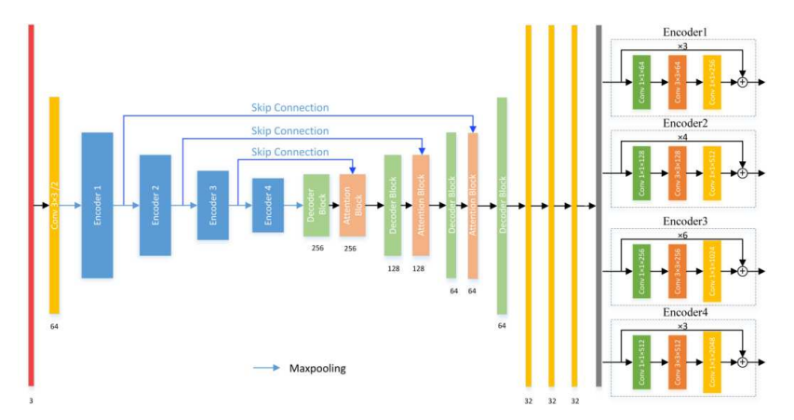
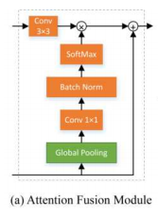
Refined Attention Segmentation Network (RASNet)
Ni Z L, Bian G B, Xie X L, et al. RASNet: Segmentation for Tracking Surgical Instruments in Surgical Videos Using Refined Attention Segmentation Network[J]. arXiv preprint arXiv:1905.08663, 2019.

Slide 16
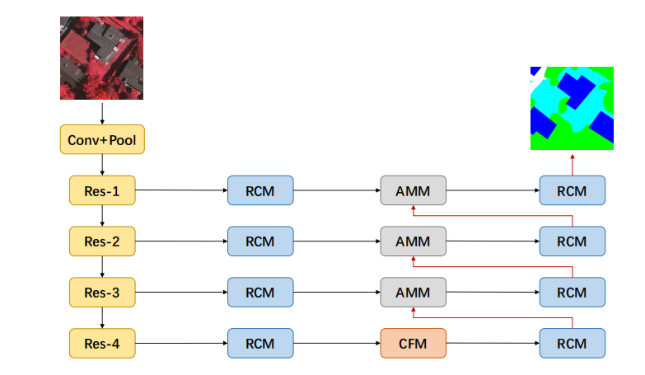
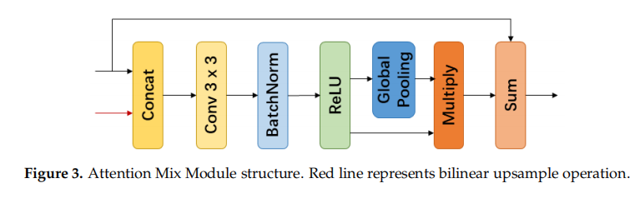
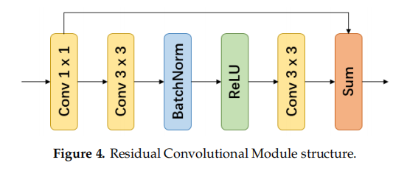
Context Aggregation Network (CAN)
Cheng W, Yang W, Wang M, et al. Context Aggregation Network for Semantic Labeling in Aerial Images[J]. Remote Sensing, 2019, 11(10): 1158.

Slide 17
模型改进 FRN-ATT

Slide 18
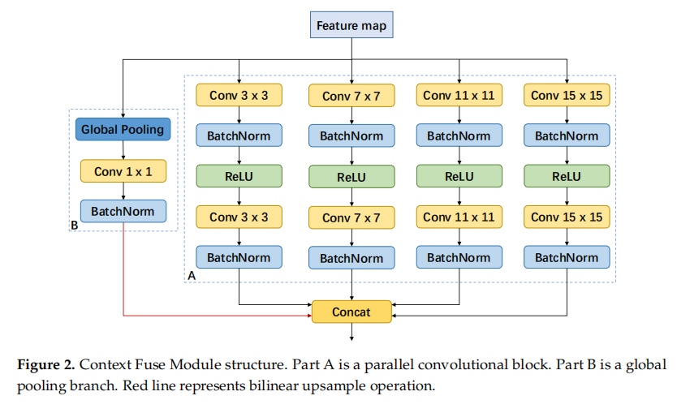
Context Aggregation Network (CAN)
Cheng W, Yang W, Wang M, et al. Context Aggregation Network for Semantic Labeling in Aerial Images[J]. Remote Sensing, 2019, 11(10): 1158.

Slide 19
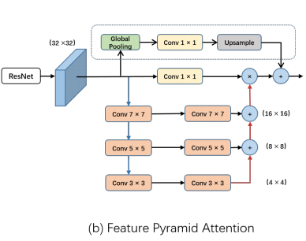
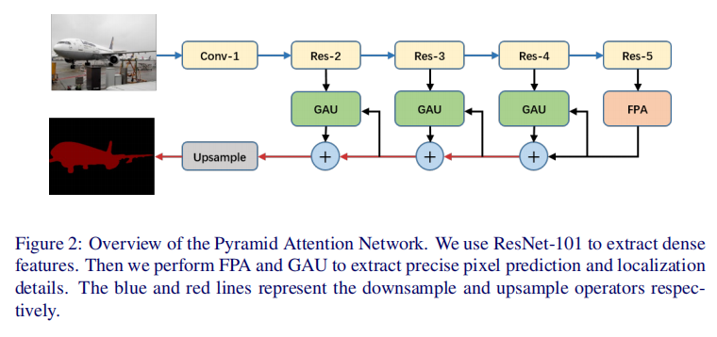
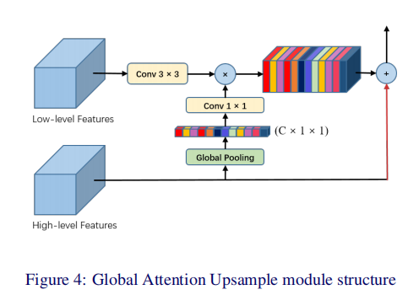
Pyramid Attention Network (PAN)
Li H, Xiong P, An J, et al. Pyramid attention network for semantic segmentation[J]. arXiv preprint arXiv:1805.10180, 2018.

Slide 20
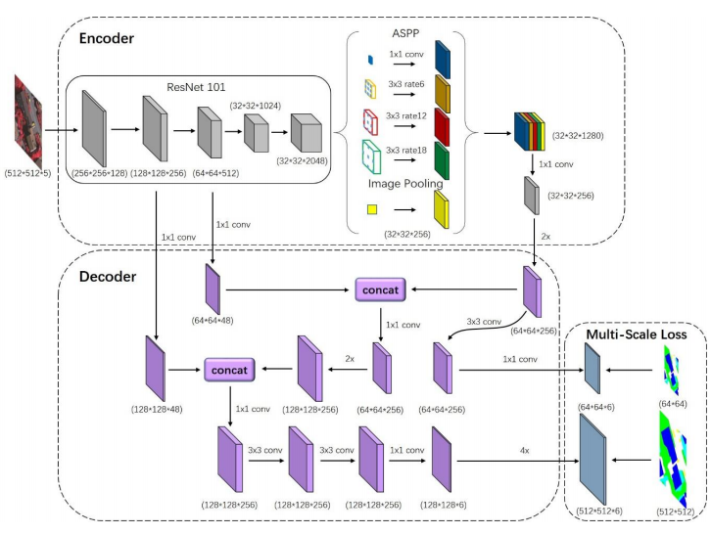
FCN with the fusion of ASPP and encoder-decoder structures
Wang Y, Liang B, Ding M, et al. Dense Semantic Labeling with Atrous Spatial Pyramid Pooling and Decoder for High-Resolution Remote Sensing Imagery[J]. Remote Sensing, 2019, 11(1): 20.

Slide 21
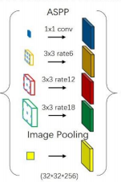
模型改进 FRN-ASPP

Slide 22
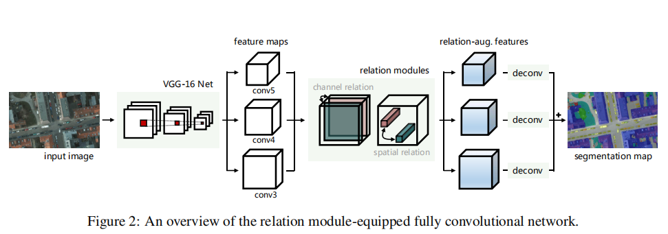
relation module-equipped fully convolutional network
Mou L, Hua Y, Zhu X X. A relation-augmented fully convolutional network for semantic segmentation in aerial scenes[C]//Proceedings of the IEEE Conference on Computer Vision and Pattern Recognition. 2019: 12416-12425.

Slide 23
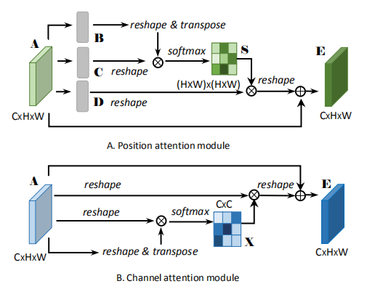
模型改进 FRN-DAN

Slide 24
实验结果
FRN-PYM
AA | 0.8307
OA | 0.8501
miou | 0.7299
 | tree | low vegetation | building | impervious surface | cars
precisions | 0.8188 | 0.7540 | 0.9196 | 0.8967 | 0.8919
recalls | 0.6794 | 0.8794 | 0.9341 | 0.8408 | 0.8198
FRN-ATT
AA | 0.7541
OA | 0.8369
miou | 0.6522
 | tree | low vegetation | building | impervious surface | cars
precisions | 0.8341 | 0.7417 | 0.9218 | 0.8585 | 0.7597
recalls | 0.6847 | 0.8627 | 0.9176 | 0.8442 | 0.4614
FRN-ASPP
AA | 0.8465
OA | 0.8620
miou | 0.7526
 | tree | low vegetation | building | impervious surface | cars
precisions | 0.8178 | 0.7581 | 0.9568 | 0.9027 | 0.9105
recalls | 0.7249 | 0.8825 | 0.9177 | 0.8686 | 0.8387
FRN-DAN
AA | 0.7944
OA | 0.8103
miou | 0.6773
 | tree | low vegetation | building | impervious surface | cars
precisions | 0.7872 | 0.7401 | 0.8198 | 0.8874 | 0.8839
recalls | 0.6611 | 0.8379 | 0.9103 | 0.7754 | 0.7874

Slide 25
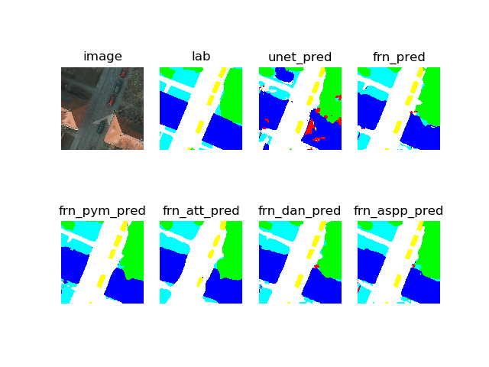
实验结果

Slide 26
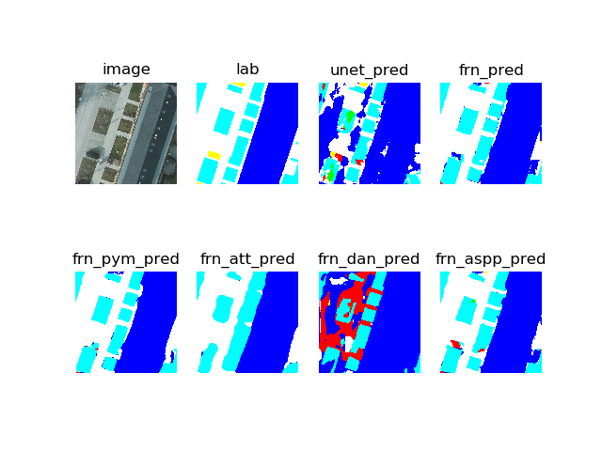
实验结果

Slide 27
Augmentation?
no augmentation
with augmentation (flip)
unet
AA | 0.7859
OA | 0.7875
miou | 0.6604
 | tree | low vegetation | building | impervious surface | cars
precisions | 0.8302 | 0.7656 | 0.7651 | 0.8099 | 0.8739
recalls | 0.6625 | 0.7916 | 0.8958 | 0.7486 | 0.8310
unet
AA | 0.8256
OA | 0.8565
miou | 0.7352
 | tree | low vegetation | building | impervious surface | cars
precisions | 0.8837 | 0.7759 | 0.9231 | 0.8581 | 0.9331
recalls | 0.6396 | 0.8787 | 0.9233 | 0.8975 | 0.7887
FRN
AA | 0.8468
OA | 0.8646
miou | 0.7525
 | tree | low vegetation | building | impervious surface | cars
precisions | 0.8409 | 0.7727 | 0.9417 | 0.8946 | 0.8981
recalls | 0.7183 | 0.8830 | 0.9265 | 0.8724 | 0.8338
FRN
AA | 0.8404
OA | 0.8599
miou | 0.7452
 | tree | low vegetation | building | impervious surface | cars
precisions | 0.7974 | 0.8030 | 0.9366 | 0.8705 | 0.9182
recalls | 0.7596 | 0.8429 | 0.9189 | 0.8777 | 0.8029

Slide 28
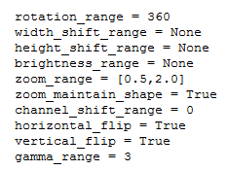
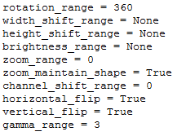
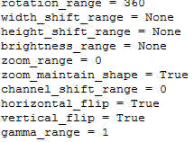
how to augment
zoom + flip + stretch 0.8586
zoom / flip / stretch 0.8368
flip / stretch 0.8598
flip 0.8398

Slide 29
实验结果
FRN-PYM
AA | 0.7809
OA | 0.8022
miou | 0.6700
 | tree | low vegetation | building | impervious surface | cars
precisions | 0.8451 | 0.6812 | 0.9055 | 0.8118 | 0.9463
recalls | 0.7159 | 0.8775 | 0.7930 | 0.8108 | 0.7074
FRN-ATT
AA | 0.7261
OA | 0.8017
miou | 0.6073
 | tree | low vegetation | building | impervious surface | cars
precisions | 0.7790 | 0.6745 | 0.8876 | 0.8655 | 0.7150
recalls | 0.7690 | 0.8240 | 0.8851 | 0.7665 | 0.3860
KSIZE = 3 RATE = 2
KSIZE = 5 RATE = 1
FRN-ASPP
AA | 0.8349
OA | 0.8618
miou | 0.7478
 | tree | low vegetation | building | impervious surface | cars
precisions | 0.8073 | 0.7606 | 0.9633 | 0.9055 | 0.9626
recalls | 0.7941 | 0.8640 | 0.9009 | 0.8776 | 0.7380
FRN-DAN
AA | 0.7691
OA | 0.8093
miou | 0.6609
 | tree | low vegetation | building | impervious surface | cars
precisions | 0.8678 | 0.7198 | 0.8364 | 0.8281 | 0.9302
recalls | 0.5314 | 0.8087 | 0.8914 | 0.8845 | 0.7295

Slide 30
RGB or RGBIR?
RGBIR
RGB
FRN
AA | 0.8377
OA | 0.8599
miou | 0.7476
 | tree | low vegetation | building | impervious surface | cars
precisions | 0.8702 | 0.7511 | 0.9463 | 0.8749 | 0.9470
recalls | 0.7228 | 0.8886 | 0.8874 | 0.8975 | 0.7922
FRN
AA | 0.8395
OA | 0.8585
miou | 0.7478
 | tree | low vegetation | building | impervious surface | cars
precisions | 0.8840 | 0.7297 | 0.9391 | 0.8904 | 0.9449
recalls | 0.7019 | 0.9059 | 0.9095 | 0.8753 | 0.8048
AUG
FRN
AA | 0.8365
OA | 0.8561
miou | 0.7413
 | tree | low vegetation | building | impervious surface | cars
precisions | 0.8517 | 0.7511 | 0.9265 | 0.8888 | 0.9253
recalls | 0.7376 | 0.8783 | 0.8953 | 0.8817 | 0.7898
FRN
AA | 0.8388
OA | 0.8582
miou | 0.7452
 | tree | low vegetation | building | impervious surface | cars
precisions | 0.8570 | 0.7545 | 0.9372 | 0.8778 | 0.9321
recalls | 0.7293 | 0.8819 | 0.8954 | 0.8872 | 0.8004
NO
AUG

Slide 31
FRN and FRN-ASPP?
FRN
FRN-ASPP
unet
AA | 0.8377
OA | 0.8599
miou | 0.7476
 | tree | low vegetation | building | impervious surface | cars
precisions | 0.8702 | 0.7511 | 0.9463 | 0.8749 | 0.9470
recalls | 0.7228 | 0.8886 | 0.8874 | 0.8975 | 0.7922
ASPP
AA | 0.8349
OA | 0.8618
miou | 0.7478
 | tree | low vegetation | building | impervious surface | cars
precisions | 0.8073 | 0.7606 | 0.9633 | 0.9055 | 0.9626
recalls | 0.7941 | 0.8640 | 0.9009 | 0.8776 | 0.7380
AUG
FRN
AA | 0.8365
OA | 0.8561
miou | 0.7413
 | tree | low vegetation | building | impervious surface | cars
precisions | 0.8517 | 0.7511 | 0.9265 | 0.8888 | 0.9253
recalls | 0.7376 | 0.8783 | 0.8953 | 0.8817 | 0.7898
ASPP
AA | 0.8256
OA | 0.8590
miou | 0.7353
 | tree | low vegetation | building | impervious surface | cars
precisions | 0.8422 | 0.7597 | 0.9330 | 0.8860 | 0.9519
recalls | 0.7520 | 0.8693 | 0.9000 | 0.8878 | 0.7187
NO
AUG

Slide 32
模型改进 FRN-SOFTMAX
ADD
SOFTMAX

Slide 33
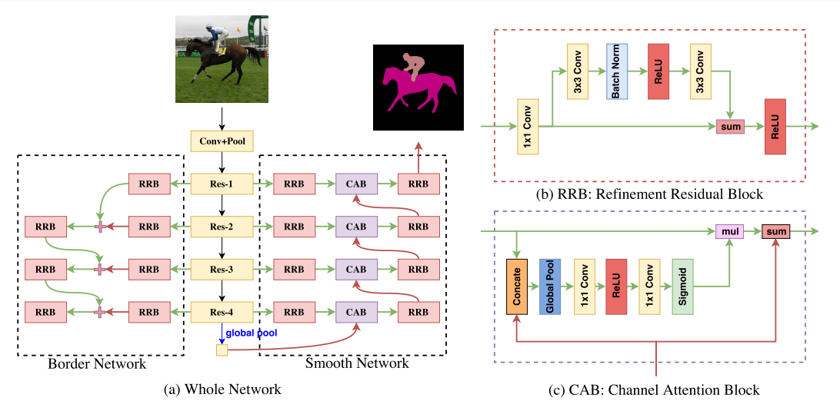
Discriminative Feature Network (DFN)
Yu C, Wang J, Peng C, et al. Learning a discriminative feature network for semantic segmentation[C]//Proceedings of the IEEE Conference on Computer Vision and Pattern Recognition. 2018: 1857-1866.

Slide 34
模型改进 FRN-CAB
ADD
MUL
SOFTMAX
conv 3×3

Slide 35
实验结果
FRN
AA | 0.8377
OA | 0.8599
miou | 0.7476
 | tree | low vegetation | building | impervious surface | cars
precisions | 0.8702 | 0.7511 | 0.9463 | 0.8749 | 0.9470
recalls | 0.7228 | 0.8886 | 0.8874 | 0.8975 | 0.7922
FRN-SOFTMAX
AA | 0.8495
OA | 0.8524
miou | 0.7486
 | tree | low vegetation | building | impervious surface | cars
precisions | 0.8464 | 0.7369 | 0.9612 | 0.8753 | 0.9030
recalls | 0.7632 | 0.8810 | 0.8510 | 0.8815 | 0.8711
FRN-ASPP
AA | 0.8349
OA | 0.8618
miou | 0.7478
 | tree | low vegetation | building | impervious surface | cars
precisions | 0.8073 | 0.7606 | 0.9633 | 0.9055 | 0.9626
recalls | 0.7941 | 0.8640 | 0.9009 | 0.8776 | 0.7380
FRN-CAB
AA | 0.7292
OA | 0.8135
miou | 0.6167
 | tree | low vegetation | building | impervious surface | cars
precisions | 0.8784 | 0.6696 | 0.9051 | 0.8509 | 0.6891
recalls | 0.6177 | 0.8755 | 0.9058 | 0.8349 | 0.4121

Slide 36
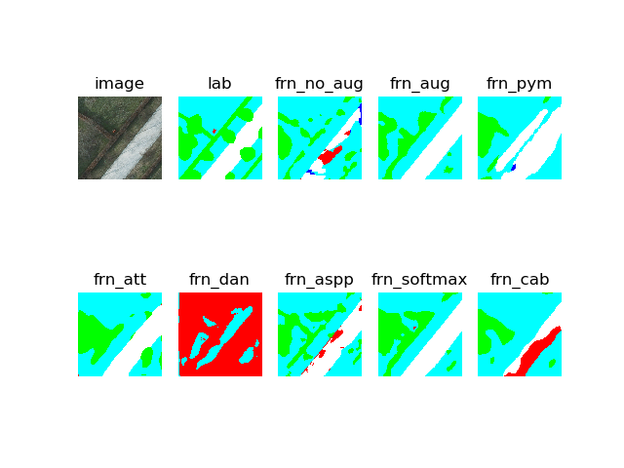
实验结果

Slide 37
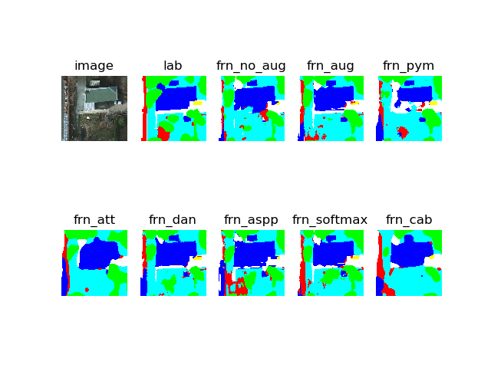
实验结果

Slide 38
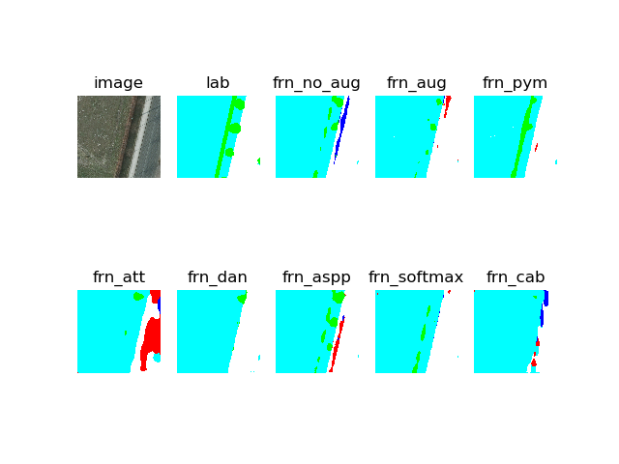
实验结果

Slide 39
今后学习方向
1.多阅读论文，多积累
2.进一步了解attention机制的应用和探清波段数、augmentation和评价指标的应用

Slide 40
Thank You

