Slide 1
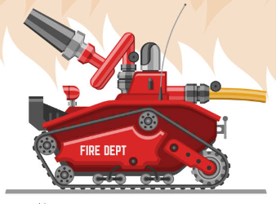
Presentation on “Fire Fighting Robot”
Presented By: “Group 2”
Md. Jamil Hossain Shaharia (1801012)
Md. Sajaratul Yakin Sagor (1801018)
Suraiya (1801021)
Adiba Jahan (1801044)
Mohammad Armaan (1801046)

Slide 2
Contents Covered
Introduction
Problem Statement
Objectives
Components
Design
Flow Chart
Problem and Challenges
Application
Demo/Output
Conclusion

Slide 3
Introduction
A robot that detects fire and extinguish it automatically.
A good replacement of fireman in dangerous place.
High-speed, strength for powerful strikes.
Applications in military, and search and rescue

Slide 4
Problem Statement
Fire accidents in power plants, buildings, and other locations require a substantial allocation of time and human resources.
So there may be a big possibility of heavy damage to human beings.
Early fire elimination prevents catastrophic effects by stopping the spread of fire.

Slide 5
Objectives
Enhance the effectiveness of system.
Increase human safety and minimize risks.
Improve mission success rates.
Drive technological innovation and advancements.
Expand applications beyond combat scenarios.

Slide 6
Components
Arduino UNO
Servo Motor
Flame Sensor
Water Pump
4WD Smart Robot Chassis Kit
Battery Holder With Wire
Li-ion Rechargeable Battery
L293D Motor Driver Module

Slide 7
Design
There are 3 steps to build this robotic design.
Movement Step
Flame Tracking Step
Extinguishing Fire Step

Slide 8
Flow Chart
Start
Gear Motor Run
Move Forward
Flame sensing
No
Yes
Stop movement
Initiate Water Pump
Fire
Extinguished

Slide 9
Problem and Challenges
Mechanical Challenge
Financial Challenge
Component Challenge.

Slide 10
Application
Firefighting
Military operations
Search and rescue missions
Hazardous material handling
Industrial and construction tasks

Slide 11
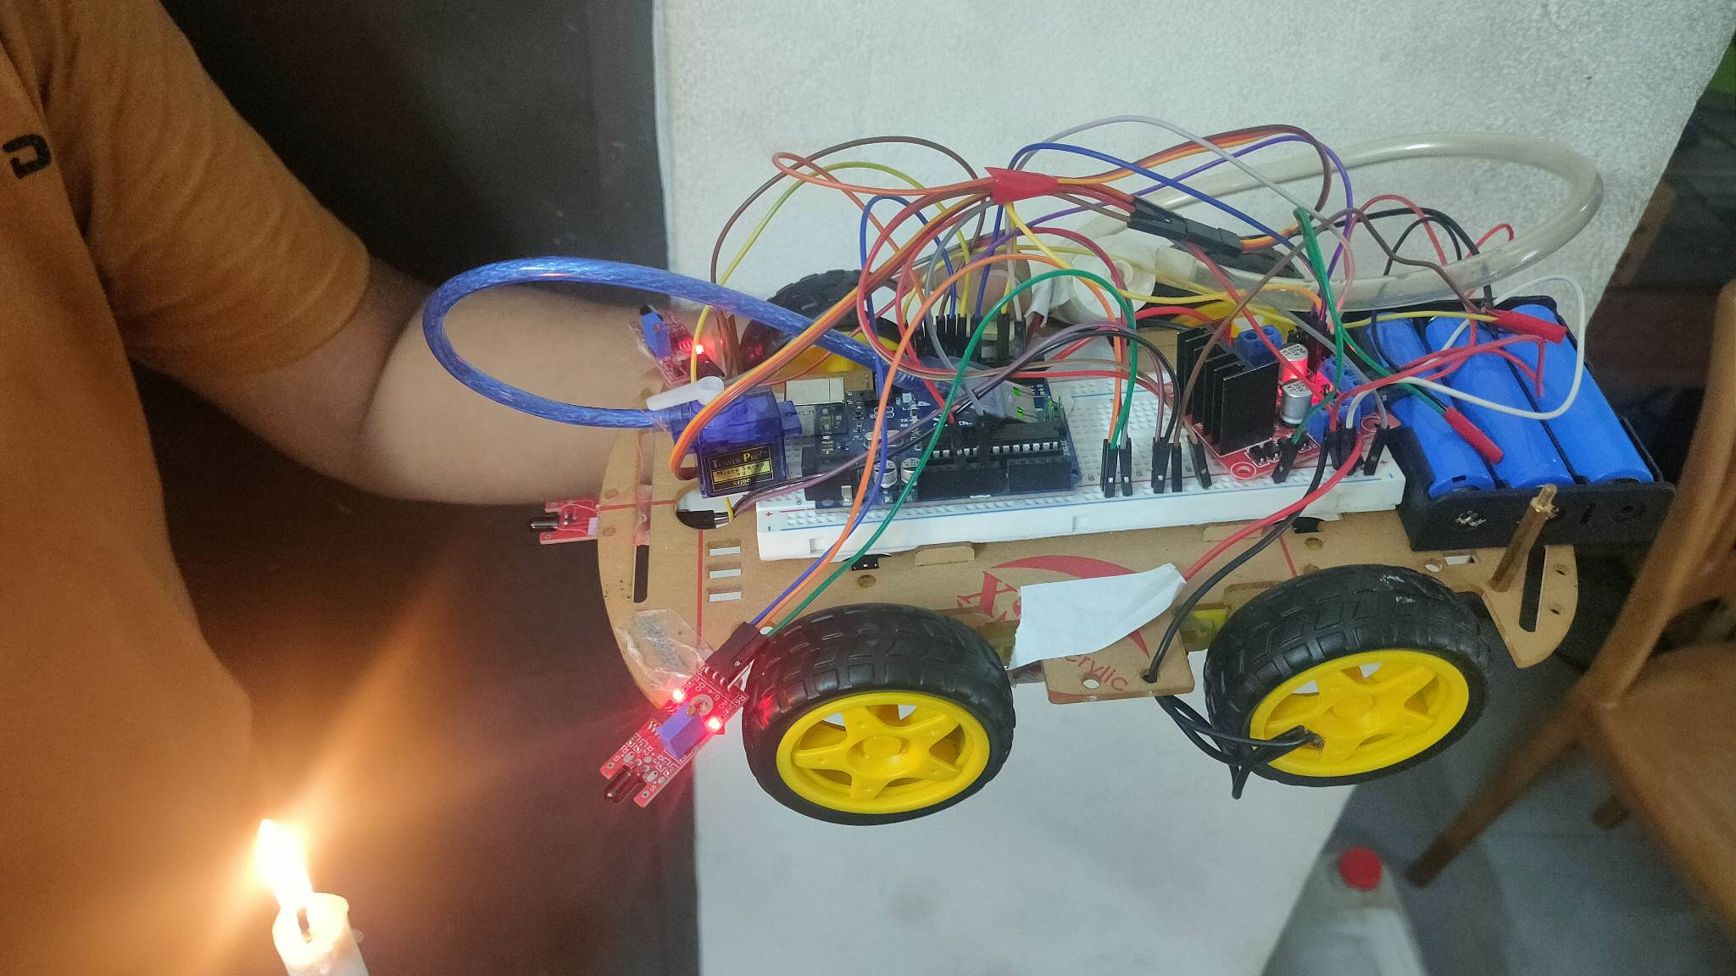
Current Robot/Output with link
Video Link:
https://drive.google.com/file/d/1ajvL3hD_hgniqnrnGWpm-PQl1yoyrpY3/view?usp=drivesdk

Slide 12
Conclusion
In this project, the main goal is to save lives and resources by reducing the impact of fire accidents, starting from the early stages of small flames.
This robot can successfully find fire and reach it without running into obstacle.
We have managed to construct the robot comfortably and user friendly within our budget.

Slide 13
Thank You For Your Time & Patience!

